Slide 1
Music Album Suggestion Algorithm
APSTA 2017
Stewart Gibson

Slide 2
Overview
Objective: Create a machine learning algorithm that suggests new music albums based on a users’ pre-existing collection.
Clustering (?)
Criteria
Genre
Year
Label (?)
Billboard position (?)
Personal/Community rating
Who cares? Music collectors/consumers! Particularly those seeking to expand their musical interests.
A “success” will be an album suggestion that is met with positive reception from the user. This success might not be extremely profound or “impactful” in any way, but the discovery of a new album or artist can often be rewarding for a listener.

Slide 3
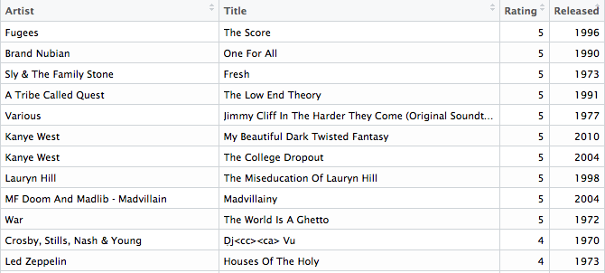
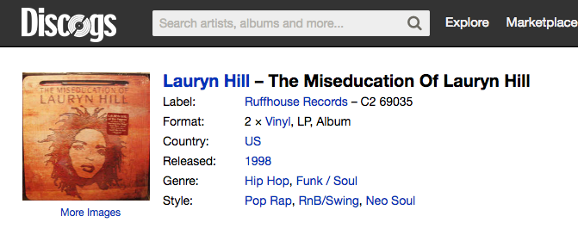
Data: What?
70’s funk/soul
00’s R&B
Genre
80’s pop
Year

Slide 4
Data: How?
Two approaches:
1) Crowdsource: The dataset of albums (and users’ ratings of albums) is made up of all user submissions.
Pro: Create a music network & suggestion library that is completely shaped by the users.
Con: Limited. Can’t suggest an album that isn’t owned by a user.
2) Web Scrape: Pull information on all (or perhaps subset) albums, including album name, artist, year, genre, style, etc.
Pro: More expansive database from which to generate suggestions.
Con: Perhaps too expansive.
Skills Needed (help!)
Web scraping
ML clustering

