Slide 1
Paper 211 : Improving Clinical Outcome Predictions Using Convolution over Medical Entities with Multimodal Learning
CS 598 DLH - Gs25@Illinois.edu | st26@Illinois.edu

Slide 2
What is this paper trying to solve
Improve the following :
Predicting mortality of patients in Hospital
Predicting mortality of patients in ICU
Predicting Length of Stay in ICU greater than 3 days
Predicting Length of Stay in ICU greater than 7 days

Slide 3
Data
MIMIC–III data is used as proposed by the paper
The paper implementation uses the MIMIC Extract pipeline to preprocess the data.
A “pre-processed output” of the MIMIC Extract pipeline is available already in GCP. We leveraged this extract after getting MIMIC-III GCP access through physionet
Total No of Patients | 34, 472
Total Time Series Variables | 104

Slide 4
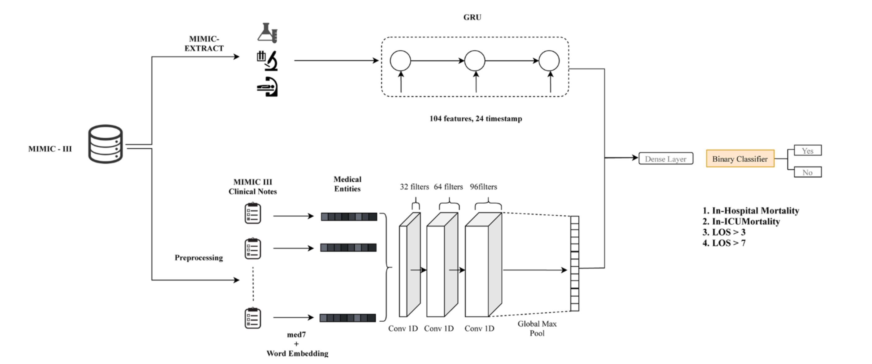
Proposed Model

Slide 5
Results

Slide 6
Ablations
Glove

Slide 7
Software Usage

Slide 8
Future Work
Bert

