Slide 1
Paper 211 : Improving Clinical Outcome Predictions Using Convolution over Medical Entities with Multimodal Learning
CS 598 DLH | Spring 2022
Team ID : 46
Paper : 211
Gopikrishnan Srinivasan | gs25@illinois.edu
Selvaganapathy Thirugnanam | st26@illinois.edu
Original Paper: Batuhan Bardak and Mehmet Tan. 2021. Improving clinical outcome predictions using convolution over medical entities with multimodal learning. Artificial Intelligence in Medicine, 117:102112.
https://doi.org/10.1016/j.artmed.2021.102112

Slide 2
What is this paper trying to solve
Improve Clinical Predictions
Predicting mortality of patients in Hospital
Predicting mortality of patients in ICU
Predicting Length of Stay in ICU greater than 3 days
Predicting Length of Stay in ICU greater than 7 days
Claims
Performance improvement of 1% - 1.5% AUPRC against multimodal baseline models
Performance improvement of 2.5% - 3% AUPRC against time series baseline model

Slide 3
Data
MIMIC–III dataset is used as proposed by the paper
MIMIC Extract pipeline to extract structured time series features
Clinical notes events, admissions events and ICU stay events
Data split into Train/Dev/Test set to 70%/20%/10%
Eliminate data of patients age < 15 years and the LOS <12 hours and LOS > 10 days
No of Patients | 34, 472
Total Time Series Variables | 104
Dosage | Drug | Duration | Route | Frequency | Strength | Form
84130 | 684196 | 6303 | 215923 | 131607 | 186851 | 19582
Med 7 – NER output after processing clinical notes

Slide 4
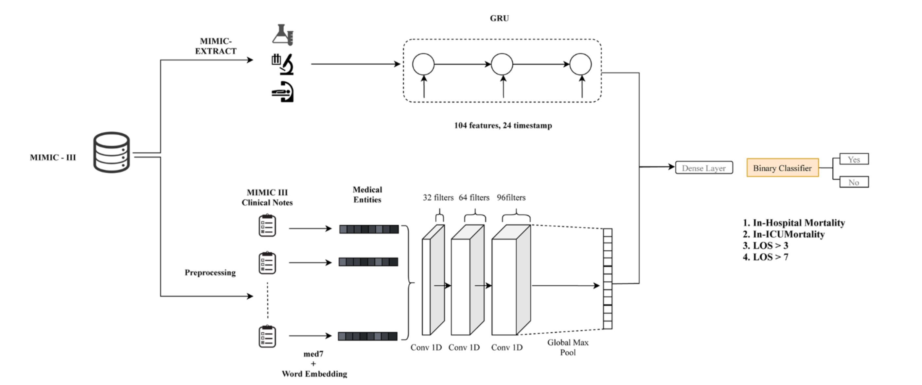
Proposed Model Architecture
Clinical notes passed to med7 to extract medical entities
Word Embedding (Word2Vec, FastText, Concatenation) used to produce fixed vectors for clinical notes which is then fed to a 3 1D Convolution layer are stacked with filter size of 32, 64 and 96 to extract features on medical entities.
The output of the last Convolution layer is fed to Max Pool layer.
Timeseries data (1st 24 hours ICU data) is passed to Single layer GRU with 256 hidden units
Output of GRU and Max Pool Layer is combined and fed to a Fully Connected Dense Layer with 512 hidden units
A Non Linear Sigmoid classifier is applied at the end of the model.
HyperParameters
Epochs : 100 GRU hidden units : 256 FC hidden units : 512
Batch size: 64 Conv Kernel size : 3
Learning Rate: 0.001 Dropout Rate : 0.2

Slide 5
Results
Paper Claim 1 - Performance improvement of 1% - 1.5% AUPRC against multimodal baseline models
Reproducibility Attempt Result - We noticed performance improved for most of the prediction tasks. On average , they match with authors claim.
Latest version of the pretrained word embedding models could be one of the reason on why the numbers couldn’t exactly match
AUPRC | In-Hospital | ICU mort | LOS > 3 | LOS > 7
Proposed | 0.580 | 0.520 | 0.647 | 0.231
Multimodal | 0.580 | 0.527 | 0.644 | 0.216
Comparison – Average 1.62% better
Proposed vs Multimodal | 0.05% | -1.27% | 0.47% | 7.23%
Actual results from our reproduction attempt

Slide 6
Results – Contd..
Paper Claim 2 - Performance improvement of 2.5% - 3% AUPRC against time series baseline model
Reproducibility Attempt Result – We noticed, our results outperformed the improvement claimed by the author by 3%.
Latest version of the pretrained word embedding models could be one of the reason on why the the proposed model outperformed the timeseries baseline claim.
AUPRC | In-Hospital | ICU mort | LOS > 3 | LOS > 7
Proposed | 0.580 | 0.520 | 0.647 | 0.231
TimeSeries | 0.558 | 0.483 | 0.627 | 0.205
Comparison – Average 6.8% better
Proposed vs Timeseries | 4.03% | 7.56% | 3.08% | 12.51%
Actual results from our reproduction attempt

Slide 7
Ablations – Pretrained Glove Model
Modifying the proposed model to use Glove Embedding instead of Word2Vec / Fastext yielded better results for 3 out of the 4 prediction tasks.
AUPRC | In-Hospital | ICU mort | LOS > 3 | LOS > 7
Ablation - GloVe | 0.582 | 0.526 | 0.655 | 0.212
Proposed | 0.580 | 0.520 | 0.647 | 0.231
Comparison
GloVe vs Proposed | 0.28% | 1.16% | 1.36% | -8.29%
Actual results using Glove on top of proposed model

Slide 8
Conclusions
The results reproduced conform to the author’s claims on leveraging 1D-CNN based multimodal architecture which uses timeseries features and medical entities together producing better results when compared to timeseries and multimodal baseline models.
Notes:
Test notes

