Slide 1
Paper 211 : Improving Clinical Outcome Predictions Using Convolution over Medical Entities with Multimodal Learning
CS 598 DLH - Gs25@Illinois.edu | st26@Illinois.edu

Slide 2
What is this paper trying to solve
Improve the following :
Predicting mortality of patients in Hospital
Predicting mortality of patients in ICU
Predicting Length of Stay in ICU greater than 3 days
Predicting Length of Stay in ICU greater than 7 days

Slide 3
Data
MIMIC–III dataset is used as proposed by the paper
MIMIC Extract pipeline to extract structured time series features
Clinical notes events, admissions events and ICU stay events
Data split into Train/Dev/Test set to 70%/20%/10%
Eliminate data of patients age < 15 years and the LOS <12 hours and LOS > 10 days
No of Patients | 34, 472
Total Time Series Variables | 104
Dosage | Drug | Duration | Route | Frequency | Strength | Form
84130 | 684196 | 6303 | 215923 | 131607 | 186851 | 19582
Med 7 – NER output after processing clinical notes

Slide 4
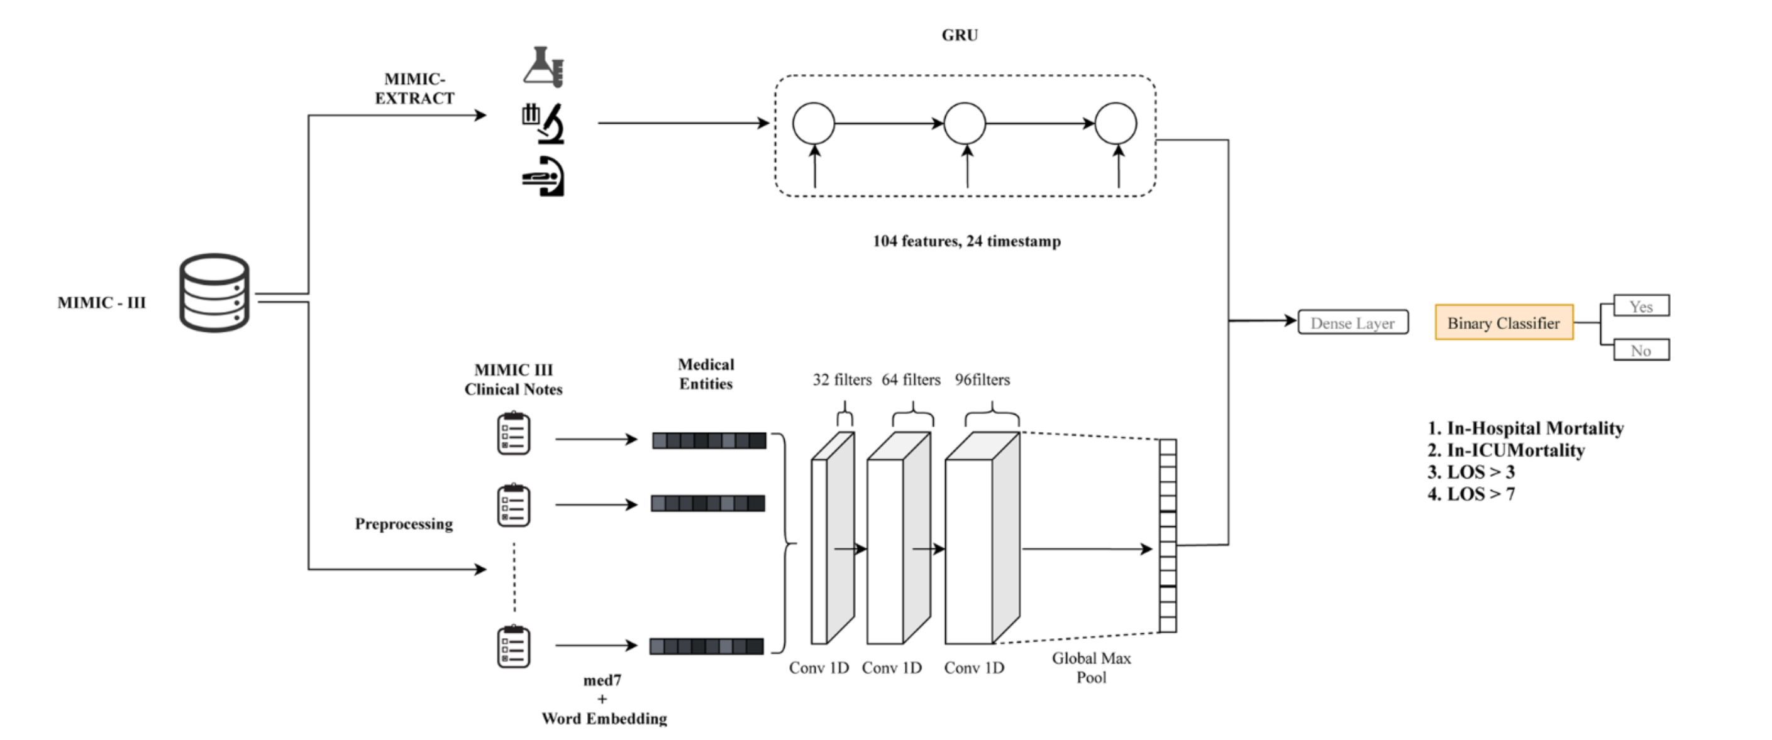
Proposed Model

Slide 5
Results
Paper Claim 1 - Performance improvement of 1% - 1.5% AUPRC against multimodal baseline models
AUPRC | In-Hospital | ICU mort | LOS > 3 | LOS > 7
Proposed | 0.580 | 0.520 | 0.647 | 0.231
Multimodal | 0.580 | 0.527 | 0.644 | 0.216
Comparison – Average 1.62% better
Proposed vs Multimodal | 0.05% | -1.27% | 0.47% | 7.23%
Actual results from our reproduction attempt

Slide 6
Results
Paper Claim 2 - Performance improvement of 2.5% - 3% AUPRC against time series baseline model
AUPRC | In-Hospital | ICU mort | LOS > 3 | LOS > 7
Proposed | 0.580 | 0.520 | 0.647 | 0.231
TimeSeries | 0.558 | 0.483 | 0.627 | 0.205
Comparison – Average 6.8% better
Proposed vs Timeseries | 4.03% | 7.56% | 3.08% | 12.51%
Actual results from our reproduction attempt

Slide 7
Ablations
Pretrained GloVe model
AUPRC | In-Hospital | ICU mort | LOS > 3 | LOS > 7
Ablation - GloVe | 0.582 | 0.526 | 0.655 | 0.212
Proposed | 0.580 | 0.520 | 0.647 | 0.231
Comparison
GloVe vs Proposed | 0.28% | 1.16% | 1.36% | -8.29%

Slide 8
Conclusions
The results reproduced conform to the author’s claims on leveraging 1D-CNN based multimodal architecture which uses timeseries features and medical entities together producing better results when compared to timeseries and multimodal baseline models.
Notes:
Test notes

