Slide 1
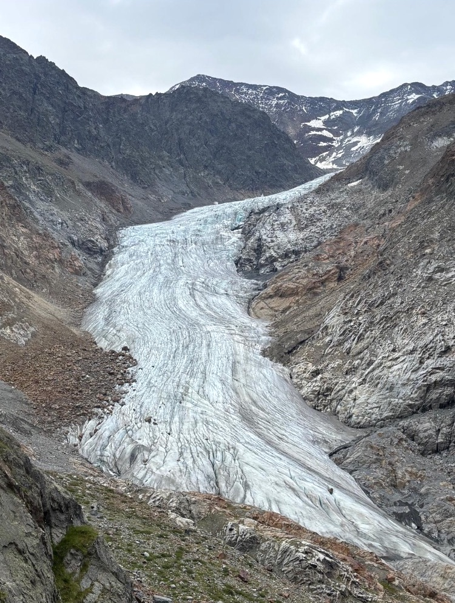
Source Area
Accumulation
Path to Rauekopfhütte

