Slide 1
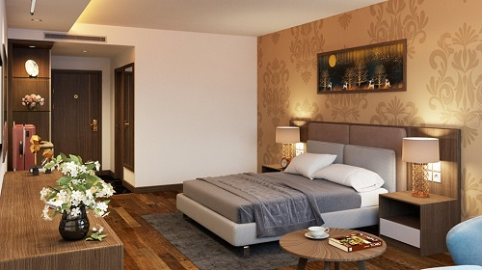
RESORT
Luxury Pool Villa
Fusce 11 tincidunt maximus leo, sed scelerisque massa auctor sit amet. Donec ex mauris, hendrerit quis nibh ac, efficitur fringilla enim.
Villa Amenities
Max Occupancy : 4 adults
Villa Size: 550 sqft
USD $200.00/night

