Slide 1


COVID 19 DISEASE DETECTION AND CLASSIFICATION BASED ON RESNET50 DEEP LEARNING TECHNIQUE Dissertation Submitted in partial fulfilment for the award of Post Graduate Degree of Master of Technology in Computer Science Engineering Submitted to RAJIV GANDHI PRODYOGIKI VISHWAVIDYALAYA, BHOPAL (M.P.)
Submitted by
HIMANSHI SOLANKI [0850CS18MT06]
himanshisolanki04@outlook.com
Approved and Guided By
PROF. MOHIT JAIN
BM COLLEGE OF TECHNOLOGY
MASTERS OF TECHNOLOGY IN COMPUTER SCIENCE PROGRAM

Slide 2
CONTENTS
Abstract
Introduction
Object of the Research
Problem definition
Literature review
Implementation modules
Result Analysis
Conclusion
Future scope
References

Slide 3
Abstract
The COVID-19 disease caused by the SARS-CoV-2 virus has become a global pandemic. Early and accurate detection of COVID-19 is crucial to control its spread. In recent years, deep learning techniques have shown great potential in medical image analysis tasks, including disease detection. In this regard, a study was conducted to detect COVID-19 from chest X-ray images using the ResNET50 deep learning model. The ResNET50 model was trained on a dataset of chest X-ray images, which included normal and COVID-19 infected cases. The results of the study showed that the ResNET50 model achieved an accuracy of 92 % in detecting COVID-19 from chest X-ray images. The study concluded that the ResNET50 model has the potential to be a valuable tool for the early and accurate detection of COVID- 19, which can aid in the effective management of the disease.

Slide 4
Introduction
Corona disease detection, commonly referring to COVID-19 caused by the SARS-CoV-2 virus, has seen significant advancements through the application of machine learning techniques. Machine learning models have been employed to aid in the diagnosis and identification of COVID-19 cases. These models utilize various data sources, such as medical images (like chest X-rays and CT scans) and clinical data (including symptoms and patient history), to detect patterns that are indicative of the disease.
Convolutional Neural Networks (CNNs) have played a crucial role in analyzing medical images. These networks can identify specific visual features in X-rays and CT scans that might be associated with COVID-19, aiding radiologists and medical professionals in making accurate assessments. Transfer learning, a technique where pre-trained models are fine-tuned for a specific task, has been particularly effective in COVID-19 detection due to limited labeled data.
In addition to medical images, machine learning models have been used to predict COVID-19 infection based on clinical data. By analyzing symptoms, vital signs, and other patient information, these models can provide rapid preliminary assessments. However, it's important to note that these models are meant to assist healthcare professionals and not replace clinical judgment.
While machine learning has shown promise in COVID-19 detection, there are challenges to address, including the need for diverse and high-quality datasets, potential biases in the data, and the necessity of validation through rigorous clinical trials. Nevertheless, the ongoing research and development in this field continue to contribute to more effective tools for early detection, monitoring, and management of the disease.

Slide 5
OBJECT OF THE RESEARCH
This work discusses the scenarios for providing vaccination to the people based on the following issues:
Collect and accurate COVID-19 patient data from kaggle website https://www.kaggle.com/
To preprocess the data to ensure that it is clean, standardized, and in a format suitable for deep learning model.
Train deep learning model such as ResNet50 on the COVID-19 patient data to identify patterns and insights.
Evaluate the performance of the deep learning models using various metrics such as accuracy, precision, recall, and F1 score.
Analyze the results and identify actionable insights that can inform the diagnosis, treatment, and management of COVID-19.

Slide 6
PROBLEM DEFINITION
The problem statement revolves around the urgent need to develop a robust and accurate system for early detection and diagnosis of COVID-19, caused by the SARS-CoV-2 virus.
The global pandemic has highlighted the challenges in swiftly identifying and isolating infected individuals to mitigate the spread of the virus.
Conventional diagnostic methods such as PCR testing have limitations in terms of scalability, speed, and resource requirements. Furthermore, the virus's diverse range of symptoms and the potential for asymptomatic carriers make it challenging to promptly differentiate COVID-19 from other respiratory illnesses.
The goal is to leverage advanced machine learning techniques, including deep learning and data analytics, to create a reliable and efficient tool capable of analyzing medical images, clinical data, and epidemiological trends to accurately detect and diagnose COVID-19 cases. Addressing this problem holds immense significance in enhancing our ability to manage and control the pandemic, enabling timely medical interventions, reducing transmission rates, and ultimately saving lives.

Slide 7
Motivation
The motivation behind addressing the aforementioned problem stems from the unprecedented global impact of the COVID-19 pandemic. The outbreak has not only led to a significant loss of human lives but has also overwhelmed healthcare systems, disrupted economies, and upended daily lives. Conventional methods of pandemic management have revealed their limitations in the face of such a rapidly evolving and complex crisis. Therefore, the pressing need to harness the power of machine learning and advanced data analysis techniques to develop innovative solutions for COVID-19 detection and diagnosis becomes evident.
By creating accurate and efficient tools for early detection, healthcare professionals can make informed decisions about patient care, isolation, and treatment, leading to more effective disease management. Furthermore, reliable diagnostic tools can help mitigate the strain on healthcare systems by facilitating targeted testing efforts and minimizing unnecessary testing of non-infected individuals. Such technology can also aid in contact tracing and epidemiological modeling, enabling public health authorities to respond more swiftly to potential outbreaks and implement appropriate containment measures.
Ultimately, the motivation behind tackling this challenge is rooted in the desire to save lives, reduce the global burden of disease, and restore a sense of normalcy to societies worldwide. The fusion of cutting-edge machine learning with medical expertise has the potential to revolutionize our approach to pandemic response, laying the groundwork for more agile and data-driven strategies to combat not only COVID-19 but also future infectious diseases.

Slide 8
Literature review
Author & Year | Work Description | Advantages | Disadvantages
Jun Wang, Yiming Bao et al. (2020) | Efficient COVID-19 screening in 3D chest CT images | Efficient COVID-19 screening in 3D chest CT images | Potential overfitting with limited data
Wang et al. (2020) | Deep learning-based COVID-19 diagnosis using CT | Accurate diagnosis, rapid processing | Requires 3D CT volumes, limited dataset size
Hussain (2022) | Wasserstein GAN for COVID-19 CXR data augmentation | Effective data augmentation, lightweight | Dependency on GAN performance, model complexity
Hoang (2022) | COVID-19 detection from cough sounds | Non-invasive, real-world cough sound data | Dependency on audio quality, cough variability
Meepaganithage (2022) | Deep learning for COVID-19 CXR classification | High performance, transfer learning benefits | Limited dataset size, variations in X-ray quality
Lu (2022) | PIRL-based prediction model for COVID-19 diagnosis | Uses unlabeled data, transfer learning effect | Model performance based on dataset quality
Yao (2022) | DenseNet-based deep transfer learning for COVID-19 CXR | Effective transfer learning, interpretable | Limited data augmentation, model complexity
Shakil (2022) | ML models for COVID-19 detection from CXR | High accuracy, various model comparisons | Limited dataset size, class imbalance
Almansoor et al. (2020) | ML-based forecasting of COVID-19 cases | Efficient prediction, various ML methods | May not capture complex pandemic dynamics
Sear et al. (2020) | Quantifying COVID-19 content among anti-vax groups | Reveals content trends, potential intervention | Focus on online content, potential biases

Slide 9
COVID-19 Dataset
https://www.kaggle.com/datasets/imdevskp/corona-virus-report
A new coronavirus designated 2019-nCoV was first identified in Wuhan, the capital of China's Hubei province
People developed pneumonia without a clear cause and for which existing vaccines or treatments were not effective.
The virus has shown evidence of human-to-human transmission
Transmission rate (rate of infection) appeared to escalate in mid-January 2020
As of 30 January 2020, approximately 8,243 cases have been confirmed

Slide 10
Problem Statement
The problem at hand revolves around the need to develop an accurate, efficient, and reliable system for the automated detection and diagnosis of COVID-19 from medical images, particularly chest X-rays and CT scans.
The ongoing global pandemic has underscored the critical importance of early and accurate detection of COVID-19 cases to curb the spread of the virus, provide timely medical interventions, and optimize healthcare resources.
Conventional diagnostic methods, while effective, can be time-consuming, resource-intensive, and subject to human error. Moreover, the diverse clinical presentations of COVID-19 and the potential for asymptomatic carriers pose challenges to swift and precise diagnosis.
As such, there is an urgent demand for advanced technological solutions that can leverage the power of deep learning and image analysis to assist healthcare professionals in rapidly identifying COVID-19 cases.
The proposed system aims to address these challenges by utilizing the ResNet-50 architecture, a state-of-the-art deep learning model, for feature extraction and classification from medical images. However, several key hurdles must be overcome to achieve success.

Slide 11
Proposed flow diagram
Input Image
Preprocessing
Segmentation
Classification
Performance Measure

Slide 12
IMPLEMENTATION MODULES
Input Image
Pre-processing
Segmentation
Feature extraction
Classification

Slide 13
MODULE DESCRIPTION
Input Image: The process begins with obtaining the image(s) to be analyzed. In the context of your query, this could be a medical image like a chest X-ray or CT scan that is suspected to contain features related to a specific condition, such as COVID-19.
Pre-processing: Raw images often require pre-processing to enhance their quality and remove noise. This step can involve tasks like resizing, noise reduction, contrast adjustment, and normalization. In the context of COVID-19 detection, pre-processing might help improve the clarity of lung regions in medical images, making subsequent analysis more effective.
Segmentation: Image segmentation involves dividing an image into meaningful regions, which can be useful for isolating specific areas of interest. In medical imaging, lung segmentation might be performed to separate lung regions from the rest of the image. This step is crucial for focusing subsequent analysis on relevant parts of the image.
Feature Extraction: Once the image is pre-processed and segmented, features need to be extracted from it. Features are specific characteristics or patterns that can be quantified and used to represent the image. In the case of COVID-19 detection, features might include texture patterns, shapes, or pixel intensity distributions within the segmented lung regions.
Classification: Classification involves assigning a label or category to the image based on the extracted features. Machine learning algorithms, such as Support Vector Machines (SVMs), Random Forests, or Neural Networks, can be trained on labeled data to learn the patterns that distinguish COVID-19 cases from non-COVID-19 cases. The trained model can then be used to classify new, unseen images as either COVID-19 positive or negative.

Slide 14
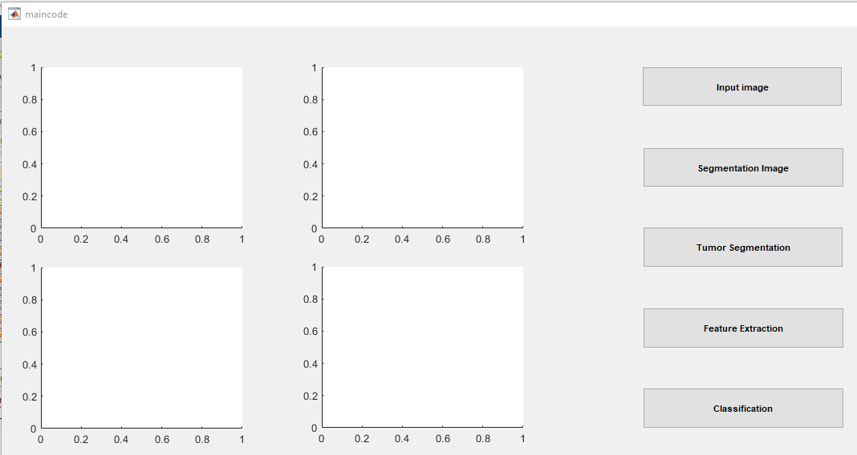
GUI Window

Slide 15
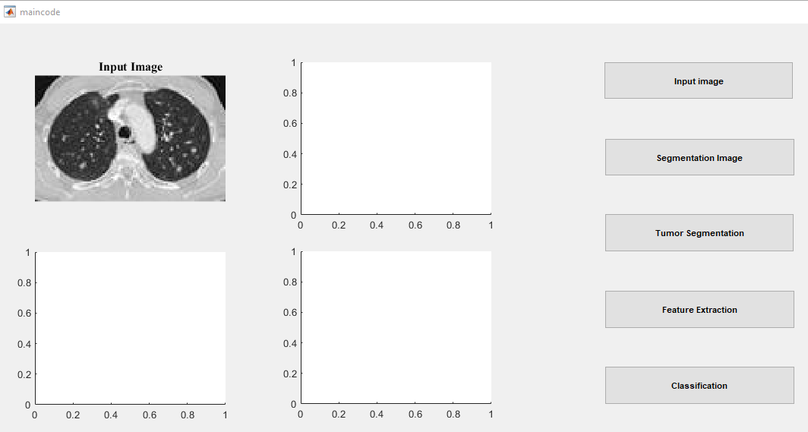
Input Image

Slide 16
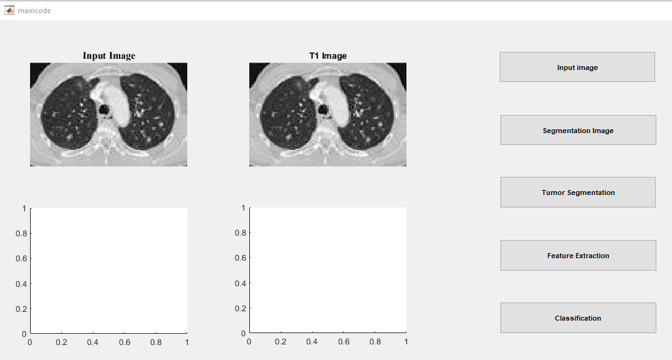
Pre-Processing Image

Slide 17
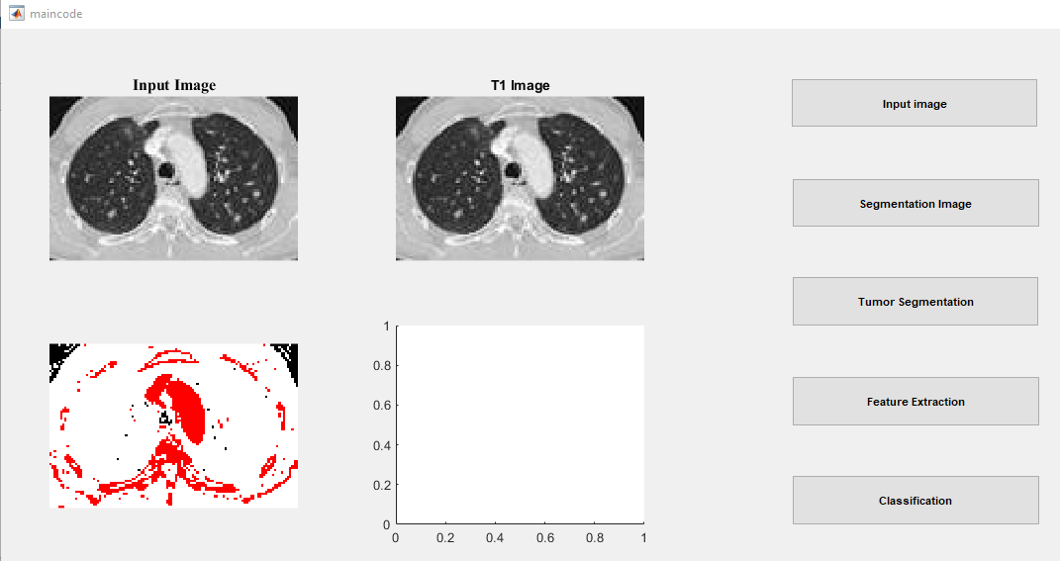
Segmentation Image

Slide 18
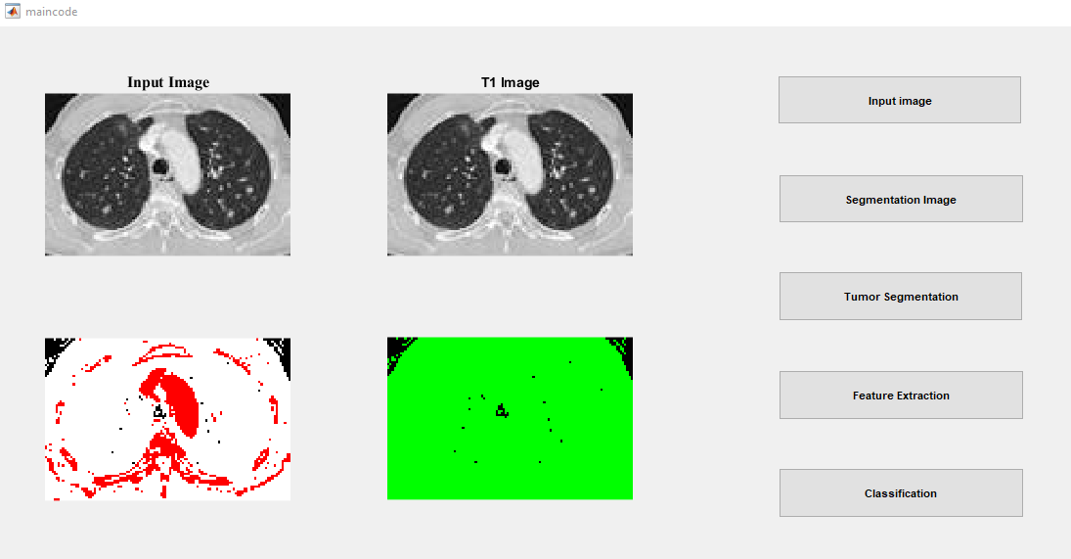
Feature Extraction

Slide 19
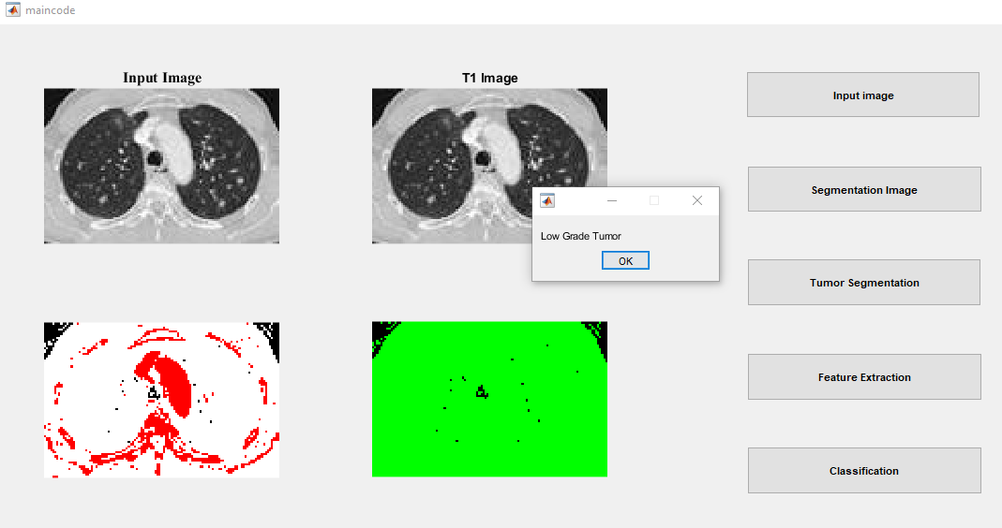
Classification image

Slide 20
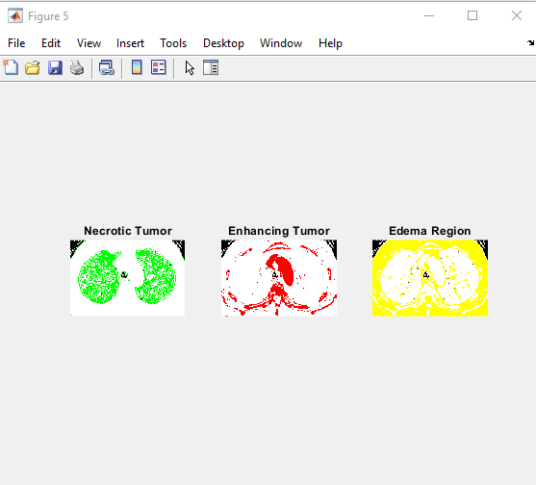
CLASSIFICATION IMAGE

Slide 21
Classification and Segmentation Evaluation Parameters
Technique | Accuracy | Sensitivity | Specificity | Recall | F-Score | Jaccard Coefficient | Dice Coefficient
ResNet50 | 92 | 70.1316 | 69.2987 | 70.1316 | 0.6938 | 0.5312 | 0.6938

Slide 22
COMPARISON RESULT WITH EXISTING WORK
 | Accuracy (%) | Sensitivity (%) | Specificity (%)
RESNET[1] | 93.3 | 87.6 | 95.5
RESNET50 | 96 | 92.1316 | 90.2987

Slide 23
COMPARISON RESULT WITH EXISTING WORK

Slide 24
CONCLUSION
This work is a state of the art that gives an overview of some of the most important digital solutions that have been used around the world for COVID-19 disease screening and diagnosis, contact tracing, drug and vaccine development, prognosis and forecasting, and contact tracing.
There is also separate information about each scientific contribution, such as the nature of the application, the used machine learning techniques and the findings from a data science perspective.
It will be demonstrated that the rapid development of automated diagnostic systems based on machine learning not only protects healthcare personnel by reducing the number of times they interact with COVID-19 patients, but also saves money, expedites the process, and improves the accuracy of diagnoses. All of these benefits will be discussed.

Slide 25
Future Scope
Predicting the spread of the virus: Deep learning algorithms could be trained on data from previous pandemics and outbreaks to predict the spread of COVID-19. They could take into account factors such as population density, travel patterns, and public health interventions to make accurate predictions.
Identifying high-risk areas: By analyzing data on factors such as age, pre-existing health conditions, and location, deep learning algorithms could identify areas that are at higher risk of experiencing severe outbreaks of COVID-19. This could help public health officials to target their resources and interventions more effectively.
Developing treatments: Deep learning could be used to identify potential treatments for COVID-19 by analyzing large datasets of medical research and patient data. It could identify patterns in the data that might not be apparent to human researchers and suggest novel treatments or drug combinations.

Slide 26
References
Jun Wang, Yiming Bao, Yaofeng Wen, Hongbing Lu, Hu Luo, Yunfei Xiang, Xiaoming Li, Chen Liu, and Dahong Qian Prior-Attention Residual Learning for More Discriminative COVID-19 Screening in CT Images 0278-0062 (c) 2020 IEEE IEEE TRANSACTIONS ON MEDICAL IMAGING, VOL. xx, NO. X, NOVEMBER 2020
“Improving epidemic surveillance and response: big data is dead, long live big data,” 2020. [Online]. Available: https://www.thelancet.com/journals/landig/article/ PIIS2589-7500(20)30059-5/fulltext
B. Zahid Hussain;Ifrah Andleeb;Mohammad Samar Ansari;Amit Mahesh Joshi;Nadia Kanwal
Wasserstein GAN based Chest X-Ray Dataset Augmentation for Deep Learning Models: COVID-19 Detection Use-Case 2022 44th Annual International Conference of the IEEE Engineering in Medicine & Biology Society (EMBC) Year: 2022 |
Truong Hoang;Lam Pham;Dat Ngo;Hoang D. NguyenA Cough-based deep learning framework for detecting COVID-19 2022 44th Annual International Conference of the IEEE Engineering in Medicine & Biology Society (EMBC) Year: 2022 |
Ayesh Meepaganithage;Mgnas Fernando Detecting COVID-19 Pneumonia using Chest X-rays through Deep Learning Techniques 2022 2nd International Conference on Advanced Research in Computing (ICARC) Year: 2022 |
Zihao Lu;Yanyu Chen;Zihao Chu;Sida Chen;Bowen Sun A COVID-19 detection method based on self-supervised learning and transfer learning 2022 International Conference on Wearables, Sports and Lifestyle Management (WSLM) Year: 2022 |

Slide 27
Thank you
Submitted by
HIMANSHI SOLANKI [0850CS18MT06]
himanshisolanki04@outlook.com
Saturday , 26th Aug, 2023
M.Tech Dissertation

