Slide 1
Introduction to Spark
Sajan Kedia

Slide 2
Agenda
What is Spark
Why Spark
Spark Framework
RDD
Immutability
Lazy Evaluation
Dataframe
Dataset
Spark SQL
Architecture
Cluster Manager

Slide 3
What is Spark?
Apache Spark is a fast, in-memory data processing engine
With development APIs it allow to execute streaming, machine learning or SQL.
Fast, expressive cluster computing system compatible with Apache Hadoop
Improves efficiency through:
In-memory computing primitives
General computation graphs (DAG)
Up to 100× faster
Improves usability through:
Rich APIs in Java, Scala, Python
Interactive shell
Often 2-10× less code
open source parallel process computational framework primarily used for data engineering and analytics.

Slide 4

About Apache Spark
Initially started at UC Berkeley in 2009
Open source cluster computing framework
Written in Scala (gives power of functional Programming)
Provides high level APIs in
Java
Scala
Python
R
Integration with Hadoop and its ecosystem and can read existing data.
Designed to be fast for iterative algorithms and interactive queries for which mapReduce is inefficient.
Most popular for running Iterative Machine Learning Algorithms.
With support for in memory storage and efficient fault recovery.
10x (on disk) - 100x (In-Memory) faster

Slide 5
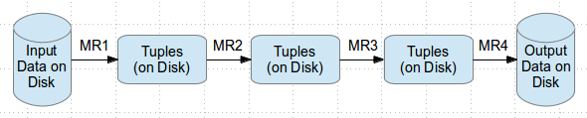
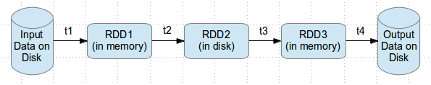
Why Spark ?
Most of Machine Learning Algorithms are iterative because each iteration can improve the results
With Disk based approach each iteration output is written to disk making it slow
Hadoop execution flow
Spark execution flow

Slide 6
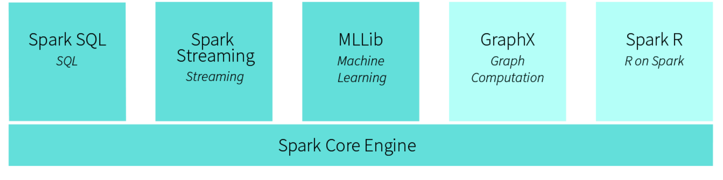

Spark Core Engine

Slide 7
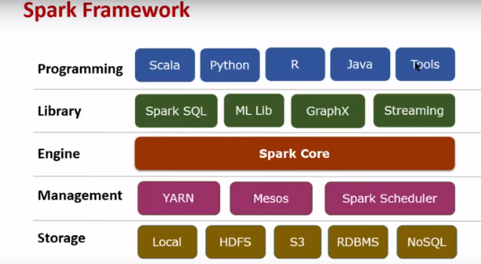

Spark Framework

Slide 8
RDD (Resilient Distributed Dataset)
Key Spark Construct
A distributed collection of elements
Each RDD is split into multiple partitions which may be computed on different nodes of the cluster
Spark automatically distributes the data in RDD across cluster and parallelize the operations
RDD have following properties
○ Immutable
○ Lazy evaluated
○ Cacheable
○ Type inferred

Slide 9
RDD Operations
How to create RDD:
Loading external data sources
lines=sc.textfile(“readme.txt”)
Parallelizing a collection in a driver program
Lines=sc.parallelize([“pandas”, “I like pandas”])
Transformation
transform RDD to another RDD by applying some functions
Lineage graph (DAG) : keep the track of dependencies between transformed RDDs using which on demand new RDDs can be created or part of persistent RDD can be recovered in case of failure.
Examples : map, filter,flapmap,distinct,sample , union, intersect,subtract ,cartesian etc.
Action
Actual output is being generated in transformed RDD once action is applied
Return values to the driver program or write data to external storage
The entire RDD gets computed from scratch on new action call and if intermediate results are not persisted.
Examples : reduce, collect,count,countByvalue,take,top,takeSample,aggreagate,foreach etc.

Slide 10
Immutability
● Immutability means once created it never changes
● Big data by default immutable in nature
● Immutability helps to
○ Parallelize
○ Caching
Immutability in actio
const int a = 0 //immutable
int b = 0; // mutable
Updation
b ++ // in place
c = a + 1
Immutability is about value not about reference

Slide 11
Challenges of Immutability
● Immutability is great for parallelism but not good for space
● Doing multiple transformations result in
○ Multiple copies of data
○ Multiple passes over data
● In big data, multiple copies and multiple passes will have poor performance characteristics.

Slide 12
Lazy Evaluation
Laziness means not computing transformation till it’s need
Once, any action is performed then the actual computation starts
A DAG (Directed acyclic graph) will be created for the tasks
Catalyst Engine is used to optimize the tasks & queries
It helps reduce the number of passes
Laziness in action
val c1 = collection.map(value => value +1) //do not compute anything
val c2 = c1.map(value => value +2) // don’t compute
print c2 // Now transform into
Multiple transformations are combined to one
val c2 = collection.map (value => {var result = value +1
result = result + 2 } )

Slide 13
Challenges of Laziness
Laziness poses challenges in terms of data type
If laziness defers execution, determining the type of the variable becomes challenging
If we can’t determine the right type, it allows to have semantic issues
Running big data programs and getting semantics errors are not fun.

Slide 14
Type inference
Type inference is part of compiler to determining the type by value
As all the transformation are side effect free, we can determine the type by operation
Every transformation has specific return type
Having type inference relieves you think about representation for many transforms.
Example:
c3 = c2.count( ) // inferred as Int
collection = [1,2,4,5] // explicit type Array

Slide 15
Caching
Immutable data allows you to cache data for long time
Lazy transformation allows to recreate data on failure
Transformations can also be saved
Caching data improves execution engine performance
Reduces lots of I/O operations of reading/writing data from HDFS

Slide 16
What Spark gives Hadoop?
Machine learning module delivers capabilities not easily exploited in Hadoop.
in-memory processing of sizeable data volumes, remains an important contribution to the capabilities of a Hadoop cluster.
Valuable for enterprise use cases
Spark’s SQL capabilities for interactive analysis over big data
Streaming capabilities (Spark streaming)
Graph processing capabilities (GraphX)

Slide 17
What Hadoop gives Spark?
YARN resource manager
DFS
Disaster Recovery capabilities
Data Security
A distributed data platform
Leverage existing clusters
Data locality
Manage workloads using advanced policies
Allocate shares to different teams and users
Hierarchical queues
Queue placement policies
Take advantage of Hadoop’s security
Run on Kerberized clusters

Slide 18
Data Frames in Spark
Unlike an RDD, data is organized into named columns.
Allows developers to impose a structure onto a distributed collection of data.
Enables wider audiences beyond “Big Data” engineers to leverage the power of distributed processing
allowing Spark to manage the schema and only pass data between nodes, in a much more efficient way than using Java serialization.
Spark can serialize the data into off-heap storage in a binary format and then perform many transformations directly on this off-heap memory,
Custom memory management
Data is stored in off – heap memory in binary format.
No Garbage collection is involved ,due to avoidance of serialization
Query optimization plan
Catalyst Query optimizer

Slide 19
Datasets in Spark
Aims to provide the best of both worlds
RDDs – OOP and compile time safely
Data frames - Catalyst query optimizer, custom memory management
How dataset scores over Data frame is an additional feature it has: Encoders .
Encoders act as interface between JVM objects and off-heap custom memory binary format data.
Encoders generate byte code to interact with off-heap data and provide on-demand access to individual attributes without having to deserialize an entire object.

Slide 20
Spark SQL
Spark SQL is a Spark module for structured data processing
It lets you query structured data inside Spark programs, using SQL or a familiar DataFrame API.
Connect to any data source the same way
Hive, Avro, Parquet, ORC, JSON, and JDBC.
You can even join data across these sources.
Run SQL or HiveQL queries on existing warehouses.
A server mode provides industry standard JDBC and ODBC connectivity for business intelligence tools.
Writing code in RDD API in scala can be difficult, using Spark SQL easy SQL format code can be written which internally converts to Spark API & optimized using the DAG & catalyst engine.
There is no reduction in the performance.

Slide 21
PySpark Code - Hands On

Slide 22
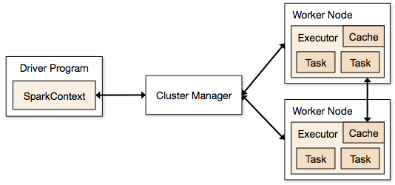
Spark Runtime Architecture

Slide 23
Spark Runtime Architecture - Driver
Master node
Process where “main” method runs
Runs user code that
creates a SparkContext
Performs RDD operations
When runs performs two main duties
Converting user program into tasks
logical DAG of operations -> physical execution plan.
Optimization Ex: pipelining map transforms together to merge them and convert execution graph into set of stages.
Bundled up task and send them to cluster.
Scheduling tasks on executors
Executor register themselves to driver
Look at current set executors and try to schedule task in appropriate location ,based on data placement.
Track location of cache data and use it to schedule future tasks that access that data, to avoid side effect of storing cached data while running a task.

Slide 24
Spark Runtime Architecture - Spark Context
Driver accesses Spark functionality through SC object
Represents a connection to the computing cluster
Used to build RDDs
Works with the cluster manager
Manages executors running on worker nodes
Splits jobs as parallel task and execute them on worker nodes
Partitions RDDs and distributes them on the cluster

Slide 25
Spark Runtime Architecture - Executor
Runs individual tasks in given spark job
Launched once at the beginning of spark application
Two main roles
Runs the task and return results to driver
Provides in-memory data stored for RDDs that are cached by user programs, through service called Block Manager that lives within each executor.

Slide 26
Spark Runtime Architecture - Cluster Manager
Launches Executors and sometimes driver
Allows sparks to run on top of different external managers
YARN
Mesos
Spark built-in stand alone cluster manager
Deploy modes
Client mode
Cluster mode

Slide 27
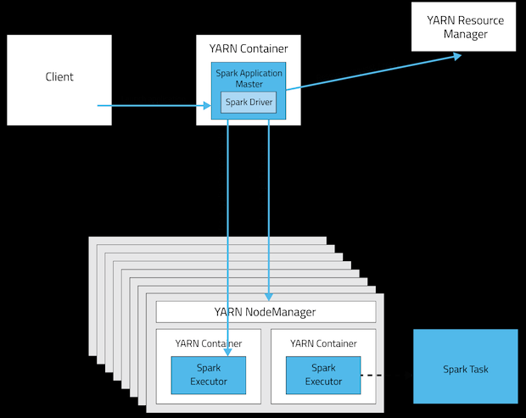
Spark + YARN (Cluster Deployment mode)
Driver runs inside a YARN container
Notes:
https://www.cloudera.com/documentation/enterprise/5-4-x/topics/cdh_ig_running_spark_on_yarn.html

Slide 28
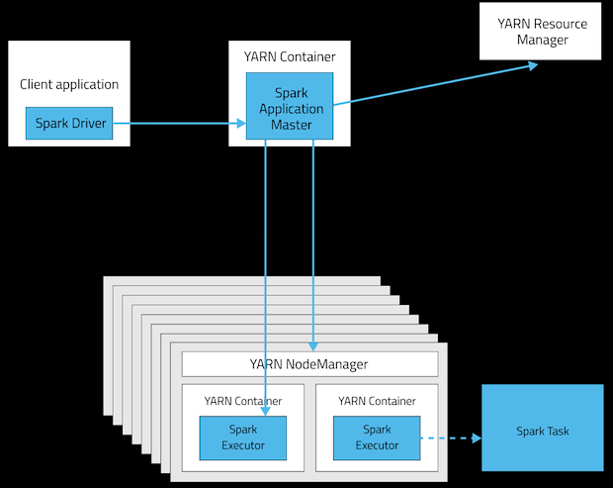
Spark + YARN (Client Deployment Mode)
Driver runs on the machine that you submitted the application.
e.g. local on laptop

Slide 29
Steps: running spark application on cluster
Submit an application using spark-submit
spark-submit launches driver program and invoke main() method
Driver program contact cluster manager to ask for resources to launch executors
Cluster manager launches executors on behalf of the driver program.
Drive process runs through user application and send work to executors in the form of tasks.
Executors runs the tasks and save the results.
driver’s main() method exits or SparkContext.stop() – terminate the executors and release the resources.

Slide 30
Thanks :)

