Slide 1

Data Frames in Spark SQL

Slide 2
Agenda
Identify the drawbacks of handling structured data in an RDD
Understand the challenges of handling structured BIG DATA sets
Why do we need data frames in SPARK
Use cases of data frames in SPARK SQL

Slide 3
RDD’s
They are objects in SPARK which represent BIG DATA
They are distributed
They are fault tolerant
They are lazily evaluated
Scalable
Supports near real time stream processing
They have a lot of other benefits which makes it THE element of BIG DATA computation in SPARK

Slide 4
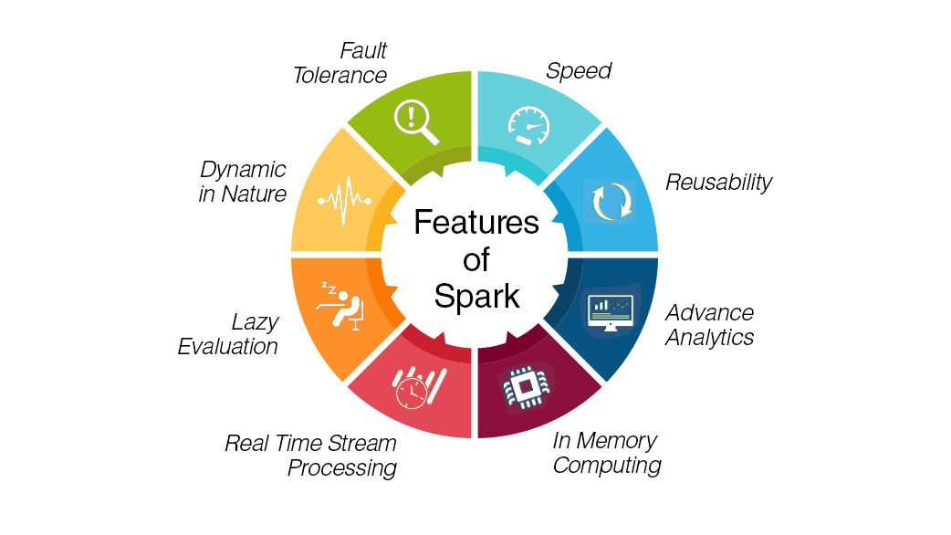
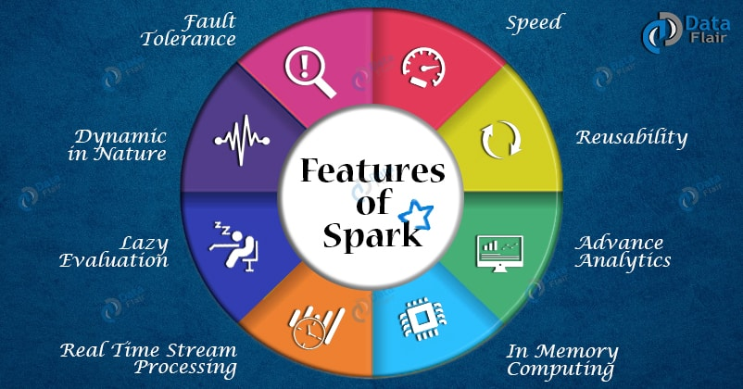
RDD’s are actually great

Slide 5
How do we normally create the RDD’s ?
The parallelize() method
sc = SparkContext.getOrCreate()
myrdd = sc.parallelize([1,2,3,4,5,6,7,8,9])
Data source API (eg. The textFile API)
sc = sc.textFile(“FILE PATH")

Slide 6
How is the data stored in an RDD ?
What is the data format inside an RDD ?
It’s just raw sequence of bytes. Especially when its created using a
the textFile() or parallelize() API
Creating RDD’s using structured data (CSV data)
sc = sc.textFile("sample.csv")
myrdd = sc.flatMap(lambda e:e.split(" "))
myrdd.collect()

Slide 7
Drawbacks of RDD’s
They store data as sequence of bytes
This suits unstructured data manipulation
Data does not have any schema
There is no direct support to handle structured data
The native API’s on RDD’s seldom provide any support for structured data handling
Special RDD format is needed to store structured data (BIG DATA)
Special set of API’s are needed to manipulate and query such RDD’s

Slide 8
SCHEMA RDD’s (DATA FRAMES)
The idea of named columns and schema for the RDD data is borrowed from data frames
Spark allows creation of data frames using specific data frame API’s
An RDD can be created using the standard set of regular data set API’s , schema can be assigned to the data and explicitly converted into a data frame
There is provision to manipulate the spark data frames using the library “SPARK SQL”
The standard set of SPARK transformation API’s can also be used on SPARK data frames

Slide 9
Creating a SPARK Data Frame
Consider the following CSV data saved in a text file
1,Ram,48.78,45
2,Sita,12.45,40
3,Bob,3.34,23
4,Han,16.65,36
5,Ravi,24.6,46
rdd = sc.textFile("sample.csv")
csvrdd = rdd.map(lambda e:e.split(","))
emp = csvrdd.map(lambda e: Row( id=long(e[0]), name=e[1],sal=e[2], age=int(e[3].strip())))
empdf = sqlContext.createDataFrame(emp)

Slide 10
DEMO

Slide 11
Summary
Understand the drawbacks of the RDD’s in efficiently handling structured data
The need for data frames and data frame operations
There are a bunch of other DATA SOURCE API’s which can directly read data from sources like CSV, JSON, Parquet, JSON etc.

