Slide 1
Apache SPARK fundamentals

Slide 2
Agenda
Overview of job execution in Hadoop map reduce
Recap of the drawbacks in map reduce
Overview of spark architecture
Spark deployment
Job execution in SPARK
RDD’s
Actions and transformations
Demo

Slide 3




Overview of job execution in HADOOP
Name node
Resource manager/YARN
Data nodes
Job client
Name node
A job submitted by the user is picked up by the name node and the resource manager
Job gets submitted to the name node and eventually resource manager is responsible for scheduling the execution of the job on the data nodes in the cluster
The data nodes in cluster consists the data blocks on which the user’s program will be executed in parallel

Slide 4
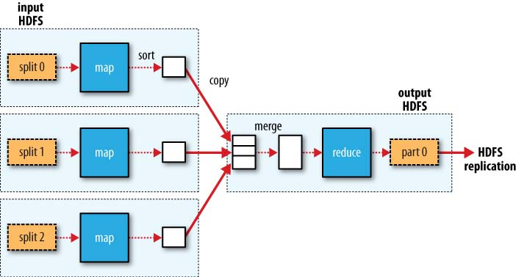
The map and reduce stage
Notes:
4

Slide 5
Disc I/O problem in Hadoop Map-Reduce
The above example demonstrates a map-reduce job involving 3 mappers on 3 input splits
There is 1 reducer
Each input split on each data resides on the hard disc. Mapper reading them would involve a disc read operation.
There would be 3 disc read operations from all the 3 mappers put together
Merging in the reduce stage involves 1 disc write operation
Reducer would write the final output file to the HDFS, which indeed is another disc write operation
Totally there are a minimum of 5 disc I/O operations in the above example (3 from the map stage and 2 from reduce stage)
The number of disc read operations from the map stage is equal to the number of input splits

Slide 6
Calculating the number of disc I/O operations on a large data set
Typically a HDFS input split size would be 128 MB
Let’s consider a file of size 100TB and the number of file blocks on HDFS would be (100 * 1024 * 1024) / 128 = 8,19,200
There would around 8.2 lakh mappers which needs to run on the above data set once a job is launched using Hadoop map reduce
8.2 lakh mappers means, 8.2 lakh disc read operations
Disc read operations are 10 times slower when compared to a memory read operation
Map-Reduce does not inherently support iterations on the data set
Several rounds of Map-Reduce jobs needs to be chained to achieve the result of an iterative job in Hadoop
Most of the machine learning algorithms involves an iterative approach
10 rounds of iterations in a single job leads to 8.2 lakh X 10 disc I/O operations

Slide 7
SPARK’s approach to problem solving
Spark allows the results of computation to be saved in the memory for future re-use
Reading the data from the memory is much faster than that of reading from the disc
Caching the result in memory is under the programmer’s control
Not always is possible to save such results completely in memory especially when the object is too large and memory is low
In such cases the objects needs to be moved to the disc
Spark, therefore is not a completely in memory based parallel processing platform
Spark however is 3X to 10X faster in most of the jobs when compared to that of Hadoop

Slide 8
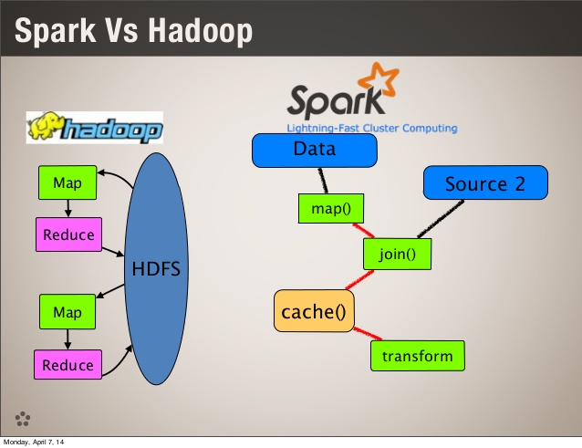

Slide 9
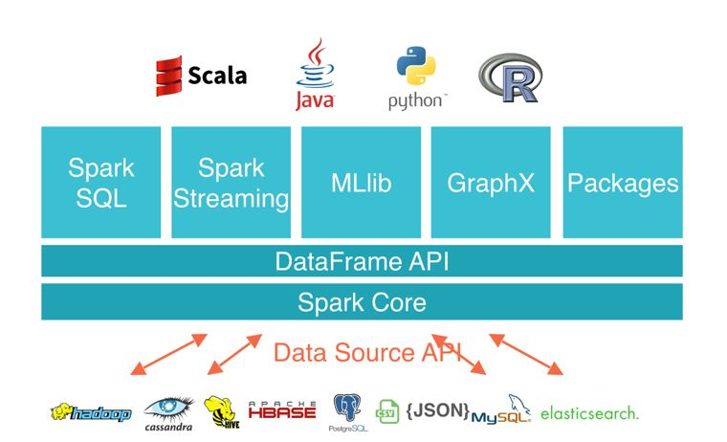
Understanding SPARK architecture

Slide 10
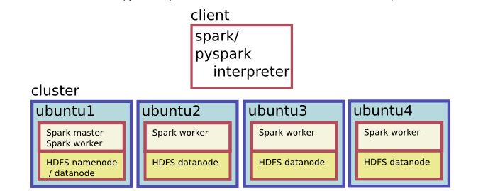
Spark cluster on Ubuntu host machines

Slide 11
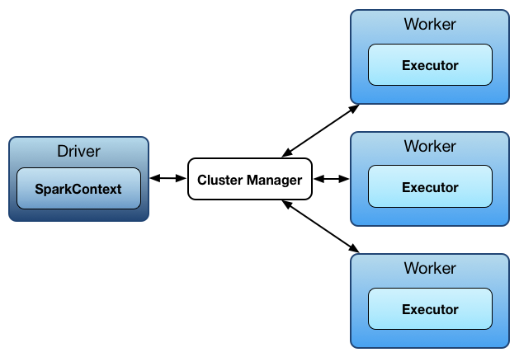
Simplifying SPARK architecture
Driver is the starting point of a job submission (this can be compared to the driver code in Java MR)
Cluster Manager can be compared to the Resource Manager in Hadoop
Worker is a software service running on slave nodes, similar to the are the data nodes in a HADOOP cluster
The executor is a container which is responsible for running the tasks

Slide 12
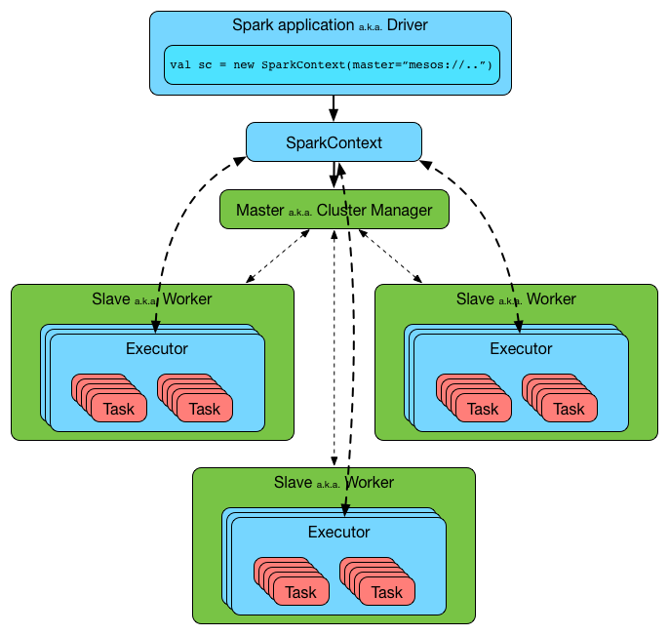
Job execution in a SPARK cluster

Slide 13
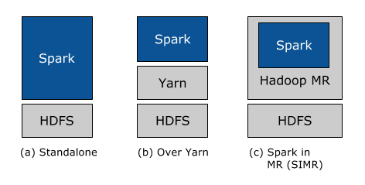
Spark deployment modes
Image courtesy : https://databricks.com/blog/2014/01/21/spark-and-hadoop.html

Slide 14
Spark deployment modes
Standalone mode :
All the spark services run on a single machine but in separate JVM’s. Mainly used for learning and development purposes(something like the pseudo distributed mode of Hadoop deployment)
Cluster mode with YARN or MESOS:
This is the fully distributed mode of SPARK used in a production environment
Spark in Map Reduce (SIMR) :
Allows Hadoop MR1 users to run their map reduce jobs as spark jobs

Slide 15
Loading spark data objects (RDD)
Data source
Data loaded into the spark object and subjected to manipulations
Capture the final result
The data loaded into a SPARK object is called as an RDD
A detailed discussion about RDD’s will be covered shortly

Slide 16

Under the hood
Capture the final result
Job execution starts with loading the data from a data source (e.g. HDFS) into spark environment
Data read from the hard drives of worker nodes and loaded into the RAM of multiple machines
The data could be spread out into different files (each file could be a block in HDFS)
After the computation, the final result is captured

Slide 17
Partitions and data locality
Loading of the data from the hard drives to the RAM of the worker nodes is based on data locality
The data in the data blocks is illustrated in the block diagram below
Block 1 Block 2 Block 3
1,2
3,4
5

Slide 18
Transformation the data object
The data in the objects cannot be modified as the very nature of the SPARK objects is immutable and the data in these objects are partitioned & distributed across nodes
1,2
3,4
5
Object 1
Transformation
User defined
Object 2
2,3
4,5
6

Slide 19
3 important properties of an RDD
We have just understood 3 important properties of an RDD in spark
1) They are immutable
2) They are partitioned
3) They are distributed and spread across multiple nodes in a machine

Slide 20
Task execution
Data nodes/workers
1,2
Executor
2,3
4,5
Tasks
MAP(increment)
3,4
Executor
5
6
Task

Slide 21
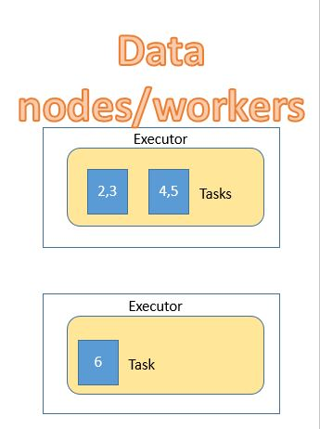
Workflow
Job is launched from the driver
Cluster manager
(MESOS/YARN)
SC
Result is brought back to the driver

Slide 22
RDD lazy evaluation (DAG creation)
Lets start calling these objects as RDD’s hereafter
RDD’s are immutable & partitioned
RDD’s mostly reside in the RAM (memory) unless the RAM (memory) is running of space
RDD 1
(2,3,4,5,6)
RDD 2
(2,4,6)
Base RDD:
(1,2,3,4,5)
Nothing happens
map(increment) filter (even)

Slide 23

Execution starts only when ACTION starts
Base RDD:
(1,2,3,4,5)
Object 1 : (2,3,4,5,6)
Object 2:
(2,4,6)
Display output or save in a persistent file
map(increment) filter(even nos) collect the output

Slide 24
RDD’s are fault tolerant (resilient)
RDD’s lost or corrupted during the course of execution can be reconstructed from the lineage
Final output
Base RDD
RDD1
LOSTRDD
RDD3
RDD4
0. Create Base RDD
Increment the data elements
Filter the even numbers
Pick only those divisible by 6
Select only those greater than 78

Slide 25
RDD’s are fault tolerant (resilient)
Lineage is a history of how an RDD was created from it’s parent RDD through a transformation
The steps in the transformation are re-executed to create a lost RDD
Final output
Base RDD
RDD1
RDD2
RDD3
RDD4
0. Create Base RDD
Increment the data elements
Filter the even numbers
Pick only those divisible by 6
Select only those greater than 78

Slide 26
Properties of RDD
They are RESILIENT DISTRIBUTED DATA sets
Resilience (fault tolerant) due to the lineage feature in SPARK
They are distributed and spread across many data nodes
They are in-memory objects
They are immutable

Slide 27
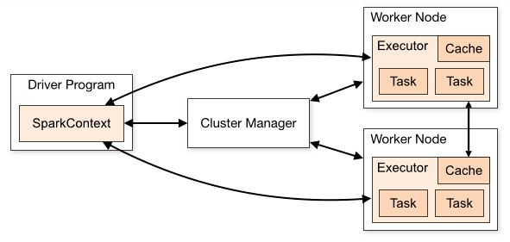
Caching the RDD’s

Slide 28
SPARK’s approach to problem solving
Spark reads the data from the disc once initially and loads it into its memory
The in-memory data objects are called RDD’s in spark
Spark can read the data from HDFS where large files are spit into smaller blocks and distributed across several data nodes
Data nodes are called as worker nodes in Spark eco system
Spark’s way of problem solving also involves map and reduce operations
The results of the computation can be saved in memory in case if its going to be re-used as the part of an iterative job
Saving a SPARK object(RDD) in memory for future re-use is called caching
Note : RDD’s are not always cached by default in the RAM (memory). They will have to be written on to the disc when the system is facing a low memory condition due to too many RDD’s already in the RAM. Hence SPARK is not a completely in memory based computing framework

Slide 29
3 different ways of creating an RDD in SPARK
Created by read a big data file directly from an external file system, this is used while working on large data sets
Using the parallelize API, this is usually used on small data sets
Using the makeRDD API

Slide 30
Actions and transformations
Transformations are any operations on the RDD’s which are subjected to manipulations during the course of analysis
A SPARK job is a collection of a sequence of a several TRANSFORMATIONS
The above job is usually a program written in SCALA or Python
Actions are those operations which trigger the execution of a sequence of transformations
There are over 2 dozen transformations and 1 dozen actions
A glimpse of the actions and transformations in SPARK can be found in the official SPARK programming documentation guide
https://spark.apache.org/docs/2.2.0/rdd-programming-guide.html
Most of them will be discussed in detail during the demo

Slide 31
Summary
A quick recap about the drawbacks of Map-Reduce in Hadoop
Spark architecture
Spark deployment modes
Job execution in SPARK
RDD’s

