Slide 1
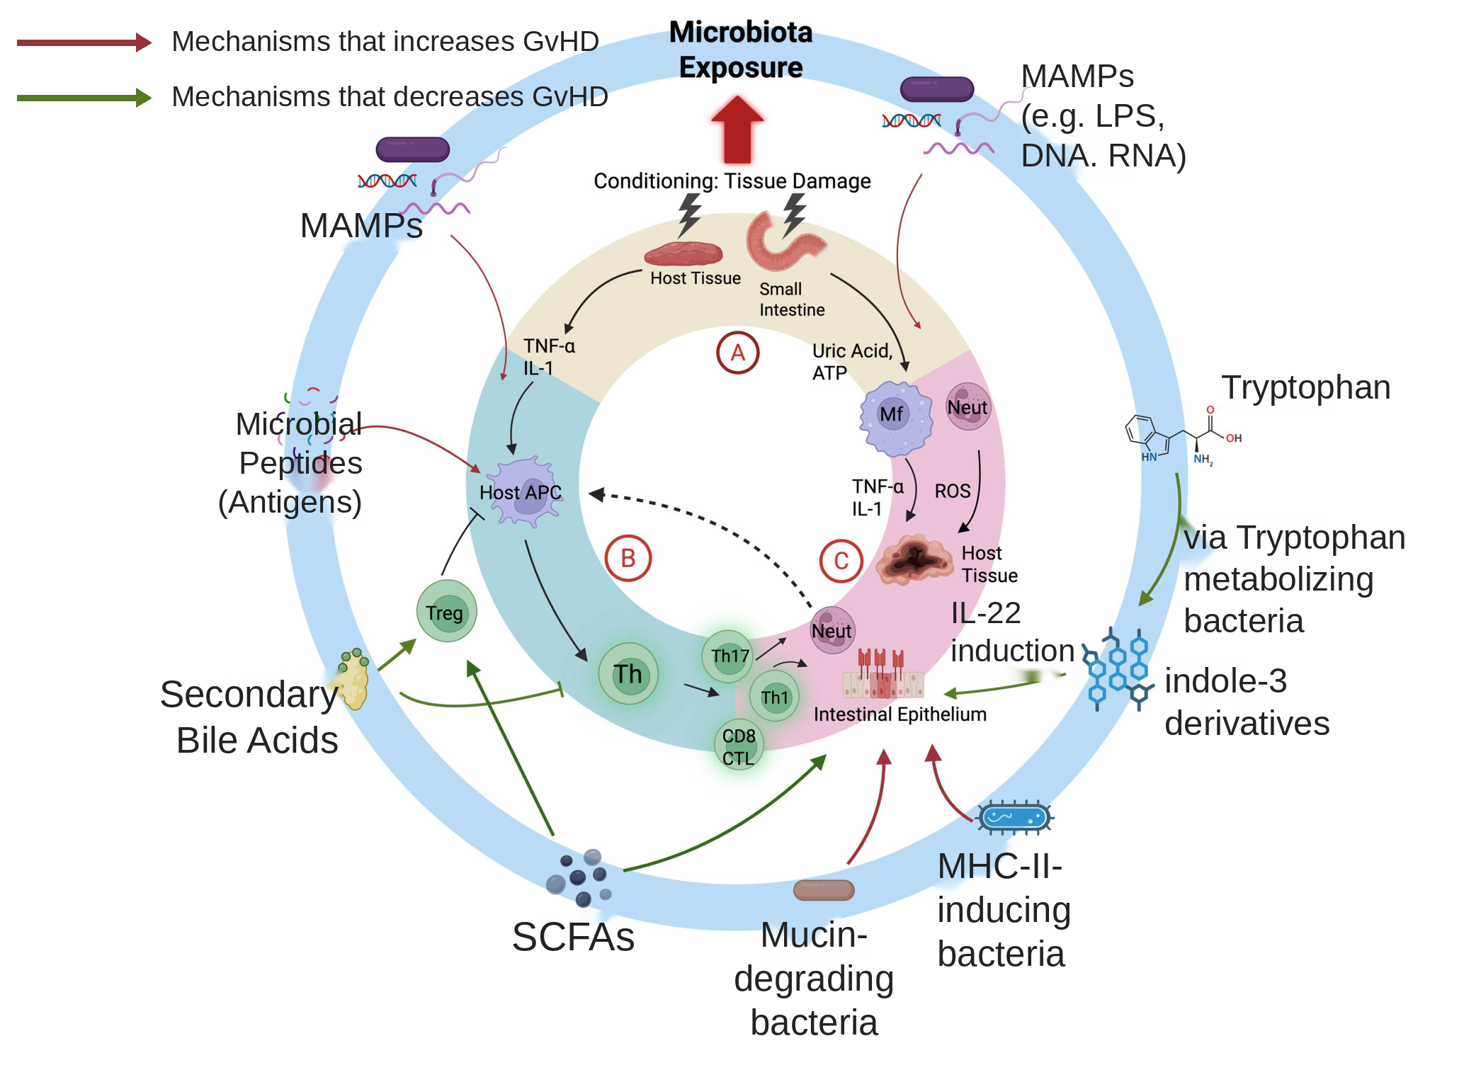
Microbiome acts in all three phases
Ferrara three-phase model, extended to the microbiota
Phase 1, innate: MAMPs and DAMPs activate host APCs
Phases 2 and 3, adaptive: antigens and metabolites steer T cell fate
Outer ring: function, not taxon, sets direction
Elimination first, rebalancing now
Moses, et al., 2026: Figure 1*
*Figure edited for size by Claude, content unchanged
Adonai Blessington Moses & Albert C. Yeh (2026) The gut microbiome in graft-versus-host disease: mechanisms of immune modulation and therapeutic approaches, Gut Microbes, 18:1, 2631224, DOI: 10.1080/19490976.2026.2631224
Soleimani Samarkhazan, H., Nouri, N., Maleknia, M., Aghaei, M., 2025. The microbiome in graft-versus-host disease: a tale of two ecosystems. J. Transl. Med. 23, 832. https://doi.org/10.1186/s12967-025-06832-5
Notes:
The backbone is Ferrara's three-step model (Ferrara 1991, cited as ref 28 in Moses 2026). Moses and Yeh keep the three phases and layer microbiota contributions onto each one.
The classic paradigm put the microbiota only in phase 1. Their argument is that it acts in all three, through antigen presentation, T cell shaping, and amplification of tissue injury (Moses 2026, Microbial mechanisms of immune modulation).
Phase 1 (Figure 1A): conditioning releases DAMPs such as uric acid and ATP, MAMPs translocate across damaged mucosa, and together they activate host APCs and inflammatory myeloid cells through TLR and NLRP3 signalling.
LPS is the prototypical MAMP here. Translocation after total body irradiation amplifies GvHD, and LPS-resistant donor grafts produce less disease (Moses 2026, ref 33).
For the innate versus adaptive split I am using Samarkhazan's framing, which divides the microbiome's immune roles into innate immunomodulation and adaptive immunomodulation (Samarkhazan 2025, Table 2).
Innate examples from that table: polysaccharide A from B. fragilis acting through the TLR2/IL-10 axis, and LPS from E. coli through TLR4/NLRP3/IL-1-beta, both driving regulatory macrophage differentiation (Samarkhazan 2025, Table 2, refs 27-31).
Adaptive examples: butyrate-producing Clostridia clusters IV and XIVa and F. prausnitzii inhibit HDAC and expand colonic Foxp3+ Tregs (Samarkhazan 2025, Table 2, refs 36-38). Clostridium scindens transforms bile acids and suppresses Th1 through FXR signalling (refs 45-46).
The same table carries a counterexample, so the framing is not uniformly protective. B. thetaiotaomicron succinate drives macrophage activation and is listed as detrimental under dysbiotic conditions (Samarkhazan 2025, Table 2, ref 44).
Point to the outer ring. It is organized by microbial function, not by organism. SCFA producers, tryptophan metabolizers, mucin degraders, MHC class II inducers. Green arrows protect, red arrows exacerbate.
Historical arc for the therapeutics section later. Germ-free animal models showed reduced GvHD (Moses 2026, refs 3-4), which motivated decontamination. The target was effectively this APC pathway in phase 1.
But clinical decontamination never eliminated GvHD, and antibiotics with broad anaerobic activity such as piperacillin/tazobactam and carbapenems paradoxically increased GvHD risk (Moses 2026, Part 1, refs 16, 82-84). That is why the field moved from elimination to rebalancing.
If asked why one taxon can carry both a green and a red arrow: direction depends on which function is being exercised, not on the organism's name. That is the premise of the claims network later in the talk.

Slide 2
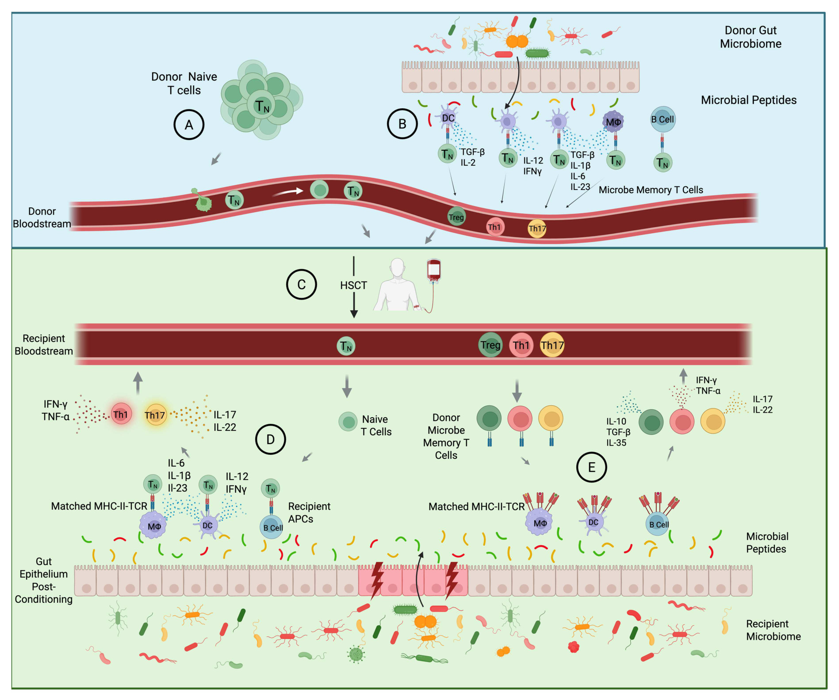
The donor graft arrives programmed
Panel A: most donor T cells are naive
Panel B: donor microbiota primes memory T cells
Th1, Th17 or Treg polarization is set in the donor
Up to 0.4% of CD4+ T cells react per taxon
Moses, et al., 2026: Figure 2
Adonai Blessington Moses & Albert C. Yeh (2026) The gut microbiome in graft-versus-host disease: mechanisms of immune modulation and therapeutic approaches, Gut Microbes, 18:1, 2631224, DOI: 10.1080/19490976.2026.2631224
Notes:
Start by noting this is a proposed framework, not established fact. Moses and Yeh write that they posit this and propose it as a way of thinking (Moses 2026, Donor memory T cells are shaped by the donor microbiota).
Peripheral blood CD4 T cell reactivity to commensal bacteria is normal and has been shown in both murine and human settings (Moses 2026, refs 53, 55, 56).
In healthy individuals, circulating memory T cells react to heat-inactivated Escherichia, Lactobacillus, Bifidobacterium, Faecalibacterium, Bacteroides, Roseburia, Ruminococcus, Salmonella and Clostridium, comprising up to 0.4 percent of CD4+ T cells per taxon (Moses 2026, ref 55).
The response is phenotypically diverse. Predicted bacterial epitopes elicited combinations of IFN-gamma, IL-10 or IL-17 across 40 peripheral blood samples (Moses 2026, ref 56).
Panel B is the key idea. Donor DCs, macrophages and B cells present microbial peptides in the donor gut, and the cytokine context at that moment fixes the polarization. TGF-beta and IL-2 give Treg, IL-12 and IFN-gamma give Th1, TGF-beta with IL-1-beta, IL-6 and IL-23 give Th17.
Worked example: F. prausnitzii produces SCFA and experimentally induces Treg differentiation (Moses 2026, ref 57), and IL-10 producing CD4 T cells reactive to F. prausnitzii have been found in human blood (ref 55). A graft carrying those cells could be protective.
The figure assumes an MHC-matched setting. In the mismatched setting the naive compartment plays the larger role (Moses 2026, Figure 2 caption).

Slide 3
Naive T cells meet host peptides
Panel C: graft delivers naive and memory T cells
Panel D: injury exposes host microbial peptides
IL-12, IL-1β, IL-6 and IFNγ skew them to Th1 and Th17
Most donor T cells are naive
Moses, et al., 2026: Figure 2
Adonai Blessington Moses & Albert C. Yeh (2026) The gut microbiome in graft-versus-host disease: mechanisms of immune modulation and therapeutic approaches, Gut Microbes, 18:1, 2631224, DOI: 10.1080/19490976.2026.2631224
Notes:
Panel D is the pathogenic route. Conditioning-induced mucosal injury gives host APCs access to recipient microbiota peptides, and naive donor T cells differentiate de novo against them (Moses 2026, Figure 2D caption).
The reason the output is pathogenic is the cytokine environment. The peri-transplant phase is rich in IL-12, IFN-gamma and IL-6 from macrophages, DCs and alloreactive T cells responding to tissue injury and DAMP/MAMP exposure, so naive T cells recognizing microbial antigen are skewed to Th1 or Th17 (Moses 2026, Naive donor T-cell recognition of microbial peptides).
Direct transplant evidence: expansion of microbiota-specific T cells from the donor graft targeting MHC II peptides derived from bacterial flagellin or Clostridium savagella exacerbated GvHD in murine models carrying those commensals (Moses 2026, ref 46).
Supporting evidence from outside transplant, if someone pushes on how general this is. Oral Toxoplasma gondii infection drove Th1 differentiation of flagellin-targeting T cells against commensal Clostridium XIVa, persisting as long-term memory (ref 47).
Helicobacter hepaticus specific T cells became ROR-gamma-T+ Foxp3+ Tregs in colonized wild-type mice, but the same cells transferred into IL-10 knockouts generated Th17 cells driving severe colitis (ref 50). Context decides the outcome, not the antigen.
In humans, SusC, a membrane protein epitope from Bacteroides, elicits an IL-10 tolerant response in healthy people but shifts to Th17 in Crohn disease (ref 59).
Clinical corollary: it would be logical to minimize naive T cell recognition of cognate microbial antigen, which is consistent with MHC-mismatched transplants carrying higher GvHD risk (Moses 2026).

Slide 4
Memory T cells need MHC II
Panel E: memory T cells act immediately
Needs a matched MHC II allele in the recipient
Output reflects priming in the donor
Direction may be set before collection
Moses, et al., 2026: Figure 2
Adonai Blessington Moses & Albert C. Yeh (2026) The gut microbiome in graft-versus-host disease: mechanisms of immune modulation and therapeutic approaches, Gut Microbes, 18:1, 2631224, DOI: 10.1080/19490976.2026.2631224
Notes:
Panel E. Microbe-specific memory T cells rapidly exert effector functions on recognizing cognate antigen in the proper MHC II context, and the resulting cytokine milieu depends on how they were primed in the donor (Moses 2026, Figure 2E caption).
Two conditions have to hold for this to happen. The cognate donor MHC II allele must also be present in the recipient, and the polarization state depends on the donor environment and which microbes the donor was exposed to (Moses 2026, Donor memory T cells are shaped by the donor microbiota).
The practical suggestion they draw: the optimal donor with respect to regulatory microbiota-specific T cells may be the one with the most similar commensal composition in the right HLA context, since that maximizes the chance of cognate recognition. A matched transplant does both.
This reconciles with the clinical observation that reconstitution of SCFA-producing commensal anaerobes appears to reduce GvHD risk.
Be honest about the state of evidence. Their own words are that how donor T cells respond to recipient microbial antigens in the clinical setting, and the subsequent impact on outcomes, remain poorly understood.
Forward-looking point: as GvHD prophylaxis improves, particularly regimens that blunt the initial expansion and activation of alloreactive donor T cells, the microbial-driven donor T cell response may become relatively more important in restoring intestinal immune homeostasis (Moses 2026, refs 60-64).
If asked how this differs from the previous slide: panel D is de novo priming of naive cells in the recipient and takes time, panel E is recall of cells already committed in the donor and is immediate.

Slide 5
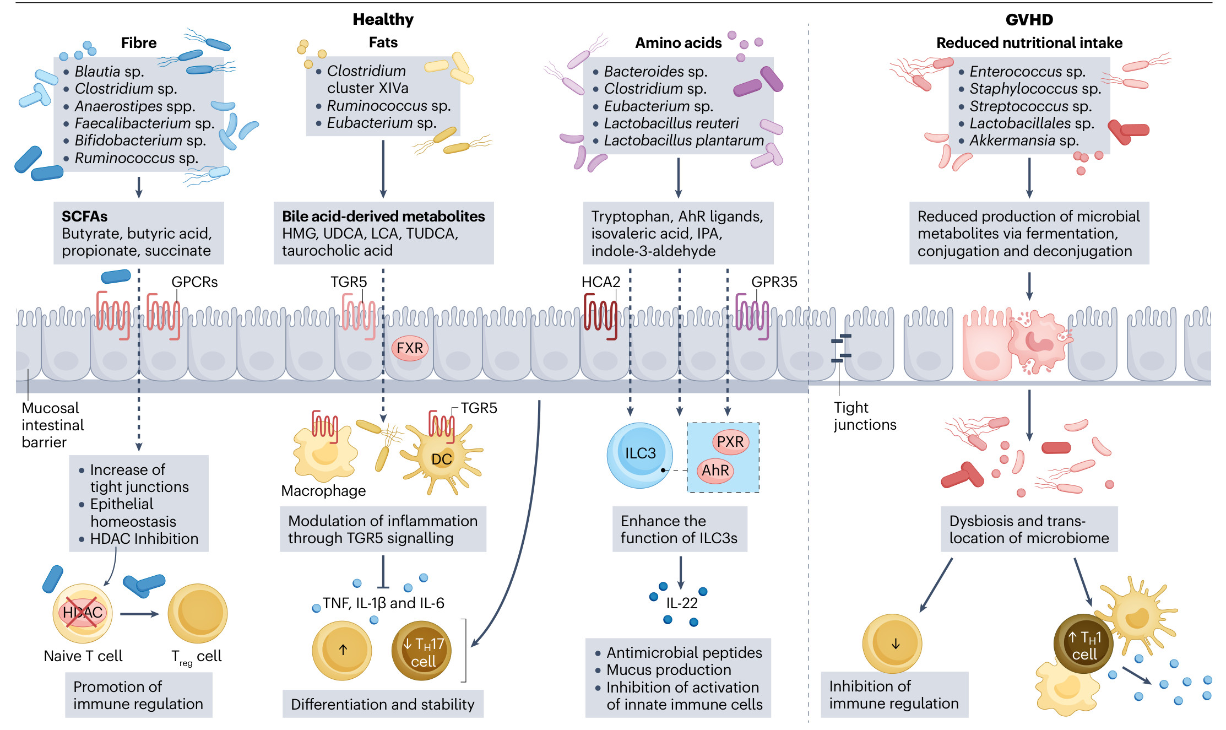
Fibre and short-chain fatty acids
Blautia, Clostridium and Faecalibacterium ferment fibre
Butyrate signals via GPCRs and inhibits HDAC
Tight junctions up, Treg up, inflammation down
Butyrate gives up to 70% of colonocyte energy
Paredes, et al., 2026: Figure 3
Paredes, J., Schmiester, M., Jenq, R., Brink, M.R.M. van den, 2026. The intestinal microbiota as a key modulator of acute graft-versus-host disease. Nat. Rev. Cancer 26, 328–350. https://doi.org/10.1038/s41568-026-00910-6
Notes:
Work the left-hand column of the figure. Dietary fibre, the taxa that ferment it, the SCFAs they produce, and the two receptor routes.
Butyrate oxidation provides up to 70 percent of the energy needs of colonocytes, which is why this is a barrier story and not only an immune story (Paredes 2026, ref 83).
SCFAs stimulate goblet cells to increase mucin gene expression and secretion, and upregulate tight junction proteins (Paredes 2026, refs 84, 85).
On the immune side they inhibit HDAC in Treg cells, promoting differentiation and suppressing excessive immune responses (Paredes 2026, refs 86, 87).
Butyrate administration mitigates both acute and chronic GVHD in preclinical models (Paredes 2026, ref 44).
Important complication, and worth raising before someone else does. Golob et al. found that higher levels of butyrogenic bacteria after GVHD were associated with steroid refractoriness (Paredes 2026, ref 88). More butyrate producers is not uniformly good.
That fits with loss of overall diversity, not just loss of butyrogens, tracking with GVHD severity and outcomes (Paredes 2026, ref 24).
Thiele Orberg et al. built an immunomodulatory metabolite risk index from five metabolites. Butyrate biosynthesis pathways, particularly butyryl-CoA:acetate CoA transferase, were enriched in low-risk patients, and bacteriophages encoding butyrate production genes were also identified (Paredes 2026, ref 40).
In the same study, patients who received broad-spectrum antibiotics showed disrupted bacterial and viral communities and decreased SCFA levels, which links this slide back to antibiotic stewardship.
Minor figure quirk if anyone is reading closely: the caption calls succinate an SCFA, and the figure lists butyrate and butyric acid as separate entries.

Slide 6
Fat and bile acid signalling
Clostridium XIVa and Ruminococcus transform bile acids
UDCA, LCA and TUDCA act on TGR5 and FXR
TGR5 suppresses TNF, IL-1β and IL-6
GVHD depletes bile salt hydrolase and bai genes
Paredes, et al., 2026: Figure 3
Paredes, J., Schmiester, M., Jenq, R., Brink, M.R.M. van den, 2026. The intestinal microbiota as a key modulator of acute graft-versus-host disease. Nat. Rev. Cancer 26, 328–350. https://doi.org/10.1038/s41568-026-00910-6
Notes:
Second column of the figure. Dietary fat, microbial transformation of primary into secondary bile acids, and two receptors, TGR5 and FXR.
Secondary bile acids activate TGR5, suppressing pro-inflammatory cytokines and chemokines and contributing to an anti-inflammatory gut environment (Paredes 2026, ref 94).
LCA specifically impairs Th1 activation and reduces their secretion of TNF and IFN-gamma (Paredes 2026, ref 93).
UDCA regulates pro-inflammatory responses of antigen-presenting cells, decreasing TNF, IL-6, IL-12 and IL-1-beta from LPS-stimulated macrophages, consistent with TGR5 inhibiting NF-kappa-B through the cAMP-PKA pathway (Paredes 2026, refs 95, 96).
Flag the genuine uncertainty. Whether UDCA is an FXR agonist or antagonist is disputed in the literature (Paredes 2026, refs 98, 99).
Haring et al. identified TUDCA as the most potent bile acid metabolite. It protected intestinal epithelial cells from TNF and IFN-gamma induced apoptosis, improved survival and lowered histopathological scores in preclinical allo-HCT, and downregulated MHC class II on epithelial cells, while preserving graft-versus-leukaemia activity (Paredes 2026, ref 101).
Notably TUDCA did not significantly alter microbiota composition or diversity, suggesting a direct epithelial effect rather than a microbiome-mediated one (ref 101).
Lindner et al. showed the mechanism of collapse. GVHD mice had reduced abundance of the gene encoding bile salt hydrolase, and patient metagenomes showed downregulation of BSH plus baiA, baiB, baiCD and baiE, which catalyse 7-alpha-dehydroxylation (Paredes 2026, ref 102).
In the same work, T cell specific FXR ablation reduced GVHD histopathology in the large intestine and liver, pharmacological FXR activation increased mortality, and UDCA supplementation in patients restored bile acid balance and limited T cell driven inflammation (ref 102).
Han et al. found reduced Bacteroides and lower isoCDCA, 6-keto-LCA and 3-oxo-CA in patients with acute GVHD (Paredes 2026, ref 103).
Figure quirk: HMG is listed among the bile acid derivatives in the figure box.

Slide 7
Tryptophan, indoles and ILC3
Bacteroides and L. reuteri metabolize tryptophan
IPA and indole-3-aldehyde engage AhR and PXR
ILC3 activation drives IL-22 and mucosal repair
Indoles are higher in recipients without GVHD
Paredes, et al., 2026: Figure 3
Paredes, J., Schmiester, M., Jenq, R., Brink, M.R.M. van den, 2026. The intestinal microbiota as a key modulator of acute graft-versus-host disease. Nat. Rev. Cancer 26, 328–350. https://doi.org/10.1038/s41568-026-00910-6
Notes:
Third column. Tryptophan is the substrate, indole derivatives are the products, and ILC3 is the cell type that matters.
Indoles arise from microbial tryptophan catabolism and promote barrier function and epithelial homeostasis, which prevents bacterial translocation from the large intestine (Paredes 2026, ref 90).
Indole-3-aldehyde engages AhR on innate lymphoid cells and other immune cells, activating transcription of IL-22. IL-22 then drives antimicrobial peptide production and repair of damaged epithelium (Paredes 2026, ref 91).
Human evidence: serum metabolomic profiles from two cohorts of HLA-matched related donor and recipient pairs showed indoles higher in recipients who did not develop GVHD, with the difference most evident at GVHD onset (Paredes 2026, ref 100).
Be careful with causality here. The authors note it remains unexplored whether this contributes to severity, and that the bacterial imbalance may be both a cause and a result of the allogeneic immune response.
Weber's review adds a related pathway worth mentioning, the tryptophan-MDSC axis. MDSC-expressed IDO degrades tryptophan into kynurenines, activating AhR to promote MDSC expansion and Treg induction, attenuating GvHD while preserving graft-versus-leukaemia (Weber 2026, Gut-derived metabolites section).
Forward link: tryptophan and indole signalling becomes mechanism class 1c in the claims network, carrying 21 of the 329 claims.

