Slide 1
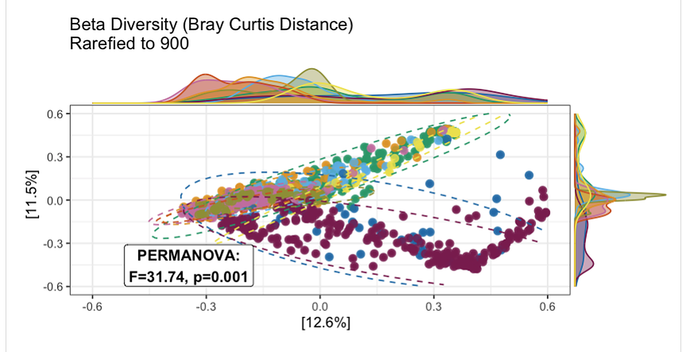
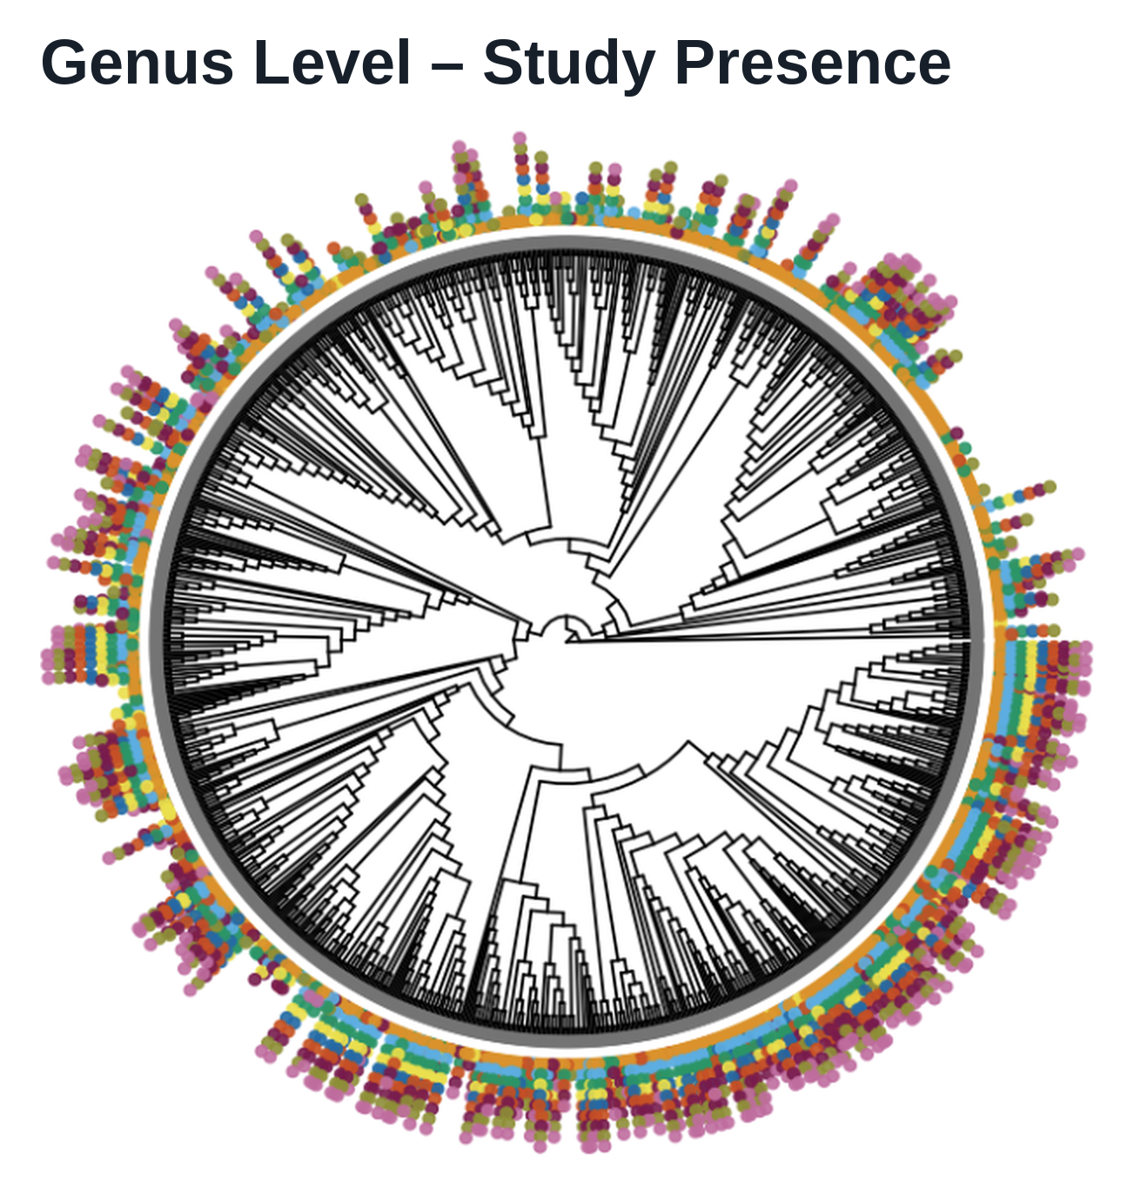
Pooling

Slide 2
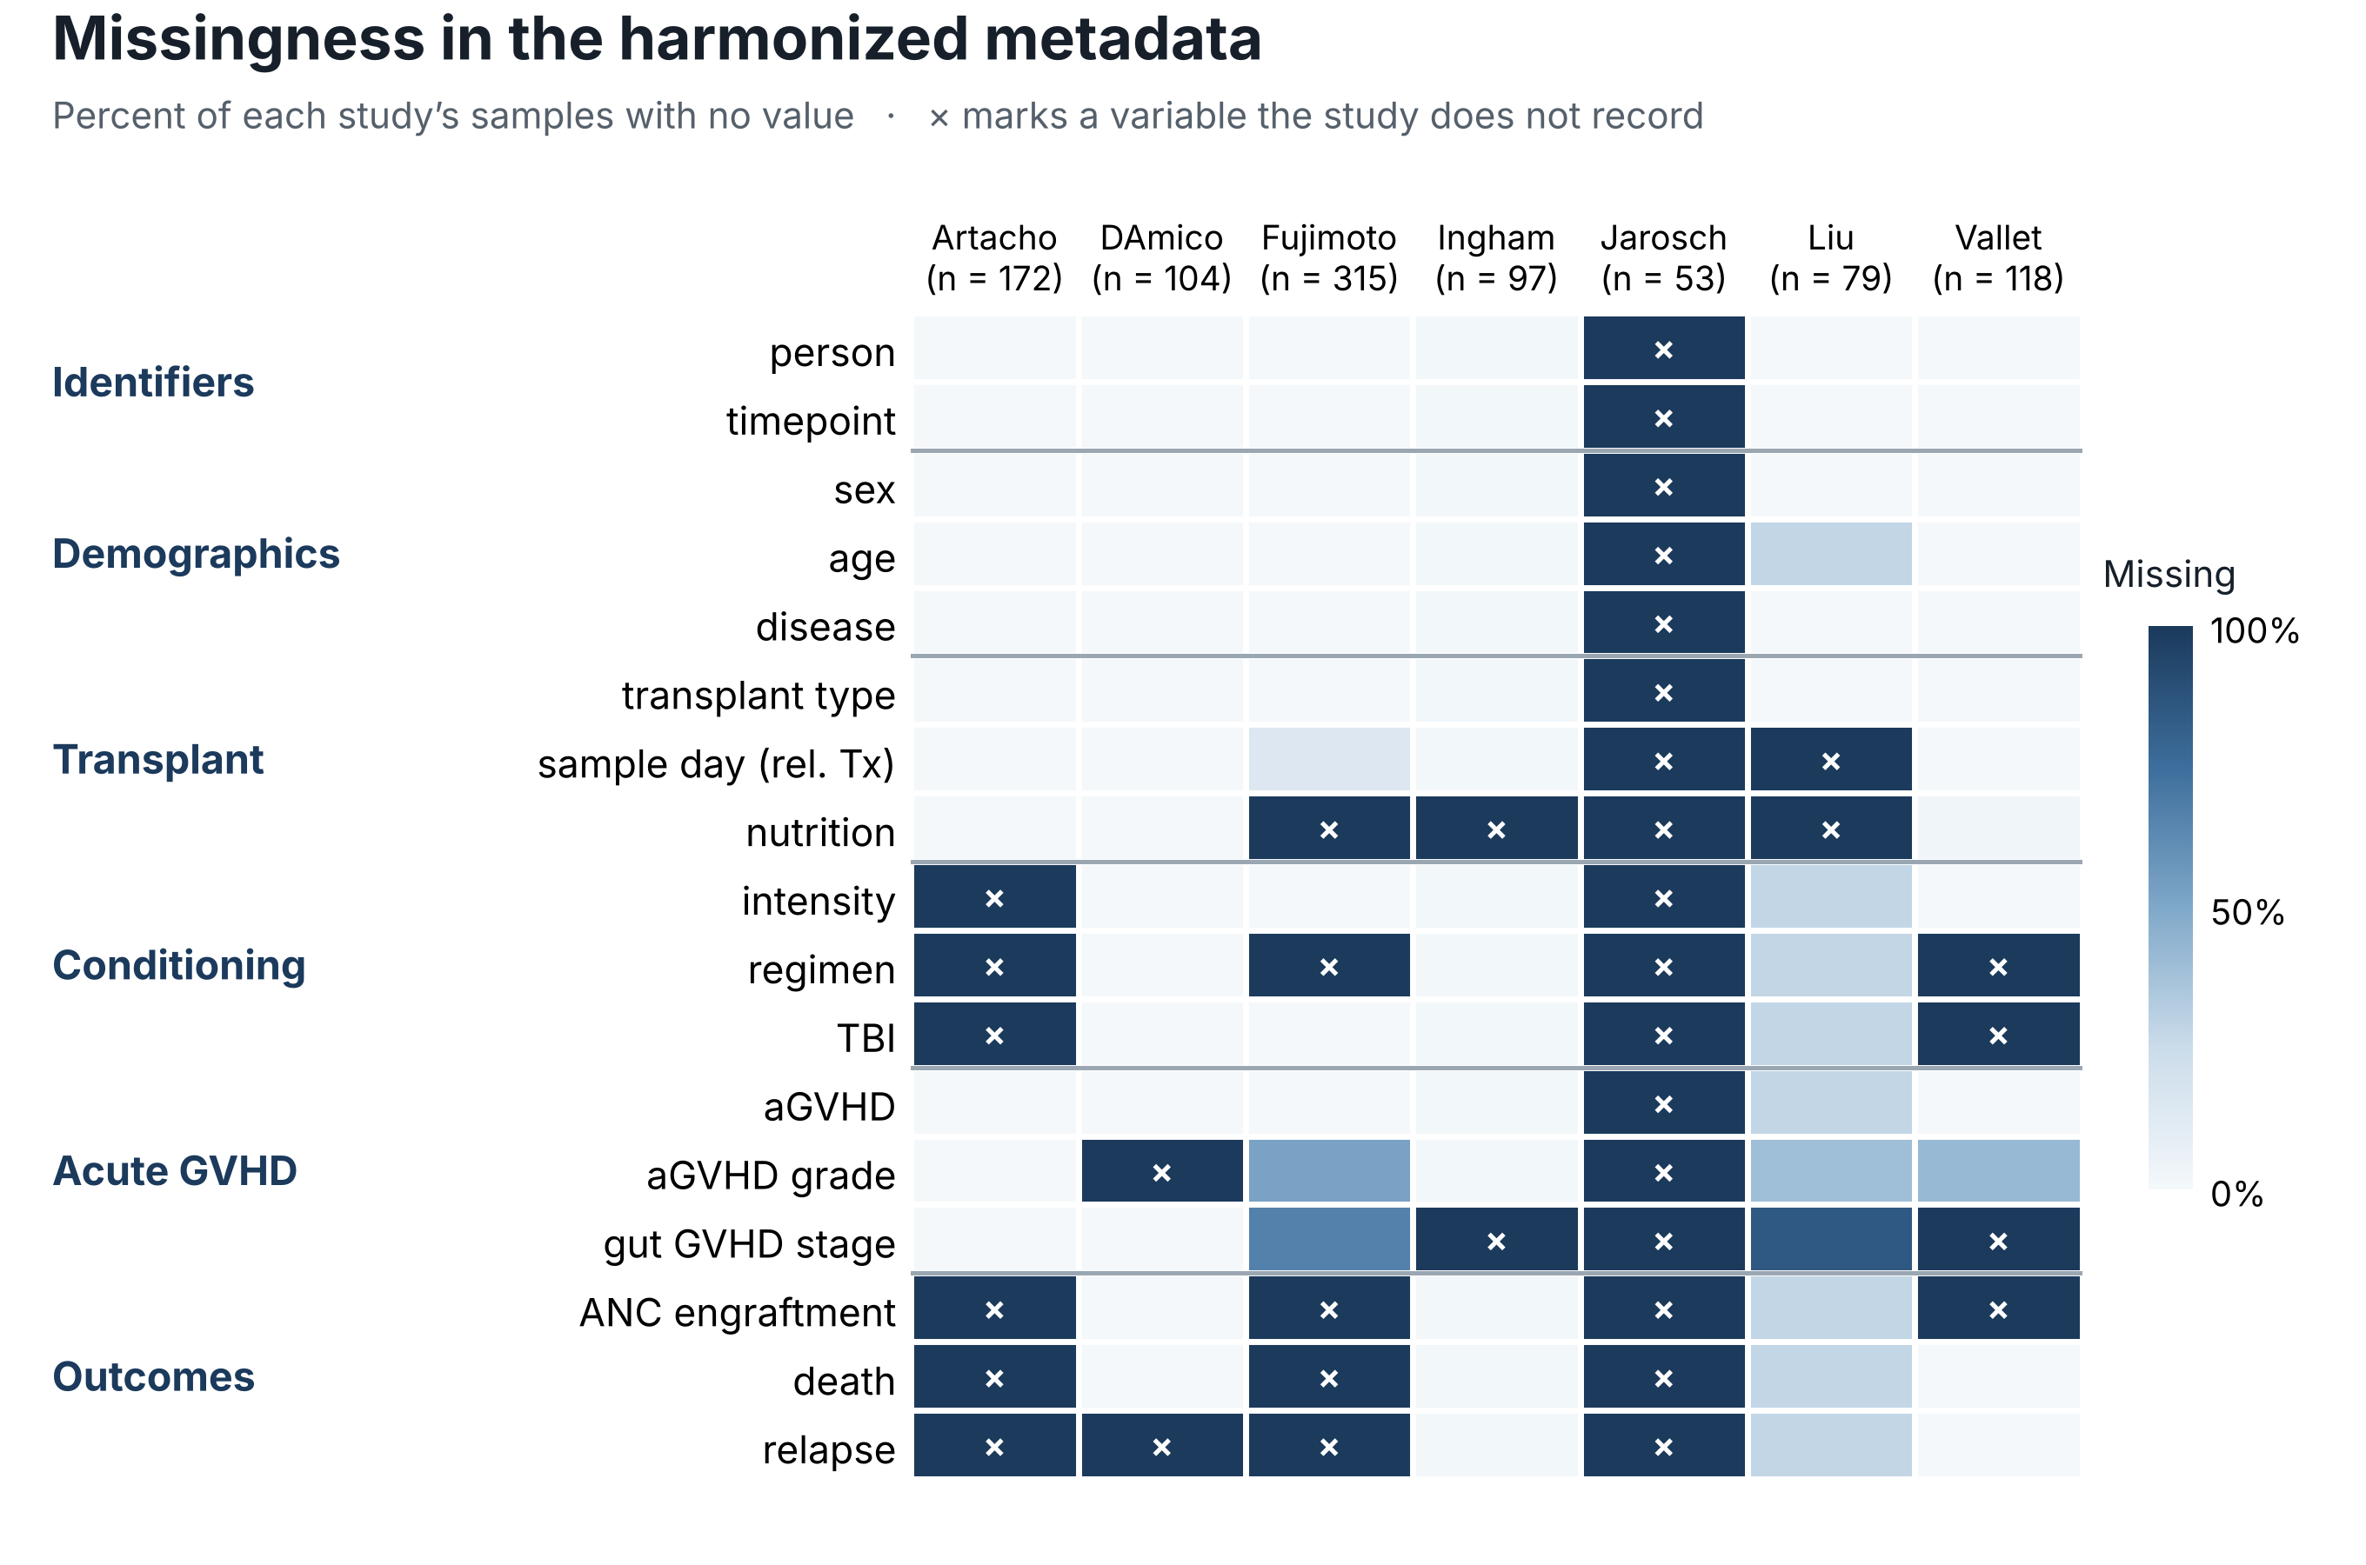
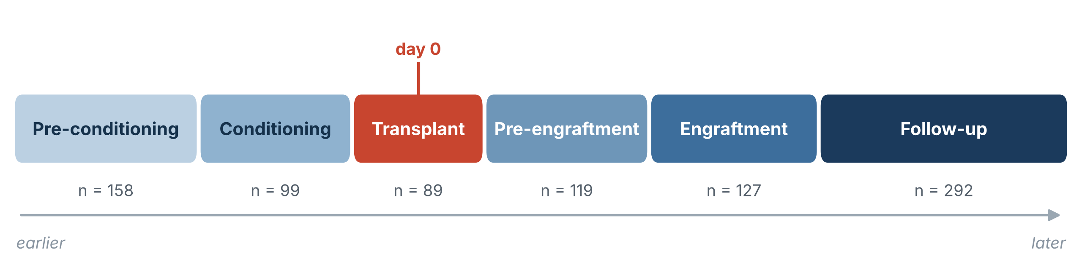
Harmonization and batch correction
In progress: harmonizing the metadata to be able to apply batch correction methods
Critical step: timepoint selection

Slide 3
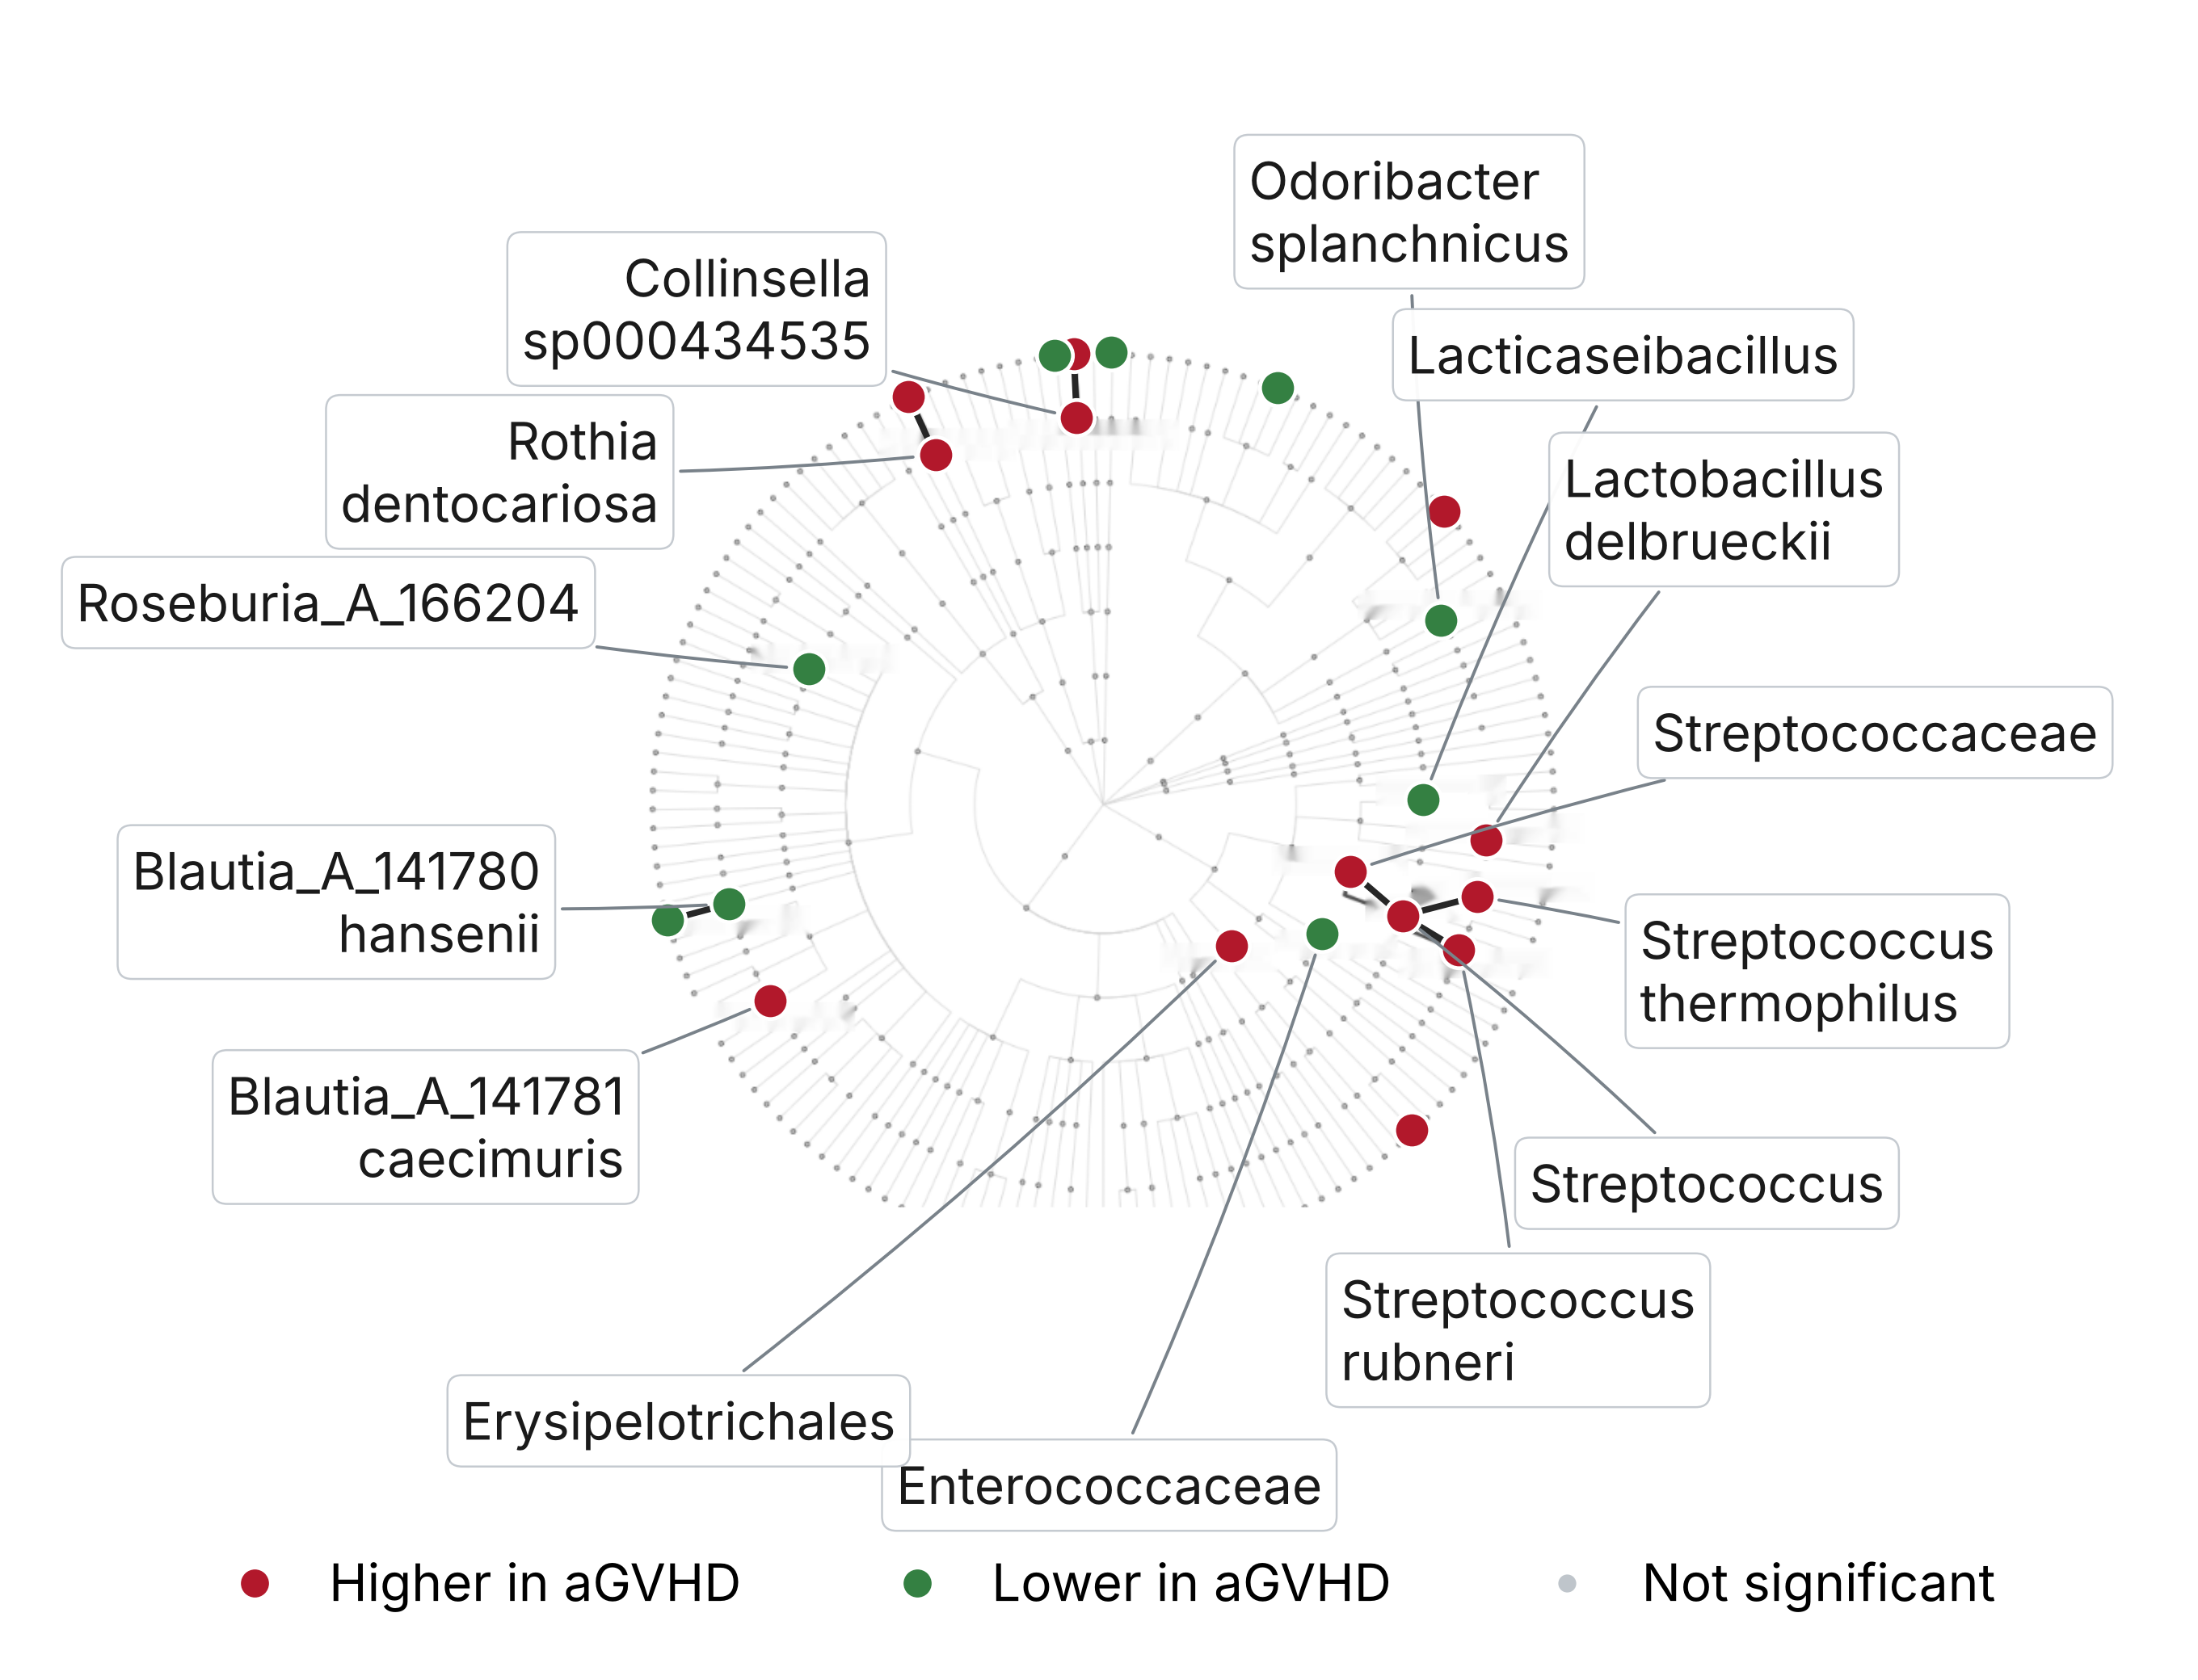
Can we match up the claims network to the quantitative signal found in the data?

