Slide 1
Addressing Competing Risks in High-Dimensional Survival Analysis: a Bayesian Spike-and-Slab LASSO Approach
Sophie Huebler
University of Utah
Population Health Science - Biostats: PhD Student
Huntsman Cancer Institute: Oncological Data Science Trainee

Slide 2
Model Structure
Final Model
Outcome
Model
Tuning
Notes:
I’m going to explain my construction of a Bayesian spike-and-slab-LASSO model in a competing risks setting
Where I argue that the practical implementation depends on both the choice between the underlying likelihood and the choice of evaluation metric used in hyperparameter tuning
And I’ll explain how my choices represent a unified competing risks framework

Slide 3
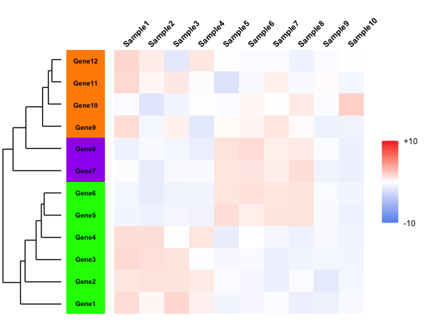
Context
High dimensional (n < p)
Time-to-event outcomes
Interpretability >> predictive accuracy
Bayesian penalized regression
Simultaneous variable selection and estimation
Can self adapt to sparse signals
Notes:
The context here could be anywhere where we have high dimensional predictors and time to event outcomes, and critically, where interpretability of the model is much more important than predictive accuracy
As a biostatistician, one common case we encounter is identifying potential drug targets,
where our variables come from high dimensional omics data
And our outcomes come from patient health outcomes
We want a model that can select variables and simultaneously give us enough information on the direction and relative strengths of the associations captured by those variables
to be useful for hypothesis generation for our downstream bench scientists to prioritize testing targets.
And this motivates the Bayesian penalized regression.
Which can do simultaneous variable selection and estimation
And, they can also self adapt to sparse signals

Slide 4
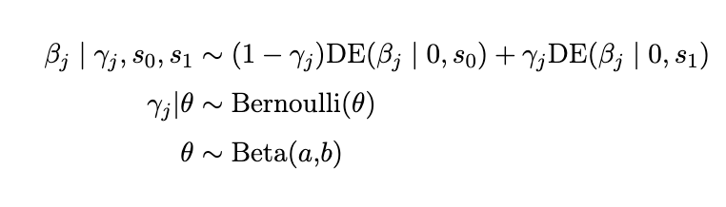
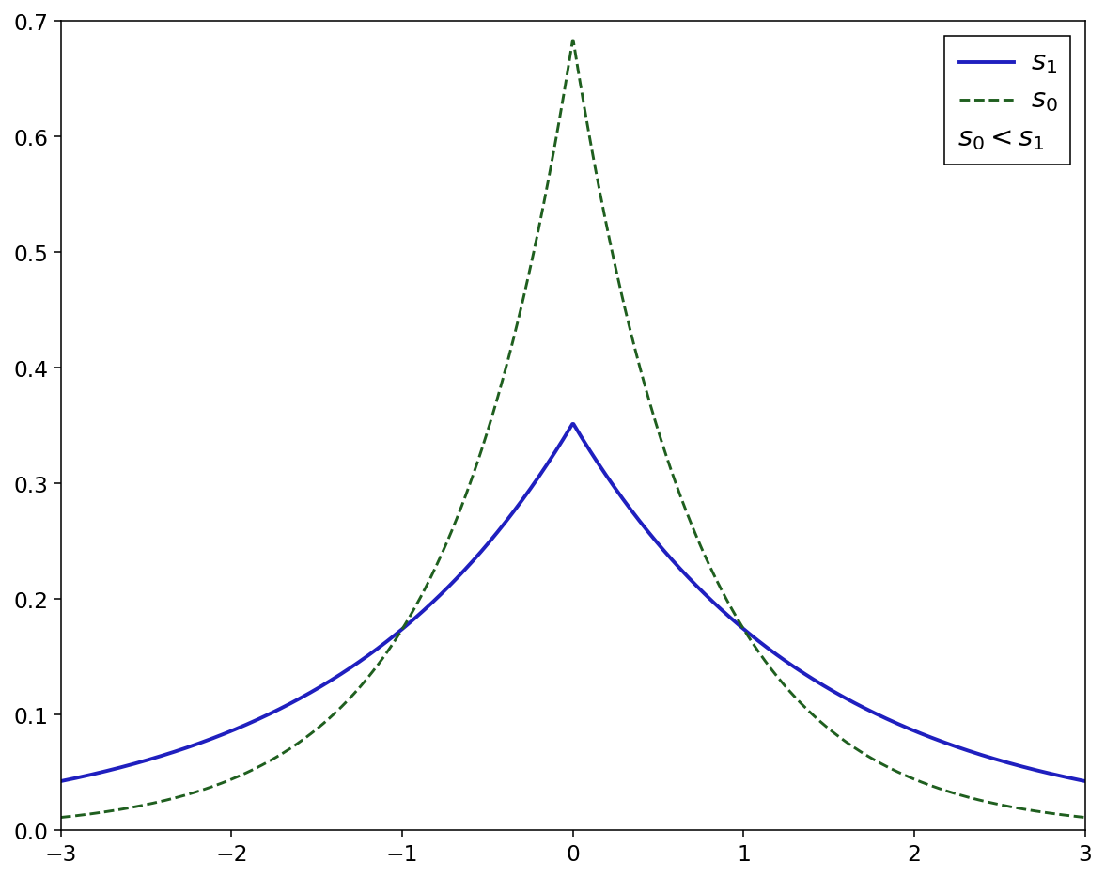
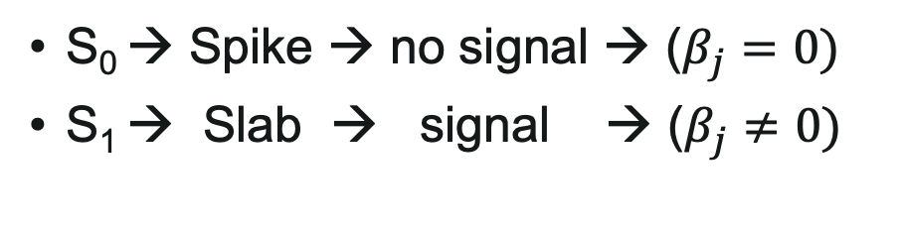
Bayesian penalized regression: Spike-and-Slab LASSO
S₀ → Spike → no signal → ($β_{j}=0)$
S₁ → Slab → signal → ($β_{j}≠0)$
Notes:
In this context we’re considering a hierarchical model,
and what makes it spike and slab LASSO is the distribution we place on the beta coefficients
This is a mixture of two double exponential distributions centered around 0 with different scales
The smaller scale s0 corresponding to a spike, where beta coefficients are shrunk to 0
The larger scale s1 corresponds to a more diffused slab, for the coefficients that do have signal
Because we are bayesian, we parameterize both the gamma here that controls the mixture
As well as the theta here that controls the gamma.
this is the really cool part in my opinion, because its what allows the model to actually self adapt to the sparsity.
But even Bayesians have hyperparameters, and ours are the spike and slab scales.
And this is where we need to pay closer attention to the outcome that we’re interested in,
because we need some predictive framework to tune these hyperparameters.
I said before we’re interested in time to event,
Unfortunately, this is often complicated by competing risks.

Slide 5
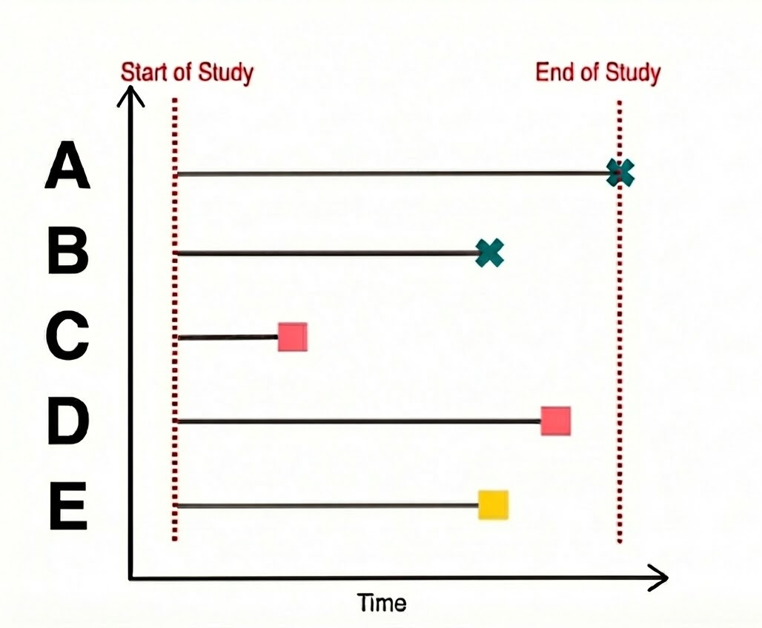
Competing risks outcome:
Notes:
This diagram shows competing risks during the followup timelines for 5 hypothetical patients
Patients A and B have green x’s neaning they were censored
Basically we lost sight of them and don’t know what happens after this point
C and D have red squares, which means we saw them experience our outcome of interest
And person E has a yellow square, meaning we saw them experience a competing event that precludes our event of interest
The way a competing risk is handled depends on Person E
In a cox ph model, they’d just be censored

Slide 6
Competing risks outcome:
FACT:
Censoring and competing risks are fundamentally different
B could experience the event unobserved
E cannot experience the event
Notes:
But that’s wrong
Because then they’d look like person B
But those two are fundamentally different
B can experience the event albeit unobserved, but E can never experience the event

Slide 7
Competing risks outcome:
FACT:
Censoring and competing risks are fundamentally different
B could experience the event unobserved
E cannot experience the event
Model Structure
Model Tuning
Proportional subdistribution hazard (Fine & Gray, 1999)
Wolber’s C-index
(Wolbers, 2014)
Notes:
We need to acknowledges this not just when building the model structurally, but also in the implementation through tuning
I’m using the proportional subdistribution hazard likelihood as the basis of my model
This is the competing risk extension to the cox likelihood
The important part here is that person E is kept in the likelihood even after their event
Doing this induces a direct monotonic relationship between the regression coefficients and the cumulative incidence function
And this cumulative incidence is actually observable
And this is what we tune on
So then we also need a metric that acknowledges our core fact
And Wolber’s concordance index for competing risks does this by explicitly defining a concordant criteria
Person E is kept as a potential observation to be compared even after they experience the event of interest
And a concordant prediction is one that says they’re at the lowest risk of the primary even,
because their risk is low, it’s 0, they can’t experience it
So using these two techniques together, we’ve formed a cohesive competing risk framework that we can use for the spike-and-slab LASSO model

