Slide 1

MTG Card Search
Noah Scarbrough, Samuel Dunn
Team:$NS^{2}D$

Slide 2
Dataset
Magic: The Gathering
Base source: gatherer.wizards.com
Elements of a card
Try to be as comprehensive as possible
Cards may not have fields populated, or may have extra fields based on their type
Name
Mana Cost
Type
Subtype[s](?)
Rules Text (?)
Flavor Text(?)
P/T(?)
? Denotes field may not be present
Currently scraping for 14 fields, may add more.

Slide 3
Feature 1: Advanced Searching
Allow users to submit keyword queries to specific text fields
Name
Rules Text
Flavor Text
Allow users to submit range or point queries to numeric fields.
P / T
Mana cost
Legality

Slide 4
Feature 2: Related Cards
Many sites host user made custom decks
Tappedout.net
Mtgvault
Many more
Scrape from user made decks
Look for commonly occurring other cards
Present these cards to the user
Lack of significant other cards?
Fall back to cards with common features (scored high in the initial query)

Slide 5
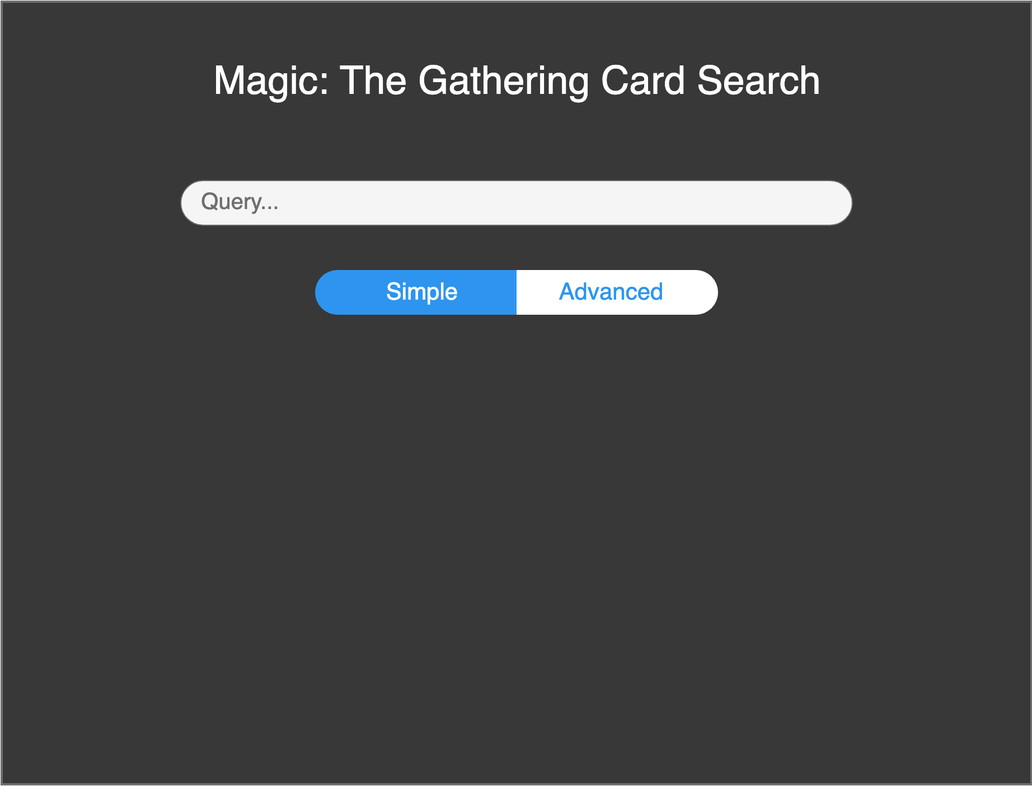
UI Mockup: Simple Search

Slide 6
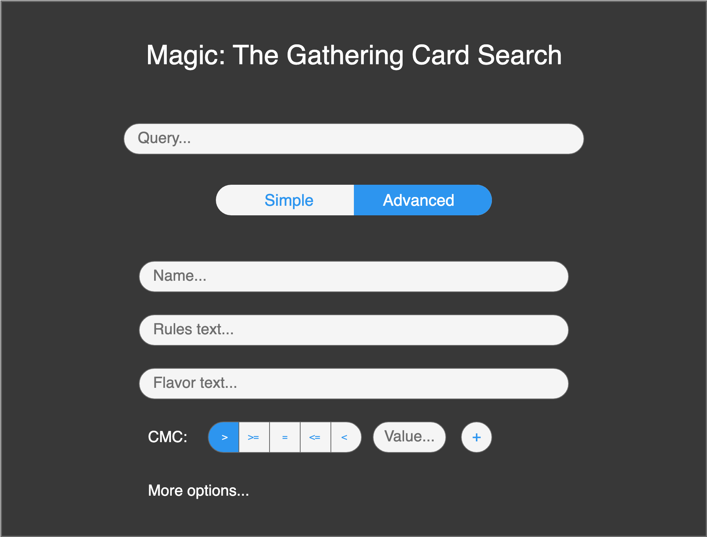
UI Mockup: Advanced Search

Slide 7
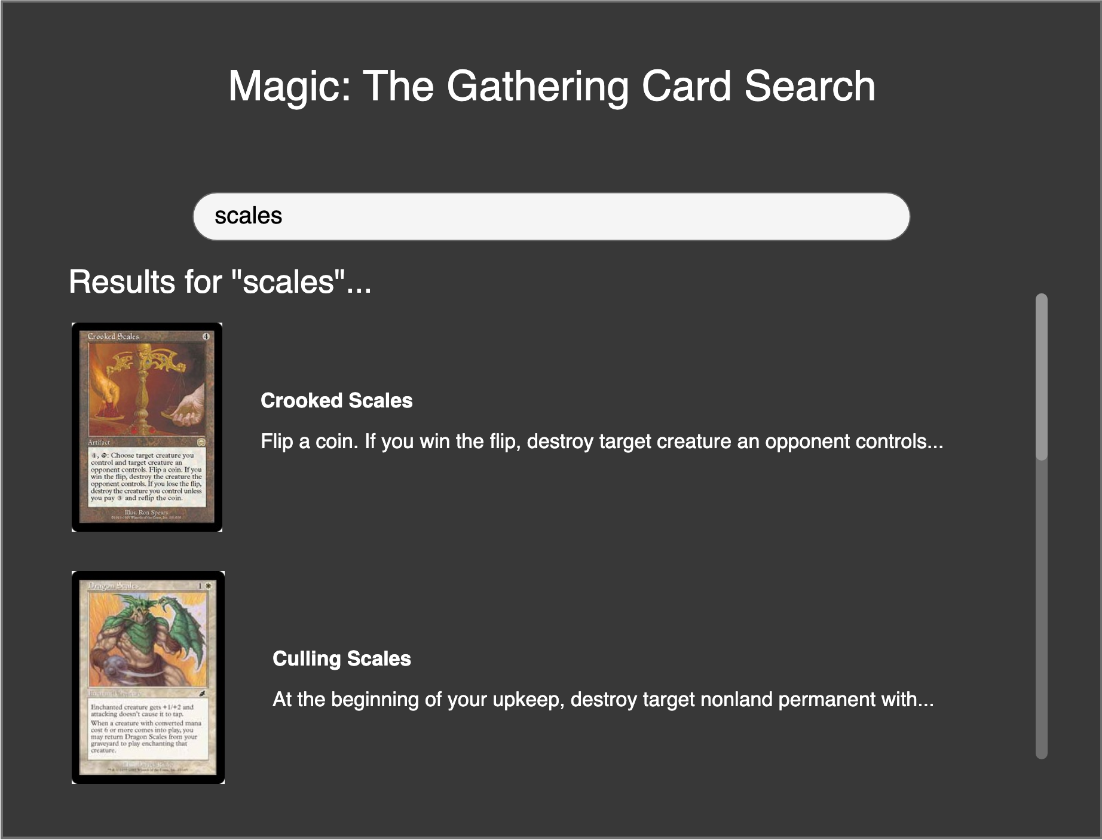
UI Mockup: Results Page

Slide 8
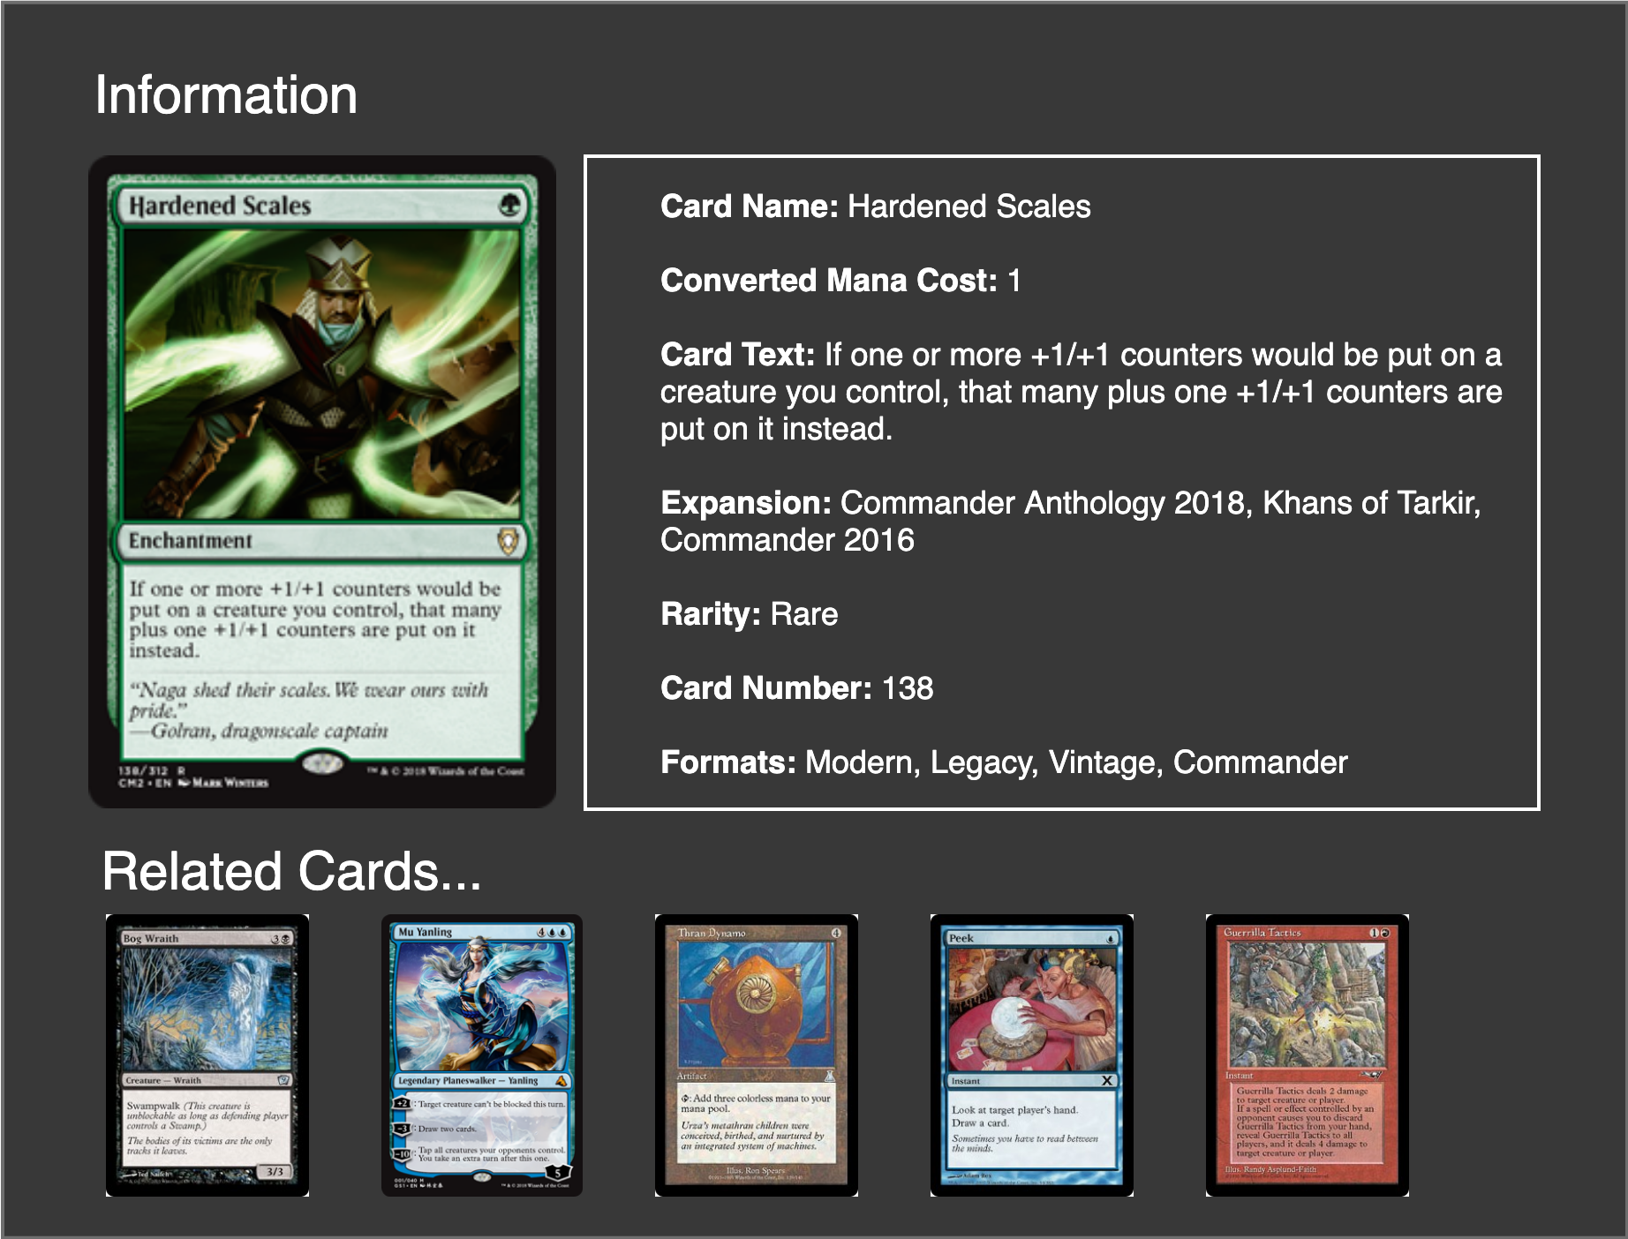
UI Mockup: Card Details page

Slide 9
Questions

