Slide 1
A-MAZE-ING ANIMAL RESCUE
By Ryan, Sam, Mark, George

Slide 2
3 Key Requirements
Roughly 5 minutes per habitat
Teach users things they can do to help the environment (Educational)
A game that can keep the user engaged long enough in order to provide that information

Slide 3
Game Overview
2D, top-down, Puzzle solving game
Players must guide animals through a maze
The animal will then tell the player (via speech bubbles) something they can do to help the environment, relating to that habitat.
3 animals per habitat
Each animal gives a unique 'solution'
Each 'solution' is rated on its effectiveness on the right hand side using a meter that fills up the more effective the 'solution' is

Slide 4
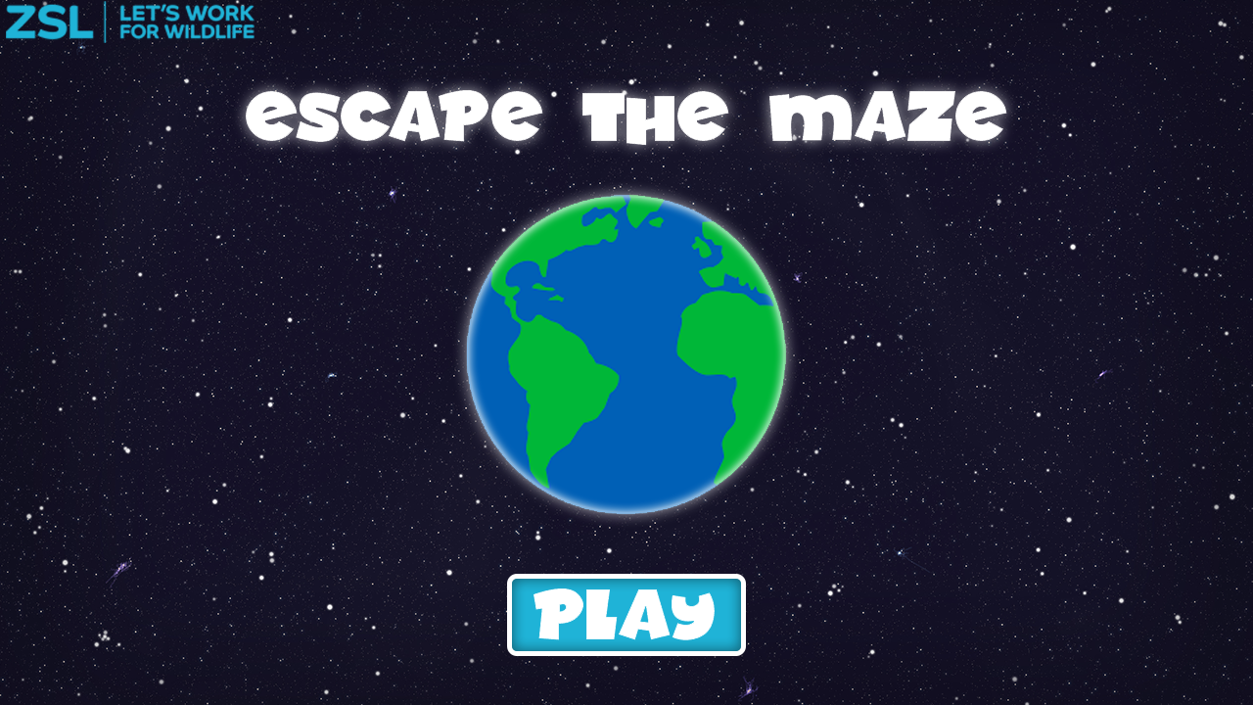

Slide 5
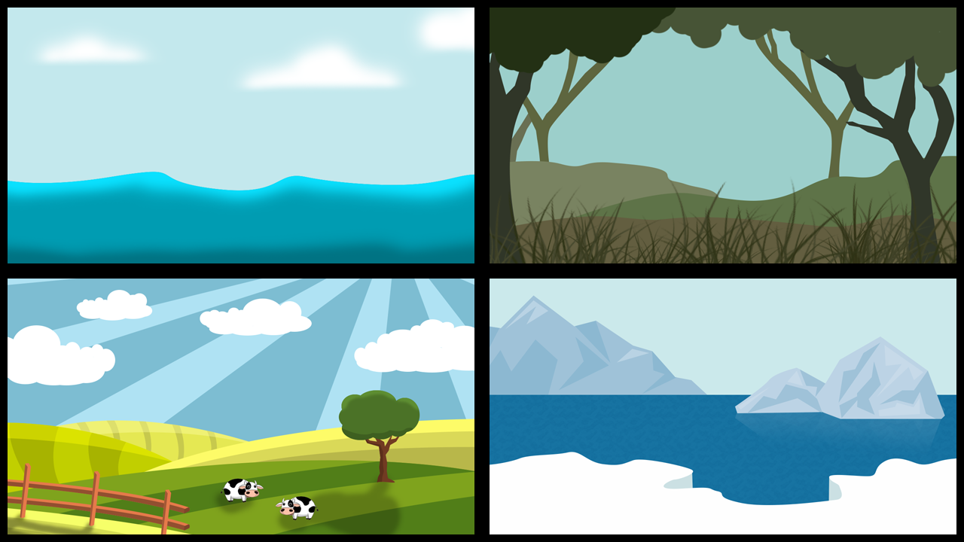

Slide 6
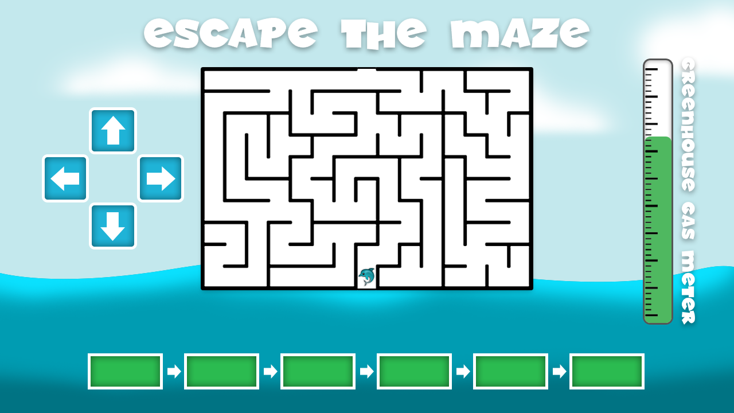

Slide 7



Tundra / Electronics Left On
Moose, Snow Fox and Snowy Owl
Tundra solutions aim to stop the ice and snow melting by reducing greenhouse gas emissions
1. Turn off mobile phone charger when your phone is fully charged
2. Turning TV's off instead of on standby
3. Turn off Heating/Air-Conditioning/Lights when not home

Slide 8


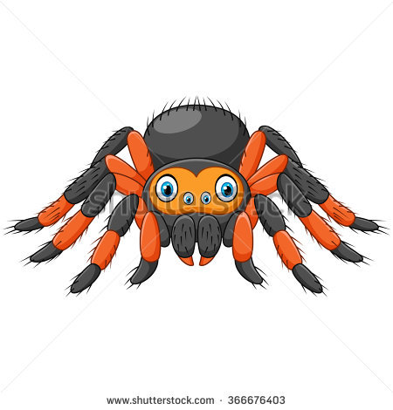
Rainforest / Mobile Phones
Tiger, Chimpanzee and Tarantula
Rainforest solutions aim to reduce deforestation
1. Use/Buy a second hand mobile
2. Always resell or recycle your old mobile
3. Don't be tempted to buy a new mobile each year

Slide 9



Ocean / Plastic
Coral, Blue Whale and Seahorse
Ocean solutions aim to reduce Littering of the oceans with plastic
1. Use a bag for life instead of 5p plastic bags
2. Always recycle plastic drinks bottles
3. Try to avoid buying plastic cups, plates and cutlery

Slide 10
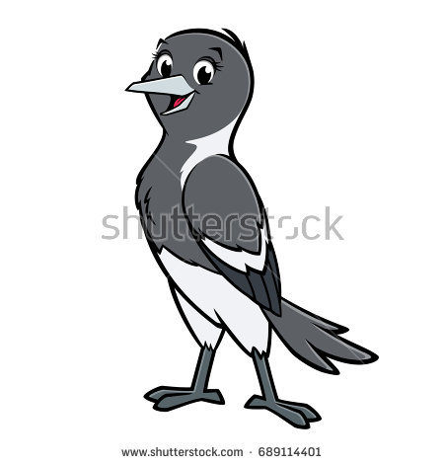

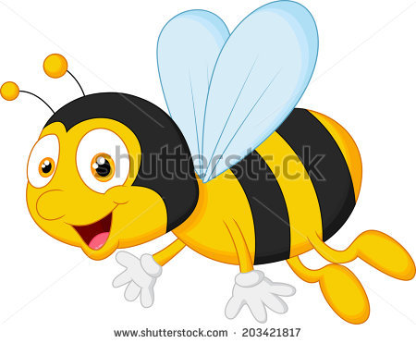
British Wildlife / Beef
Magpie, Badger and Honeybee
British Wildlife solutions relate to Beef production (could expand to other British sourced meat products)
1. Walk to the shops instead of driving
2. Remember to recycle any packaging that the beef comes in
3. Try to not let food go to waste (Eat all of your dinner!)

Slide 11
Pledges
When the game has been completed it will take you back to the home screen where a drop down menu will appear with a list of a few pledges
There will be a total of 15 pledges relating to all 4 of the habitats
The children can then pick 2 pledges within their teams or groups
Examples:
Arctic Tundra- I will unplug my mobile phone charger from the wall (REASON: even when a phone is not attached to a charger that’s switched on at the wall, it uses electricity!)
British Wildlife- If I have access to a special food waste bin, I will throw beef (and any other food waste) in it (REASON: Throwing food waste into landfill releases methane into the atmosphere)
Rainforest- I will recycle my phone instead of throwing it in landfill (REASON: The recycled parts can be used in new phones, so less raw materials need to be sourced)
Ocean- I will use a reusable bottle instead of buying single use plastic bottles (REASON: Less single use plastic bottles will be needed and made)

Slide 12
Thank you For Listening To Our Pitch

