Slide 1

Solbrille : Bringing Back the Time
Arne Bergene Fossaa, Simon Jonassen, Jan Maximilian W. Kristiansen, Ola Natvig
TDT4215 “Web-Intelligence”, Spring 2009
Arne Bergene Fossaa, Simon Jonassen, Jan Maximilian W. Kristiansen, Ola Natvig

Slide 2
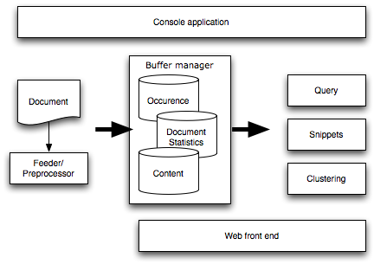
System Architecture
Arne Bergene Fossaa, Simon Jonassen, Jan Maximilian W. Kristiansen, Ola Natvig

Slide 3
Components
Preprocessing
  Stemming, tokenizing, html and punctuation remover
Index structures: Occurrence (Inverted), Statistics, Content
Modular query pipeline
  Matcher: produces documents which matches query
  Scoring: Ranks documents, Cosine and OkapiBM25 implemented
  Filtering: Phrase search filter implemented
  Snippets
  Clustering
Console application and web front-end
Arne Bergene Fossaa, Simon Jonassen, Jan Maximilian W. Kristiansen, Ola Natvig

Slide 4
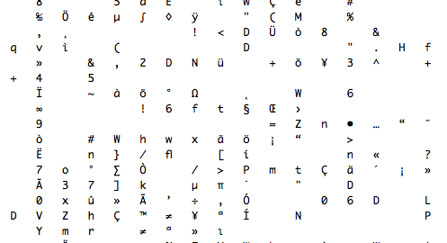
Inverted File
It’s in binary.
Arne Bergene Fossaa, Simon Jonassen, Jan Maximilian W. Kristiansen, Ola Natvig

Slide 5
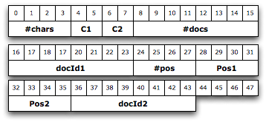
Inverted file - syntax

Slide 6
Query Language
AND/OR/NAND single terms
  ’kari bremnes’, ’+kari +bremnes’, ’+bremnes –kari’, etc
AND/NAND Phrases
  ’”kari bremnes”’, ’bremnes -”kari bremnes”’, ’kari +”kari bremnes”’
Arne Bergene Fossaa, Simon Jonassen, Jan Maximilian W. Kristiansen, Ola Natvig

Slide 7
Proximity
No direct implementation, but can be implemented by a scorer.
Indirect implementation: sniplets are based on max occurrence windows (proximity), clusters in the extended system are generated based on supplied sniplets.
Arne Bergene Fossaa, Simon Jonassen, Jan Maximilian W. Kristiansen, Ola Natvig

Slide 8
Ranking Algorithms
System has result ranking implemented as a pluggable module
It is possible to write custom scorers (Cosine, Okapi, PageRank*, ProximityScorer*, etc) and combine score values from these
Current System implementation uses Cosine and Okapi scorers.
Top endpage# results are kept in a queue, endpage#-startpage# of which are returned to a user
Arne Bergene Fossaa, Simon Jonassen, Jan Maximilian W. Kristiansen, Ola Natvig

Slide 9
Clustering
Suffix Tree Clustering
Finds similar phrases in documents
Scores based on cluster size, result score
Overlapping
Works on snipplets
Not too good for TIME, diversity too low

Slide 10
Demonstrations
<Ola says something funny>
Arne Bergene Fossaa, Simon Jonassen, Jan Maximilian W. Kristiansen, Ola Natvig

Slide 11
Evaluation of Basic System
Arne Bergene Fossaa, Simon Jonassen, Jan Maximilian W. Kristiansen, Ola Natvig

Slide 12
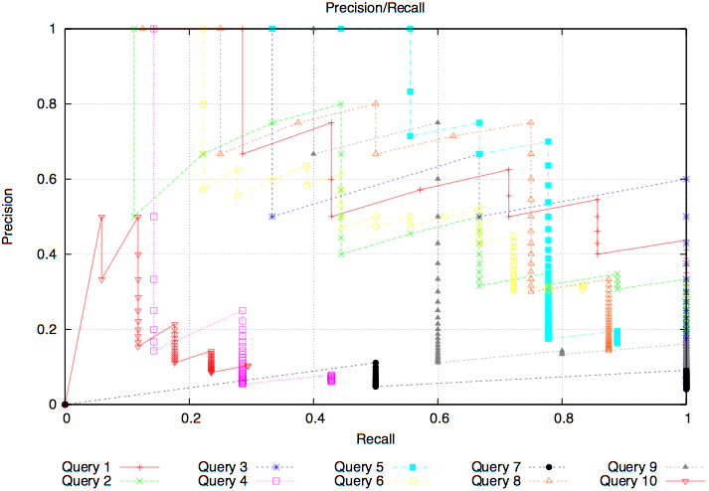
Cosine
Arne Bergene Fossaa, Simon Jonassen, Jan Maximilian W. Kristiansen, Ola Natvig

Slide 13
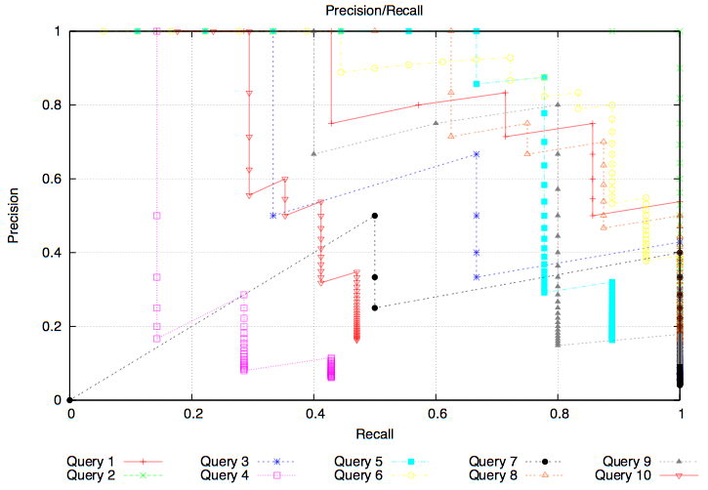
Okapi BM-25
Arne Bergene Fossaa, Simon Jonassen, Jan Maximilian W. Kristiansen, Ola Natvig

Slide 14
Evaluation of Extended System
Have not done a quantitative evaluation
For simple queries, most clusters have similar documents
Good when trying to find articles about the subject
Bad when tring to interpret more spread

