Slide 1
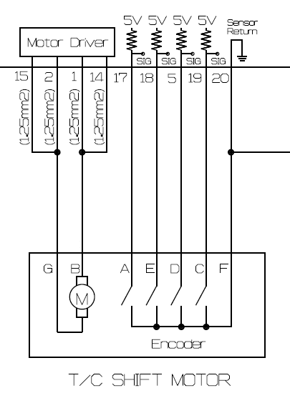
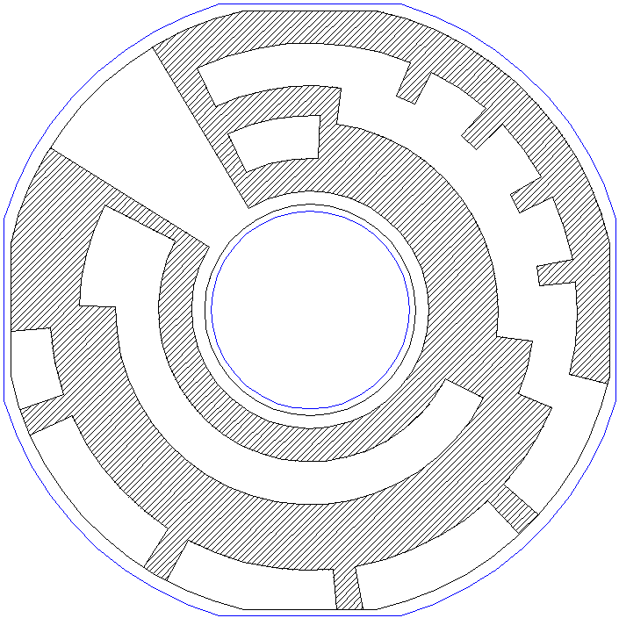
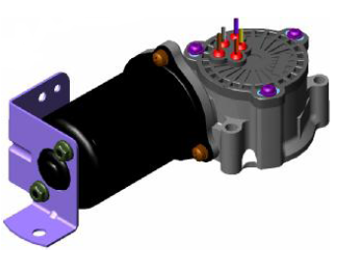
Motor Position Information
1: 5V
0 : GND
ITEM | POSITION | 2H | 4H | 4L
A | POS_4 | 0 | 1 | 0
E | POS_1 | 1 | 0 | 1
D | POS_2 | 0 | 0 | 1
C | POS_3 | 1 | 1 | 0
F | POS_RETURN | 0 | 0 | 0
POS_4
2H
POS_3
POS_2
POS_1
4L
POS_RETURN
4H
Sensor Plate

