Slide 1
Mastering the Fine Art of the Pivot
Todd Austin, University of Michigan

Slide 2
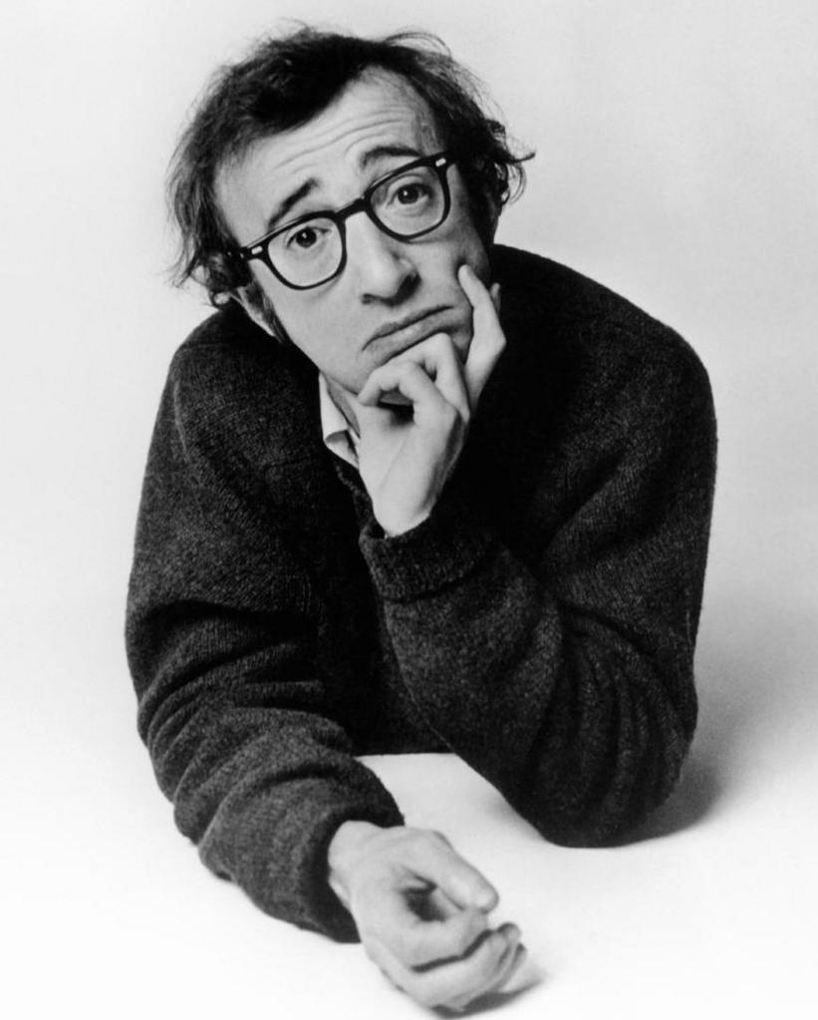
Perspectives on Failure
If you're not failing every now and again, it's a sign you're not doing anything very innovative.

Slide 3
Rule-Breaking Research
A rule-breaking approach to research is effective and engaging
Find a venerable rule and break it however possible
E.g., DIVA – designs must be bug-free to launch
E.g., CDI – programs need indirect jumps to implement calls/returns/dll’s
The “rules” create artificial barriers that hide good ideas
You will often find yourself on very fertile ground
You will more fully engage your community
One half will think your crazy idea will never work
One half will be intrigued (with your crazy idea)
A rule-breaking approach is more prone to failure
Often the outcome of the work is a deeper understanding of why the rule you broke should never be broken
Even when the research is successful, it can be very difficult to publish

Slide 4
Working Through Failures
Step #1: the failure
Essentially, the hypothesis that you have been working toward is incorrect
Step #2: the enlightenment
Assess why your hypothesis is incorrect
Step #3: the pivot
Piv·ot /ˈpivət/ - turn on or as if on a swivel
Explore how you can use this new understanding to reach your goal
Or, reach a new goal with this new understanding

Slide 5
The Downside of Failure
Let’s face it, failure really sucks
Try to stay focused on the bigger picture and eventual possible payoffs
Be resilient, and be ready to pivot
Most of my top-cited papers are in MICRO, rejected out of ISCA
It is more difficult to publish negative results
Not true for all research communities, e.g., life sciences
WDDD and NOPE are welcome additions to computer architecture
There is a fundamental tension between high-risk failure-prone research and PhD students
PhD students need to make steady progress toward a PhD degree
Often, I will “skunk work” my new ideas with undergraduate students

Slide 6
Case #1: Discovering Runahead
The failure: Attempting to show that simulators that don’t model mispeculation are overestimating performance
These simulators underestimate performance
The enlightenment: Executing the mispeculation path (runahead) provides significant performance advantages as it warms up the caches
The pivot: Years later, using this same idea to develop the DIVA runtime checker, which uses runahead ideas to keep the checker processor very simple

Slide 7
Case #2: Cache-Conscious Data Placement
The failure: Attempting to improve D-cache performance by reordering data in memory for better spatial/temporal locality
Extremely difficult for the compiler to improve upon natural data layout
The enlightenment: Programmers co-place logically related data, leading to significant spatial/temporal locality
Randomly ordered data reduces cache performance by 20-30%
The pivot: Reimagine the placement algorithm to only make highly reliable placement improvements over natural layout
Eventually leading to a 24% improvement in cache performance, and my first ASPLOS paper!

Slide 8
Additional Advise for Graduate Student
Getting papers published
Important tip: assume your paper will never be read
Corollary: write your paper so that the i) abstract, ii) intro, iii) figures and well-detailed captions, and iv) conclusion transmit the key ideas
Approach meshes well with the highly demanding review process
Getting the word out is critical to an idea’s success
Be an evangelist for your project
Name your project so the community can talk about it

Slide 9
Questions or Comments?
?
?
?
?
?
?
?
?
?
?
?
?

