Slide 1
Tableau Guest Lecture
Spencer Shadley
5/29/29 | sshadley@tableau.com
Notes:
Title Slide

Slide 2
About Me

Slide 3

Notes:
https://www.utexas.edu/

Slide 4


Slide 5

Notes:
https://www.amazon.co.uk/Seeds-Varieties-TRINIDAD-MORUGA-SCORPION/dp/B01M4LAHG7

Slide 6

Notes:
https://mangarock.com/manga/mrs-serie-154427

Slide 7
Notes:
Tableau Logo

Slide 8

Move to the Web Team
Notes:
Table

Slide 9
Agenda
Growth of Data
Why Data Matters – Three Examples
Tableau
Career Opportunities
Notes:
Table of Contents

Slide 10
Growth of Data
Notes:
Section Header

Slide 11
“Healthcare data will experience a compound annual growth rate (CAGR) of 36 percent through 2025.”
Jessica Kent, Health IT Analytics, 2018
Notes:
https://healthitanalytics.com/news/big-data-to-see-explosive-growth-challenging-healthcare-organizations

Slide 12
“…data in the manufacturing industry is projected to see a CAGR of 30 percent, financial services data is expected to grow at a rate of 26 percent, and data in the media and entertainment industry will increase at a compound rate of 25 percent.”
Jessica Kent, Health IT Analytics, 2018
Notes:
https://healthitanalytics.com/news/big-data-to-see-explosive-growth-challenging-healthcare-organizations

Slide 13
“Worldwide Big Data market revenues for software and services are projected to increase from $42B in 2018 to $103B in 2027, attaining a Compound Annual Growth Rate (CAGR) of 10.48% according to Wikibon.”
Louis Columbus, Forbes, 2018
Notes:
https://www.forbes.com/sites/louiscolumbus/2018/05/23/10-charts-that-will-change-your-perspective-of-big-datas-growth/#6743ec3d2926

Slide 14
“According to an Accenture study, 79% of enterprise executives agree that companies that do not embrace Big Data will lose their competitive position and could face extinction. Even more, 83%, have pursued Big Data projects to seize a competitive edge.”
Louis Columbus, Forbes, 2018
Notes:
https://www.forbes.com/sites/louiscolumbus/2018/05/23/10-charts-that-will-change-your-perspective-of-big-datas-growth/#6743ec3d2926

Slide 15
“The Hadoop and Big Data Market are projected to grow from $17.1B in 2017 to $99.31B in 2022 attaining a 28.5% CAGR. The greatest period of projected growth is in 2021 and 2022 when the market is projected to jump $30B in value in one year. Source: StrategyMRC and reported by Statista.”
Louis Columbus, Forbes, 2018
Notes:
https://www.forbes.com/sites/louiscolumbus/2018/05/23/10-charts-that-will-change-your-perspective-of-big-datas-growth/#6743ec3d2926

Slide 16
“90% of the data in the world today has been created in the last two years.”
Ralph Jacobson, IBM, 2013
Notes:
https://www.ibm.com/blogs/insights-on-business/consumer-products/2-5-quintillion-bytes-of-data-created-every-day-how-does-cpg-retail-manage-it/

Slide 17
Amount of data per second
40,000 average Google searches as of 5/27/19 (Internet Live Stats)
57,870 YouTube videos watched on average in 2018 (YouTube)
11,574 hours of YouTube video watched on average in 2018 (YouTube)
34,722 Snapchat photos shared on average in 2018 (Snapchat)
1,157 Instagram photos and videos uploaded as of 9/17/18 (Omnicore)
6,000 tweets on Twitter as of 5/17/19 (Internet Live Stats)
Record second was 143,199 on August 3, 2013 when Castle in the Sky aired in Japan (Twitter)
Previous record was set on June 25, 2009 at 456 tweets after Michael Jackson’s death (Twitter)

Slide 18
Why is there more data?
More opportunities to collect data
Virtual Assistants, chatbots
More “smart” devices (50 billion collecting data by 2020, according to Attunity)
Consumers are sharing more information (social media, photo sharing, purchase transactions, etc.)
More people to collect data from (increasing world population, increasing percent of digital users)
Telemetry (feature usage, performance, etc.)
Data is increasingly utilizable
Modern tools such as machine learning and modern visual analytics
Applicable to more scenarios such as machine learning (autonomous cars, image recognition)
It’s new (see “Technology Adoption Over Time”)
Notes:
Earthquakes are difficult to predict – one of the best predictors is just a twitter scraper looking at people talking about earthquakes
improves many metrics (increases sales, decreases costs, reduces response times, etc.)

Slide 19
Why Data Matters – Three Examples
Notes:
Section Header

Slide 20
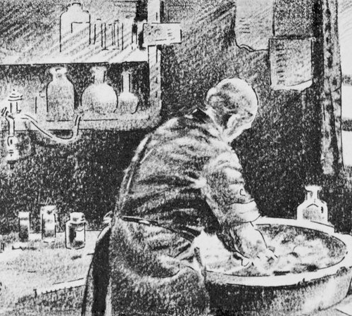
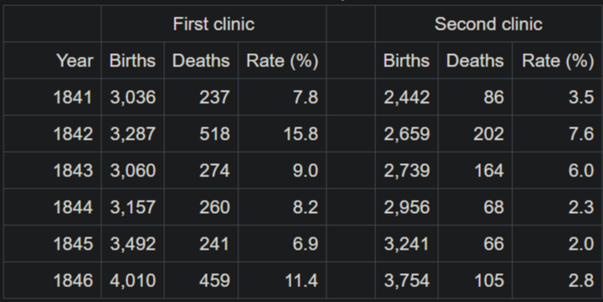
Ignaz Semmelweis
Wrote down mortality rates in a table
Births assisted by doctors had higher mortality rates than those assisted by midwives
Theorized something invisible to the eye must be transferring from previous surgeries
Asked doctors to wash their hands before examining pregnant women
Mortality rate decreased from 18% to 2.2%
Notes:
Picture credit: https://www.npr.org/sections/health-shots/2015/01/12/375663920/the-doctor-who-championed-hand-washing-and-saved-women-s-lives
Table credit: https://en.wikipedia.org/wiki/Ignaz_Semmelweis
Hungarian physician
Pioneer of antiseptic prcedures
Wash hands with chlorinated lime water
Simple Table from 1847
- Microscopic germs, invisible to the eye, can make us sick!
- A doctor who doesn’t wash his hands can spread his disease from one person to another
- Discovery made with data by Ignaz Semmelweis
- In his first year, in fact in his first six months, using this data right here, after being turned down from a more prestigious job he discovered the Germ Theory of Disease
- He noticed that doctors coming from autopsies who then delivered babies had dramatically higher maternal mortality rates due to puerperal fever.
- After asking doctors to wash their hands before examining pregnant women he documented a reduction in mortality rate from 18% to 2.2% over a year
- He, originally, was mocked for this. He had no explanation but from the data he knew that when doctors washed their hands it saved lives.
- He died in an insane asylum at age 47 before his theory was ever accepted.
- A few years after his death in 1865, Louis Pasteur confirmed germ theory and Joseph Lister used their research to practice and operate with hygienic methods with great success.
- John Snow also contributed to this replacement of miasma theory (disease spread through bad air, even caused by things like bad breath).
- Game of Thrones!
- Wrote essay called On the Mode of Communication of Cholera in 1849

Slide 21

Ignaz Semmelweis (continued)
Germ Theory of Disease
Replaced Miasma theory
Saved many lives
Community did not accept it
Semmelweis died in an insane asylum
John Snow!
With research from Louis Pasteur, Joseph Lister and others confirmed the theory
Wrote persuasive essay called On the Mode of Communication of Cholera (1849)
Notes:
Picture credit: https://www.npr.org/sections/health-shots/2015/01/12/375663920/the-doctor-who-championed-hand-washing-and-saved-women-s-lives
- Simple Table from 1847
- Microscopic germs, invisible to the eye, can make us sick!
- A doctor who doesn’t wash his hands can spread his disease from one person to another
- Discovery made with data by Ignaz Semmelweis
- In his first year, in fact in his first six months, using this data right here, after being turned down from a more prestigious job he discovered the Germ Theory of Disease
- He noticed that doctors coming from autopsies who then delivered babies had dramatically higher maternal mortality rates due to puerperal fever.
- After asking doctors to wash their hands before examining pregnant women he documented a reduction in mortality rate from 18% to 2.2% over a year
- He, originally, was mocked for this. He had no explanation but from the data he knew that when doctors washed their hands it saved lives.
- He died in an insane asylum at age 47 before his theory was ever accepted.
- A few years after his death in 1865, Louis Pasteur confirmed germ theory and Joseph Lister used their research to practice and operate with hygienic methods with great success.
- John Snow also contributed to this replacement of miasma theory (disease spread through bad air, even caused by things like bad breath).
- Game of Thrones!
- Wrote essay called On the Mode of Communication of Cholera in 1849

Slide 22
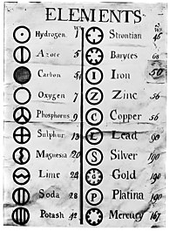
Dmitri Mendeleev
Russian chemist and inventor
Became teacher in 1867 and made a great discovery while writing his textbook – Principles of Chemistry
Viewed elements from a different perspective, playing with how to visualize them
Notes:
Great minds are constantly changing the way they look at a problem. Dmitri Mendeleev is a great example of this.
He took this collection of data and looked at it like this, then this, then this.
In an involved thinking process looked at this way then this way then this way. And finally in this way.
There is no difference between the data stored in that first table and the last one. Not any difference at all.
Here’s the power of perspective shifting. The first table is virtually useless. The last table is one of the most impactful tables of data ever created. You can predict the behavior of elements and even predict new elements.

Slide 23
“I saw in a dream a table where all the elements fell into place as required. Awakening, I immediately wrote it down on a piece of paper.”
Dmitri Mendeleev
Notes:
Quote

Slide 24
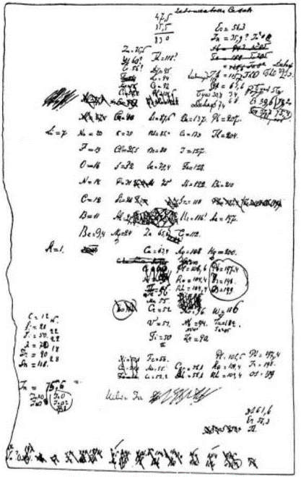
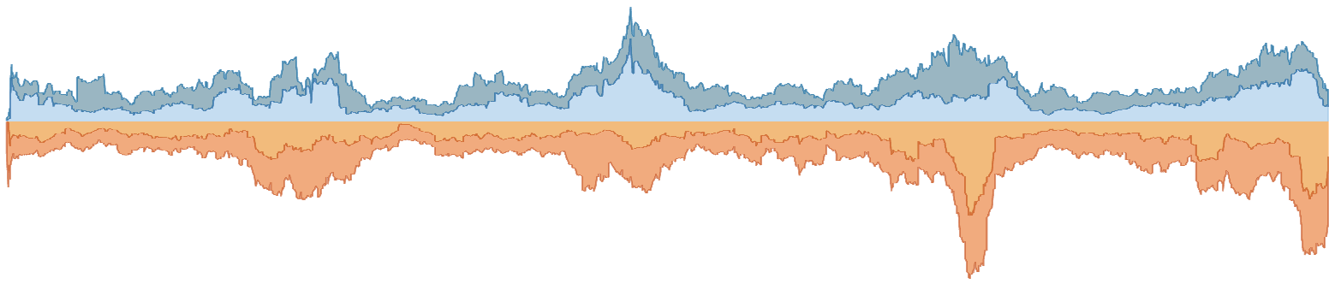
1868
First
Draft
Notes:
https://www.meta-synthesis.com/webbook/35_pt/pt_database.php?Button=pre-1900+Formulations

Slide 25
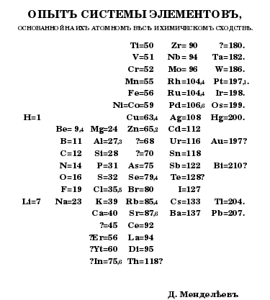
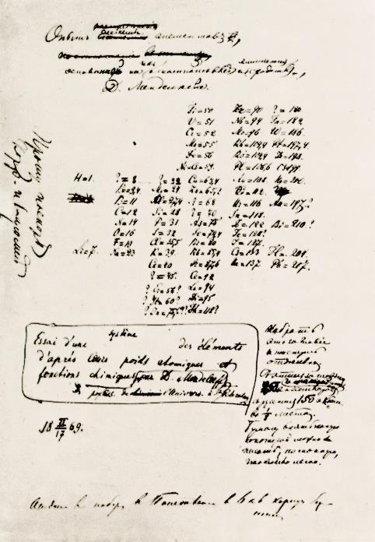
1869
Mendeleev’s
Tabelle I
Notes:
https://www.meta-synthesis.com/webbook/35_pt/pt_database.php?Button=pre-1900+Formulations

Slide 26
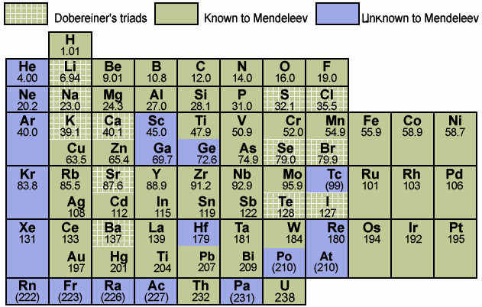
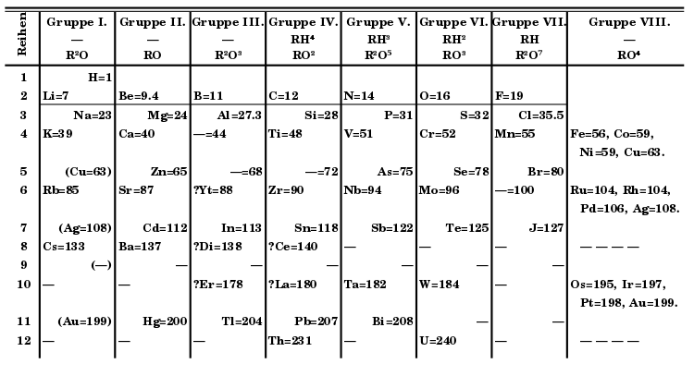
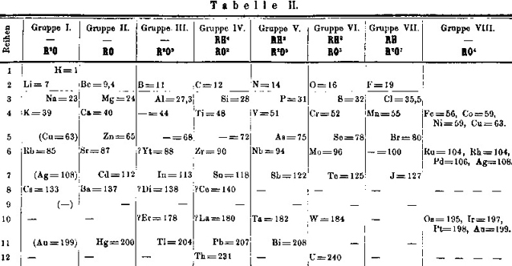
1871
Mendeleev’s
Tabelle II
Notes:
https://www.meta-synthesis.com/webbook/35_pt/pt_database.php?Button=pre-1900+Formulations

Slide 27
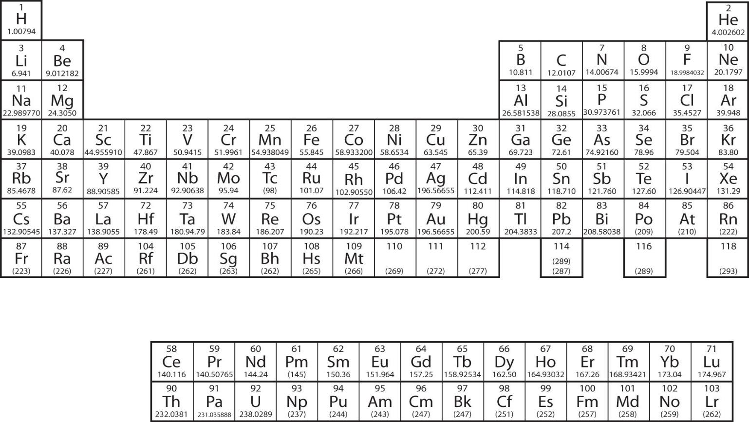
Notes:
https://saylordotorg.github.io/text_introductory-chemistry/s12-04-electronic-structure-and-the-p.html

Slide 28

Steven Levitt
Economist, author of Freakonomics
Chicago Public School System switched to new testing criterium
Introduced potential penalties and restrictions on teachers and schools
Grades improved, substantially
Released test scores publicly
Letter == correct answer; number == incorrect
700,000 tests, organized by classroom
1993 – 2000
400,000 students per year
100 million individual answers
Notes:
Steven Levitt, author of Freakonomics
This shows test answers for students in different classrooms
A letter indicates a correct answer and a number indicates an incorrect answer
This data is trying to tell us that over 200 teachers in the Chicago public school system are cheating
They’re changing the answers that students are filling out on tests to make themselves look better
You’ll see it if you just look at it the right way
The Chicago Public Schools teaches more than 400,00 students a year. In 1996 The Chicago Public School system adopted “high-stakes” testing. This enacted minimum scores required on a number of tests in the 3rd, 6th and 8th grade. What was unique here was that it held the school accountable for these scores. For example, a school could be shut down entirely if it didn’t meet minimum reading scores or staff members could have a raise withheld, a promotion cancelled or even be dismissed if they did not meet certain thresholds.
Chicago Public Schools made available a database of the test answers for every CPS student from third grade through seventh grade from 1993 to 2000. This amounts to roughly 30,000 students per grade per year, more than 700,000 sets of test answers, and nearly 100 million individual answers. The data, organized by classroom, included each student’s question-by-question answer strings for reading and math tests

Slide 29



What’s Different Here?
Notes:
Image & Copy

Slide 30
Tableau
Notes:
Section Header

Slide 31
Tableau Resources
Community Forums (Web Data Connector)
Tableau Help
Getting Started with Tableau
Dashboard Best Practices (lots of resources for Tableau Dashboard Design)
Using Web Data Connector
Web Data Connector Tutorial
Tableau Web Data Connector Home
Web Data Connector Examples
Featured Tableau Public Vizzes

Slide 32
Career Opportunities
Data Scientist
“Data investments in the financial services industry will account for nearly $9 Billion in 2018 alone” (Attunity, 2018)
“AI’s impact on marketing is growing, predicted to reach nearly $40 billion by 2025.” (Attunity, 2018)
“The salaries of data scientists are rapidly increasing with demand.” (Attunity, 2018)
“Consider this figure: $136 billion per year. That’s the research firm IDC’s estimate of the size of the big data market, worldwide, in 2016. This figure should surprise no one with an interest in big data.” (Harvard Business Review, 2016)
“83% of data scientists polled feel that there is shortage of data scientists today” (CrowdFlower, 2016)
“80% of data scientists feel really positive about their current gig” (CrowdFlower, 2016)
“[b]y 2020 the number of Data Science and Analytics job listings is projected to grow by nearly 364,000 listings to approximately 2,720,000.” (Forbes, 2017)
Data Analyst
“Most companies only analyze 12% of the data they have.” (Attunity, 2018)
“But here’s another number: $3.1 trillion, IBM’s estimate of the yearly cost of poor quality data, in the US alone, in 2016. While most people who deal in data every day know that bad data is costly, this figure stuns.” (Harvard Business Review, 2016)

Slide 33
Any Questions?
Slides, workbooks and assets are available at
https://github.com/spencer-shadley/data-lecture
Notes:
Title Slide

Slide 34
[Title/Topic]
2 lines max
Notes:
Title Only

Slide 35
[Title/Topic]
[Copy content]
Notes:
Title & Copy

Slide 36
[Title/Topic]
Why does data matter?
[High-level content]
[Secondary information about high-level content]
[More details]
[More details]
[More details]
[Secondary information about high-level content]
[High-level content]
Notes:
Numbered List

Slide 37
[Title/Topic]
[First Point]
[Second Point]
[Sub bullet]
[Sub bullet]
[First Point]
[Second Point]
[Sub bullet]
[Sub bullet]
Notes:
Bulleted Copy – 2 Column

Slide 38
“Insert quote here.”
Name, Title, Company
Notes:
Quote

Slide 39
[Title/Topic]
[Content relevant to image]
Notes:
Image & Copy

Slide 40
Notes:
Full Page Image w Color Bar

Slide 41
Instructional Slides

Slide 42
Best Practices
All headline copy should be in Benton Sans. All body copy should be in Merriweather.
Title copy should be top left aligned.
Copy blocks should be top left aligned.
Copy should be in the dark grey theme color, or reversed out.
Please use theme colors for all elements.
Copy should be minimal & should be reference points to be discussed verbally.
Reference guides for margins & alignment.
Use provided template pages when possible. They are named for best use.
Keep slides simple & clean like normal Tableau branding.
Delete unused master pages when saving to help with file size.
Compress images & delete cropped out areas to reduce file size.

Slide 43
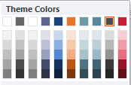
Theme Colors
PowerPoint palette for this Slide Master
Text & slide background colors
Accent colors
Text/
Background
Light 1
Text/
Background
Dark 1
Text/
Background
Dark 2
Accent 1
Accent 2
Accent 3
Accent 4
Accent 5
Accent 6
Type and background combinations must meet a minimum 4.5:1 contrast ratio or greater for accessibility and large format screen legibility. Examples above demonstrate correct color use for on-screen applications.

Slide 44
Typography
Fonts
This template has been formatted with Benton Sans & Merriweather which are the new corporate fonts. If you do not have these on your machine, please reach out to IT for assistance. If you are still having issues with fonts, or are sending the deck to someone outside of Tableau please set the deck in Arial, as it is a system font on all machines. Do this at Format>Replace Fonts.
Slide Titles and Headers
Slide Title and Header text should be set in Benton Sans Book and have each word capitalized. Slide Titles should be set at 45pt when possible, sub headings should be set at 28pt.
Body Copy
Body copy should be set to Merriweather Light 28pt when possible. Try to limit each slide to a maximum of 3 font sizes.
Type Tips
Create visual differentiation/focus by using scale versus using bullets.

Slide 45
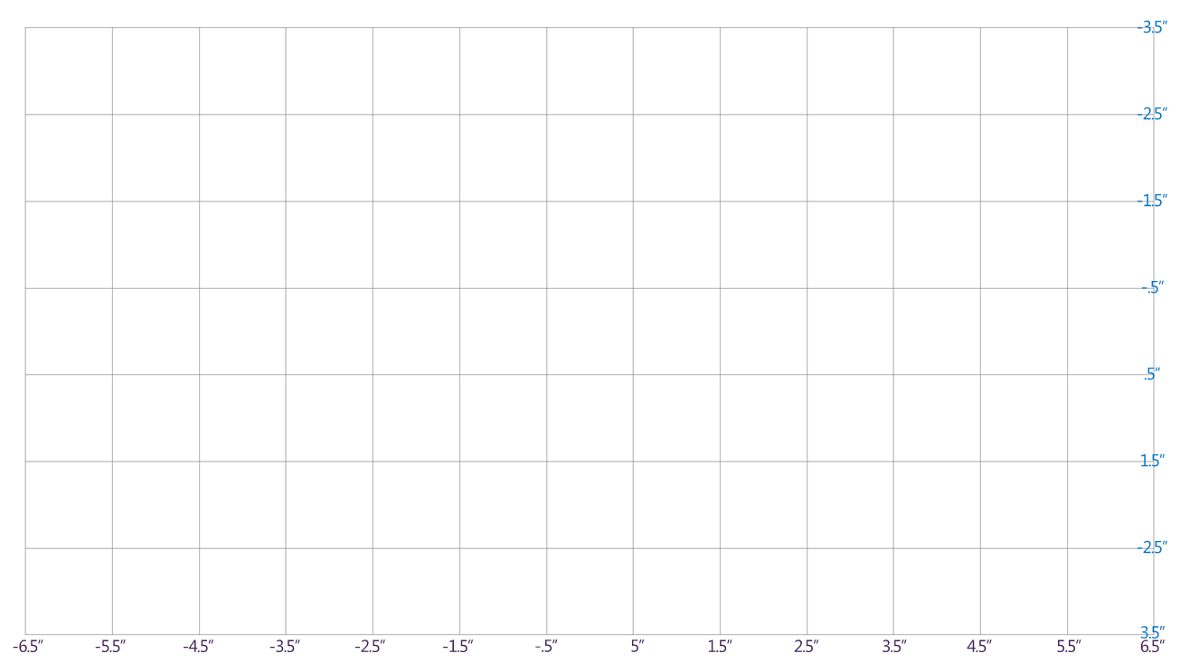
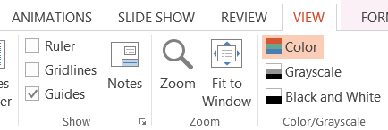
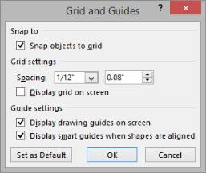
Guidelines
To view the grid and guidelines, check the Guides box in the Show section under the view tab.
To further aid in alignment of objects, click the expand icon in the bottom-right corner of the Show section and check ‘Display smart guides when shapes are aligned.’
Grid/Guidelines

Slide 46
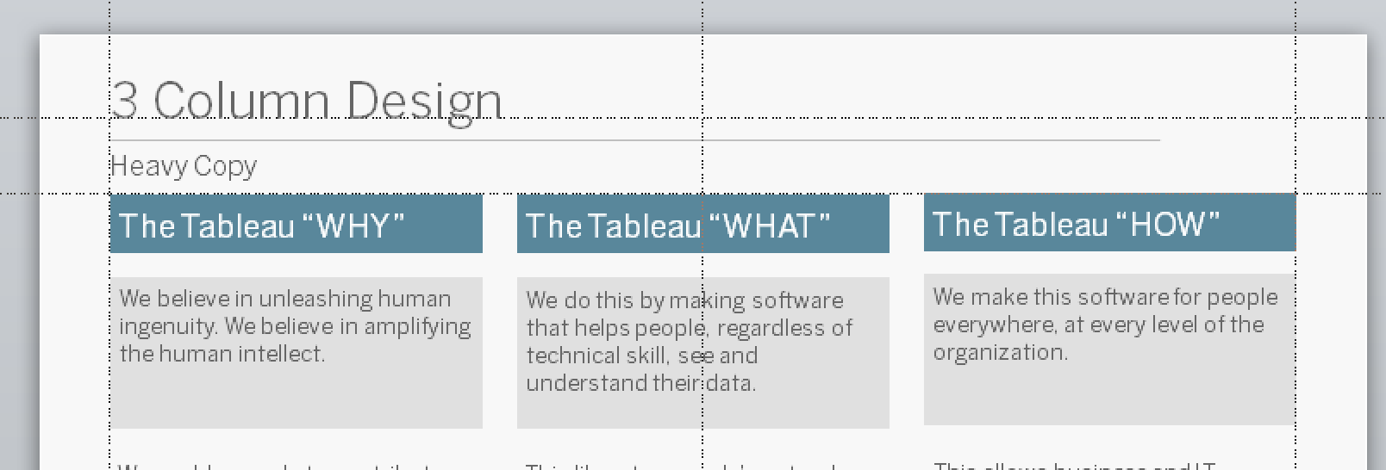
Margins
Please pay close attention to slide margins & be sure that guides are turned on when aligning objects on the slide.
Title copy should rest on top line from top & left margin line
Content should start at corner of second line from top & left margin
Content should not extend beyond the right margin line

Slide 47



Logos
Not to be altered, can be resized.
grey
reversed out use this when the background is dark
full color

Slide 48
Objects & Icons
twitter
facebook
twitter
facebook
linkedin
you tube
linkedin
you tube
instagram
googleplus
instagram
googleplus
play icon
marketing funnel
play icon
marketing funnel

Slide 49
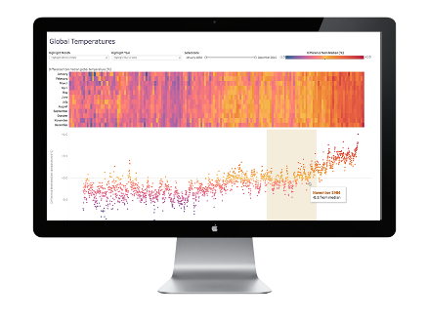


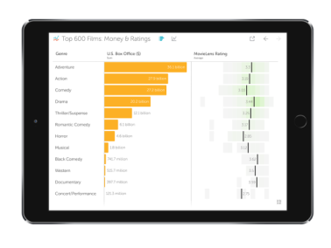
Product Photos
Tableau Desktop
Tableau Public
Tableau Server
Tableau Online
Vizable

Slide 50
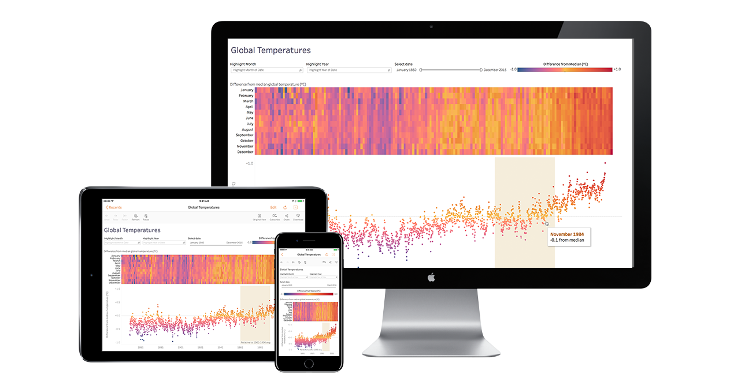
All Devices

Slide 51



Tableau Photography
Context Important: Composed photos can tell a story through context within the photo’s environment.
Software Focused: Photography is a good way to help contextualize and humanize content. Focusing in on product screens as a main visual makes our product front and center.
Lifestyle Important: Photos that show more lifestyle, environment, and context used.

Slide 52
Sample Table (Option A)
Header 1 | Header 2 | Header 3 | Header 4 | Header 5
Content | Content | Content | Content | Content
Content | Content | Content | Content | Content
Content | Content | Content | Content | Content
Content | Content | Content | Content | Content
Content | Content | Content | Content | Content
Content | Content | Content | Content | Content

Slide 53
Sample Table (Option B)
Header 1 | Header 2 | Header 3 | Header 4 | Header 5
Content | Content | Content | Content | Content
Content | Content | Content | Content | Content
Content | Content | Content | Content | Content
Content | Content | Content | Content | Content
Content | Content | Content | Content | Content
Content | Content | Content | Content | Content

Slide 54
Sample Table (Option C)
Header 1 | Header 2
To modify table, first click anywhere in table, so the Table Tools menu is highlighted at top | Layout > Shrink or expand column widths by adjusting the Cell Size, or set them to same size with Distribute
To modify the table layout, click Table Tools > Layout To modify the table style, click Table Tools > Design | Layout > Use Alignment settings to adjust text alignment and cell margins
Layout > To add rows, click into cell and choose, Insert Above or Insert Below
Layout > To add columns, click into cell and choose Insert Left or Insert Right | Tip: To quickly add a row, place cursor in this last cell and hit Tab key

Slide 55
“Insert quote here.”
Name, Title, Company
Notes:
Quote

Slide 56
[Title/Topic]
[Content relevant to image]
Notes:
Image & Copy

Slide 57
All Devices

