Slide 1
RCTD - Spatial Transcriptomics Deconvolution
Katya Aladyeva, JT Bobik, Sidney Lenz, Kate Zoller
BMI 5750
July 16, 2026

Slide 2
What is Spatial Transcriptomics?
High dimensional resolution of genes with a spatial context.
Some cell types less amenable to scRNAseq protocols.
Advantage in providing tissue context to help inform biology of the sample.
Sub-cellular localization of mRNA integral to gene function.
Williams, C. G. et al. An introduction to spatial transcriptomics for biomedical research. Genome Medicine 14, 68 (2022).

Slide 3
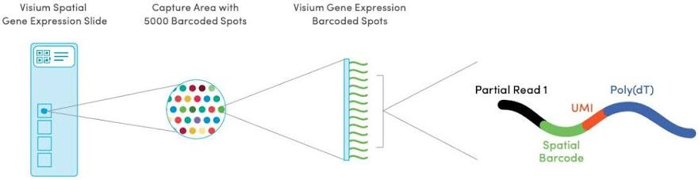
Spatial Transcriptomics – 10X Visium (standard resolution) technology
https://www.10xgenomics.com/support/spatial-gene-expression-fresh-frozen/documentation/steps/tissue-prep/visium-spatial-protocols-tissue-preparation-guide

Slide 4
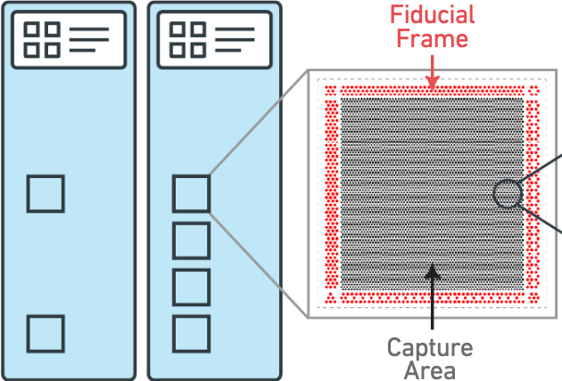
10X Visium pipeline
Sections within the squares
Square = Capture Area (6.5mm x 6.5mm)
Capture area surrounded by Fiducial Frame
for proper image recognition in data analysis
One section per square, no folding
Cryosectioning with OCT
Can also use parrafin
Can also evaluate RNA quality
within the cryosections before
proceeding with experiment
https://www.10xgenomics.com/support/spatial-gene-expression-fresh-frozen/documentation/steps/tissue-prep/visium-spatial-protocols-tissue-preparation-guide

Slide 5
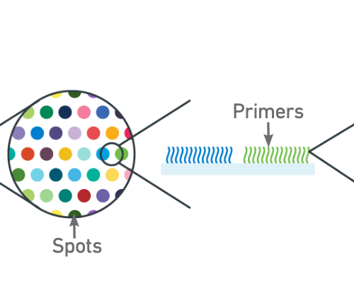
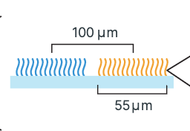
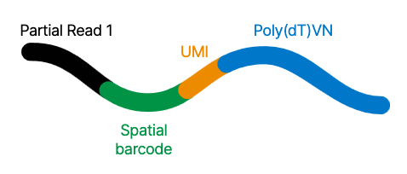
10X Visium pipeline
Roughly 5000 spots per
capture area
Each spot has a barcode
associated to track
location on the slide
Each spot has multiple primers
to capture genes
Spots generally 55 microns by
55 microns, spaced 100
microns apart
https://www.10xgenomics.com/support/spatial-gene-expression-fresh-frozen/documentation/steps/tissue-prep/visium-spatial-protocols-tissue-preparation-guide

Slide 6
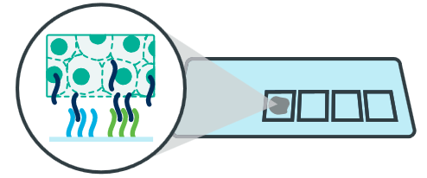
10X Visium pipeline
Partial read:
Spatial barcode:
UMI:
Poly(dT)VN
Proprietary primer
16 nucleotides long
12 nucleotides long
30 nucleotides long
Unique to the spot
Unique
Molecular
Identifier
Captures the mRNA
Links rest of the
primer to slide
Tells software which
spot the read came
from
Specifies mature mRNA
using polyA mRNA tail
Tells different molecules
in same spot apart
Goes into cDNA synthesis
https://www.10xgenomics.com/support/spatial-gene-expression-fresh-frozen/documentation/steps/tissue-prep/visium-spatial-protocols-tissue-preparation-guide

Slide 7
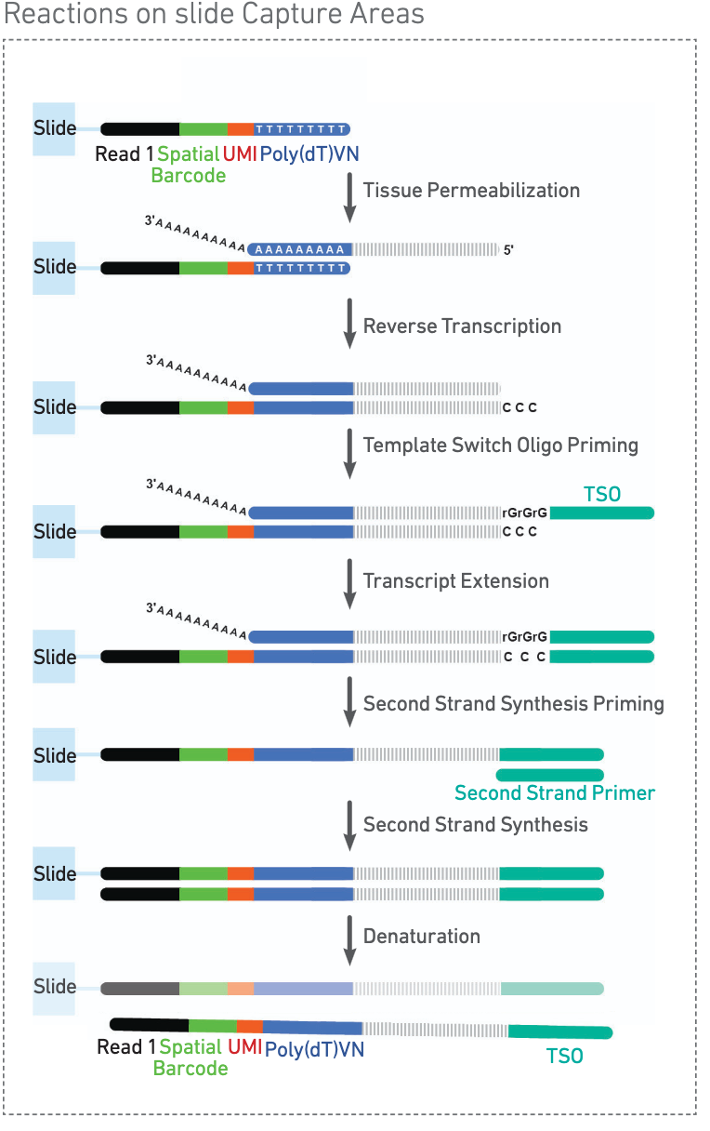
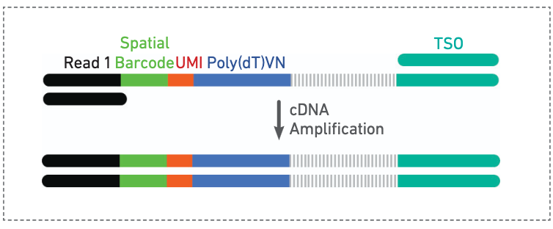
10X Visium pipeline
Tissue is permeabilized and mRNA released from cells
cDNA is transcribed and second strand generated
Second strand is used for amplification (using PCR)
and library construction
https://www.10xgenomics.com/support/spatial-gene-expression-fresh-frozen/documentation/steps/tissue-prep/visium-spatial-protocols-tissue-preparation-guide

Slide 8
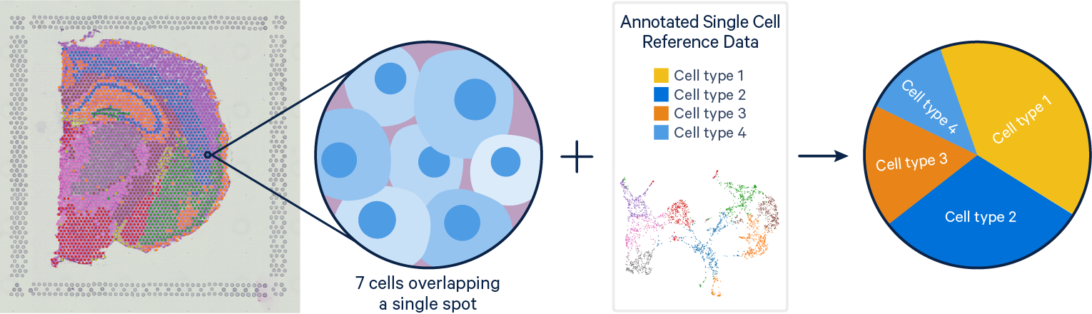
Spatial Deconvolution
https://www.10xgenomics.com/analysis-guides/integrating-single-cell-and-visium-spatial-gene-expression-data
Notes:
Explain that spots are not cells.
For Visium:
spot diameter ≈55 μm
Each spot contains multiple cells
typically anywhere from 1–10+ cells depending on tissue density
Therefore,
Observed counts are mixtures:
Yspot=Ycell1+Ycell2+Ycell3+...
But we don't know the proportions of cell types on each spot.
Spatial deconvolution is a computational technique used in spatial transcriptomics to untangle mixed gene expression signals in order to estimate those proportions .
It uses a single cell RNA sequencing database as a reference to estimate the proportion of cell types on each spot.

Slide 9
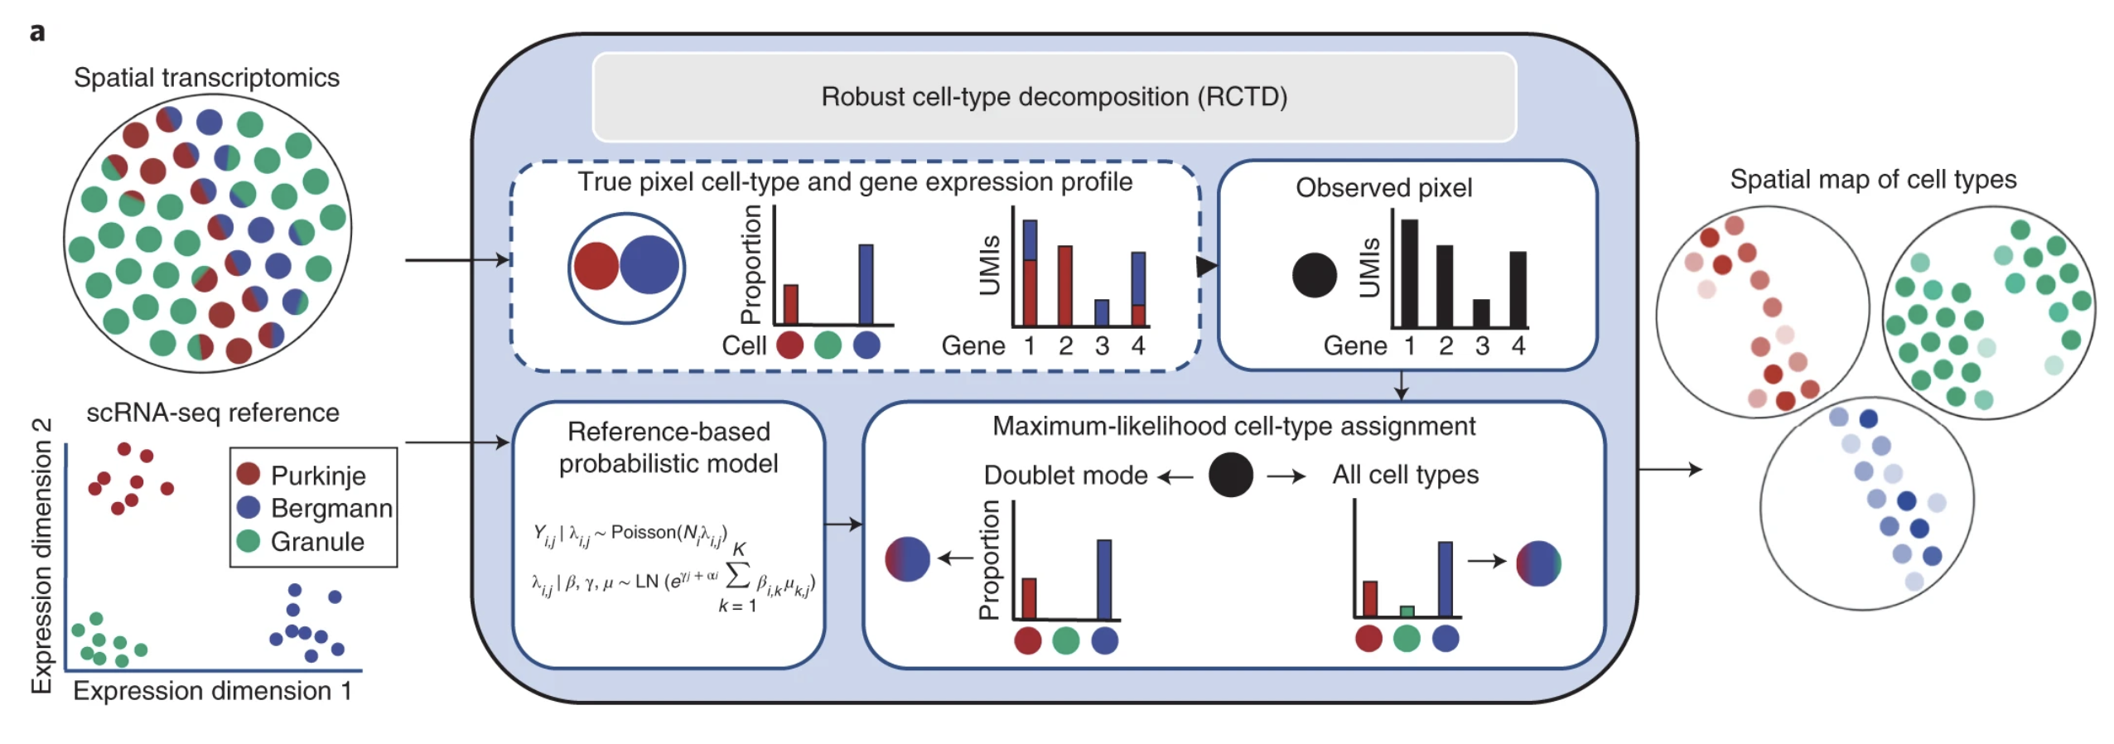
The goal of RCTD Deconvolution is to estimate the unknown cell type proportions
Y = Xw
Gene | T Cell | Fibroblast
CD3D | High | Low
COL1A1 | Low | High
Y = observed spatial counts
X = reference expression profiles
W = unknown cell type proportions
Cable, D. M. et al. Robust decomposition of cell type mixtures in spatial transcriptomics. Nature Biotechnology 40, 517–526 (2021).
Notes:
RCTD Deconvolution – the tool we are using is called Robust Cell Type Decomposition which again is used to detangle these mixed gene expression data from each spot
We have our spot that measures the expression of genes. To keep it simple, let's say that we have two genes that our spot is measuring and that both of the genes that the spot is detecting have a combined medium expression. Based on the single cell RNA sequencing reference data, it seems like we have a mixture of the two cell types, but we don't know in what proportions.
Mathematically, we can represent this as:
Y=Xw
where
Y = observed spatial counts
X = reference expression profiles
w = unknown cell type proportions
The goal is simply to estimate w.

Slide 10
RCTD Estimates the Cellular Composition of Each Spatial Spot
Cable, D. M. et al. Robust decomposition of cell type mixtures in spatial transcriptomics. Nature Biotechnology 40, 517–526 (2021).
Notes:
RCTD uses two datasets:
Spatial transcriptomics
mixed spots
coordinates
counts
Single-cell RNA-seq reference where every cell type already has a known annotation in terms of gene expression
RCTD then
Constructs reference expression profiles for each annotated cell types from the single-cell RNA-seq data.
models each spatial spot as a weighted mixture of the reference cell-type expression profiles.
Uses a probabilistic model to estimate the proportions of each cell type contributing to every spatial spot.
RCTD accounts for platform effects between the single-cell reference set and the spatial transcriptomics experiment, as well as measurement noise.
It optimizes the cell-type proportion estimations by maximizing the likelihood of observing the measured gene counts under its statistical model – this process is called maximum likelihood estimation
The RCTD output is an estimated cell-type composition for every spatial capture spot, allowing researchers to reconstruct the spatial organization of different cell types across the tissue.

Slide 11
RCTD deconvolution steps
Calculate average expression profile for each cell type from single-cell reference. Expression profiles contain only cell type DEGs
For each spot - make initial estimates of cell-type proportions most likely to contribute to that spot's expression profile using model and distribution assumptions
Add model components accounting for technical bias and noise
Iteratively adjusts the proportions to maximize the likelihood of each spot's expression profile matching estimated cell type distribution (MLE algorithm)
Cable, D. M. et al. Robust decomposition of cell type mixtures in spatial transcriptomics. Nature Biotechnology 40, 517–526 (2021).

Slide 12
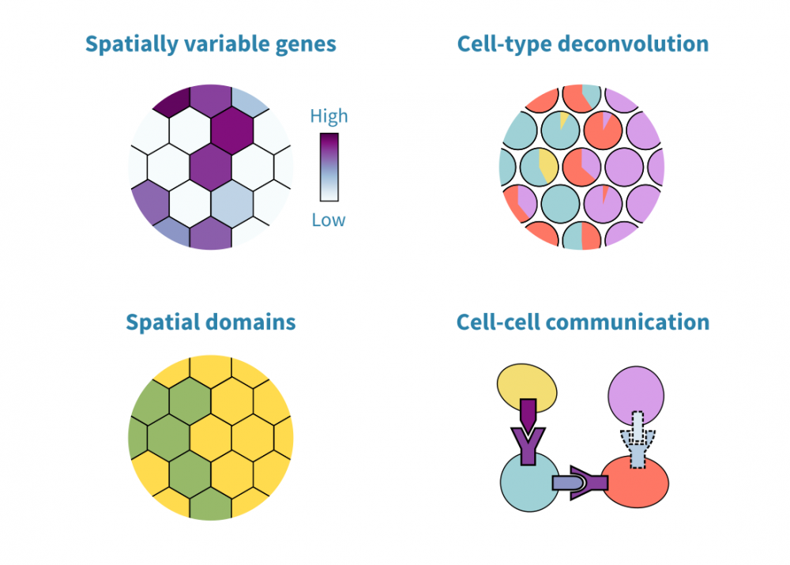
Spatial transcriptomics data analysis
Spatial deconvolution
Spatial clustering (niches, microenvironments)
Spatial driven cell-cell communication
and etc…
https://geneviatechnologies.com/bioinformatics-analyses/spatial-transcriptomic-data-analysis/

Slide 13
Script Demonstration
GitHub repository link
https://github.com/s-lenz/spatial_transcriptomics_hcc

