Slide 1
Latent-GEPA: Accelerating Prompt Optimization via Embedding Inversion and Latent Semantic Guidance in Large Language Models
Bachelor Thesis in Data Intensive Applications
Candidate: Simone Mazzacano
Supervisor: Prof. Gianluca Moro
Co-supervisors: Dr. Lorenzo Molfetta, Dr. Stefano Fantazzini, Dr. Giacomo Frisoni
Computer Science and Engineering | Academic Year 2025-2026 | First Session

Slide 2
Why Latent Text Needs Semantic Checks
Problem
Large Language Model (LLM)
latent states can be decoded
into readable text
Why it matters
Fluent reconstructions
can lose negation or
commonsense meaning
New in this thesis
Semantic-Fidelity Corpus
Latent-GEPA tests
soft-prompt diagnostic
Roadmap
Semantic stress tests
-> feedback loop
-> matched evidence
Concrete semantic-drift example
The ice does not melt under the sun
The ice melts under the sun
Lexically close
Negation removed
Surface overlap is not semantic fidelity
Test meaning first; then test whether latent evidence improves judge-prompt search
Simone Mazzacano | Latent-GEPA
Bachelor Thesis Defense
2

Slide 3
From Readouts to Prompt Optimization
Task
example
Base judge
fixed weights
Score +
error
Feedback
record
Proposer
rewrites prompt
New judge
prompt
LLM-as-a-judge
The model scores generated text against a rubric
Quality is measured by agreement with human judgments
The evaluated judge remains fixed during prompt search
Latent-GEPA idea
GEPA: reflective prompt search
Search space: natural-language prompts
Latent signals are attached to reflection feedback
The proposer receives richer evidence for prompt revision
Key terms: Base judge | Proposer | Feedback | Held-out evaluation
GEPA: Agrawal et al., 2025
G-EVAL: Liu et al., 2023
Simone Mazzacano | Latent-GEPA
Bachelor Thesis Defense
3

Slide 4
Thesis Contributions
RQ1
Semantic fidelity
RQ2
Latent feedback
RQ3
Soft prompts
New controlled corpus for fragile meaning
GEPA feedback enriched with PPL and activation text
Continuous-prompt readout tests semantic transparency
Corpus validated
PPL helps most clearly
Useful but opaque
The contributions connect the corpus, the feedback loop, and the final claim boundaries
Simone Mazzacano | Latent-GEPA
Bachelor Thesis Defense
4

Slide 5
Semantic-Fidelity Corpus
A new 2080-row surface: 1060 examples or contrastive pairs built around meaning-changing contrasts
Block A
Block B
Block C
40 rows
Standard controls
720 rows
Negation and polarity
1320 rows
Commonsense stress
Ordinary short sentences
Positive/negative pairs
Plausible vs counterfactual pairs
A example
The meeting starts
at nine in the morning
B contrast
The church is empty of song
-> filled with song
C contrast
when it rains humidity forms
-> when it is hot humidity forms
Stable metadata joins inversion, activation verbalization, and scoring outputs
Simone Mazzacano | Latent-GEPA
Bachelor Thesis Defense
5

Slide 6
Latent-GEPA Feedback Loop
Seed
prompt
Task
examples
Base judge
evaluation
Reflection
feedback
Proposer
candidate prompts
Validation
frontier
Latent feedback attached to reflection data
Perplexity (PPL): response surprisal
Natural Language Activations (NLA): activation text
Metric
PPL
NLA
Optional aux compression
Final held-out evaluation is run only after validation-time prompt selection
NLA: Fraser-Taliente et al., 2026
Simone Mazzacano | Latent-GEPA
Bachelor Thesis Defense
6

Slide 7
What Feedback Was Tested
Metric feedback
Target, prediction, and error summary
Metric + PPL
Adds response-only perplexity from the base judge
Metric + PPL + raw NLA
Adds verbalizations from selected token positions
Metric + PPL + schema-fixed NLA
Cleaner metadata and token status; verbalizer not retrained
Main evaluation task
Topical-Chat / USR engagingness
Human agreement metrics on held-out rows
Model roles
Qwen2.5-7B judge/PPL model; layer-20 verbalizer
Qwen35B proposer; final scores from 7B judge
Simone Mazzacano | Latent-GEPA
Bachelor Thesis Defense
7

Slide 8
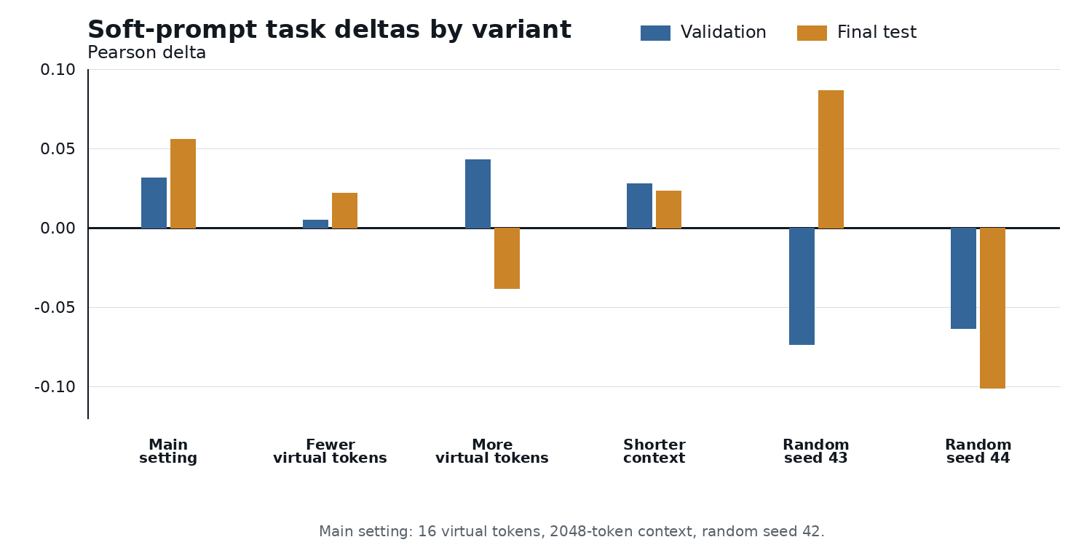
Useful Does Not Mean Interpretable
Discrete tokens
SIPIT exact recovery
100/100 GPT-2; 40/40 logical
Embedding inversion
Full-mask probes weak
Tiny overfit positive control
Soft prompts
Task-active runs exist
Exact readout still false
Relabeled source
soft_prompt_deltas.pdf
The positive soft-prompt deltas do not make the learned vectors semantically transparent
Boundary: usefulness and interpretability are separate claims
SIPIT: Nikolaou et al., 2025
Simone Mazzacano | Latent-GEPA
Bachelor Thesis Defense
8

Slide 9
Perplexity Helps Most Clearly
Pearson
0.5518 -> 0.6328
Spearman
0.5478 -> 0.6199
Agreement
0.7611 -> 0.7889
MAE
0.4778 -> 0.4222
PPL long run on Topical-Chat / USR engagingness
Baseline prompt -> optimized prompt
All reported metrics move in the favorable direction
Model-confidence feedback can help GEPA sharpen a judge prompt
Selected prompt emphasizes specificity, conversational momentum, meaningful follow-up, and concrete detail
Simone Mazzacano | Latent-GEPA
Bachelor Thesis Defense
9

Slide 10
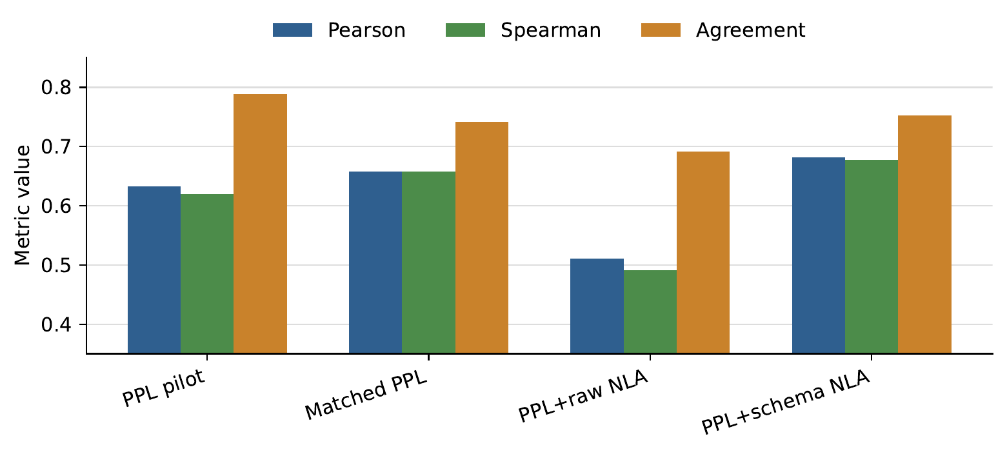
NLA Is Diagnostic, Not Yet Conclusive
Matched long-run evidence
Raw NLA underperformed
matched PPL-only
Schema-fixed NLA:
small upward movement
Selected prompt
stayed unchanged
Raw NLA
Pearson 0.5111, MAE 0.6167
Schema-fixed
Pearson 0.6812, MAE 0.4944
2/60 final-test
predictions changed
Conclusion: NLA is diagnostic evidence, but not yet a robust prompt-improvement signal
Simone Mazzacano | Latent-GEPA
Bachelor Thesis Defense
10

Slide 11
Conclusions and Future Work
What the thesis established
What remains open
Controlled corpus for semantic drift
NLA token/layer selection, deduplication, compression
Discrete recovery vs soft-prompt opacity
Target-score probabilities beyond PPL
Matched Latent-GEPA feedback tests
Matched SummEval and QAGS matrix
Clearest positive evidence: PPL feedback
Stronger continuous-prompt readout controls
Latent evidence is useful, but its interface to prompt optimization must be designed and validated carefully
Simone Mazzacano | Latent-GEPA
Bachelor Thesis Defense
11

