Slide 1
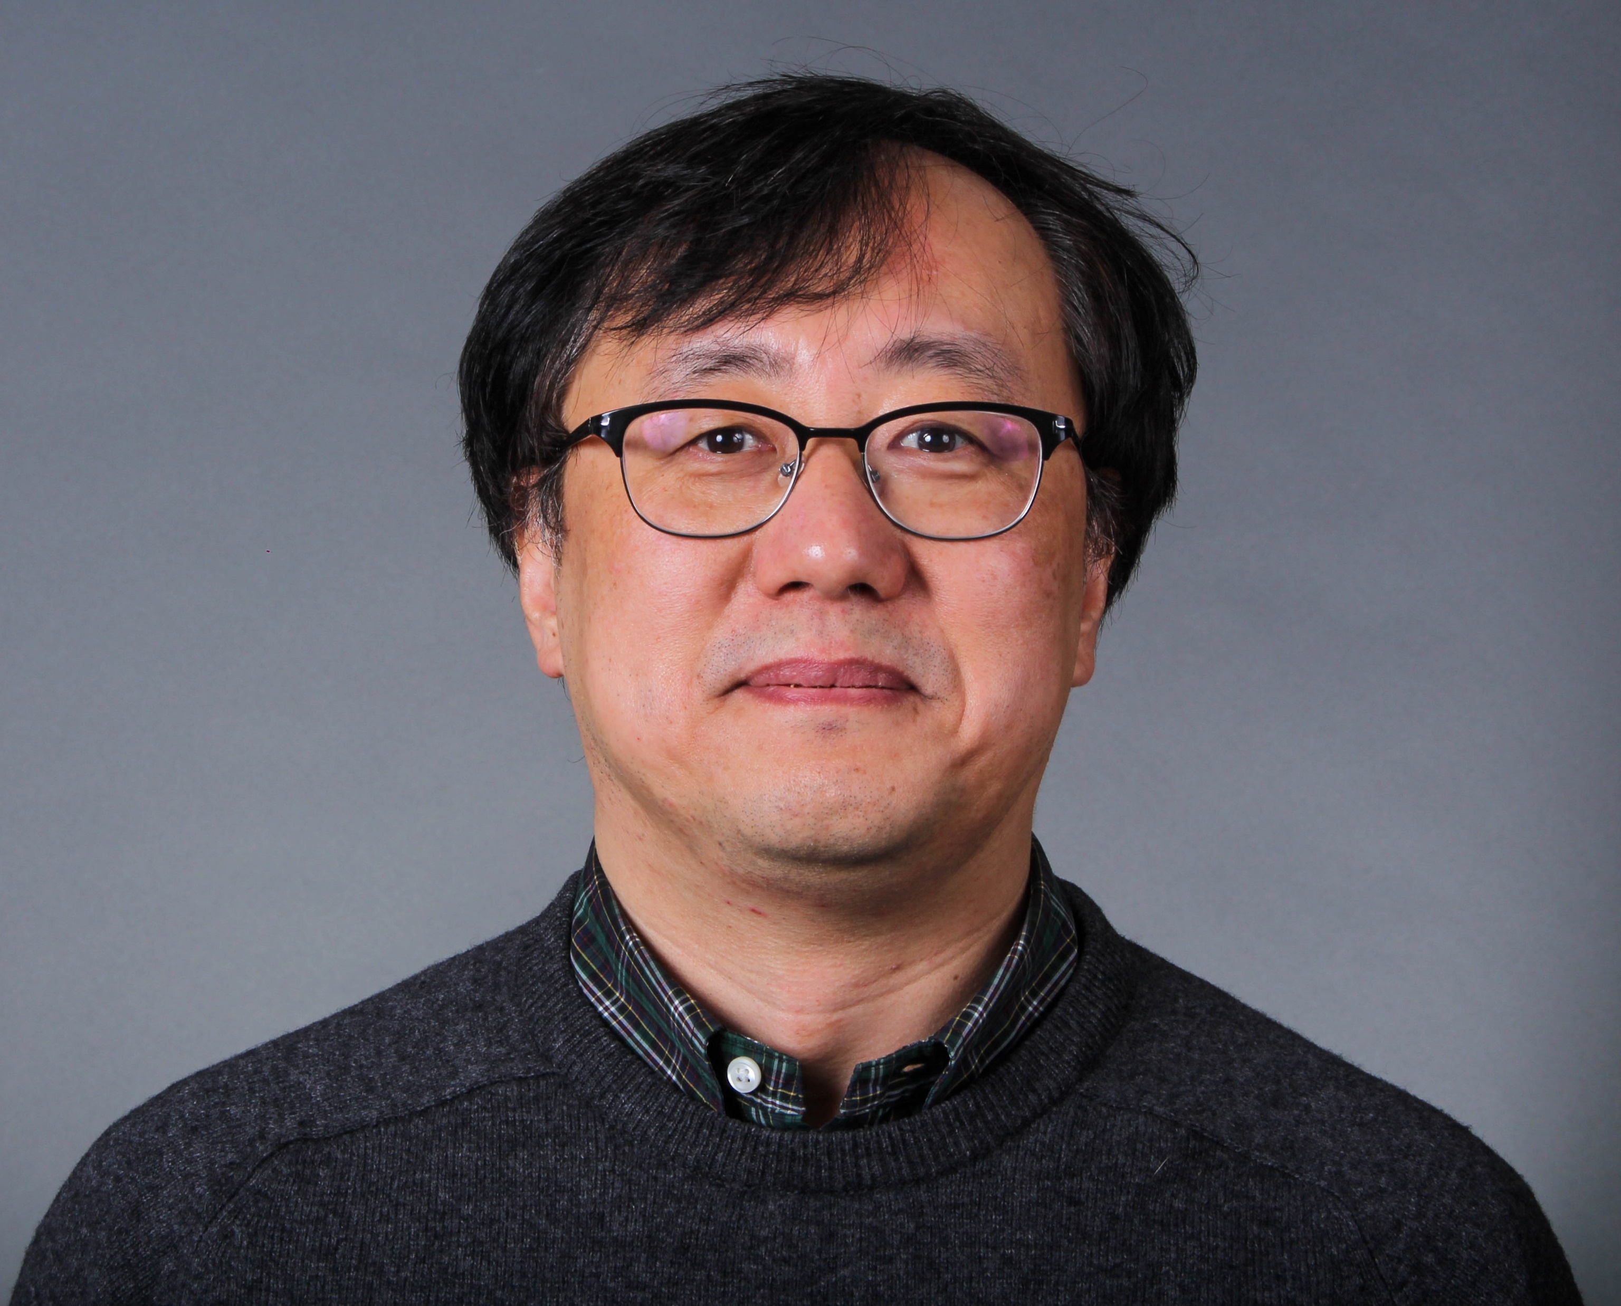
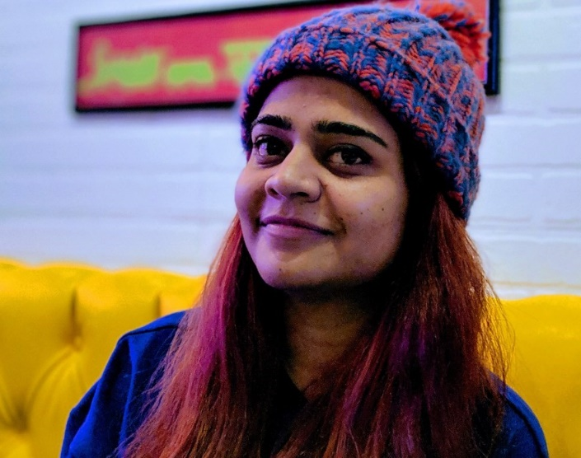
Image Filtering and Hybrid Images
Dr. Gunho Sohn
Course Director
Maryam Jameela
Teaching Assistant
gunho.sohn@gmail.com
maryumja@yorku.ca
ESSE 4690 Lab 01
21st Sep 2021

Slide 2
Zoom Links
Lab @ Every Thursday at 8:30 Join Zoom Meeting https://yorku.zoom.us/j/96152333203?pwd=U2lOaEtTV1BRNmxtV0NtTzkwM2h5UT09 Meeting ID: 961 5233 3203 Passcode: 574885
Maryam Jameela’s Office Hours @ Every Monday at 1:00pm Join Zoom Meeting
https://yorku.zoom.us/j/98880571601?pwd=R2FDN3g1NVU1cGdrQzZFaGt2a0ZWUT09 Meeting ID: 988 8057 1601 Passcode: 416282

Slide 3
Submission
Code with descriptions
Result images
Report (max 10-12 pages)
Implementation procedure (be simple)
Result (images with titles and descriptions)
Discussion (major part)
No code in Report
Submit Code, Report and Results in Separate folders and Zip them Together
Upload them via Moodle: Due 11:59pm, Sep 30th , 2021
Hints: Read the Lab1 introduction in detail
or email TA via maryumja@yorku.ca if you have more questions

Slide 4
Objective
Image filtering algorithm
Hybrid image creation
Understanding low and high frequencies of the image
MATLAB for image processing

Slide 5
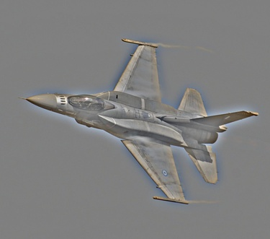
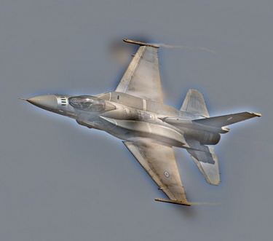
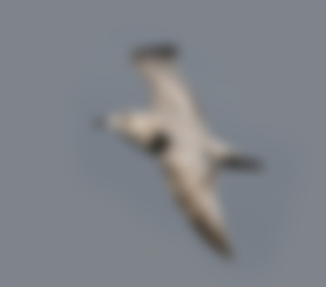
Hybrid Image
High Frequency
Low Frequency
Hybrid Image

Slide 6
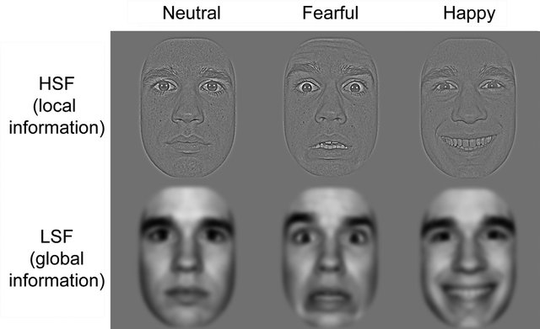
Components of Hybrid Image
High Frequency: “High spatial frequencies which are conveyed more slowly by parvocellular pathways and provide finer information.” [1]
Low Frequency: “Low spatial frequencies (LSF), containing the coarse information on a visual stimulus, are rapidly conveyed by magnocellular pathways.” [1]
[1] Louise Kauffmann, Alan Chauvin, Nathalie Guyader, and Carole Peyrin, Rapid scene categorization: Role of spatial frequency order, accumulation mode and luminance contrast, Vision Research Volume 107, February 2015, Pages 49-57
[2] N.M.Munsters,H.van Ravenswaaij, C.van den Boomen, and C.Kemner, Test-retest reliability of infant event related potentials evoked by faces, Neuropsychologia Volume 126, 18 March 2019, Pages 20-26

Slide 7
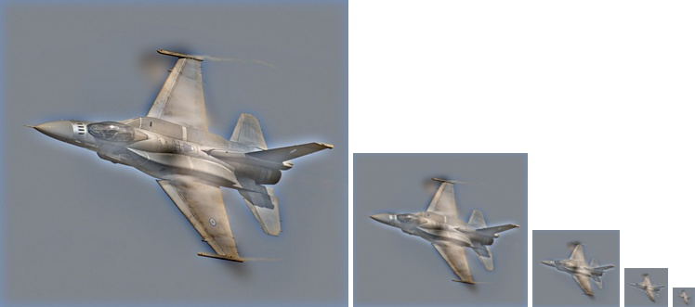
Multi-resolution Hybrid Images

Slide 8
Procedure
High=Image-Low
Input Image
High
Frequencies
My_imfilter()
Convolution
Hybrid Image
fspecial()
Filter
Generation
Low
Frequencies
Test_filtering.m
vis_hybrid_image()
Filter Function
Testing
Visualization &
Output

Slide 9
Why Convolution
Mathematical technique to combine two signals to form another.
The convolution uses the data as input signal along filter or kernel to then produce an output signal called feature map.
These feature maps are an example of human vision and our process of seeing things and extracting information to make vision decision.
Convolutions are simple operations introduced to mimic human vision in computers which only sees numbers [0,1]

Slide 10
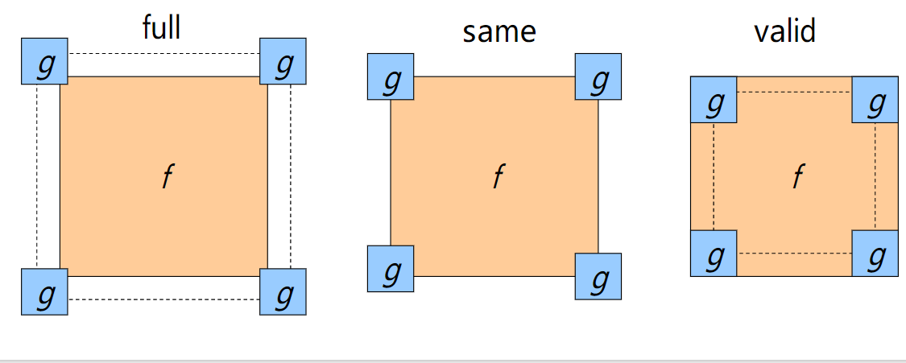
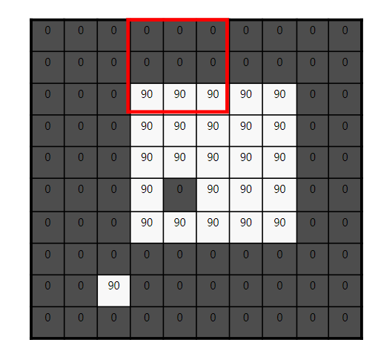
Convolution
Padding
Padarray()
Forbidden functions : imfilter(), filter2(), conv2(), nlfilter(), colfilt()

Slide 11
Convolution
2. Convolution on one pixel

Slide 12
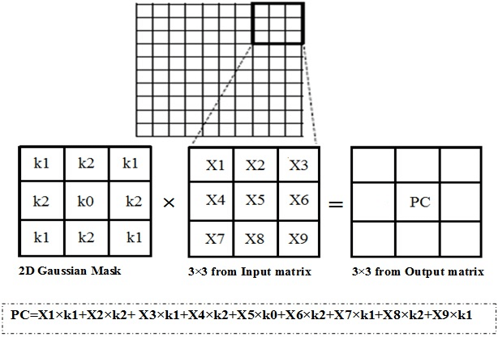
Convolution
3. Loop through the whole image

Slide 13
Requirements of Convolution Procedure
Support grayscale and color images;
Support arbitrary shaped filters as long as both dimensions are odd (e.g. 7x9 filters but not 4x5 filters);
Pad the input image with zeros or reflected image content;
Return a filtered image which is the same resolution as the input image.

Slide 14
Marks Breakdown
+50 pts: Working implementation of image filtering in my_imfilter.m +30 pts: Working hybrid image generation +20 pts: Writeup with several examples of hybrid images +10 pts: Extra credit (up to ten points) -5*n pts: Lose 5 points for every time you do not follow the instructions for the hand in format -5*n pts: Lose 5 points for every day you delay the submission of your report and codes beyond the due date.

Slide 15
Bonus Points
Discussion on the choice of the cutoff frequency value
Your understanding on the high and low frequencies
Your implementation of the generation of Gaussian Filter or other filters
Your own images for testing (Align them firstly)

Slide 16
Bonus Points
Discussion on the choice of the cutoff frequency value
Your understanding on the high and low frequencies
Your implementation of the generation of Gaussian Filter or other filters
Your own images for testing (Align them firstly)

Slide 17
Data & Codes
Log onto eClass (https://eclass.yorku.ca/)
Choose the course 4690
Click into linear filter and find the lab part

