Slide 1
RSM WORKSHOP 2012
Multi-tasking & Threading
Henry.Juang@gmail.com

Slide 2
Contents for course 10
Code optimization concepts
Vectorization concerns
Threading techniques: OpenMP
MPI interface
Halo-type MPI: data exchange
Regrouping MPI without halo
One-dimensional decomposition
Two-dimensional decomposition
Hybrid approach: combining vector OpenMP & MPI
Load-balanced consideration in decomposition

Slide 3
Massively Parallel Computing
Parallel computing evolving
Multi-tasking
Multi-nodes
Multi-nodes and multi-tasking
Parallel programming
Multi-tasking in do-loop by threading such as OpenMP
Multi-nodes or multi-cpu by domain/data decomposition such as MPI or MPICH

Slide 4
Design Concept
Grid point model (non-Galerkin)
Tilt
horizontal
2D decomposition with halo
Spectral model
Galerkin method requires total domain integral
Decomposition with transposition
no halo is required

Slide 6
Basic computation structure in RSM & MSM
Compute linear dynamics such as semi-implicit time integration, time filter, and horizontal gradients of variables
Spectral space
Transformation using FFT algorithm
Compute nonlinear dynamics and model physics
Grid-point space

Slide 7
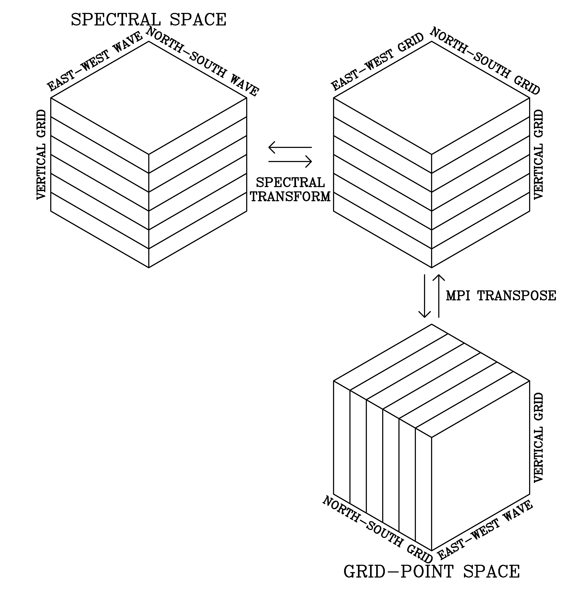
1D decomposition for parallel computing using MPI (old RSM-MPI)

Slide 8
MPI routine for transpose
P0
P1
P2
P3
P0
A0 | A1 | A2 | A3
B0 | B1 | B2 | B3
C0 | C1 | C2 | C3
D0 | D1 | D2 | D3
A0 | A1 | A2 | A3
B0 | B1 | B2 | B3
C0 | C1 | C2 | C3
D0 | D1 | D2 | D3
P1
MPI_ALLTOALL
P2
P3

Slide 9
Limitation of the old RSM-MPI code using 1D decomposition
Number of working processors is limited by the vertical grid points which are usually much smaller than horizontal grid points in NWP models
Difficulty in high-resolution run with larger dimension (larger dimension for the single processor run + additional dimension for parallel run)

Slide 10
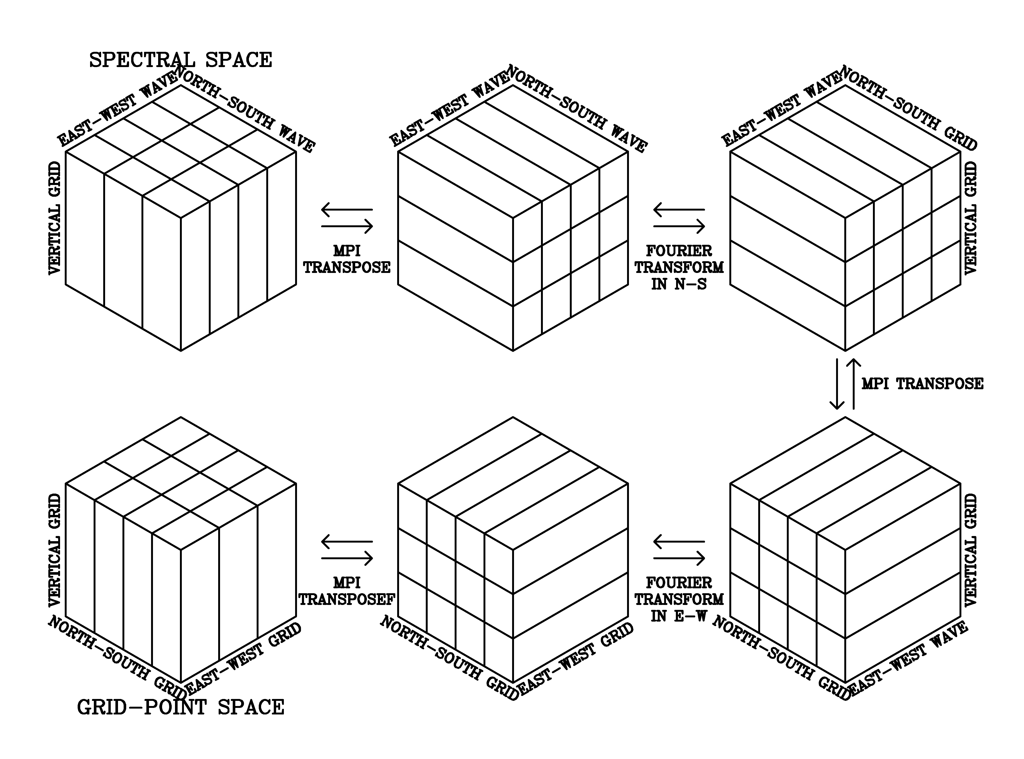
2D decomposition for fully parallel computing in the new RSM-MPI

Slide 11
Features of the RSM/MSM code using 2D decomposition MPI
Can use much more processors than the old one using 1D decomposition (e.g., for [x,y,z]=[64,64,28], maximum possible working processors are 28 for the old code 1D but 64x28 for the new one 2D)
Designed variables in each processor to have only partial dimension (except in I/O routines) and thus, the memory usage substantially decreases with increasing working processors
Subroutines interpolating from the global fields to regional domain were also parallelized

Slide 12
Theoretical maximum speedup
Assuming that the time spent in communication is negligible,
n: number of working processors
s: time spent by the sequential portion of the code
p: time spent by the parallel portion of the code

Slide 17
Wrap up
RSM/MSM is very suitable for up-to-dated massively multitasking multiple parallel computing, totally different from grid point models
The MPI is used for MPP and OpenMP is used for theads. 2D with 1D option MPI, +OpenMP => 3D
Decomposition with transposition in subgroup as 2D MPI, can be used with several hundreds, thousands tasks.
No halo is used, thus the more the decomposition, the less the memory used per task.
Since no halo, the total data in MPI transpose never increasing while decomposition increase

