Slide 1
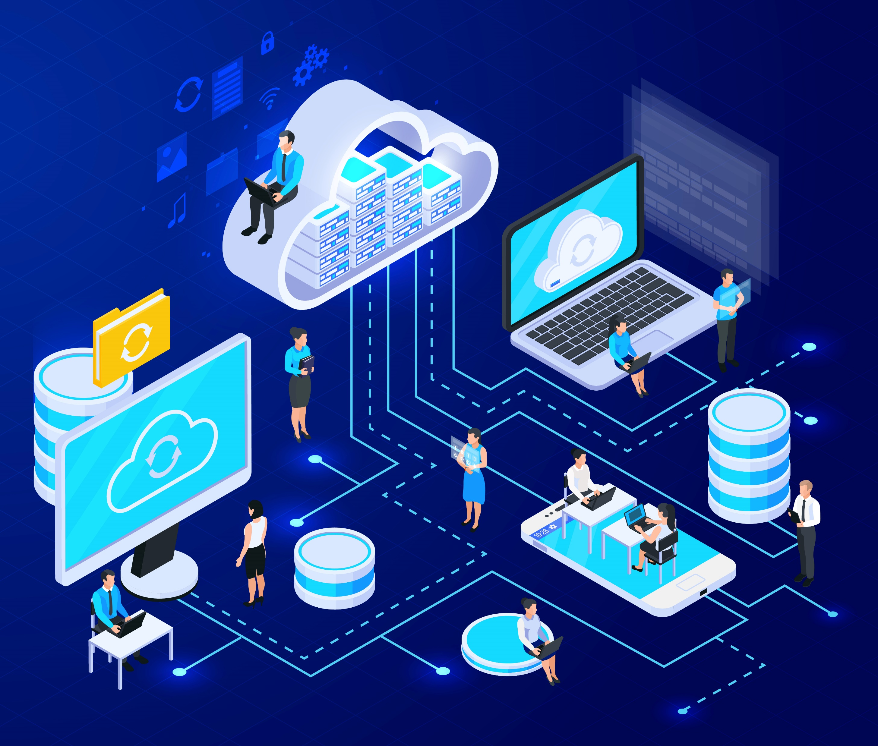
Cloud Computing
Rajarajeshwari S
Nandhini C S M

Slide 2

Introduction
What is Cloud Computing ?
A model for enabling convenient, on-demand network access to a shared pool of configurable computing resources
Computing Resources
Applications
Servers
Data storage
Development tools
Networking capabilities

Slide 3


Why Choose Cloud Computing?
Scalability
Data Recovery
Data Security
Maintenance
Data Accessibility

Slide 4





Drawbacks of On-Premise Computing
Requires an extra IT support
Require a greater capital investment
Adherence to industry compliance
Increase the risk of data loss
Increase maintenance costs
Limits company’s ability to scale

Slide 5
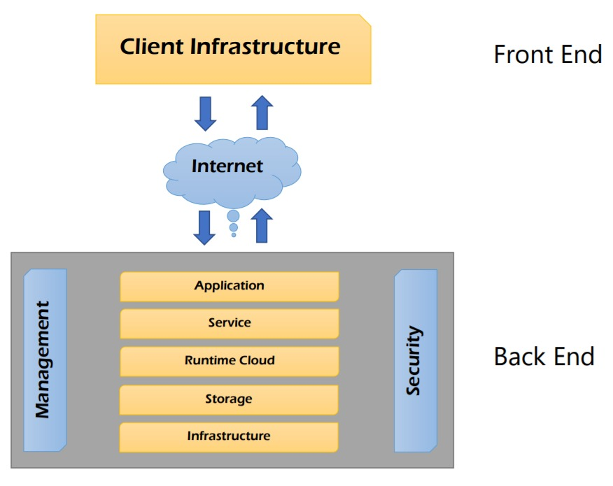
Architecture

Slide 6

Public
Cloud Infrastructure is available to public over the internet
Owned by cloud service providers
Deployment Model
Private
Cloud Infrastructure is operated by a single organization
Managed by organization or third party
Community
Cloud Infrastructure is mutually shared between organizations that belong to a particular community
Managed internally or by third party
Hybrid
Combination of functionalities of public and private cloud

Slide 7
01
Infrastructure as a
Service
Changing its Hardware Infrastructure on Demand
Access to fundamental resources such as network, storage, and servers
Amazon web service, Google cloud platform
Service Model
02
Platform
as a
Service
Providing a Flexible Environment for Software Applications
Outsourcing of Hardware Infrastructure as well Software Environment
AWS Lambda, Morpheus
03
Software
as a
Service
Releasing the User experience of Management constraints
Services can be availed over the internet and requires no prior installation
Google apps, Salesforce

Slide 8
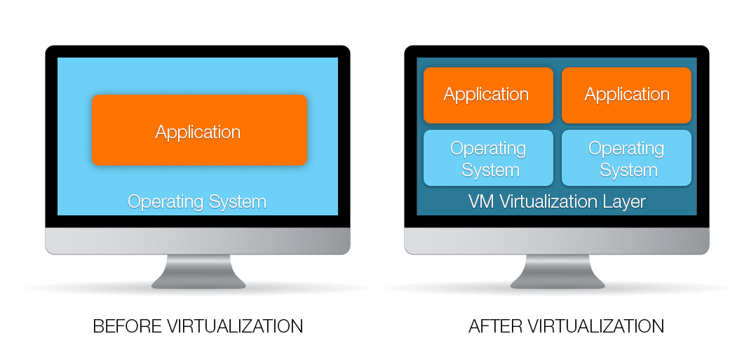
Virtualization
Virtualization:
The ability to run multiple operating systems on a single physical system and share the underlying hardware resources
Virtualization Machine:
A program that allows multiple operating systems to share a single hardware host

Slide 9
Virtualization in Cloud Computing
Resources are rented as needed from a Cloud
Choose the OS and Software
Possible to instantiate multiple Virtual Servers
Not necessary to own the Hardware
The chosen OS will run on a large Server Farm
Various providers allow creating Virtual Servers

Slide 10
PROS
Accessibility and pay per use
Data backup & recovery
Reliability
Huge cloud storage
No hardware required
Automatic software updates

Slide 11
Conclusion
One can
Innovate ways to
Grow and Accomplish when Adopting to
Cloud Infrastructure
as the Key Benefits is Enormous
Future of
Cloud Computing
will be at the Forefront
of all Technologies to
solve major
Business Challenges
with lot more features
THINK SMART!
GO CLOUD

Slide 12

THANK YOU !

