Slide 1

Wireless Technology
Rajarajeshwari S

Slide 2
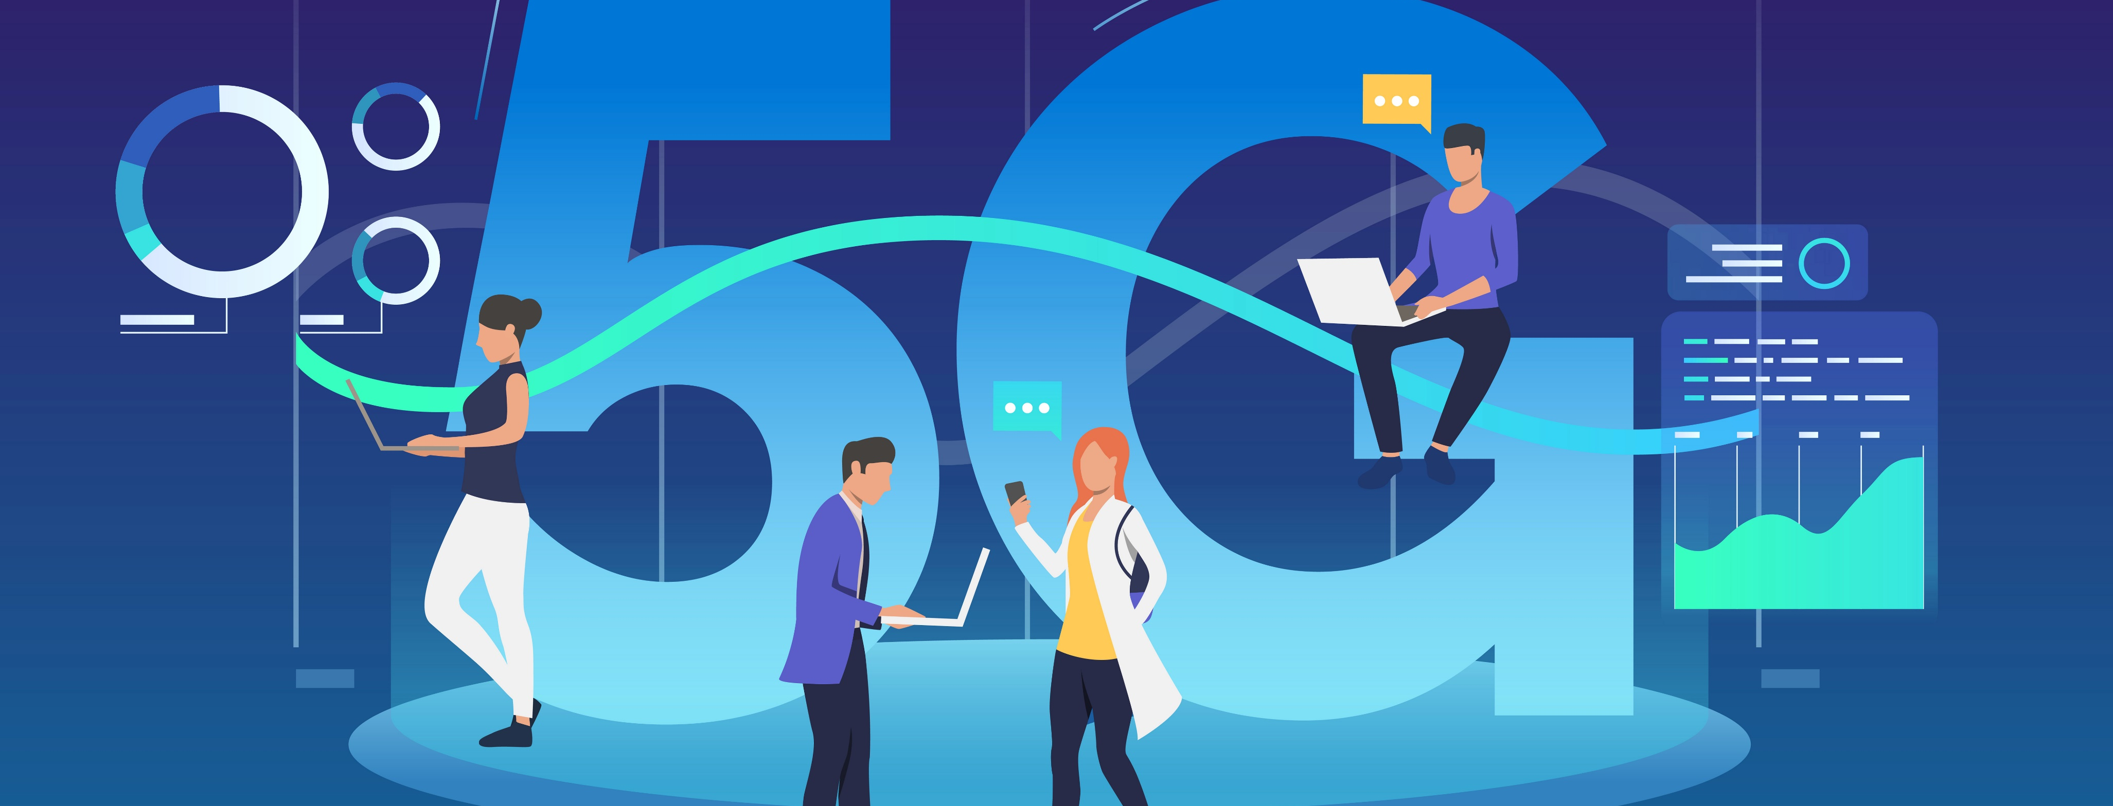
Introduction
5G is the fifth generation of wireless data networks
Abilities
High Bandwidth
Low Latency
Dense Connections

Slide 3
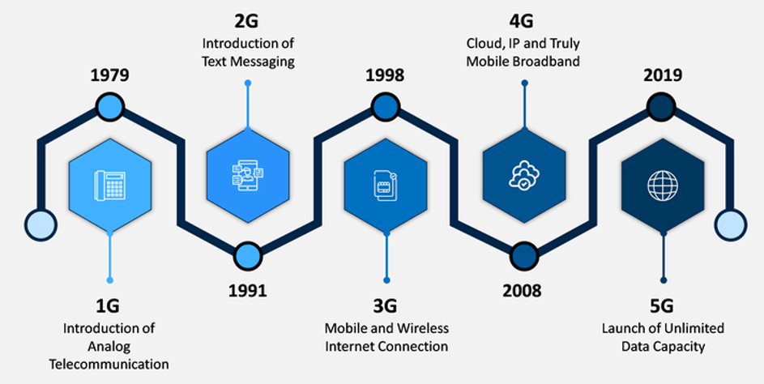
The Evolution of 5G

Slide 4

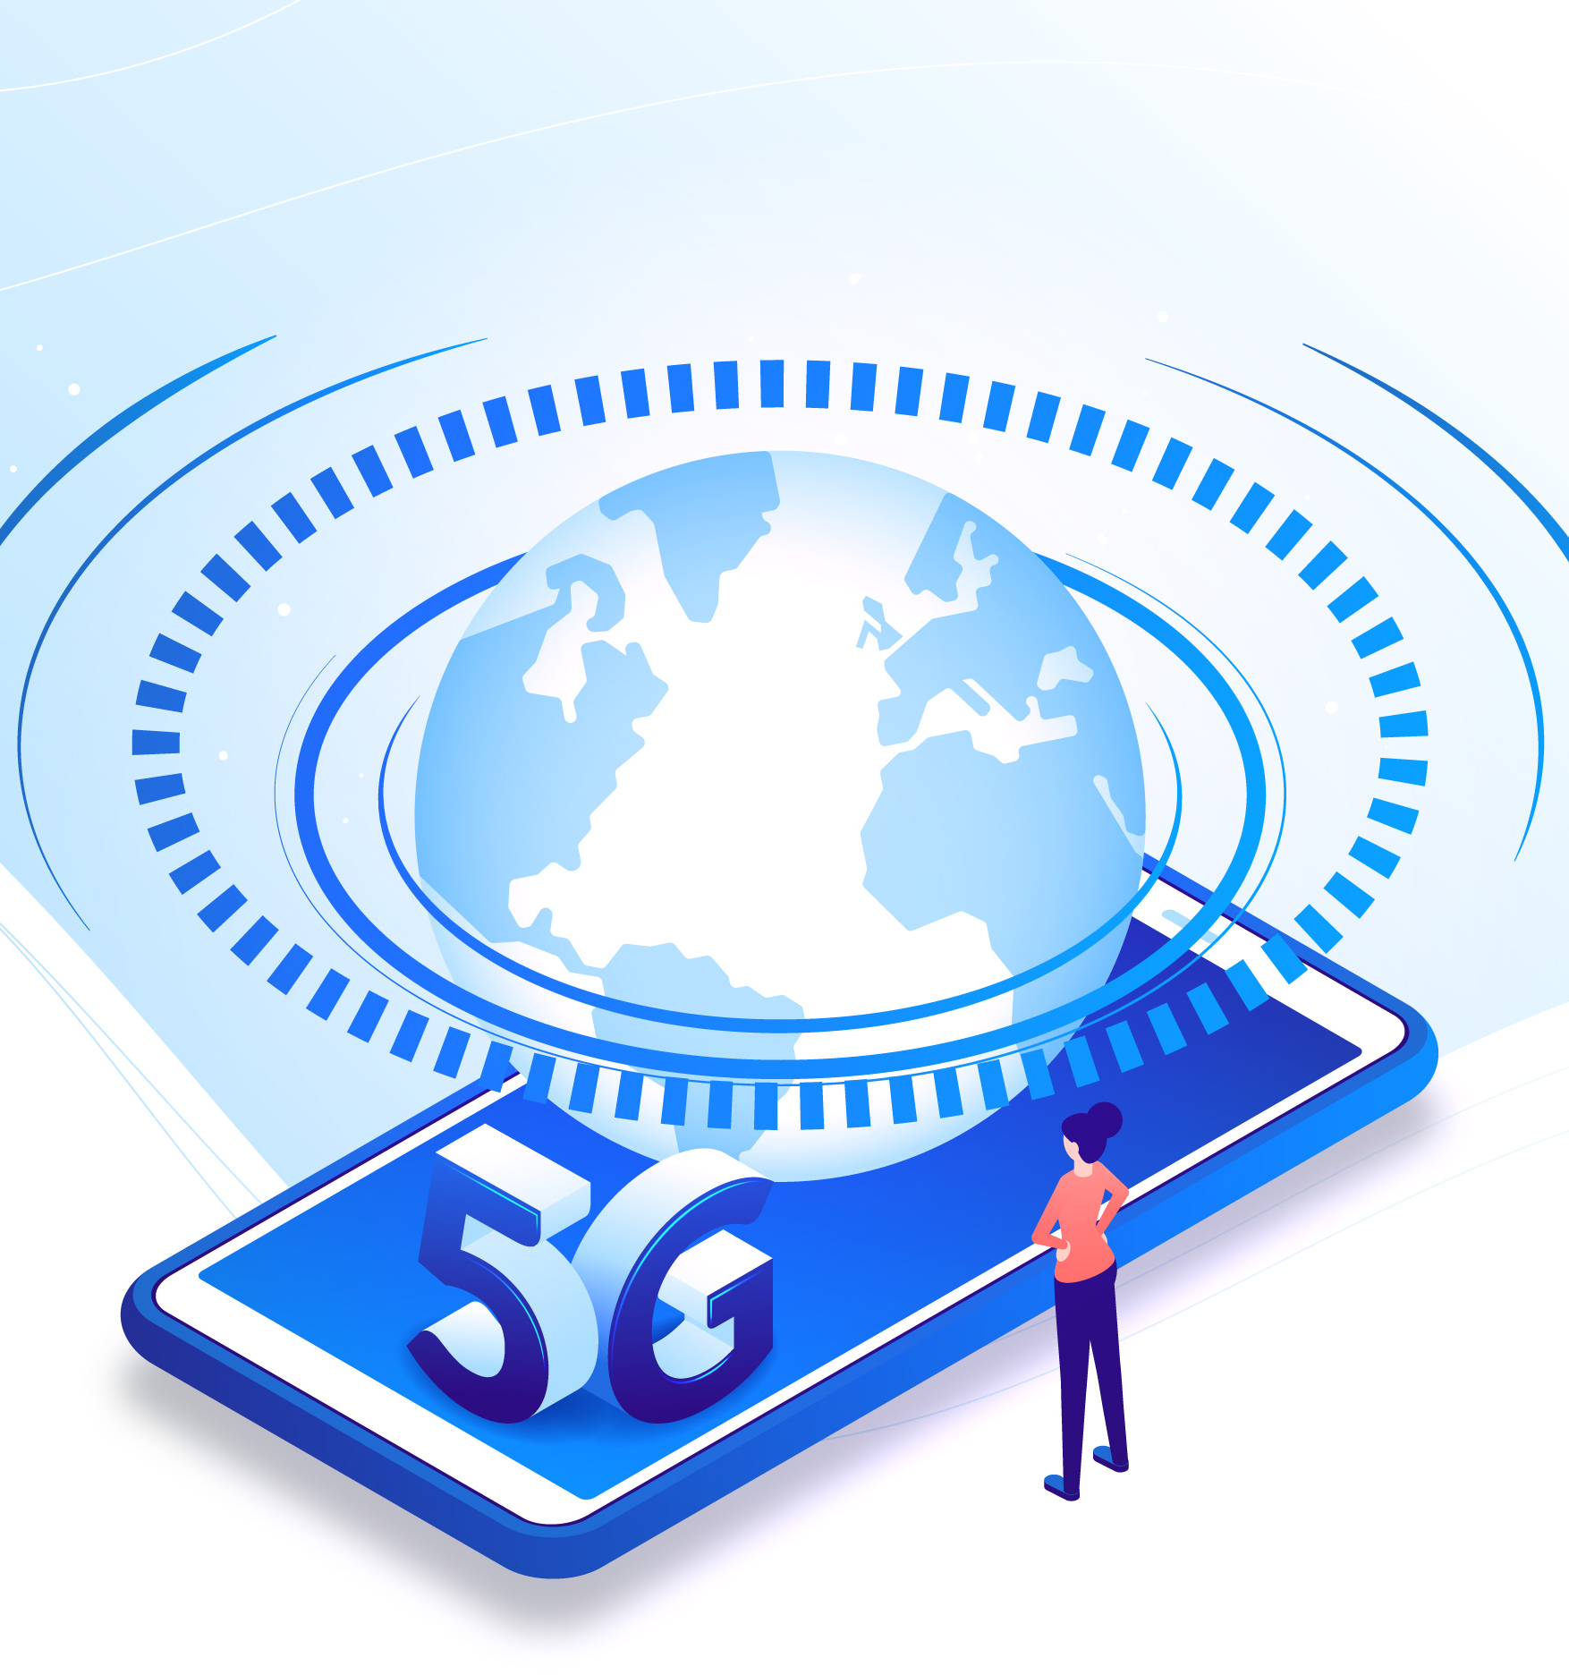
5G - Hardware & Software
Ultra Wide Band Networks
Unified of different wireless networks
Smart Antenna
5G
Software
Software Defined
5G Hardware
Radio
Encryption
Anti-virus
Code Division Multiple Access

Slide 5
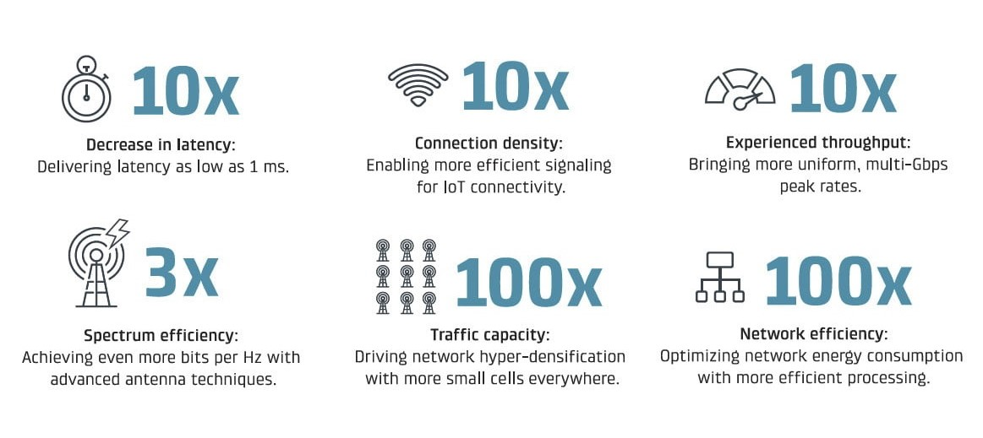
Features

Slide 6
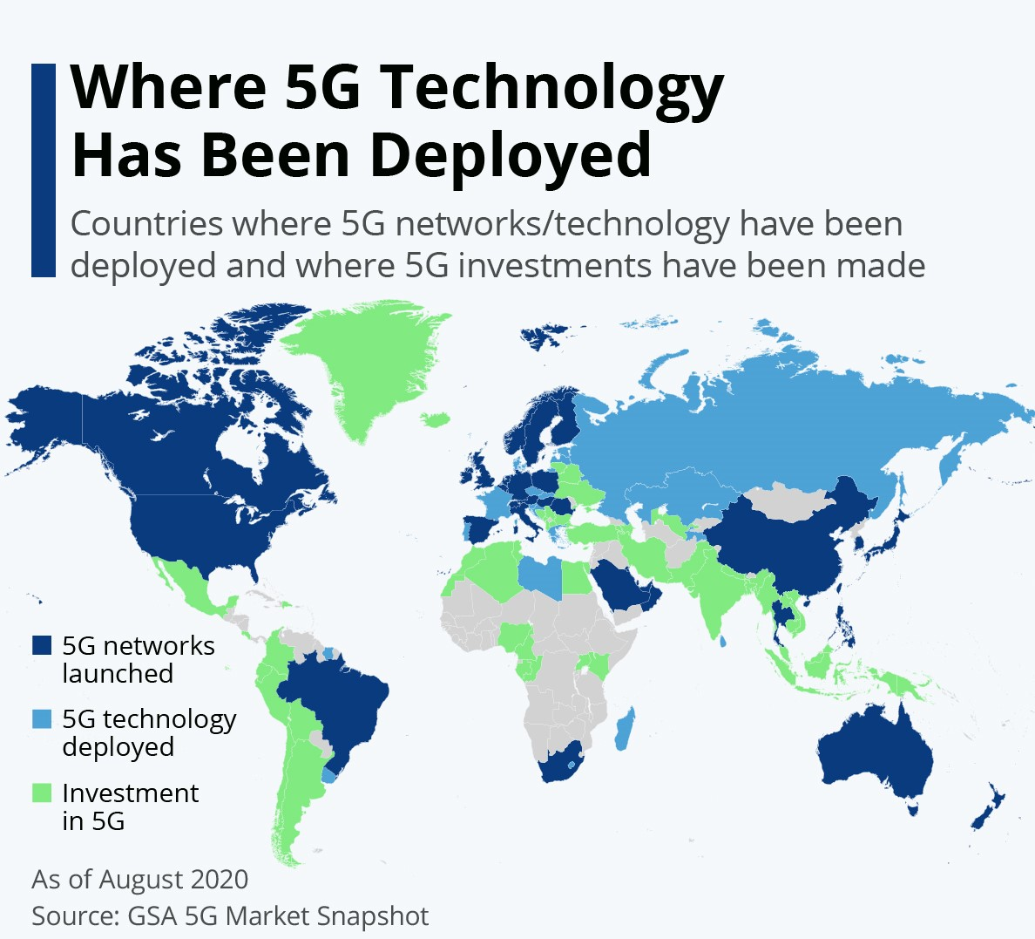

Slide 7




5G Plans in India
Jio
Announced to launch 5G in the second half of 2021
Powered by developed Hardware and Technology
Vi
Plans to launch 5G shortly
The company has upgraded its 4G network with 5G architecture
Airtel
Airtel is 5G-ready but yet to reveal its plans
Demonstrated 5g services in the city of Hyderabad
BSNL
BSNL announced its plan to build a 5G corridor in Delhi in 2019
However, there hasn’t been any update since then

Slide 8


Pros
Faster Data Speeds
High Quality
Massive Network Capacity
More Reliable
High Performance

Slide 9



CONCLUSION
5G Wireless Technology will interconnect the entire world without limits.
We would have uninterrupted access to information, communication and entertainment!
It will open a new dimension to our lives and change our lifestyle meaningfully

Slide 10


