Slide 1
Convolution Neural Network

Slide 2
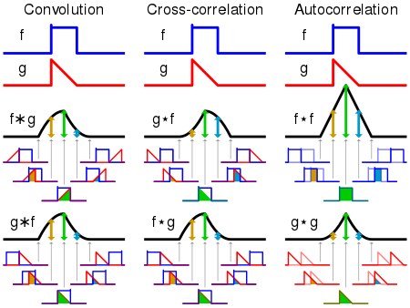
What is a convolution ?
In mathematics convolution is a mathematical operation on two functions (f and g) to produce a third function.
The convolution of f and g is written f∗g, using an asterisk or star.

Slide 3
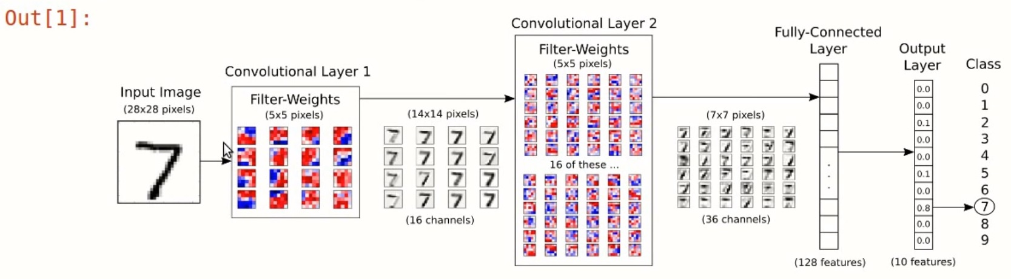
Convolution Neural Network

Slide 4
