Slide 1
…
False positive
…
Background class
True positive

Slide 2
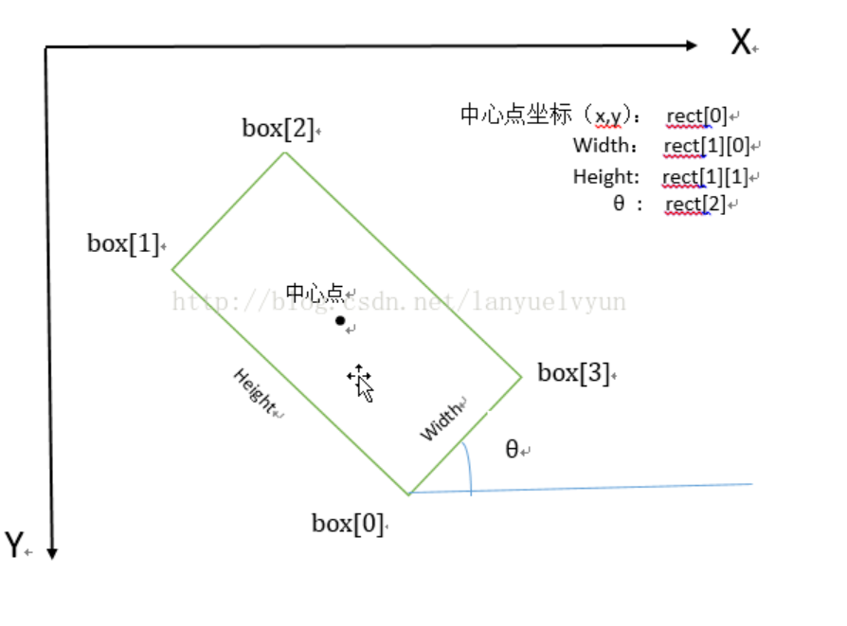
Oriented bounding boxes
# Define the four corners relative to the box center as if rectangle was not rotate
half_w=w/2
half_h=h/2
# The four corners before rotation.
corners=[[half_w, half_h],
[-half_w, half_h],
[-half_w,-half_h],
[half_w,-half_h]]
rotated_box=[]
for x,y in corners:
# Apply the 2D rotation matrix
# x'=x*cos(theta)-y*sin(theta)
# y'=x*sin(theta)+y*cos(theta)
x_rot=x*cos_theta-y*sin_theta
y_rot=x*sin_theta+y*cos_theta
# Translate back to the actual center
rotated_box.append([x_rot+xc, y_rot+yc])
(w/2,-h/2)
(-w/2,-h/2)
(xc,yc)
(w/2,h/2)
(-w/2,h/2)
(w/2 cos+h/2 sin,
w/2 sin - h/2 cos) +(xc, yc) --pt2
2D Rotation matrix
[cos -sin]
[sin cos]
(-w/2 cos+h/2 sin,
-w/2 sin-h/2 cos) +(xc,yc)-- pt3
(xc,yc)
(w/2 cos-h/2 sin,
w/2 sin+ h/2 cos) + (xc,yc) -- pt1
(-w/2 cos-h/2 sin,
-w/2 sin+h/2 cos) +(xc,yc) --pt4
Open CV : Determine angle of RotatedRect / minAreaRect | Namkeen Man's Blog
cv2.minAreaRect() | TheAILearner

