Slide 1
Feature Pyramid Network
Layers/Levels
Interpolate (if feature size does not match, e.g., nearest)
C4
P4
4
inner
layer
Output #4
C3
P3
3
inner
layer
Output #3
C2
P2
2
inner
layer
Output #2
C1
P1
1
inner
layer
Output #1
Image
T. Lin, et al. Feature Pyramid Networks for Object Detection, arXiv:1612.03144 , 2017
vision/torchvision/ops/feature_pyramid_network.py at main · pytorch/vision

Slide 2
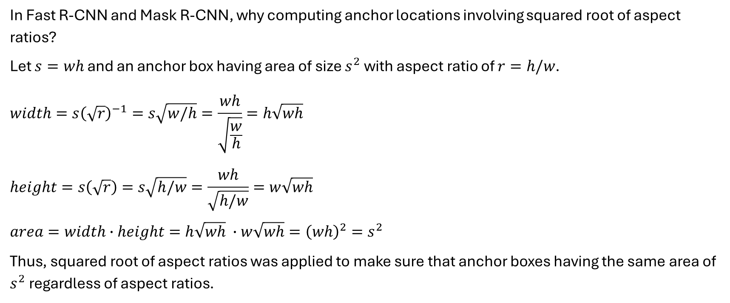
Anchor Box Calculation
In Fast R-CNN and Mask R-CNN, why computing anchor locations involving squared root of aspect ratios?
Let $s=wh$ and an anchor box having area of size $s^{2}$ with aspect ratio of $r=h/w$.
$$width=s{\left(\sqrt{r}\right)}^{−1}=s\sqrt{w/h}=\frac{wh}{\sqrt{\frac{w}{h}}}=h\sqrt{wh}$$
$$height=s\left(\sqrt{r}\right)=s\sqrt{h/w}=\frac{wh}{\sqrt{h/w}}=w\sqrt{wh}$$
$$area=width∙height=h\sqrt{wh} ∙w\sqrt{wh}={\left(wh\right)}^{2}=s^{2}$$
Thus, squared root of aspect ratios was applied to make sure that anchor boxes having the same area of $s^{2}$ regardless of aspect ratios.

Slide 3
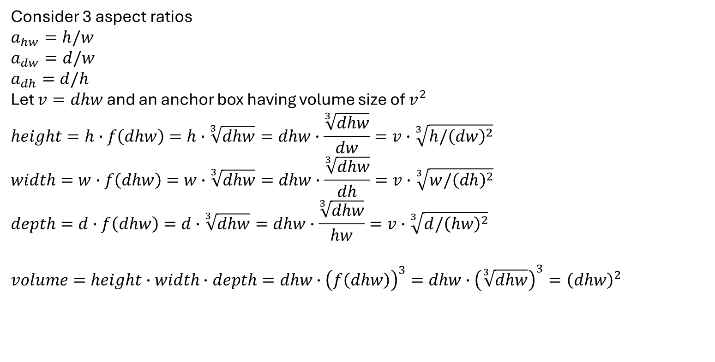
Anchor Box Calculation for 3D
Consider 3 aspect ratios
$$a_{hw}=h/w$$
$$a_{dw}=d/w$$
$$a_{dh}=d/h$$
Let $v=dhw$ and an anchor box having volume size of $v^{2}$
$$height=h∙f\left(dhw\right)=h∙\sqrt[3]{dhw}=dhw∙\frac{\sqrt[3]{dhw}}{dw}=v∙\sqrt[3]{h/{\left(dw\right)}^{2}}$$
$$width=w∙f\left(dhw\right)=w∙\sqrt[3]{dhw}=dhw∙\frac{\sqrt[3]{dhw}}{dh}=v∙\sqrt[3]{w/{\left(dh\right)}^{2}}$$
$$depth=d∙f\left(dhw\right)=d∙\sqrt[3]{dhw}=dhw∙\frac{\sqrt[3]{dhw}}{hw}=v∙\sqrt[3]{d/{\left(hw\right)}^{2}}$$
$$volume=height∙width∙depth=dhw∙{\left(f\left(dhw\right)\right)}^{3}=dhw∙{\left(\sqrt[3]{dhw}\right)}^{3}={\left(dhw\right)}^{2}$$

Slide 4
Anchor Box Calculation
image-width
feature-width
feature-height
image-height
image-width
stride
image-height

Slide 5
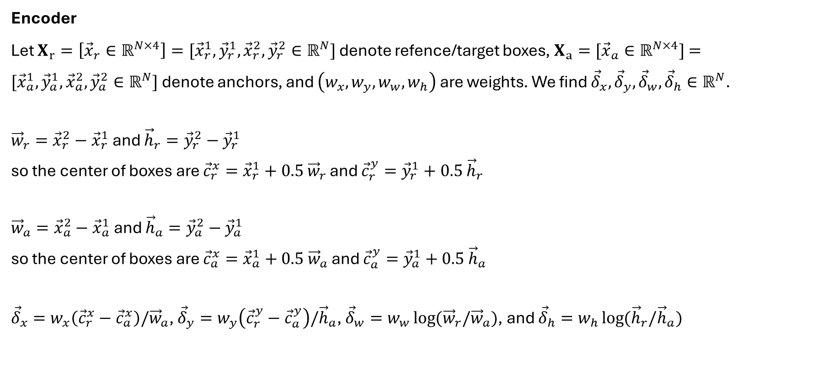
RPN: Box coder
Encoder
Let $X_{r}=\left[{\vec{x}}_{r}∈ℝ^{N×4}\right]=[{\vec{x}}_{r}^{1},{\vec{y}}_{r}^{1},{\vec{x}}_{r}^{2},{\vec{y}}_{r}^{2}∈ℝ^{N}]$ denote refence/target boxes, $X_{a}=[{\vec{x}}_{a}∈ℝ^{N×4}]$ $=[{\vec{x}}_{a}^{1},{\vec{y}}_{a}^{1},{\vec{x}}_{a}^{2},{\vec{y}}_{a}^{2}∈ℝ^{N}]$ denote anchors, and $\left(w_{x},w_{y},w_{w}, w_{h}\right)$ are weights. We find ${\vec{δ}}_{x},{\vec{δ}}_{y},{\vec{δ}}_{w},{\vec{δ}}_{h}∈ℝ^{N}$.
${\vec{w}}_{r}={\vec{x}}_{r}^{2}−{\vec{x}}_{r}^{1}$ and ${\vec{h}}_{r}={\vec{y}}_{r}^{2}−{\vec{y}}_{r}^{1}$
so the center of boxes are ${\vec{c}}_{r}^{x}={\vec{x}}_{r}^{1}+0.5$ ${\vec{w}}_{r}$ and ${\vec{c}}_{r}^{y}={\vec{y}}_{r}^{1}+0.5$ ${\vec{h}}_{r}$
${\vec{w}}_{a}={\vec{x}}_{a}^{2}−{\vec{x}}_{a}^{1}$ and ${\vec{h}}_{a}={\vec{y}}_{a}^{2}−{\vec{y}}_{a}^{1}$
so the center of boxes are ${\vec{c}}_{a}^{x}={\vec{x}}_{a}^{1}+0.5$ ${\vec{w}}_{a}$ and ${\vec{c}}_{a}^{y}={\vec{y}}_{a}^{1}+0.5$ ${\vec{h}}_{a}$
${\vec{δ}}_{x}=w_{x}\left({\vec{c}}_{r}^{x}−{\vec{c}}_{a}^{x}\right)/{\vec{w}}_{a}$, ${\vec{δ}}_{y}=w_{y}\left({\vec{c}}_{r}^{y}−{\vec{c}}_{a}^{y}\right)/{\vec{h}}_{a}$, ${\vec{δ}}_{w}=w_{w}\log{({\vec{w}}_{r}/{\vec{w}}_{a})}$, and ${\vec{δ}}_{h}=w_{h}\log{({\vec{h}}_{r}/{\vec{h}}_{a})}$

Slide 6
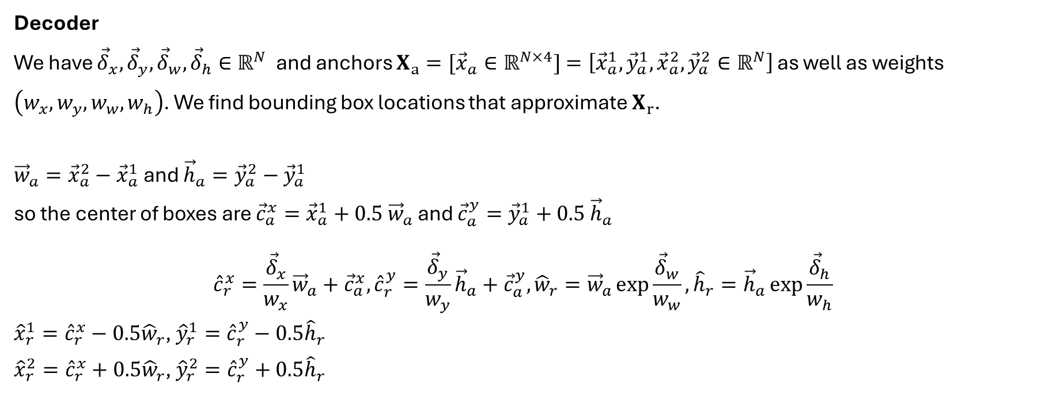
RPN: Box coder
Decoder
We have ${\vec{δ}}_{x},{\vec{δ}}_{y},{\vec{δ}}_{w},{\vec{δ}}_{h}∈ℝ^{N}$ and anchors $X_{a}=[{\vec{x}}_{a}∈ℝ^{N×4}]$ $=\left[{\vec{x}}_{a}^{1},{\vec{y}}_{a}^{1},{\vec{x}}_{a}^{2},{\vec{y}}_{a}^{2}∈ℝ^{N}\right]$ as well as weights $\left(w_{x},w_{y},w_{w}, w_{h}\right)$. We find bounding box locations that approximate $X_{r}$.
${\vec{w}}_{a}={\vec{x}}_{a}^{2}−{\vec{x}}_{a}^{1}$ and ${\vec{h}}_{a}={\vec{y}}_{a}^{2}−{\vec{y}}_{a}^{1}$
so the center of boxes are ${\vec{c}}_{a}^{x}={\vec{x}}_{a}^{1}+0.5$ ${\vec{w}}_{a}$ and ${\vec{c}}_{a}^{y}={\vec{y}}_{a}^{1}+0.5$ ${\vec{h}}_{a}$
$${\hat{c}}_{r}^{x}=\frac{{\vec{δ}}_{x}}{w_{x}}{\vec{w}}_{a}+{\vec{c}}_{a}^{x}, {\hat{c}}_{r}^{y}=\frac{{\vec{δ}}_{y}}{w_{y}}{\vec{h}}_{a}+{\vec{c}}_{a}^{y}, {\hat{w}}_{r}={\vec{w}}_{a}\exp{\frac{{\vec{δ}}_{w}}{w_{w}}},{\hat{h}}_{r}={\vec{h}}_{a}\exp{\frac{{\vec{δ}}_{h}}{w_{h}}}$$
${\hat{x}}_{r}^{1}={\hat{c}}_{r}^{x}−0.5{\hat{w}}_{r}$, ${\hat{y}}_{r}^{1}={\hat{c}}_{r}^{y}−0.5{\hat{h}}_{r}$
${\hat{x}}_{r}^{2}={\hat{c}}_{r}^{x}+0.5{\hat{w}}_{r}$, ${\hat{y}}_{r}^{2}={\hat{c}}_{r}^{y}+0.5{\hat{h}}_{r}$

Slide 7
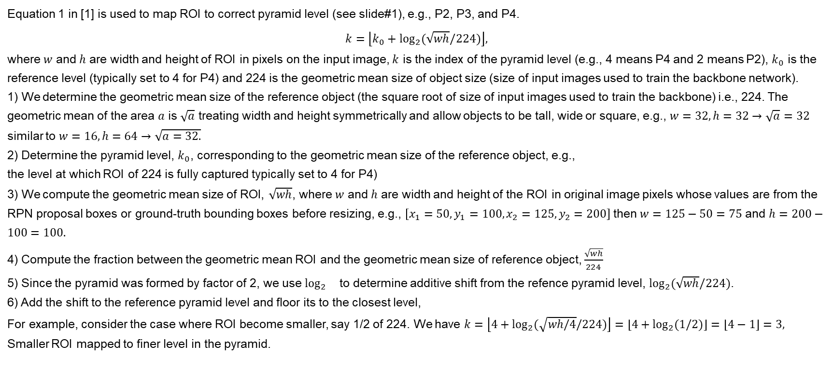
ROI to Pyramid Level Mapping in Mask R-CNN
Equation 1 in [1] is used to map ROI to correct pyramid level (see slide#1), e.g., P2, P3, and P4.
$$k=\left\lfloor k_{0}+\log_{2}{(\sqrt{wh}/224)}\right\rfloor ,$$
where $w$ and $h$ are width and height of ROI in pixels on the input image, $k$ is the index of the pyramid level (e.g., 4 means P4 and 2 means P2), $k_{0}$ is the reference level (typically set to 4 for P4) and 224 is the geometric mean size of object size (size of input images used to train the backbone network).
1) We determine the geometric mean size of the reference object (the square root of size of input images used to train the backbone) i.e., 224. The geometric mean of the area $a$ is $\sqrt{a}$ treating width and height symmetrically and allow objects to be tall, wide or square, e.g., $w=32,h=32→\sqrt{a}=32$ similar to $w=16, h=64→\sqrt{a=32.}$
2) Determine the pyramid level, $k_{0}$, corresponding to the geometric mean size of the reference object, e.g.,
the level at which ROI of 224 is fully captured typically set to 4 for P4)
3) We compute the geometric mean size of ROI, $\sqrt{wh}$, where $w$ and $h$ are width and height of the ROI in original image pixels whose values are from the RPN proposal boxes or ground-truth bounding boxes before resizing, e.g., $\left[x_{1}=50, y_{1}=100, x_{2}=125, y_{2}=200\right]$then $w=125−50=75$ and $h=200−100=100.$
4) Compute the fraction between the geometric mean ROI and the geometric mean size of reference object, $\frac{\sqrt{wh}}{224}$
5) Since the pyramid was formed by factor of 2, we use $\log_{2}{}$to determine additive shift from the refence pyramid level, $\log_{2}{(\sqrt{wh}/224)}$.
6) Add the shift to the reference pyramid level and floor its to the closest level,
For example, consider the case where ROI become smaller, say 1/2 of 224. We have $k=\left\lfloor 4+\log_{2}{(\sqrt{wh/4}/224)}\right\rfloor =\left\lfloor 4+\log_{2}{(1/2)}\right\rfloor =\left\lfloor 4−1\right\rfloor =3,$ Smaller ROI mapped to finer level in the pyramid.
T. Lin, et al. Feature Pyramid Networks for Object Detection, arXiv:1612.03144 , 2017
vision/torchvision/ops/feature_pyramid_network.py at main · pytorch/vision

Slide 8
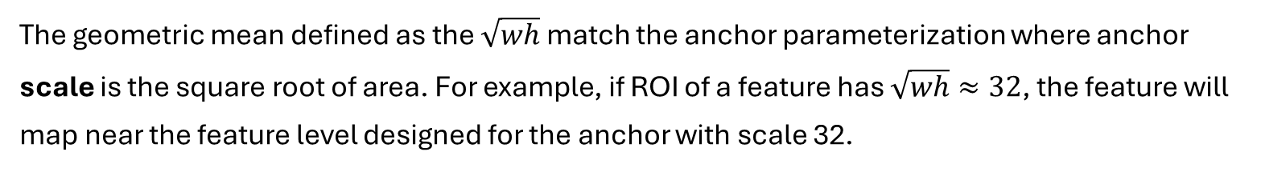
Relation between Anchor area/scale and geometric mean
The geometric mean defined as the $\sqrt{wh}$ match the anchor parameterization where anchor scale is the square root of area. For example, if ROI of a feature has $\sqrt{wh}≈32$, the feature will map near the feature level designed for the anchor with scale 32.

Slide 9
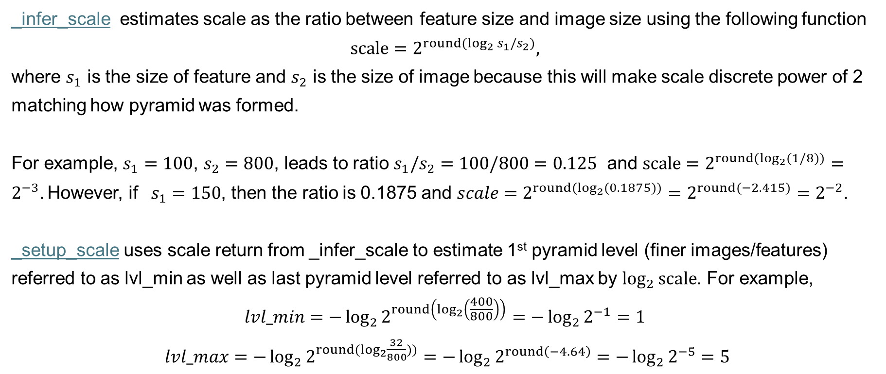
MultiscaleRoIAlign: _infer_scale and _setup_scale
_infer_scale estimates scale as the ratio between feature size and image size using the following function
$$scale=2^{round(\log_{2}{s_{1}/s_{2}})},$$
where $s_{1}$ is the size of feature and $s_{2}$ is the size of image because this will make scale discrete power of 2 matching how pyramid was formed.
For example, $s_{1}=100$, $s_{2}=800$, leads to ratio $s_{1}/s_{2}=100/800=0.125$ and $scale=2^{round(\log_{2}{(1/8))}}=2^{−3}.$However, if $s_{1}=150$, then the ratio is 0.1875 and $scale=2^{round(\log_{2}{(0.1875))}}=2^{round(−2.415)}=2^{−2}$.
_setup_scale uses scale return from _infer_scale to estimate 1st pyramid level (finer images/features) referred to as lvl_min as well as last pyramid level referred to as lvl_max by $\log_{2}{scale}$. For example,
$$lvl_min=−\log_{2}{2^{round\left(\log_{2}\left(\frac{400}{800}\right)\right)}}=−\log_{2}{2^{−1}}=1$$
$lvl_max=−\log_{2}{2^{round(\log_{2}{\frac{32}{800}}))}}=−\log_{2}{2^{round\left(−4.64\right)}}=−\log_{2}{2^{−5}}=5$

Slide 10
MultiscaleRoIAlign: ROI
We use scale from _infer_scale to map ROI to feature size
ROI (estimated proposal) is defined based on feature size
ROI (estimated proposal) is defined based on input image size
We divided feature-sized ROI into bin where the number of bins is the size of output (e.g., here is 7x7)

Slide 11
MultiscaleRoIAlign: ROI
We then divided feature-sized ROI further into sub-bin. Here each bin is 2x2 sub-bins.

