Slide 1
Yolov7 backbone

Slide 2
0 ReOrg (3→12)
20 Conv (256→512 k:3,s:2) P4/16
Continue next slide
1 Conv (12→64, k:3,s:1) P1/2
19 Conv (512→256 k:1,s:1)
2 Conv (64→128, k:3,s:2) P2/4
18 Cat (b12,13,15,17:→512)
17 Conv (128→128, k:3,s:1)
3 Conv (128→64, k:1,s:1)
4 Conv [from 2] (128→64, k:1,s:1)
16 Conv (128→128, k:3,s:1)
15 Conv (128→128, k:3,s:1)
5 Conv (64→64, k:3,s:1)
14 Conv (128→128, k:3,s:1)
6 Conv (64→64, k:3,s:1)
7 Conv (64→64, k:3,s:1)
13 Conv [from 11] (256→128, k:1,s:1)
9 Cat (b3,4,6,8:→256)
12 Conv (256→128, k:1,s:1)
8 Conv (64→64, k:3,s:1)
11 Conv (128→256, k:3,s:2) P3/8
Note: all Cats are associated with from (f) of -1, -3, -5, -6
10 Conv (256→128, k:1,s:1)

Slide 3
21 Conv (512→256 k:1,s:1)
22 Conv [from 20] (512→256, k:1,s:1)
23 Conv (256→256, k:3,s:1)
Continue next slide
24 Conv (256→256, k:3,s:1)
38 Conv (768→1024, k:3,s:2) P6/64
25 Conv (256→256, k:3,s:1)
27 Cat (b21,22,24,26:→1024)
37 Conv (1536→768, k:1,s:1)
26 Conv (256→256, k:3,s:1)
36 Cat (b30,31,33,35:→1536)
28 Conv (1024→512, k:1,s:1)
30 Conv (768→384, k:1,s:1)
29 Conv (512→768, k:3,s:2) P5/32
31 Conv [from 30] (768→384, k:1,s:1)
32 Conv (384→384, k:3,s:1)
34 Conv (384→384, k:3,s:1)
35 Conv (384→384, k:3,s:1)
33 Conv (384→384, k:3,s:1)

Slide 4
39 Conv (1024→512, k:1,s:1)
40 Conv [from 38] (1024→512, k:1,s:1)
41 Conv (512→512, k:3,s:1)
42 Conv (512→512, k:3,s:1)
43 Conv (512→512, k:3,s:1)
45 Cat (b39,40,42,44:→2048)
44 Conv (512→512, k:3,s:1)
46 Conv (2048→1024, k:1,s:1)

Slide 5
Yolov7 head

Slide 6
62 Conv (512→256, k:1,s:1)
From [28] P4
47 SPPCSPC (1024→512)
61 Nearest Upsample by 2 (256→256)
48 Conv (512→384, k:1,s:1)
63 Cat (b61,62:→512)
60 Conv (384→256, k:1,s:1)
49 Nearest Upsample by 2 (384→384,)
59 Conv (1536→384, k:1,s:1)
64 Conv (512→256, k:1,s:1)
50 Conv (768→384, k:1,s:1)
From [37] P5
58 Cat (b52-57:→1536)
65 Conv [from 63] (512→256, k:1,s:1)
66 Conv (256→128, k:3,s:1)
51 Cat (b49,50:→768)
57 Conv (192→192, k:3,s:1)
67 Conv (128→128, k:3,s:1)
Continue next slide
52 Conv (768→384, k:1,s:1)
56 Conv (192→192, k:3,s:1)
68 Conv (128→128, k:3,s:1)
70 Cat (b64-69:→1024)
53 Conv [from 51] (768→384, k:1,s:1)
54 Conv (384→192, k:3,s:1)
55 Conv (192→192, k:3,s:1)
69 Conv (128→128, k:3,s:1)

Slide 7
71 Conv (1024→256, k:1,s:1)
88 Conv (256→128, k:3,s:1)
89 Conv (128→128, k:3,s:1)
Continue next slide
72 Conv (256→128, k:1,s:1)
87 Conv [from 85] (512→256, k:1,s:1)
90 Conv (128→128, k:3,s:1)
103 Conv (1536→384, k:1,s:1)
73 Nearest Upsample by 2 (128→128)
85 Cat (b71,84:→512)
86 Conv (512→256, k:1,s:1)
102 Cat (b96-101:→1536)
74 Conv (256→128, k:1,s:1)
From [19] P3
91 Conv (128→128, k:3,s:1)
84 Conv (128→256, k:3,s:2)
101 Conv (192→192, k:3,s:1)
92 Cat (b86-91:→1024)
83 Conv (512→128, k:1,s:1)
100 Conv (192→192, k:3,s:1)
75 Cat (b73,74:→256)
82 Cat (b76-81:→512)
81 Conv (64→64 k:3,s:1)
99 Conv (192→192, k:3,s:1)
93 Conv (1024→256, k:1,s:1)
76 Conv (256→128, k:1,s:1)
80 Conv (64→64 k:3,s:1)
98 Conv (384→192, k:3,s:1)
94 Conv (256→384, k:3,s:2)
77 Conv [from 75] (256→128, k:1,s:1)
78 Conv (128→64 k:3,s:1)
79 Conv (64→64 k:3,s:1)
97 Conv [from 95] (768→384, k:1,s:1)
95 Cat (b59,94:→768)
96 Conv (768→384, k:1,s:1)

Slide 8
104 Conv (384→512, k:3,s:2)
120 Conv [from 59] (384→960, k:3,s:1)
121 Conv [from 47] (512→1280, k:3,s:1)
105 Cat (b47,104:→1024)
119 Conv [from 71] (256→640, k:3,s:1)
122 IAuxDetect [from 114, 115, 116, 117, 118, 119, 120, 121]
106 Conv (1024→512, k:1,s:1)
118 Conv [from 83] (128→320, k:3,s:1)
107 Conv [from 105] (1024→512, k:1,s:1)
117 Conv [from 113] (512→1024, k:3,s:1)
108 Conv (512→256, k:3,s:1)
116 Conv [from 103] (384→768, k:3,s:1)
109 Conv (256→256, k:3,s:1)
110 Conv (256→256, k:3,s:1)
115 Conv [from 93] (256→512, k:3,s:1)
111 Conv (256→256, k:3,s:1)
114 Conv [from 83] (128→256, k:3,s:1)
112 Cat (b106-111:→2048)
113 Conv (2048→512, k:1,s:1)

Slide 9
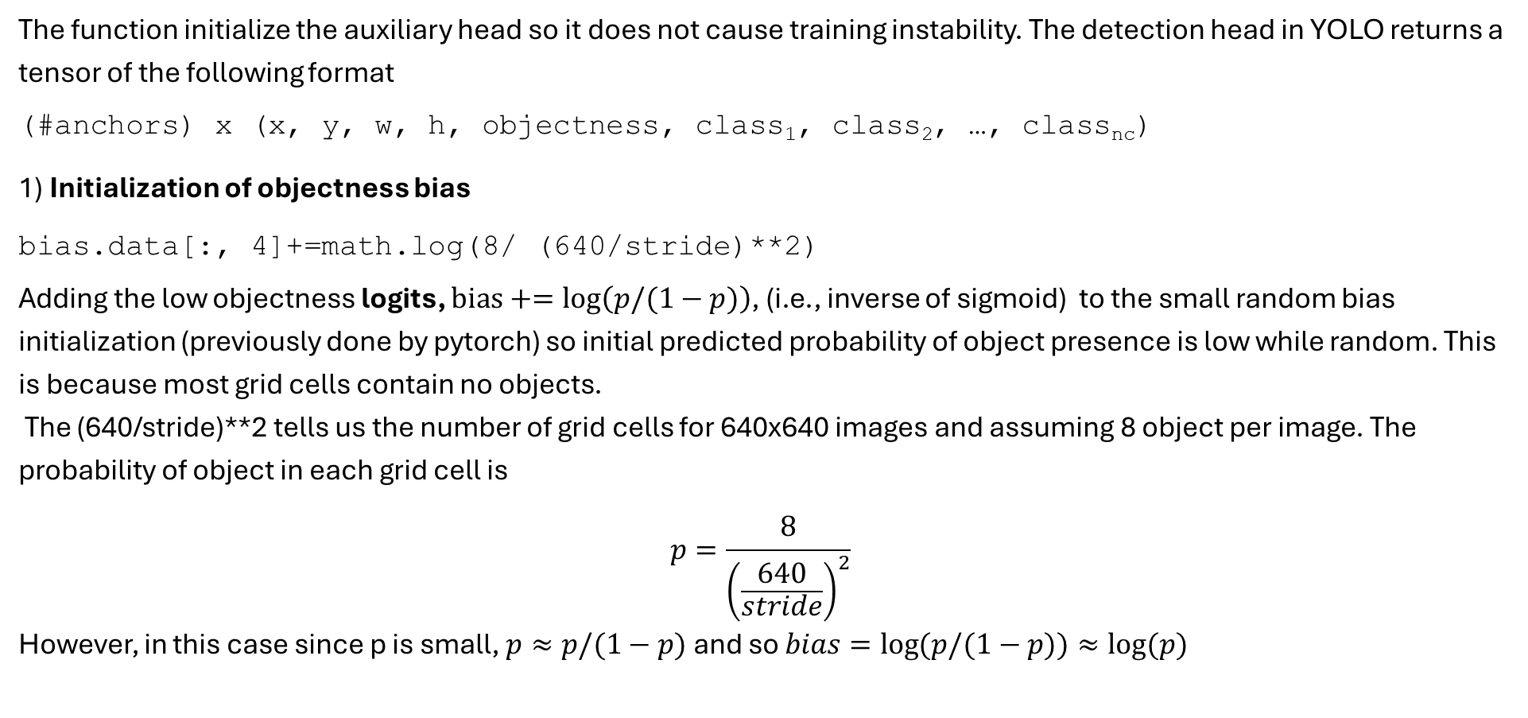
Model:: _initialize_aux_biases
The function initialize the auxiliary head so it does not cause training instability. The detection head in YOLO returns a tensor of the following format
(#anchors) x (x, y, w, h, objectness, class₁, class₂, …, class_{nc})
1) Initialization of objectness bias
bias.data[:, 4]+=math.log(8/ (640/stride)**2)
Adding the low objectness logits, $bias+=\log\left(p/(1−p)\right)$, (i.e., inverse of sigmoid) to the small random bias initialization (previously done by pytorch) so initial predicted probability of object presence is low while random. This is because most grid cells contain no objects.
The (640/stride)**2 tells us the number of grid cells for 640x640 images and assuming 8 object per image. The probability of object in each grid cell is
$$p=\frac{8}{{\left(\frac{640}{stride}\right)}^{2}}$$
However, in this case since p is small, $p≈p/(1−p)$ and so $bias=\log{(p/(1−p))}≈\log{(p)}$

Slide 10
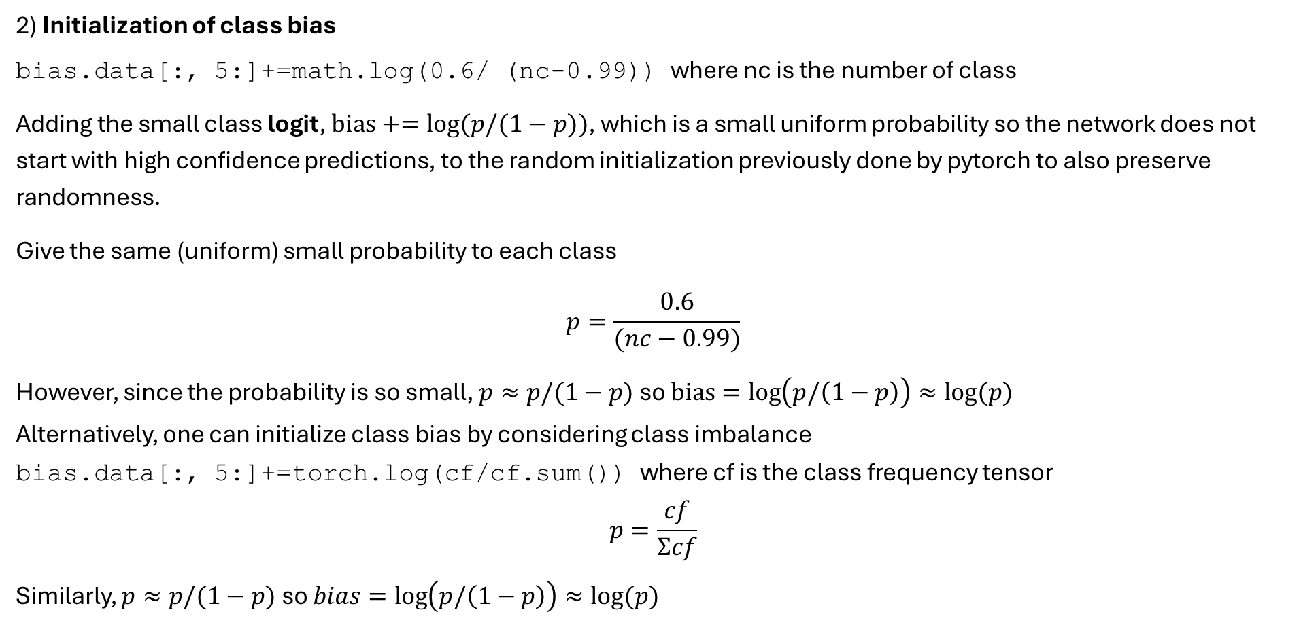
Model:: _initialize_aux_biases
2) Initialization of class bias
bias.data[:, 5:]+=math.log(0.6/ (nc-0.99)) where nc is the number of class
Adding the small class logit, $bias+=\log{(p/(1−p))}$, which is a small uniform probability so the network does not start with high confidence predictions, to the random initialization previously done by pytorch to also preserve randomness.
Give the same (uniform) small probability to each class
$$p=\frac{0.6}{(nc−0.99)}$$
However, since the probability is so small, $p≈p/(1−p)$ so $bias=\log\left(p/\left(1−p\right)\right)≈\log{(p)}$
Alternatively, one can initialize class bias by considering class imbalance
bias.data[:, 5:]+=torch.log(cf/cf.sum()) where cf is the class frequency tensor
$$p=\frac{cf}{Σcf}$$
Similarly, $p≈p/(1−p)$ so $bias=\log\left(p/\left(1−p\right)\right)≈\log{(p)}$

Slide 11
Grid cell and stride
Cumulative stride at a certain level tells us how many input pixels corresponding to 1 feature map point at that level. This one feature map point is called grid cell in yolov7.
Small objects often detected on larger feature map which means smaller cumulative stride and smaller grid cell.
Detection | Feature map size | Stride | Grid cell
Small object | 80x80 | 8 input pixels | 8x8 input pixels
Medium object | 40x40 | 16 input pixels | 16x16 input pixels
Large object | 20x20 | 32 input pixels | 32x32 input pixels
So a point (i, j) on the feature map corresponds to a center at pixel (i*stride, j*stride) in the input image.
In yolov7, each prediction head works at different scale, e.g. the head with stride 8 detects small objects.
The predicted box coordinates are local to grid cells and to map them back to the image space, multiply by stride.
Anchors were inputted in image pixel unit and divided by stride to turn them into grid units.

Slide 12

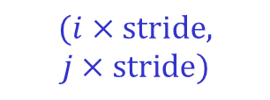
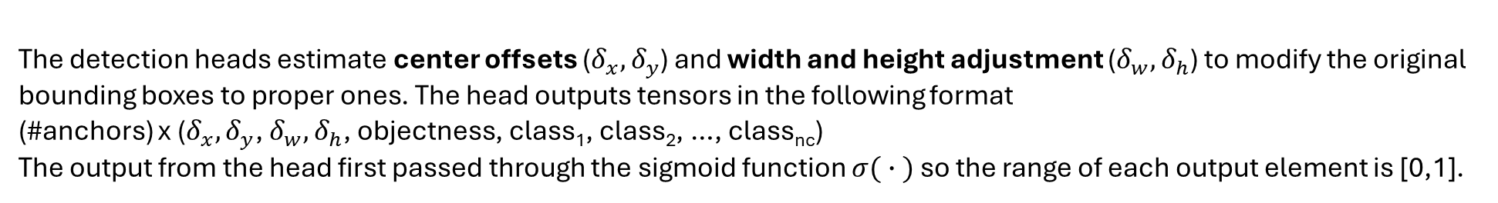
Bounding box estimation
YOLO returns $N$bounding boxes per feature map grid, where $N$is the number of anchors. These bounding box are originally defined by their center (at the feature grid location $(i,j)$mapped to the image pixel space$(i×stride, j×stride)$) and their width and height as inputted by users.
(0,0)
Pytorch (like OpenCV) the pixel locations of images and feature maps are defined at the center of pixels. So the first pixel (at the top-left corner) is at coordinate (0,0) and spanning from [-0.5, 0.5] in x and y direction.
$$(i,j)$$
$$(i×stride,$$
$$j×stride)$$
The detection heads estimate center offsets ($δ_{x}, δ_{y}$) and width and height adjustment ($δ_{w},δ_{h}$) to modify the original bounding boxes to proper ones. The head outputs tensors in the following format
(#anchors) x ($δ_{x}, δ_{y}$, $δ_{w},δ_{h}$, objectness, class₁, class₂, …, class_{nc})
The output from the head first passed through the sigmoid function $σ( ∙ )$ so the range of each output element is [0,1].

Slide 13
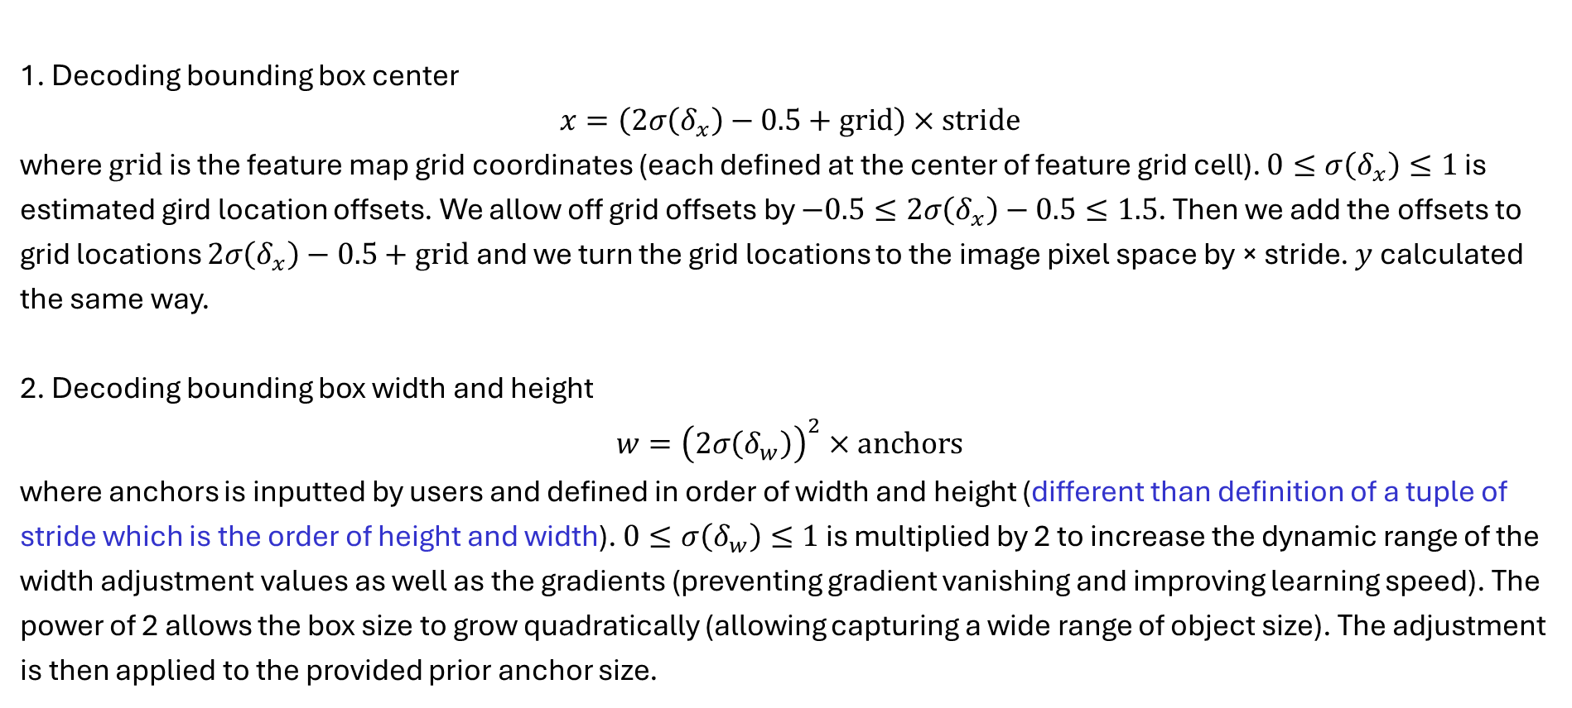
Bounding box estimation
1. Decoding bounding box center
$$x=\left(2σ\left(δ_{x}\right)−0.5+grid\right)×stride$$
where $grid$ is the feature map grid coordinates (each defined at the center of feature grid cell). $0≤σ\left(δ_{x}\right)≤1$ is estimated gird location offsets. We allow off grid offsets by $−0.5≤2σ\left(δ_{x}\right)−0.5≤1.5$. Then we add the offsets to grid locations $2σ\left(δ_{x}\right)−0.5+grid$ and we turn the grid locations to the image pixel space by × stride. $y$ calculated the same way.
2. Decoding bounding box width and height
$$w={\left(2σ\left(δ_{w}\right)\right)}^{2}×anchors$$
where anchors is inputted by users and defined in order of width and height (different than definition of a tuple of stride which is the order of height and width). $0≤σ\left(δ_{w}\right)≤1$ is multiplied by 2 to increase the dynamic range of the width adjustment values as well as the gradients (preventing gradient vanishing and improving learning speed). The power of 2 allows the box size to grow quadratically (allowing capturing a wide range of object size). The adjustment is then applied to the provided prior anchor size.

Slide 14
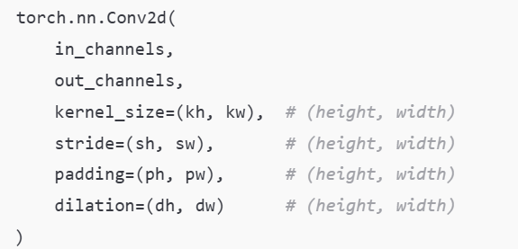
Bounding box estimation: Import Note
YOLOv7 expects anchor inputs as a pair of width/height for small, medium, and large boxes per level (in image pixel space). However, parameters of Pytorch 2D convolution (if defined as tuples) are in the order of (height, width). YOLO works because it uses a single value for stride (kernel, padding, etc.). In other words, YOLO uses the same stride for both x and y directions. If strides (and other convolution parameters) are not a single value, ordering of width and height of anchors must match that of stride since YOLO uses stride to convert the anchor image pixel unit to feature cell unit.
 | Small (width,height) | Medium (width,height) | Large (width,height)
P3 [finest] | 19,27 | 44,40 | 38.94
P4 | 96,68 | 86,152 | 180,137
P5 | 140,301 | 303,264 | 238,542
P6 [coarsest] | 436,615 | 739,380 | 925,792

Slide 15
Input
image is BxCxHxW uint8 tensor and normalized by /255 before passing to model
target-label is Bx6 where 6 is for
[image-index, class, x_{c}, y_{c}, w, h]
image-index: indices with values in [0, batch-size)
class: labels with values in [0, N_{c}) where N_{c} is the number of class
x_{c} : center of bounding box normalized by image width
y_{c} : center of bounding box normalized by image width
w: normalized width of bounding box
h: normalized height of bounding box
All coordinates are normalized, thus independent to actual image resolution
Target for loss calculation: [tx,ty,tw,th] where tx and ty is the offset of the object’s center inside its grid cell (i.e., from its grid cell top-left index) and tw and th is bounding box width/height in grid cell units.

Slide 16
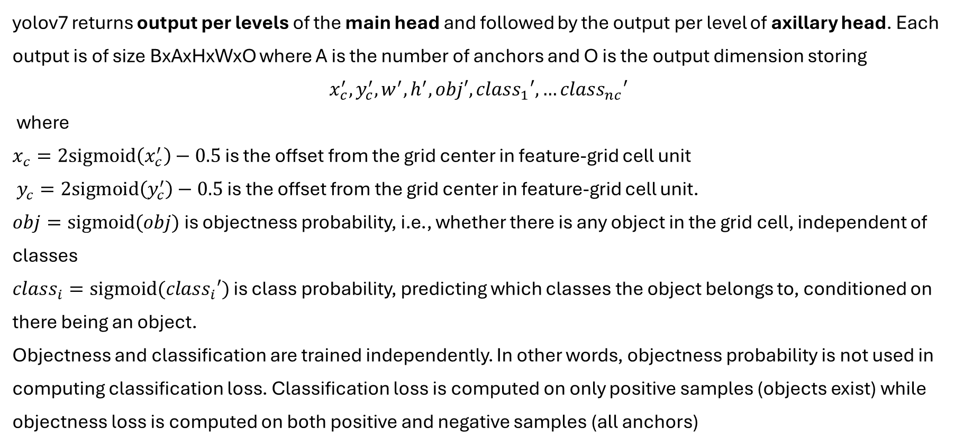
Output
yolov7 returns output per levels of the main head and followed by the output per level of axillary head. Each output is of size BxAxHxWxO where A is the number of anchors and O is the output dimension storing
$$x_{c}^{′}, y_{c}^{′}, w^{′}, h^{′},obj′, class_{1}′, …class_{nc}′$$
where
$x_{c}=2sigmoid\left(x_{c}^{′}\right)−0.5$ is the offset from the grid center in feature-grid cell unit
$y_{c}=2sigmoid\left(y_{c}^{′}\right)−0.5$ is the offset from the grid center in feature-grid cell unit.
$obj=sigmoid(obj)$ is objectness probability, i.e., whether there is any object in the grid cell, independent of classes
$class_{i}=sigmoid(class_{i}′)$ is class probability, predicting which classes the object belongs to, conditioned on there being an object.
Objectness and classification are trained independently. In other words, objectness probability is not used in computing classification loss. Classification loss is computed on only positive samples (objects exist) while objectness loss is computed on both positive and negative samples (all anchors)

