Slide 1
Feature Pyramid Network
Layers/Levels
Interpolate (if feature size does not match, e.g., nearest)
4
inner
layer
Output #4
3
inner
layer
Output #3
2
inner
layer
Output #2
1
inner
layer
Output #1
Image
T. Lin, et al. Feature Pyramid Networks for Object Detection, arXiv:1612.03144 , 2017
vision/torchvision/ops/feature_pyramid_network.py at main · pytorch/vision

Slide 2
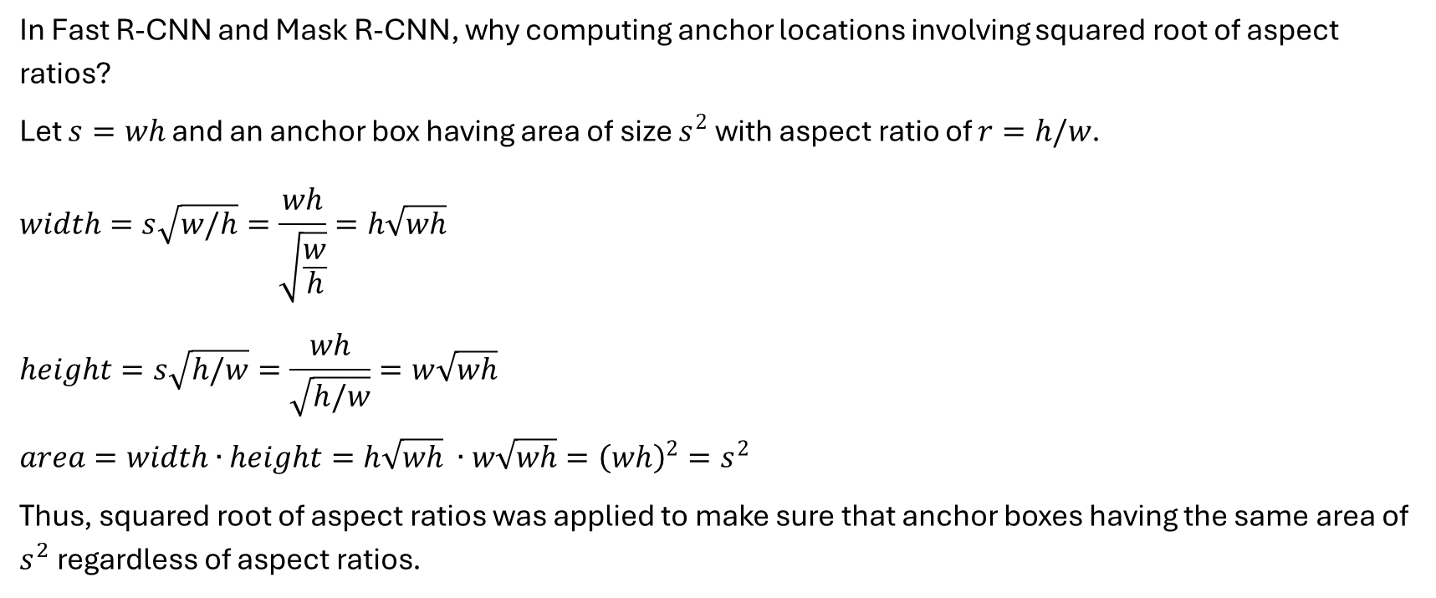
Anchor Box Calculation
In Fast R-CNN and Mask R-CNN, why computing anchor locations involving squared root of aspect ratios?
Let $s=wh$ and an anchor box having area of size $s^{2}$ with aspect ratio of $r=h/w$.
$$width=s\sqrt{w/h}=\frac{wh}{\sqrt{\frac{w}{h}}}=h\sqrt{wh}$$
$$height=s\sqrt{h/w}=\frac{wh}{\sqrt{h/w}}=w\sqrt{wh}$$
$$area=width∙height=h\sqrt{wh} ∙w\sqrt{wh}={\left(wh\right)}^{2}=s^{2}$$
Thus, squared root of aspect ratios was applied to make sure that anchor boxes having the same area of $s^{2}$ regardless of aspect ratios.

Slide 3
Anchor Box Calculation
image-width
feature-width
feature-height
image-height
image-width
stride
image-height

