Slide 1
Feature Pyramid Network
Layers/Levels
Interpolate (if feature size does not match, e.g., nearest)
4
inner
layer
Output #4
3
inner
layer
Output #3
2
inner
layer
Output #2
1
inner
layer
Output #1
Image
T. Lin, et al. Feature Pyramid Networks for Object Detection, arXiv:1612.03144 , 2017
vision/torchvision/ops/feature_pyramid_network.py at main · pytorch/vision

Slide 2
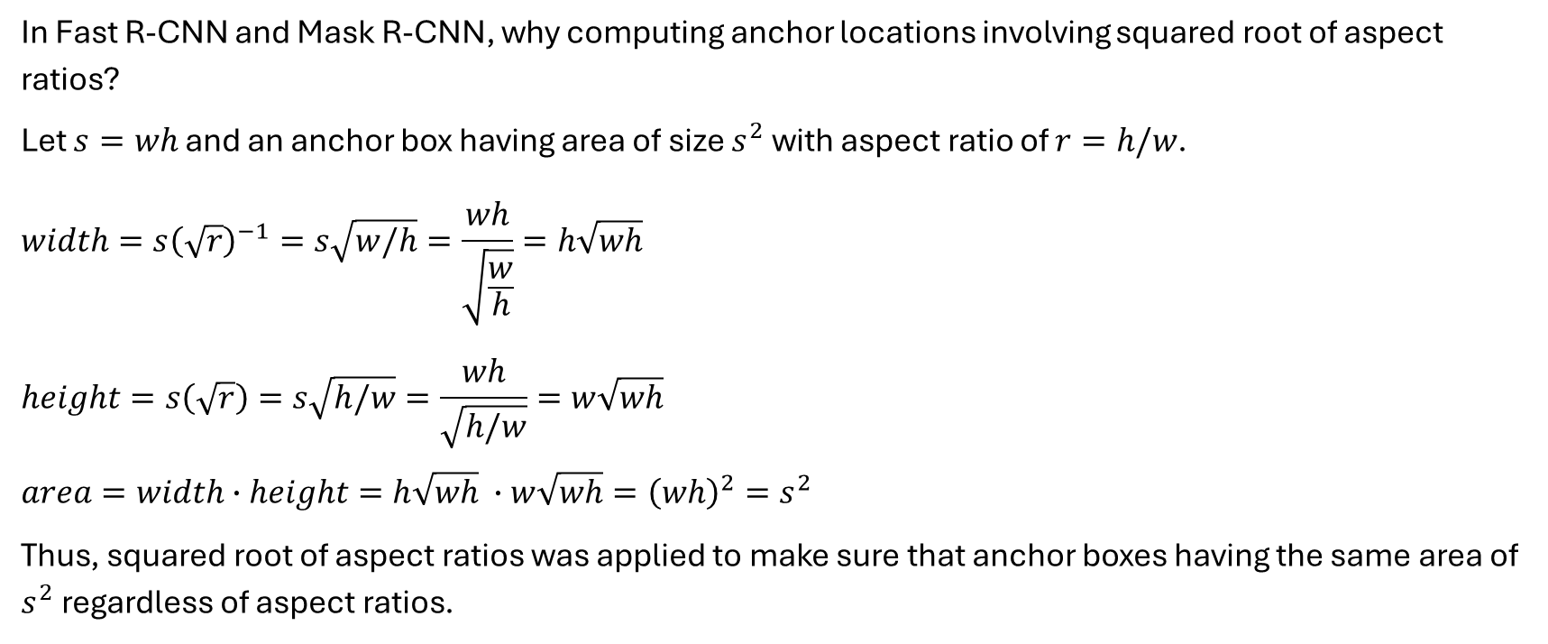
Anchor Box Calculation
In Fast R-CNN and Mask R-CNN, why computing anchor locations involving squared root of aspect ratios?
Let $s=wh$ and an anchor box having area of size $s^{2}$ with aspect ratio of $r=h/w$.
$$width=s{\left(\sqrt{r}\right)}^{−1}=s\sqrt{w/h}=\frac{wh}{\sqrt{\frac{w}{h}}}=h\sqrt{wh}$$
$$height=s\left(\sqrt{r}\right)=s\sqrt{h/w}=\frac{wh}{\sqrt{h/w}}=w\sqrt{wh}$$
$$area=width∙height=h\sqrt{wh} ∙w\sqrt{wh}={\left(wh\right)}^{2}=s^{2}$$
Thus, squared root of aspect ratios was applied to make sure that anchor boxes having the same area of $s^{2}$ regardless of aspect ratios.

Slide 3
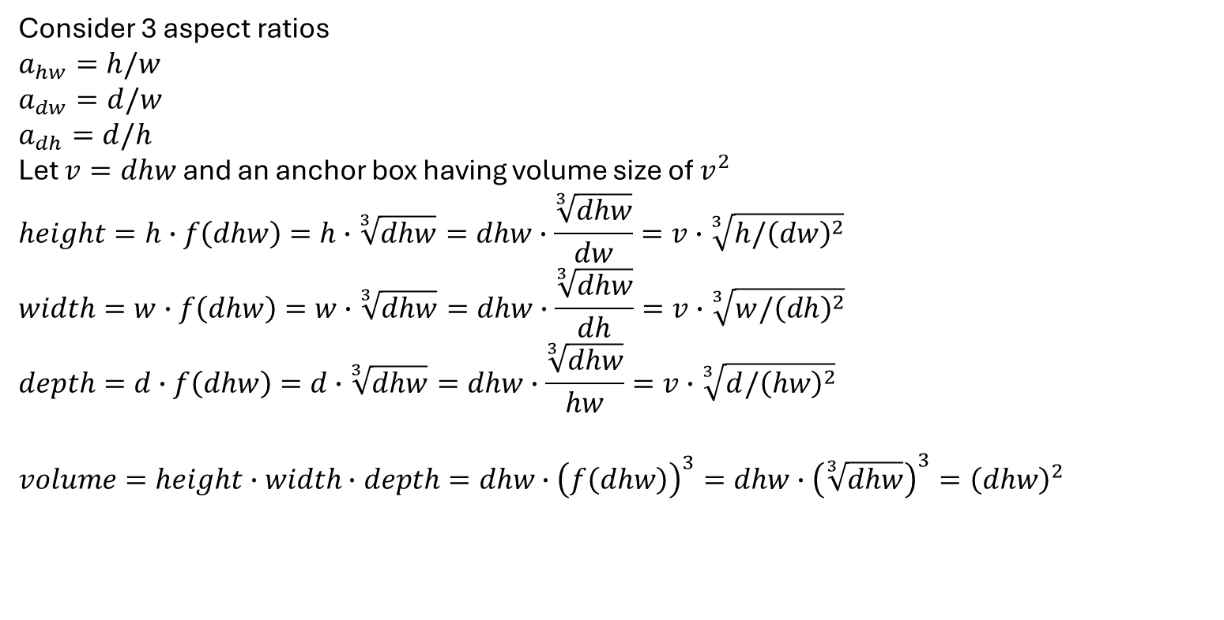
Anchor Box Calculation for 3D
Consider 3 aspect ratios
$$a_{hw}=h/w$$
$$a_{dw}=d/w$$
$$a_{dh}=d/h$$
Let $v=dhw$ and an anchor box having volume size of $v^{2}$
$$height=h∙f\left(dhw\right)=h∙\sqrt[3]{dhw}=dhw∙\frac{\sqrt[3]{dhw}}{dw}=v∙\sqrt[3]{h/{\left(dw\right)}^{2}}$$
$$width=w∙f\left(dhw\right)=w∙\sqrt[3]{dhw}=dhw∙\frac{\sqrt[3]{dhw}}{dh}=v∙\sqrt[3]{w/{\left(dh\right)}^{2}}$$
$$depth=d∙f\left(dhw\right)=d∙\sqrt[3]{dhw}=dhw∙\frac{\sqrt[3]{dhw}}{hw}=v∙\sqrt[3]{d/{\left(hw\right)}^{2}}$$
$$volume=height∙width∙depth=dhw∙{\left(f\left(dhw\right)\right)}^{3}=dhw∙{\left(\sqrt[3]{dhw}\right)}^{3}={\left(dhw\right)}^{2}$$

Slide 4
Anchor Box Calculation
image-width
feature-width
feature-height
image-height
image-width
stride
image-height

