Slide 1

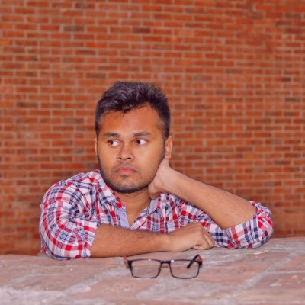
Name :Fuad Hasan
Student of CSE DEPT
Ahsanullah University
of
Science & Technology

