Slide 1
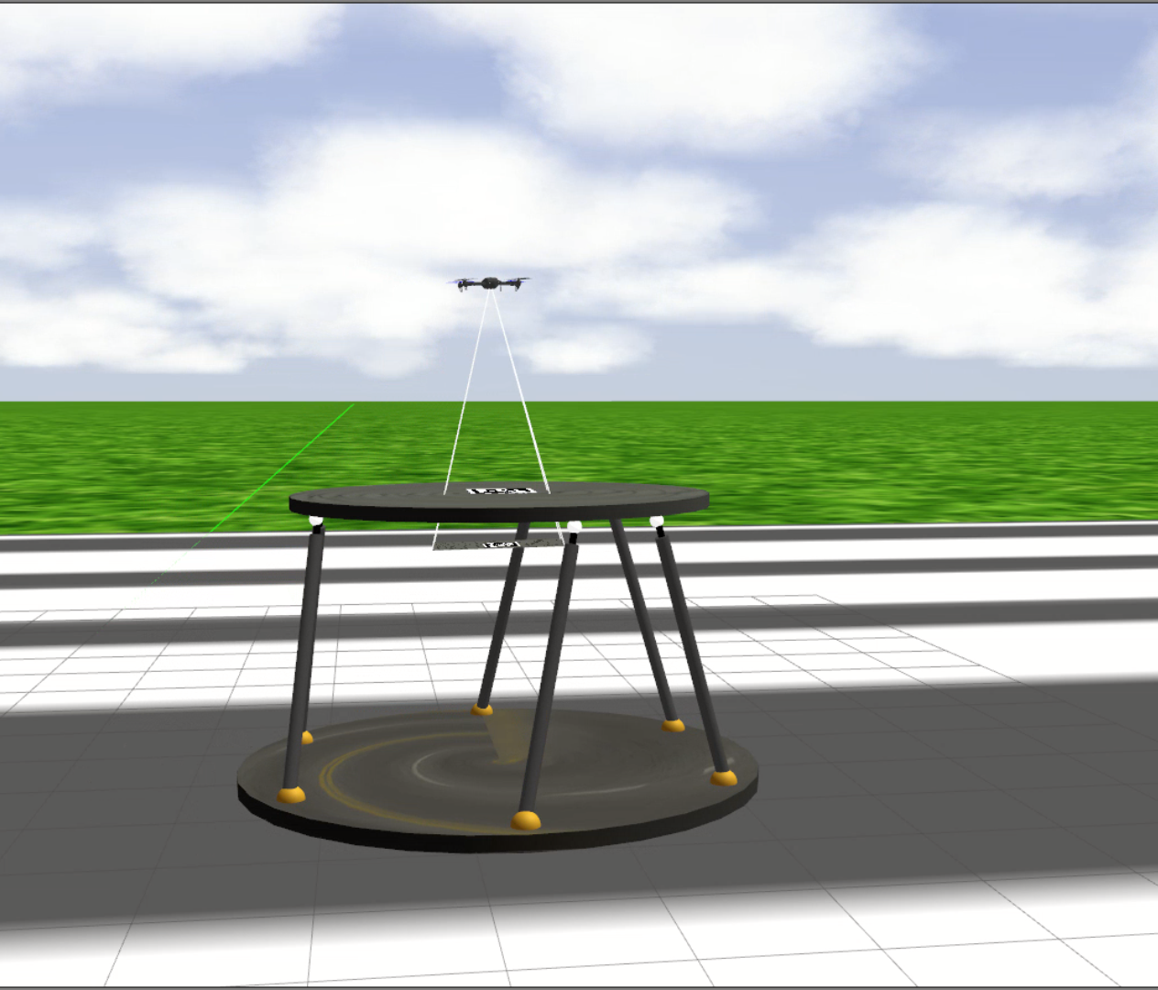
Linear tracking of drone on a stochastically moving platform
EE650 MINI PROJECT
RITWIK SHANKAR(210866)

Slide 2
INDEX
Dynamics of System
State Space Model
Objective of Design
Design of Controller
Justification of performance of controller
Output Plots for different trajectories

Slide 3
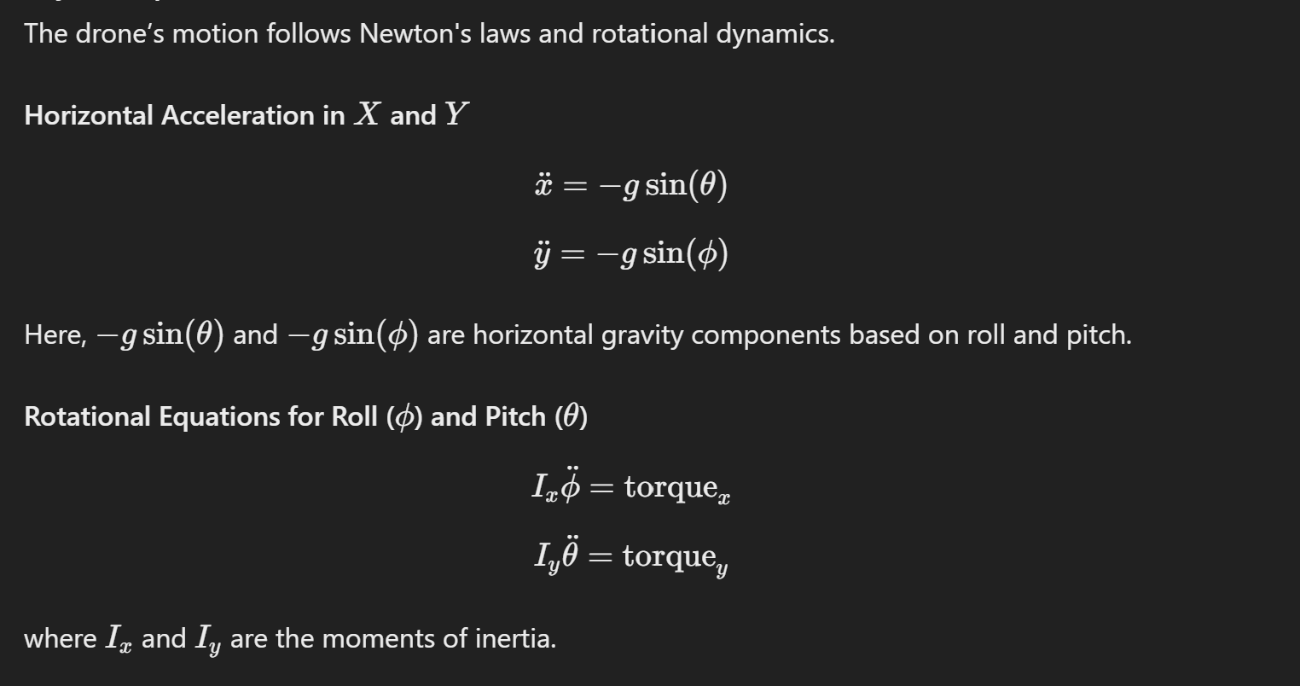
Drone Dynamics
Reference citation : State Space System Modelling of a Quad Copter UAV
Notes:
Talk about small angle estimation, sin theta=theta

Slide 4
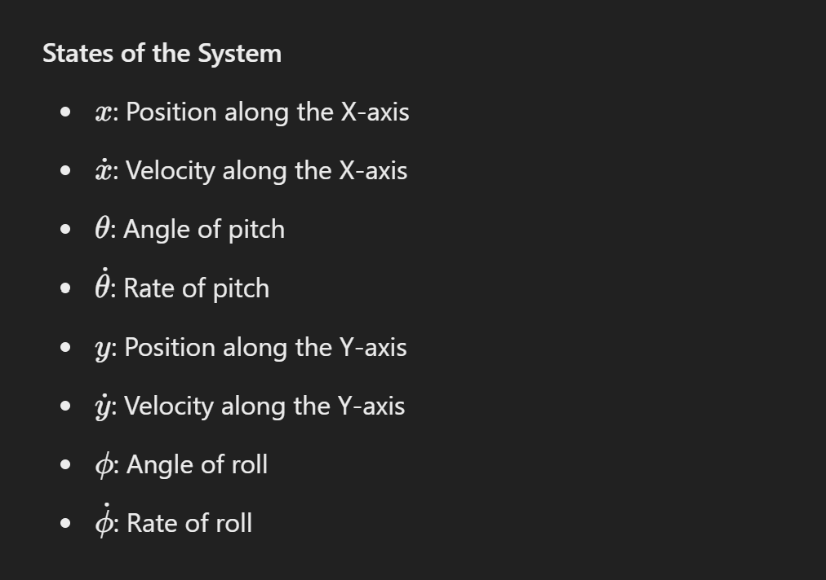
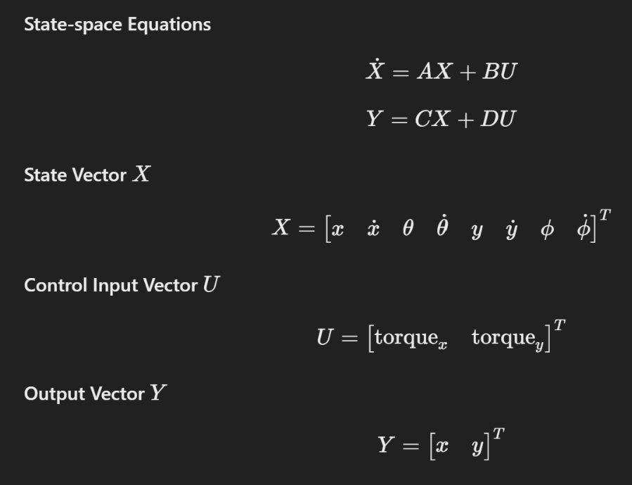
State Space Model
Notes:
Although we have access to torque z and total thrust,for our case we have just focused on tracking X and Y,

Slide 5
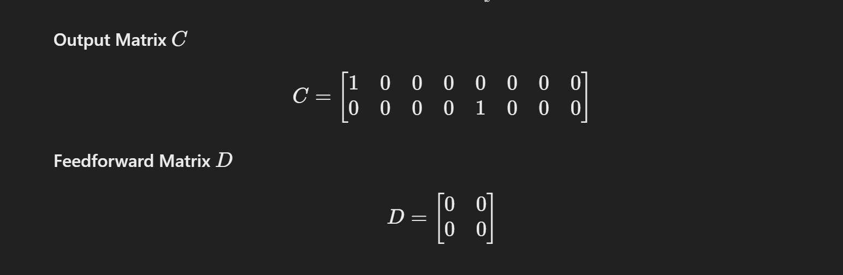
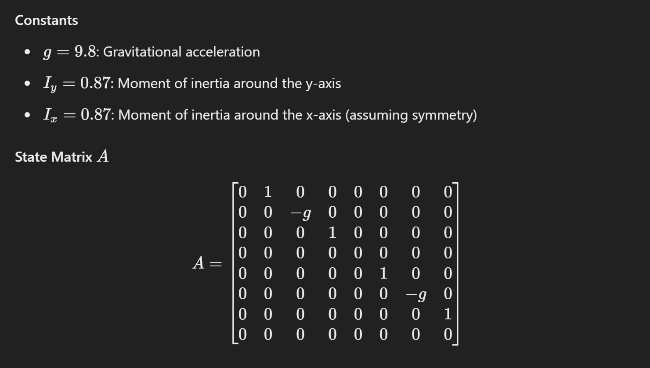
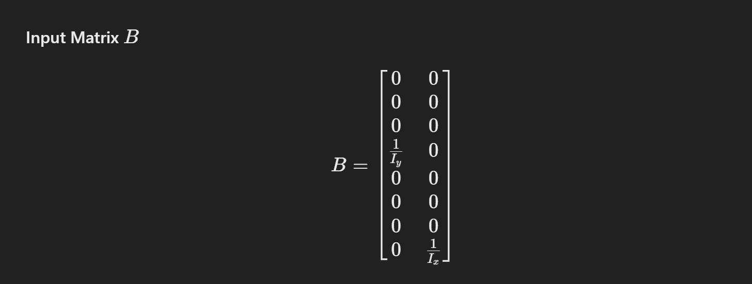
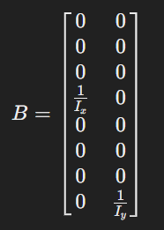
State Space Model

Slide 6
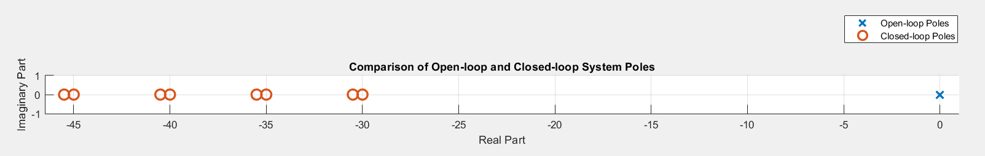
Objective of Controller
We get external setpoints of X and Y position which are sent to our controller to track
Setpoints could be generated via Vision, Lidar or MoCap systems
Poles of Original and Controlled system
Notes:
These poles values are set based on trial and error

Slide 7

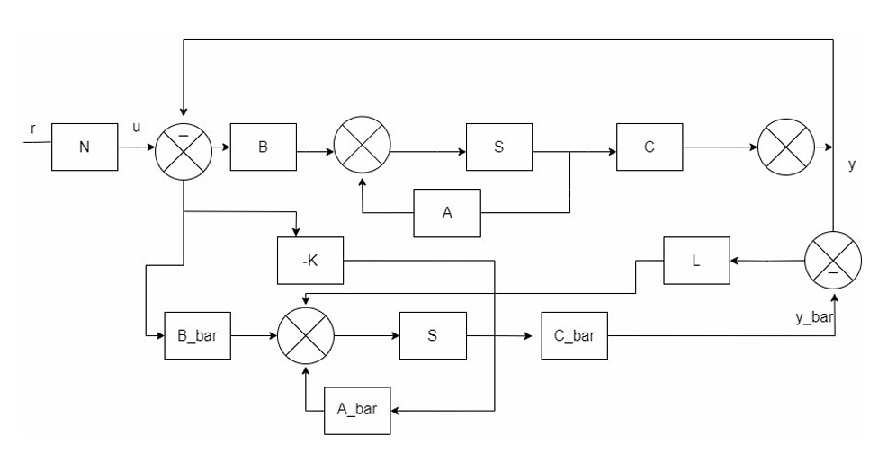
Block Diagram of Controller

Slide 8
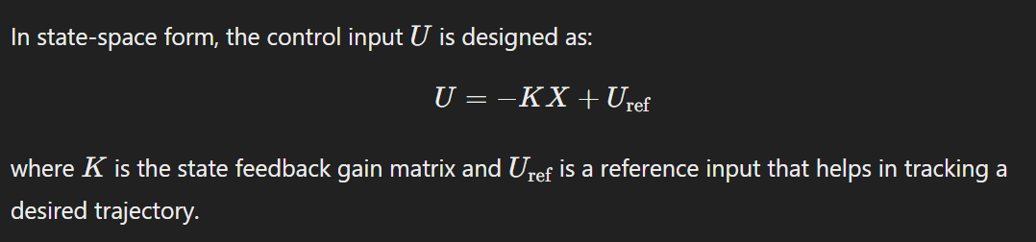
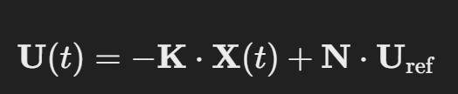
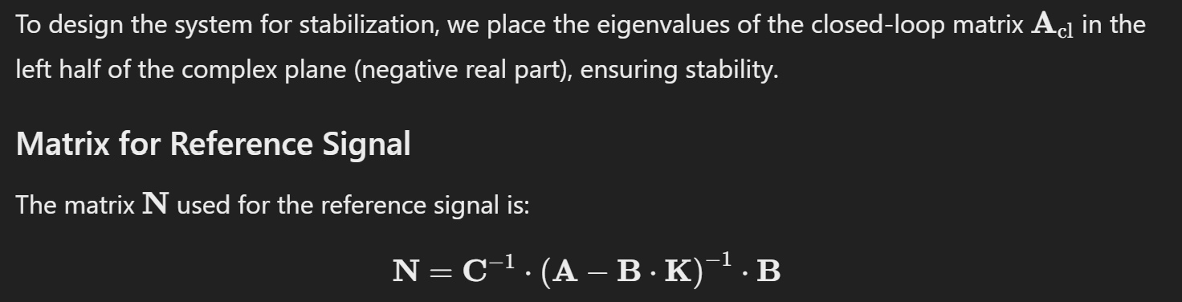
Design of the state-feedback controller
Notes:
N is basically a gain to match Yref to Uref ,so there is no Steady state error

Slide 9
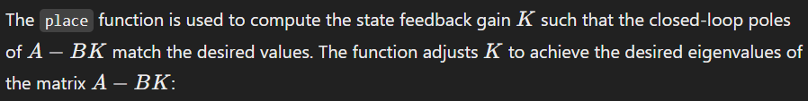
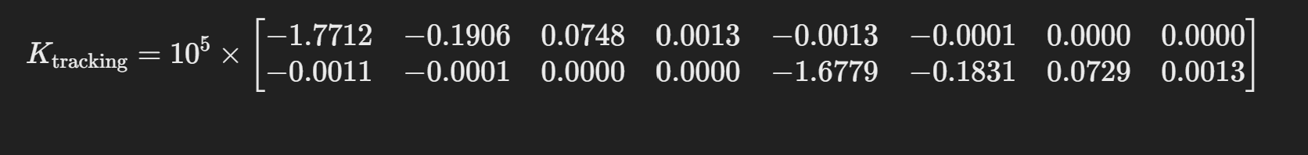
Design of the state-feedback controller

Slide 10
Justification for the performance of the controller
CONTROLLER GAINS: THE CONTROLLER GAINS PLACE THE POLES AT SPECIFIC LOCATIONS, INFLUENCING THE SYSTEM'S STABILITY AND RESPONSE SPEED. WE HAVE ARBITRARILY CHOSEN OUR POLES TO BE [-30, -35, -45, -40, -30.5, -35.5, -45.5, -40.5].
VELOCITY DEPENDENCE: THE MAXIMUM VELOCITY OF THE DRONE IS DEPENDENT ON THE POLE PLACEMENT OF THE CONTROLLER AS WELL AS THE INITIAL CONDITIONS.
PERFORMANCE METRICS: WE GET A SETTLING TIME OF ABOUT 0.24s FOR THE SELECTED POLES.
ADJUSTMENTS: DECREASING THE CONTROLLER GAINS LEADS TO FASTER SETTLING TIME BUT INCREASES STEADY STATE ERROR AND GENERATES IMPRACTICAL MOTION DEMANDS .

Slide 11
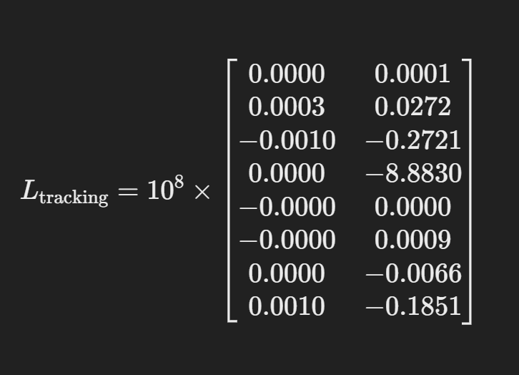
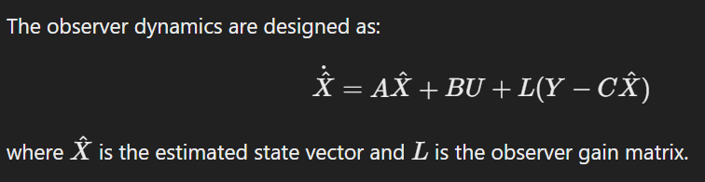
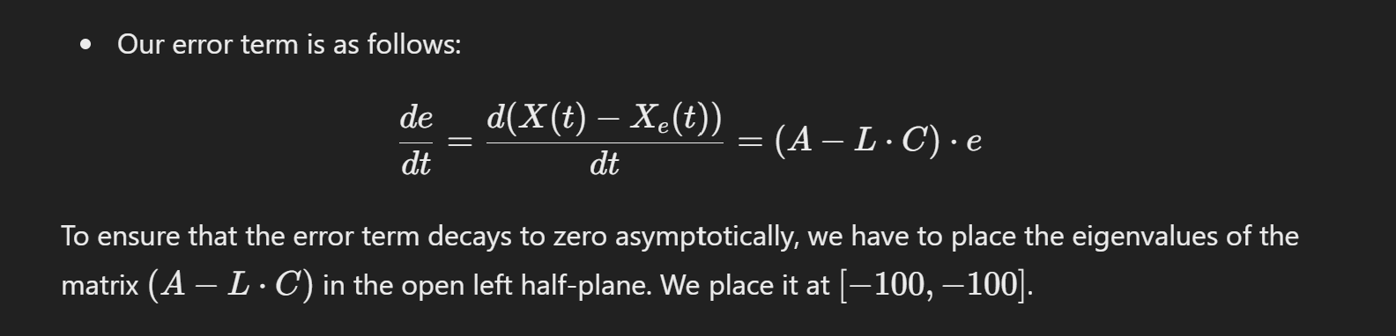
Design of Luenberger Observer

Slide 12
Justification for the performance of observer
OBSERVER GAINS: WE PLACED THE POLES OF L_TRACKING AT [-105, -100, -90, -95, -105.5, -100.5, -90.5, -95.5] TO ACHIEVE FAST CONVERGENCE, WHILE ALSO MAINTAINING THE ROBUSTNESS OF THE OBSERVER.
POLE PLACEMENT: FASTER CONVERGENCE OF THE OBSERVER REDUCES THE TIME IT TAKES TO ESTIMATE THE ACTUAL STATE.
STATE ESTIMATION ACCURACY: THE OBSERVER IS DESIGNED TO PROVIDE ACCURATE ESTIMATES OF THE UNMEASURED STATES OF THE SYSTEM.
ROBUSTNESS TO DISTURBANCES: A WELL-PERFORMING OBSERVER SHOULD EXHIBIT FAST CONVERGENCE, LOW STEADY-STATE ERROR, AND ROBUSTNESS TO DISTURBANCES.
TUNING ADJUSTMENTS: PLACING POLES FURTHER FROM THE ORIGIN (NEGATIVE) ENHANCES THE CONVERGENCE, OBSERVER GAINS CAN BE ADJUSTED TO BALANCE THE TRADE-OFF BETWEEN CONVERGENCE SPEED AND ROBUSTNESS

Slide 13
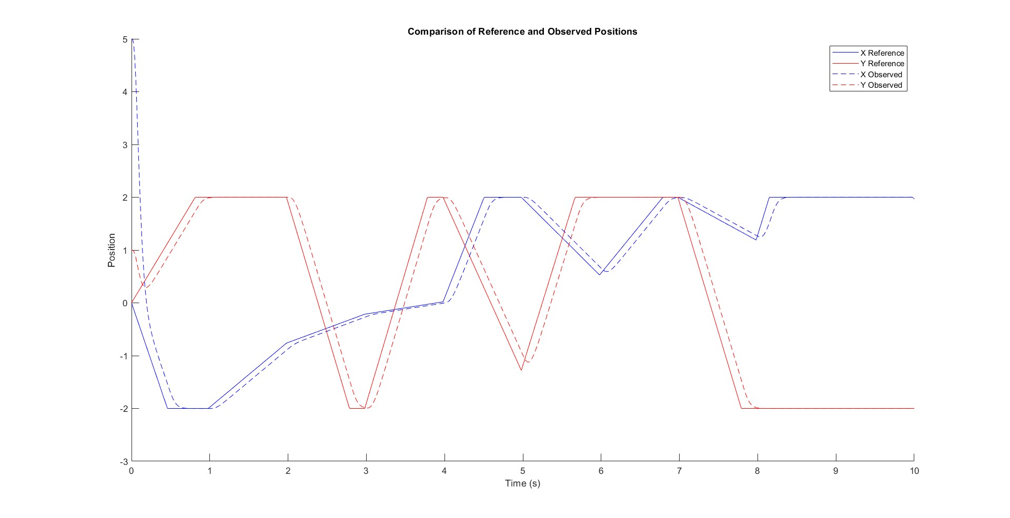
PLOTS
RANDOM PATH TRACKING*
*RUN CODE (PLOT NO:3) TO GENERATE LIVE SIM(AND MP4 video)

Slide 14
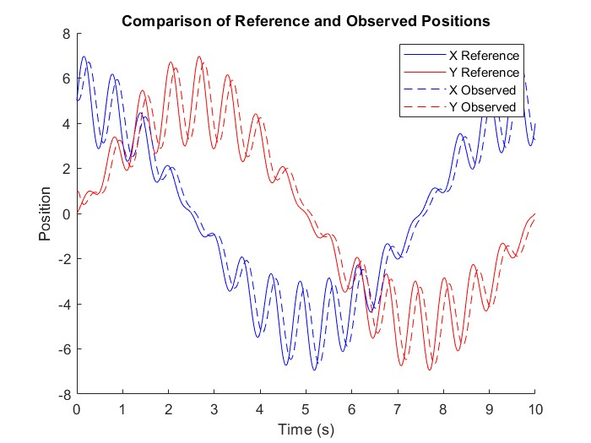
Simulation plots
Sinusoidal circle*
*RUN CODE (PLOT NO:2) TO GENERATE LIVE SIM(AND MP4 video)

Slide 15

PRACTICAL UTILISATIONS
SHIP DECK LANDING OF A UAV
WAREHOUSE ROBOT NAVIGATION
DRONE SURVEILLANCE
CROP SPRAYING FROM DRONES
LOGISTICS AND DELIVERY DRONE ROUTING WITH ADAPTIVE PATHS
urveillance

Slide 16
THANK YOU
QnA

