Slide 1
01 / PRODUCT
The product is a controlled path from brief to publishable draft
The system is an intelligent interface between a marketing team and its prospective customers.
1. BRIEF
2. GROUND
3. DRAFT
4. REVIEW
A human enters the campaign goal, audience and channel.
Curated primary + secondary Markdown sources are assembled deterministically.
OpenAI generates a channel-specific draft with reviewer notes.
Edit, revise, approve and export — only after human action.
AI Content Creator
16

Slide 2
02 / WHY NOW
The problem is not “can AI write?” — it is “can a brand stay itself?”
Generic AI-Slop creates copy that is smooth, interchangeable and weakly accountable.
GENERIC AI-SLOP
BUSINESS COST
DESIGN RESPONSE
• Broad slogans
• Homogenized tone
• Unclear source of truth
• Unsupported claims hide in fluent copy
• Weak differentiation
• Inconsistent brand identity
• More reviewer rework
• Slower path to approved copy
• Two curated knowledge bases
• Prompt-level grounding rules
• Channel-native templates
• Human review as a hard gate
Distinctive because it is specific, useful and traceable — not because it is “creative” in the abstract.
AI Content Creator
16

Slide 3
03 / STRATEGY
A small, explicit operating model keeps the prototype honest
Quality, Time and Cost are treated as constraints — not afterthoughts.
QUALITY
TIME
COST
Grounded in verified source notes
Distinct channel tone
Claim traceability
Obvious UI states
Two-day end-to-end demo
At most two active cards
Pair/review work protects flow
Day 2 demo path first
Configurable model
Bound generation/revision calls
Usage captured when available
Agreed team budget: USD 5
Stakeholders
Sergii · technical lead Sandra · primary KB owner Martha · evaluation/usability reviewer
Top risk: unsupported or stale claims → source-grounding + peer review + approval gate
AI Content Creator
16

Slide 4
04 / DELIVERY
The WBS maps directly to the Kanban path
Planning closure precedes development; the team protects a two-card WIP limit.
PLAN
KNOWLEDGE
GENERATION
INTERFACE + EVAL
DELIVERY
1.1 Board alignment
2.1 Primary KB
2.2 Secondary KB
3.1 Ingestion
3.2 Context + RAG
4.1 OpenAI
4.2 Templates
4.3 Pipeline
5.1 Streamlit
5.2 Uniqueness
6.1 Runtime
6.2 Docs + demo
Maximum two active cards team-wide; every card needs an owner, reviewer, Must ID and verification evidence.
AI Content Creator
16

Slide 5
05 / KNOWLEDGE
Two knowledge bases separate authority from context
The distinction prevents competitor or trend material from becoming an accidental Patagonia fact.
PRIMARY / PATAGONIA EVIDENCE
SECONDARY / INDUSTRY CONTEXT
4 Markdown documents
Brand voice observations
Published examples
Product facts — style 84212
Care, repair and reuse
Authority for Patagonia claims
2 Markdown documents
Competitor context
Outdoor participation + textile reuse
Positioning input only
Never transfer competitor features or claims to Patagonia
Markdown → parser → metadata + sections → deterministic context bundle → prompt
AI Content Creator
16

Slide 6
06 / ARCHITECTURE DECISION
RAG was consciously deferred — and measured conditions are defined
Current implementation: fixed, deterministic context injection. No query-based retrieval, embeddings or vector store.
WHY THIS FITS NOW
WHAT IS IMPLEMENTED
WHEN TO REVISIT
Small, stable corpus
Reviewable baseline
Two-day schedule
Bounded source inclusion
Simple failure modes
Loads 6 curated Markdown files
Serializes primary + secondary contexts
14,474 serialized characters
40,000-character guardrail
One smoke-test request: 4,230 tokens
Corpus grows or overlaps
Frequent updates
More diverse briefs
Measured token/latency burden
Review burden makes fixed inclusion inefficient
RAG becomes justified by measured corpus size, request diversity, update frequency and context limits.
AI Content Creator
16

Slide 7
07 / TECHNICAL FLOW
From Markdown sources to a reviewable draft
The pipeline is intentionally inspectable at each boundary.
INGEST
ASSEMBLE
PROMPT
GENERATE
REVIEW
document_processor.py
Parse Markdown; validate metadata; preserve sections
knowledge_base.py
Build deterministic primary + secondary context
prompt_templates.py
Apply grounding, channel constraints and anti-slop rules
llm_integration.py
Call configurable OpenAI model; capture usage
content_pipeline.py
Feedback, revision, edit, approval and export
Human gate: the draft cannot become approved/exported content without explicit confirmation of the exact revision.
AI Content Creator
16

Slide 8
08 / DEMONSTRATION
The working application demo follows one visible state machine
Demo path: load campaign → generate → revise/edit → approve → export.
CAMPAIGN
DRAFT
REVIEW
EXPORT
Channel selector
Brief text area
Load campaign
Implemented in app.py
Generate draft
Channel copy
Reviewer notes
Response metadata
Feedback for revision
Manual edit
Save edit
Approval checkbox
Dirty edits block approval
Approve exact revision
Download Markdown
Download JSON metadata
Human action required
Evidence status: Instagram path manually verified; LinkedIn/email live checks pending. No application screenshot is present in the repository.
AI Content Creator
16

Slide 9
09 / UNIQUENESS
The evaluation shows why context beats generic fluency
The evidence is a first-pass fixture comparison, not a claim about live model performance.
GENERIC FIXTURE — FAILED
CONTEXTUAL FIXTURE — PASSED
“Elevate your everyday adventure with a game-changer.”
No Patagonia context
Flags: “elevate your” + “game-changer”
Names the Nano Puff jacket
Connects to a changing forecast
Includes repair + reuse guidance
No flagged generic phrases
Specificity · Productive tension · Channel-native writing · Anti-slop control
AI Content Creator
16

Slide 10
10 / PROMPTING
Advanced prompting turns brand intent into testable constraints
The system does not ask the model to “be creative”; it specifies what good looks like and what must not happen.
GROUNDING
CHANNEL SHAPE
ANTI-SLOP
Primary is authoritative
Secondary is positioning only
Separate facts from interpretation
Preserve limitations and dates
Instagram: 60–120 words
LinkedIn: 120–200 words
Email: subject/preheader/body limits
One CTA; format-native rhythm
Avoid cliches and superlatives
No vague sustainability claims
No invented facts
Return copy + reviewer notes
Prompt output is inspectable: source paths/URLs, facts used, interpretations and unresolved limitations.
AI Content Creator
16

Slide 11
11 / IMPLEMENTATION
The technical spine is small enough to inspect end-to-end
Repository structure, configuration and AGENTS.md are part of the product discipline.
DOCUMENT PROCESSING
INTEGRATION
DELIVERY SURFACE
src/document_processor.py
MarkdownIt parser
Required metadata schema
Heading-path sections
Source URLs + access dates
src/llm_integration.py
OPENAI_API_KEY
OPENAI_MODEL
Usage capture when available
No secrets logged
app.py — Streamlit
src/main.py — CLI
templates/*.md
outputs/ — approved exports
tests/ — automated checks
AGENTS.md keeps scope explicit: Must IDs M1–M8, human approval, no fabricated facts, no secrets and no unapproved scope expansion.
AI Content Creator
16

Slide 12
12 / LEARNING
The hard parts were control problems, not syntax problems
The project’s solutions are boundary decisions: what to include, what to exclude, and how to prove it.
CHALLENGE
SOLUTION
LESSON
Grounding without retrieval
Small corpus, mixed authority
Risk of context leakage
Separate primary/secondary
Deterministic bundle
Metadata + section traceability
Measured revisit conditions
Do not infer RAG need from hype
Do not call a fixture a benchmark
Human review remains part of the system
A strong prototype can say “not measured yet” — as long as it records what would change the decision.
AI Content Creator
16

Slide 13
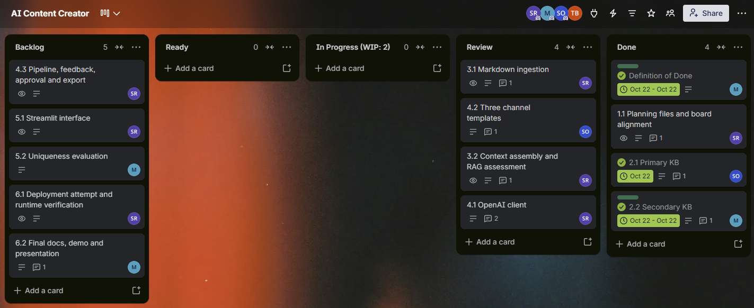
13 / KANBAN EVIDENCE
Day 1 made the work visible; Day 2 turned it into a demo path
Actual Day 1 board evidence is preserved in the repository.
DAY 1 — VERIFIED
Planning, KBs, loader, context injection, templates, offline integration, live Instagram smoke test; 62 offline tests passed.
DAY 2 — TARGET / STATUS
Pipeline, UI, review/export, evaluation, docs and presentation. Instagram path manually verified; LinkedIn/email live checks remain pending.
Screenshot source: docs/evidence/p2-kanban-day1.png
AI Content Creator
16

Slide 14
14 / OUTCOMES
What exists now — and what remains deliberately open
The outcome is a grounded, reviewable prototype with a clear next decision set.
IMPLEMENTED
LIMITATIONS
NEXT DEVELOPMENT
Two KBs + metadata
Deterministic context
Three channel templates
OpenAI integration
CLI + Streamlit flow
Human approval/export
No RAG / vector store
No automated publishing
No auth/database/scheduling
Cost not calculated
LinkedIn/email live checks pending
No production deployment evidence
Preserve live generic/contextual outputs
Measure repeated-request burden
Revisit retrieval when evidence says so
Add broader runtime validation
Capture application screenshots
AI Content Creator
16

Slide 15
BRIEF
GROUND
DRAFT
REVIEW
APPROVE
One clear takeaway
Specificity + source discipline + channel-native prompting
make the output more distinguishable and more reviewable.
Thank you
AI Content Creator — Patagonia Content Studio

