Slide 1
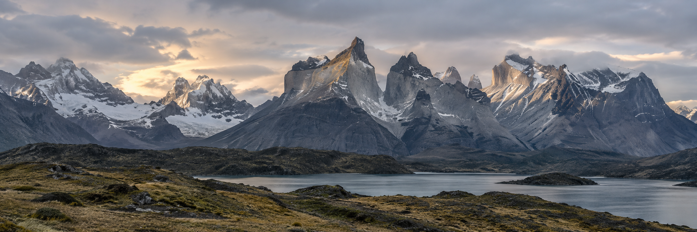
FINAL PRESENTATION
0:45
Patagonia Content Studio
A grounded generator for Instagram, LinkedIn and email
BRIEF → GROUND → DRAFT → REVIEW
Specific enough to verify.
Structured enough to review.
Human approval before export.
Sergii Rostovskyi · Sandra Obregon · Martha Olukayode
English-language Patagonia content studio prototype
Product scope: Men's Nano Puff Jacket, style 84212
Patagonia Content Studio | Card 6.2 | M7 + M8
01
Notes:
Slide 1 — 0:45 — Martha
Frame the project as a reviewable company brand generator for three channel formats.
The goal is an English-language Patagonia studio that drafts from curated source material without inventing facts. Introduce Sergii, Sandra and Martha.
Do not present a final RAG status callout as completed unless the evidence pack confirms it.

Slide 2
01 / PROBLEM
1:15
The content problem has two failure modes
A small, reviewable workflow keeps fluency from outrunning evidence.
GENERIC COPY
GROUNDING RISK
CHANNEL FIT
Broad language sounds interchangeable.
Reviewers have little to verify.
Specific product detail gets lost.
Fast generation can blur:
• product facts
• secondary context
• editorial interpretation
Instagram, LinkedIn and email
need different shapes, limits
and calls to action.
Q / T / C
QUALITY
TIME
COST
Grounded claims
Channel fit
Traceable review notes
End-to-end demo by Day 2
WIP capped at 2
Protect the demo path
Configurable model
Bounded generation / revision calls
Agreed team budget: USD 5
TOP RISK Unsupported or stale claims | control: source grounding + peer review + human approval
Patagonia Content Studio | Card 6.2 | M7 + M8
02
Notes:
Slide 2 — 1:15 — Martha, with Sandra for the KB point
Connect the problem to the project structure: the team needed a small, reviewable content studio with a human approval step.
Foreground the top risk: unsupported or stale claims. The control is primary-source grounding, explicit limitations, peer review and a human approval gate.
Mention that Sergii, Sandra, Martha, the hypothetical Patagonia approver and the instructor sit in Quadrant I, high interest and high influence. Keep Q/T/C visible. Do not claim the app eliminates generic language or guarantees factual safety.

Slide 3
02 / SOLUTION
1:30
Curated sources become channel-specific drafts
Primary evidence, secondary context and reviewer reasoning stay visibly separate.
PRIMARY KB
SECONDARY KB
LOADER
PROMPTS
REVIEW
4 Markdown files
Patagonia facts + metadata
2 Markdown files
Trends + competitor context
Preserves source,
heading and metadata
Instagram · LinkedIn
Email-specific shapes
Notes → edit →
approve → export
CURRENT RAG DIRECTION
DECISION TRADEOFFS
OpenAI embeddings · local SQLite index
Hybrid factual-first retrieval · mutable source UI
Upload / edit / delete with retrieval provenance
Targeted evidence selection
Source / version updates
Context cost + implementation complexity
Evidence boundary One live Instagram RAG draft reached manual edit, approval and export.
Other-channel RAG acceptance, live RAG revision and final deployment remain unestablished.
Historical baseline: deterministic full-context injection fit the small, stable corpus; retrieval is justified by measured scale, diversity, update frequency and review burden.
Patagonia Content Studio | Card 6.2 | M7 + M8
03
Notes:
Slide 3 — 1:30 — Sandra, with Martha for evaluation
Explain the architecture progression. The original small, stable corpus justified deterministic full-context injection. Owner-authorized mutable sources and targeted evidence selection motivate the current RAG direction.
Current confirmed RAG status: OpenAI embeddings, a local SQLite index, hybrid factual-first retrieval and source upload/edit/delete UI with provenance. Sergii performed the real browser verification: one live Instagram RAG draft was manually reviewed and edited, approved and exported.
Defend the direction using three tradeoffs: targeted evidence selection adds retrieval logic; source/version updates add source-management responsibility; context cost and implementation complexity must be measured. Do not claim lower cost, higher accuracy, or complete channel acceptance.
The historical comparison is one qualitative sample per channel, not statistical proof.

Slide 4
03 / LIVE DEMO
2:15
One brief, one grounded draft, one human review path
Sergii runs one Instagram generation; Martha makes the review decision.
1 BRIEF
2 GENERATE
3 INSPECT
4 EDIT
5 APPROVE
Enter Instagram brief
One live RAG draft
Copy + notes + provenance
Manual edit once
Export Markdown / JSON
Other channels: show preserved state only.
Do not make extra live calls.
API fallback: saved verified artifact, same narrated path.
WITHOUT SUPPLIED SOURCES vs FULL-CONTEXT INJECTION — historical non-RAG comparison
WITHOUT SUPPLIED SOURCES
FULL-CONTEXT INJECTION
“Built to pack down easily, it’s designed
with convenience in mind”
“The internal zippered chest pocket
that doubles as a stuffsack”
Read the excerpts exactly. One qualitative sample per channel, not statistical proof and not a RAG benchmark.
Patagonia Content Studio | Card 6.2 | M7 + M8
04
Notes:
Slide 4 — 2:15 — Sergii for the app, Martha for the review decision
Sergii performs the single live browser generation using the approved demo brief. Do not promise a particular model response.
Point out channel copy, separate reviewer notes and preserved retrieval provenance. Show the human gate: manual edit, approval of the exact current revision, then Markdown/JSON export.
If the API fails, use the saved verified artifact. Do not make extra live calls for LinkedIn or email.
Read the exact matched excerpts aloud and label the experiment “Without supplied sources vs full-context injection — historical non-RAG comparison.” Do not call it a RAG benchmark or a comparison with the ChatGPT product.
The preserved format observations are one qualitative sample per channel: Instagram 70 vs 81 words, LinkedIn generic 116 below minimum vs contextual 135 OK, and email generic 107 vs contextual 133 under the clarification convention. Do not add scores.

Slide 5
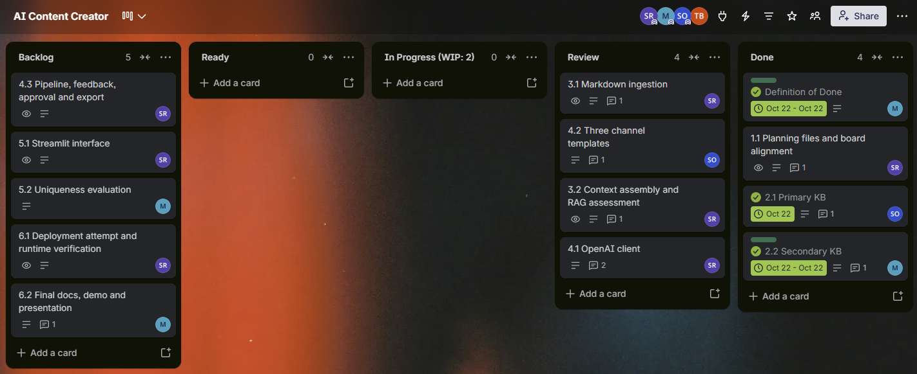
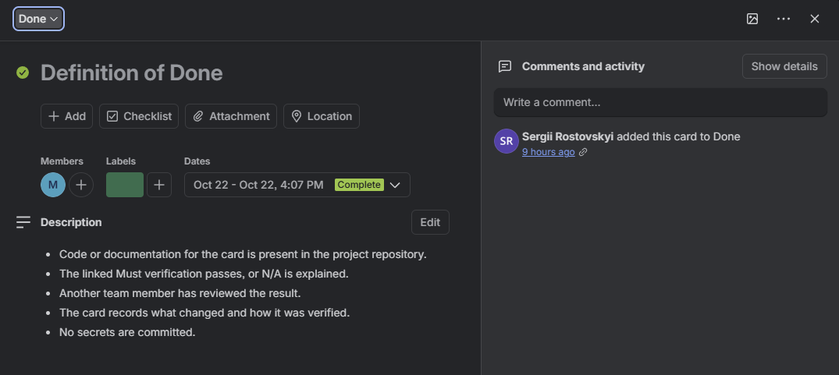
04 / TAKEAWAYS
1:15
What we can defend today
A reviewable prototype with explicit evidence boundaries and a clear next decision set.
DELIVERED
LIMITATIONS
Other-channel RAG acceptance, live RAG revision and final deployment are not established.
• Multi-channel workflow around primary + secondary Markdown KBs
• Facts, interpretation and reviewer notes stay separate
• Human approval gates export
• Historical comparison shows a concrete style-84212 detail
CURRENT RAG STATUS
Embeddings + local SQLite index + hybrid factual-first retrieval
Mutable-source UI with provenance
One live Instagram draft reached edit, approval and export
Day 1 evidence shown.
Day 2 board screenshot remains pending.
Day 1: plan, source, ingest, smoke-test | Day 2: pipeline, UI, evaluation, delivery | WIP = 2 | DoD = artifact + verification + peer review + card record
Patagonia Content Studio | Card 6.2 | M7 + M8
05
Notes:
Slide 5 — 1:15 — Martha, with Sandra and Sergii available for questions
Contrast the board checkpoints. Day 1 evidence includes the actual Kanban screenshot and supplementary Definition of Done screenshot. The actual Day 2 board screenshot remains pending.
Explain the WBS-to-Trello bridge: each WBS leaf became a card with owner, reviewer, Must IDs, dependencies and verification. Card 6.2 owns the final docs, demo and presentation.
Mention the lessons: start with a bounded corpus, add retrieval when mutable sources and targeted evidence selection justify the complexity, keep reviewer reasoning visible, protect the demo path with WIP=2, and treat comparison artifacts as evidence with explicit limits.
State the evidence boundary clearly: Sergii’s one verified Instagram RAG path is real and specific. Other-channel RAG acceptance, live RAG revision and final deployment are not established. Martha read agents.md before this revision and kept the change to presentation artifacts only.

