Slide 1
Git

Slide 2
Agenda
What is VCS?
Where does Git comes from?
Why is Git gaining popularity
Why you should care
Git for geeks
Novice gitians
GitLab – The git laboratory

Slide 3
What is VCS?
Mechanism to keep track your files and folders
Collaborate your work with fellow developers
Track of who did what and when
Backup

Slide 4
Types of VCS
CVCS (Subversion, CVS)
Server is the only master
All commits goes to server
DVCS (Git, Mercurial)
You too are a master
Commits goes locally
Work without even connecting to network
D
A
C
SERVER
A
C
B
B
SERVER
D

Slide 5
A bit more on DVCS
Your local machine is also like a server master repository
No need of internet connectivity to use version control
Committing changes will commit to your local repository
No need to bang on server for history of changes or compares
Insanely fast as most of things you do happens on local machine
Effortless creation of branches
Push code to remote (server) when you connect to network
Fetch code from remote when you connect to network to make your code sync with fellow members changes

Slide 6
Where does Git comes from?
Created by Linus Torvalds for managing Linux kernel back in 2005
Open source in nature (that’s obvious isn’t it?)

Slide 7
Why is Git gaining popularity
Designed for speed and efficiency
Insanely fast because of distribute local nature
Local nature makes creating branch process effortless
Much better that competing tools
Your best friend against
Accidental deletes
Remembering what is changed, when and WHY?
Hard drive blow ups
The local nature of Git makes it possible to coalesce a series of changes (local commits) into a single commit on the remote branch

Slide 8
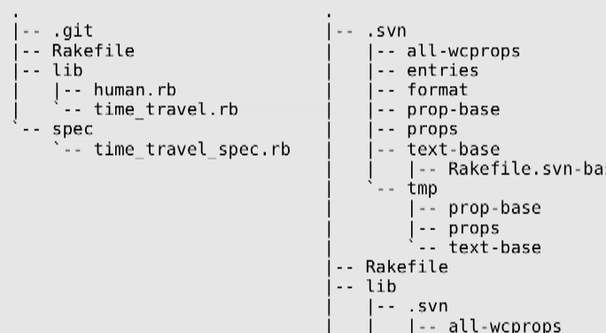
Directory structure

Slide 9
GIT Workflow
Obtain (a.k.a CLONE) a repository
Either via git init, or git clone, or if you already have the repo, pull changes!
Make some edits
Use your favorite text editor or source code IDE
Most IDEs have Git integration, including NetBeans
git tracks changes to binary files too: images, pdf, etc.
Less useful though, than text-based files
Stage your changes
using git add
Commit your work
git commit -m "Always write clear commit messages!"
Push work to remote
git push remotename localbranch:remotebranch

Slide 10
GIT Workflow
Git 101
Remote Repo
git clone
/ git pull
internet
your pc
git push
"a copy of your project"
Working Directory
git add
your edits
Index
"Staging"
git commit
Repository
"your clone of the remote repo"

Slide 11
Git for geeks – First Steps
Set your Git username and email to your global config:
git config --global user.name “Shinu Suresh"
git config --global user.email “shinu_suresh01@infosys.com"*
Setup SSH
ssh-keygen
Copy the public key to your remote repo server (GitLab – We will discuss this later)
Creating a repository (If one not exist in remote)
git init
Cloning a remote repository
git clone git@10.155.104.107:root/hybris-commerce-suite-5.4.1.git
Inspecting your repo
git status – Shows you added, modified, deleted files since your last commit

Slide 12
First Steps cont
git log
git log --pretty=oneline
git log -1
Shows the commit logs in various formats
$ git add
"This command updates the index using the current content found in the working tree, to prepare the content staged for the next commit."
In other words, stage your added, modified or deleted files for committing.
$ git commit -m "What did you change? Log messages matter.“
"Stores the current contents of the index in a new commit along with a log message from the user describing the changes.“
In other words, store the added, modified or deleted files you staged in your repository.

Slide 13
First Steps cont
git push origin master
Pushing to the remote repository (from where you have cloned) branch (refspec) named master
REMEMBER:
If you never commit, you have no history.
If you never push, you have no offsite backup.
As a rule of thumb, commit every hour, push every day.
There is no reason not to commit after every "logical stopping-point" and push when a good section of work is complete, unit tests pass, etc.
After you push, your colleagues can pull changes down from the origin repository to their local working repository.

Slide 14
First Steps cont
git pull origin master (short way is git pull)
Pulling someone else changes from remote repo to your local repo
"Incorporates changes from a remote repository into the current branch. In its default mode, git pull is shorthand for git fetch followed by git merge FETCH_HEAD."
In other words, retrieve changes made to the remote repo and merge them into your local repo, updating your working copy to match.

Slide 15
First Steps cont
git fetch origin master (Short way is git fetch)
Only fetches changes from remote branch. Changes wont be merged to your working code base. You have to do the merge manually
Fetches the changes from remote branch (master) and put it inside origin/master
git merge origin/master
Will merge the changes fetched from remote repo to your local working directory

Slide 16
Workflow visualization
Origin
Origin
internet
your pc
git clone
git pull
--> time -->
git push
(git init)
Repo
Repo
Repo
Repo
edits
git commit
edits
git commit
edits
git commit
Work
Work
Work
git add
git add
git add
Stage
Stage
Stage

Slide 17
First Steps cont - Branching
Why branches?
Try out an idea - experiment
Isolate work units - keep unfinished work separate
Work on long-running topics - come back to things later
Share your work in progress with others without altering the code in production or in development (remote feature branches)
Why is it so important?
Branches are created in local and are pushed to remote
Branch creation is effortless and faster

Slide 18
First Steps cont - Branching
Why is it so important?
Monday: You put all the client's code into a repo, clone it locally
Tuesday: You create a branch to implement a new feature, making several commits
Wednesday: You realize that it would be better to split out the feature into a couple different include files, so you create 2 new files and delete the old one. You commit your work.
Thursday: The client contacts you frantically wanting a hot fix for an issue discovered on the version of the code on the live site.
What do you do now?
You deleted their version of the file on Wednesday, right?
No! You made a branch.
Their original file is in the master branch still!
If you hadn't branched, you would be either downloading their original file again, or reverting your changes back to the version you had on Monday.
Branches are created in local and are pushed to remote
Branch creation is effortless and faster

Slide 19
First Steps cont - Branching
git branch <feature name>
Create a new branch instantaneously
git branch –list
List out all branches in local repository
git checkout <branch name>
Switch current working directory to the specified branch
git merge <branch name>
Merge changes in a local branch to your current branch which is checked out
git merge origin/<branch name>
Merge a remote branch to current branch which is checked out

Slide 20
Branching Workflow
Origin
Origin
internet
your pc
git clone
git pull
git push
Master
--> time -->
Master
git branch "Branch"
git checkout Branch
git checkout Master
git merge Branch
Branch
Branch
Branch
Branch
edits
edits
edits
Work
Work
Work
git add
git commit
git add
git commit
git add
git commit
Stage
Stage
Stage

Slide 21
Branching – Best Practices
"master" is generally accepted to mean the main branch, that tracks what is deployed on the client's site. This is the default; when creating a new repository it will have one branch named master.
"develop" or "development" is typically the name of a single branch that has newer code than what is in master. Un-named bug fixes and improvements.
"featureXYZ" or "issue123" - Branches named for specific features or specific issue tickets in a 3rd party bug tracker.
You can have branches in your local repository that are not tracked, meaning they do not exist in the remote repository. It's up to you.
Even if you never make a feature branch, it's recommended to have at least one "development" branch separate from "master"

Slide 22

Development Branches
QA
Production

Slide 23
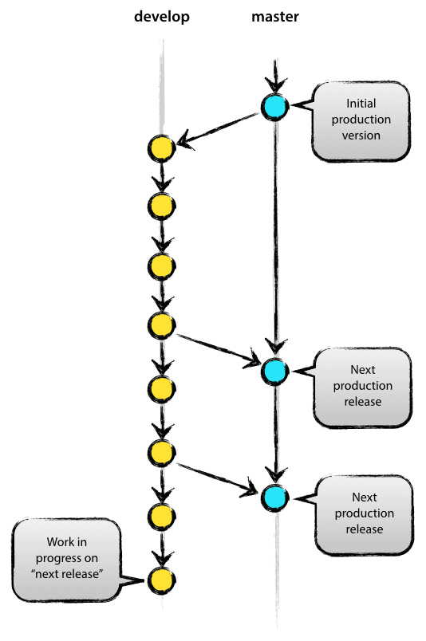
Main Branches
Develop
Master

Slide 24
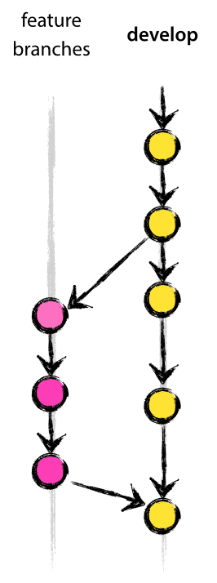
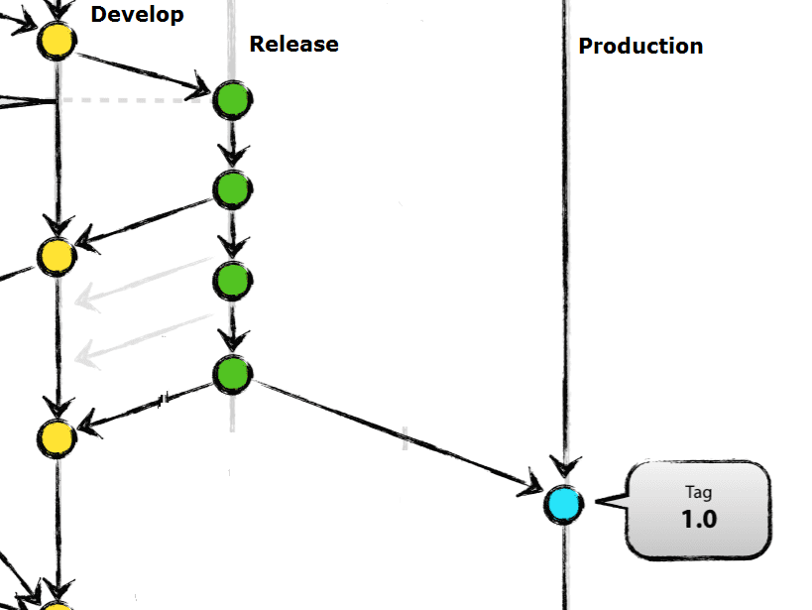
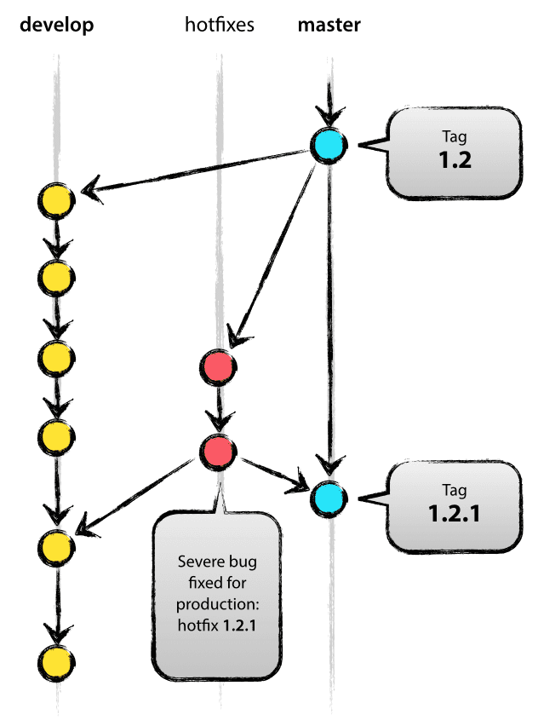
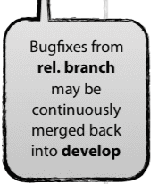
Supporting Branches
Feature
Release
Hotfix

Slide 25
Branch Naming
Feature – Anything except master, develop, release-*, hotfix-*
Eg:- Qas, Autosuggest, ScrollableProducts etc
Release – Release-*
Eg:- Release-v1.0.0 (Follow semver), Release-Woody, Release-CheckoutV2 etc
For more information on semver - http://semver.org/
Hotfix – Hotfix-*
Eg:- Hotfix-v1.0.0-PLPIssue, Hotfix-1.0-JIRA-1928 etc
Tag
Eg:- Tag-v1.0.0 (Following semver), Tag-Woody etc

Slide 26
Novice gitians
Eclipse – Egit plugin
Atlassian SourceTree
Tortoise GIT
Git Extensions
GitEye

Slide 27
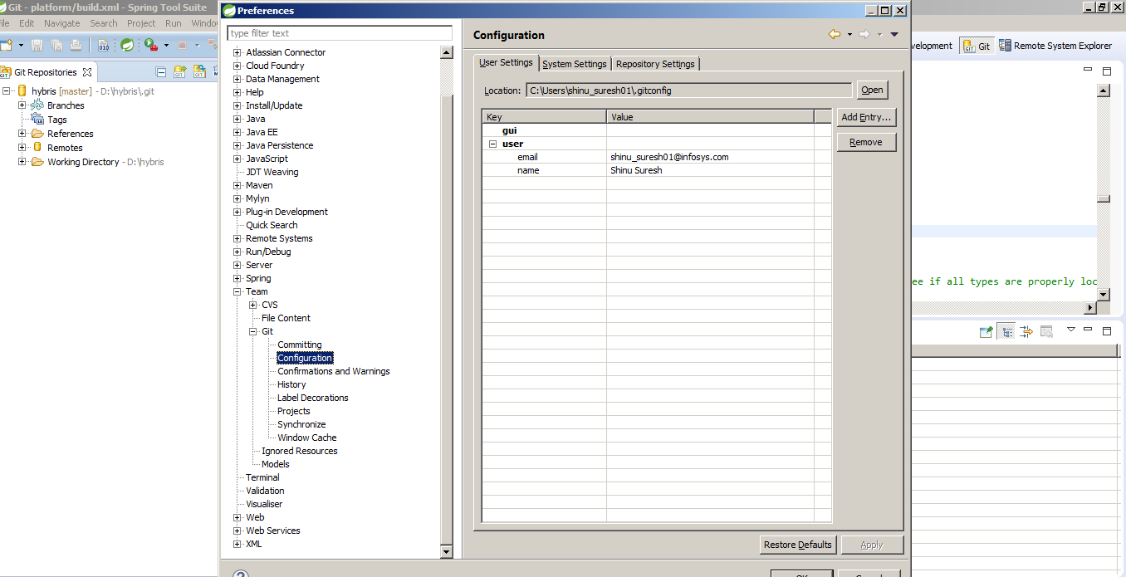
Eclipse – Egit First Steps - Configuration
Add user
Add Email
Window → Preference
→ Team
→ Git
→ Configuration

Slide 28
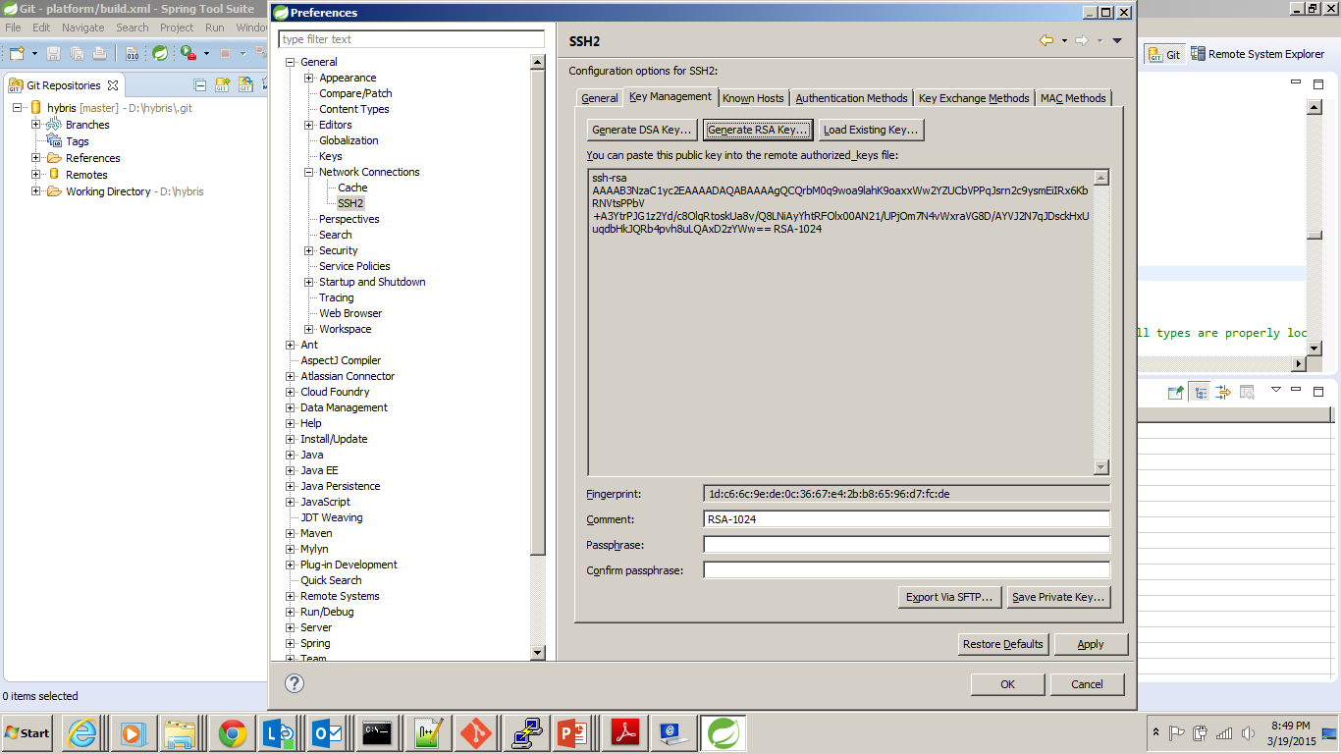
First Steps – SSH Keys
Generate SSH Key
Window → Preference
→ Network Connections
→ SSH2
Copy this key to gitlab
Save private key

Slide 29
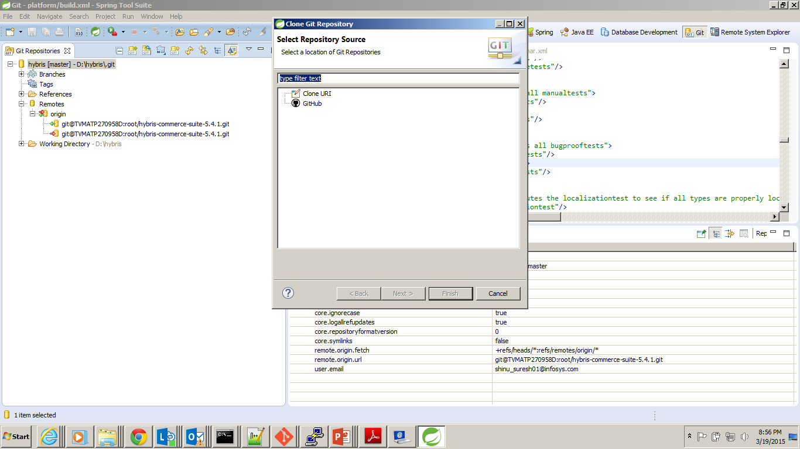
First Steps - Clone
Clone a repository
Perspective - Git

Slide 30
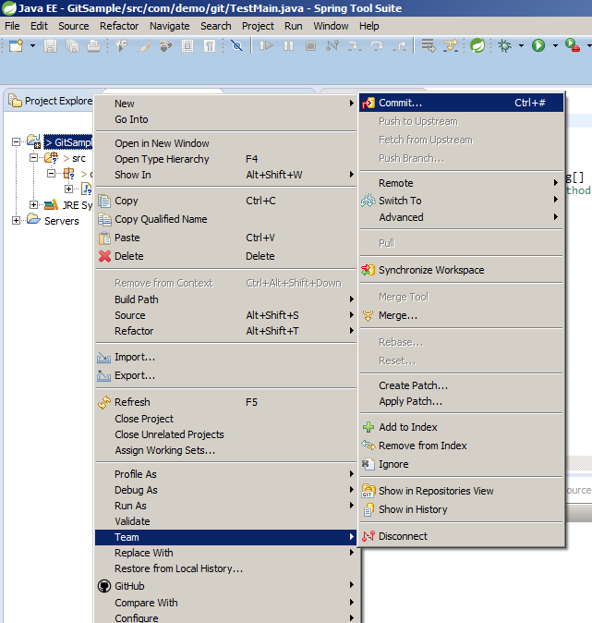
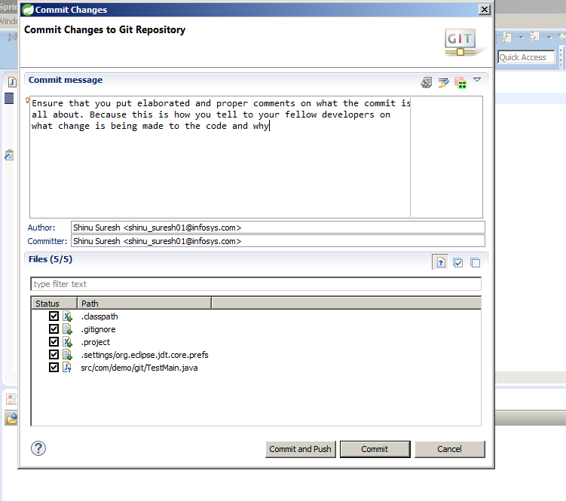
First Steps - Commit
Team
→Commit

Slide 31
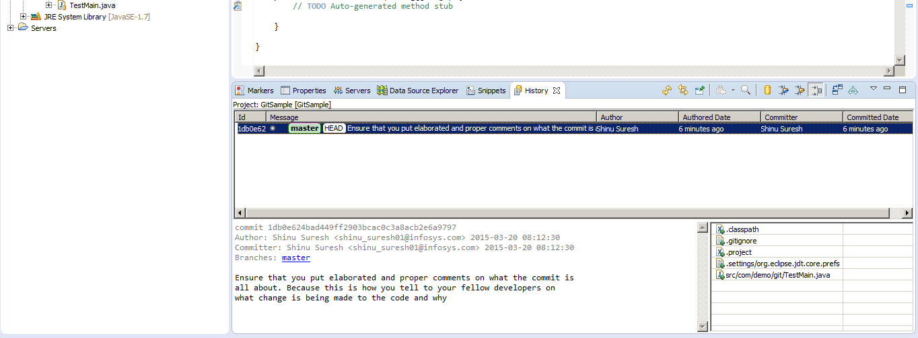
First Steps – History (log)
Team
→Show in History – Commit history in History view

Slide 32
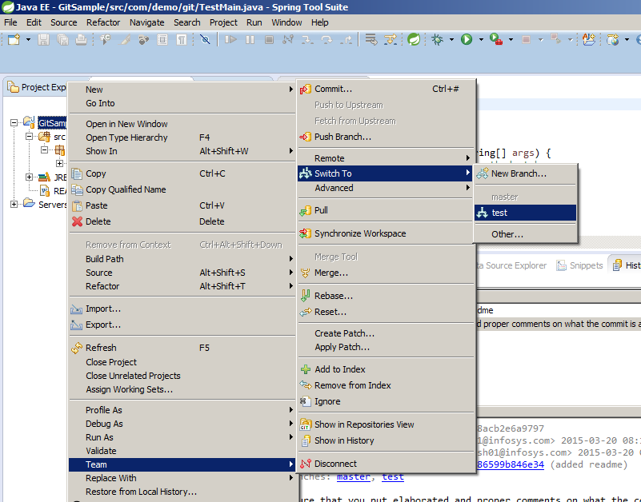
First Steps – Switching Branches
Team
→Switch To

Slide 33
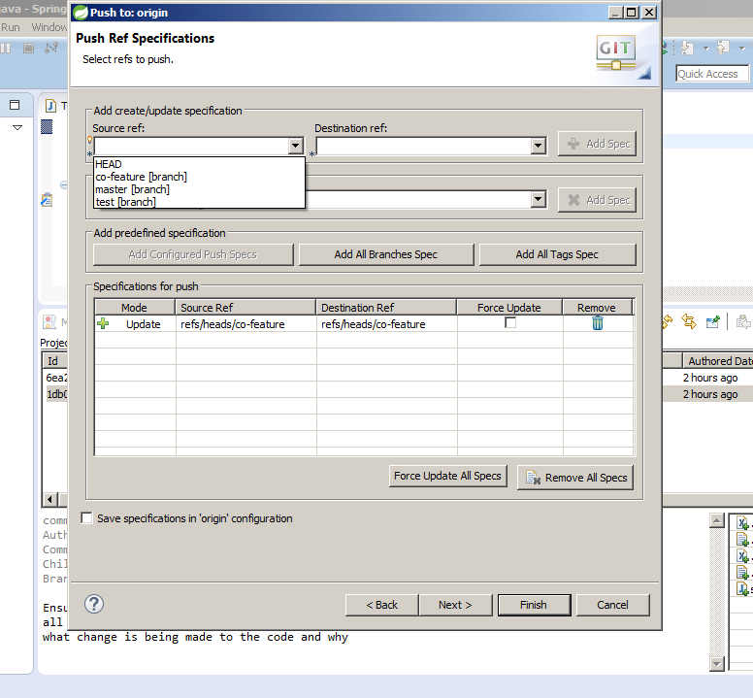
First Steps – Push to remote
Team
→Remote → Push

Slide 34
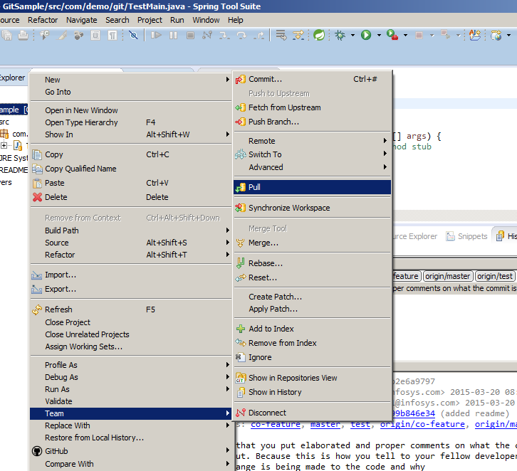
First Steps – Pull from remote
Team
→Pull

Slide 35
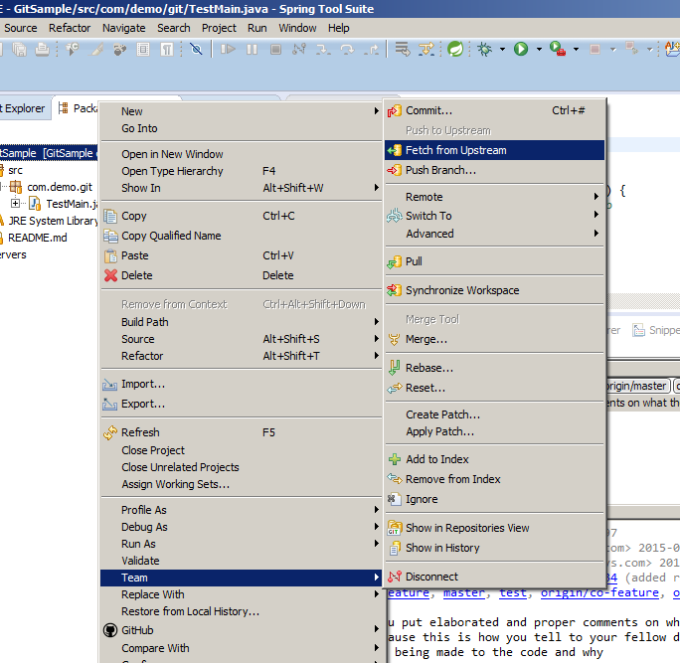
First Steps – Fetch from remote
Team
→Fetch from Upstream

Slide 36
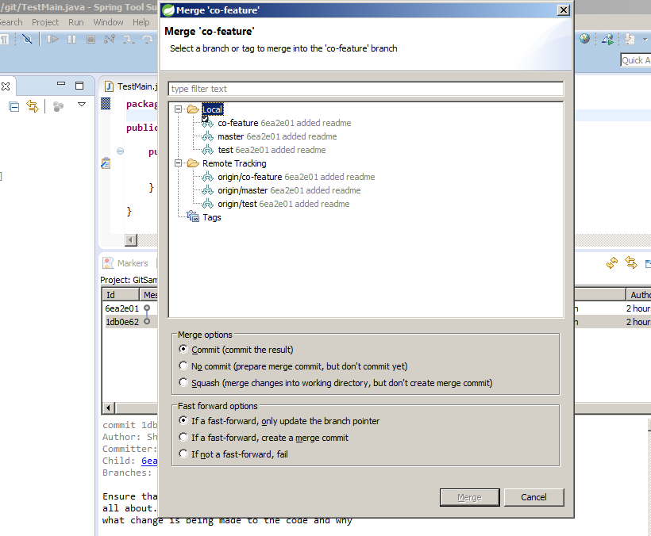
First Steps – Merge
Team
→Merge

Slide 37
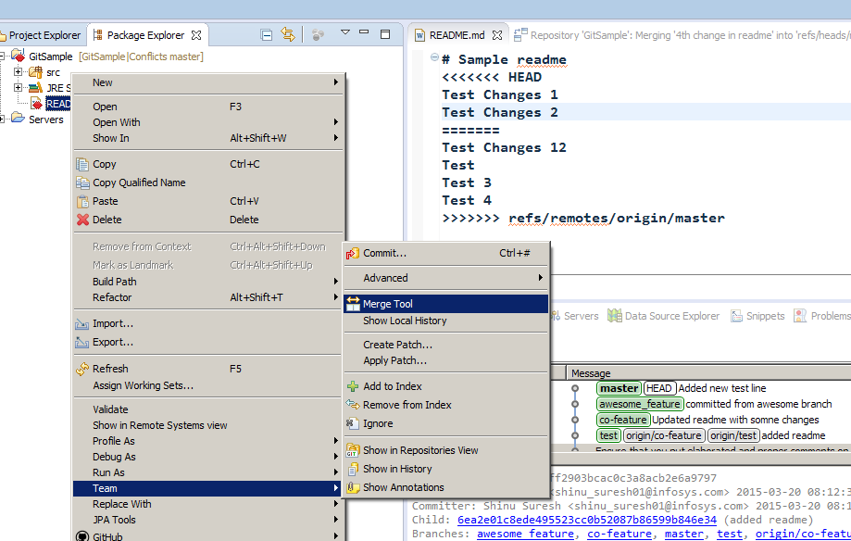
First Steps – Merge Conflicts
Team
→Merge Tool
(Will show only file
Which have conflicts)

Slide 38
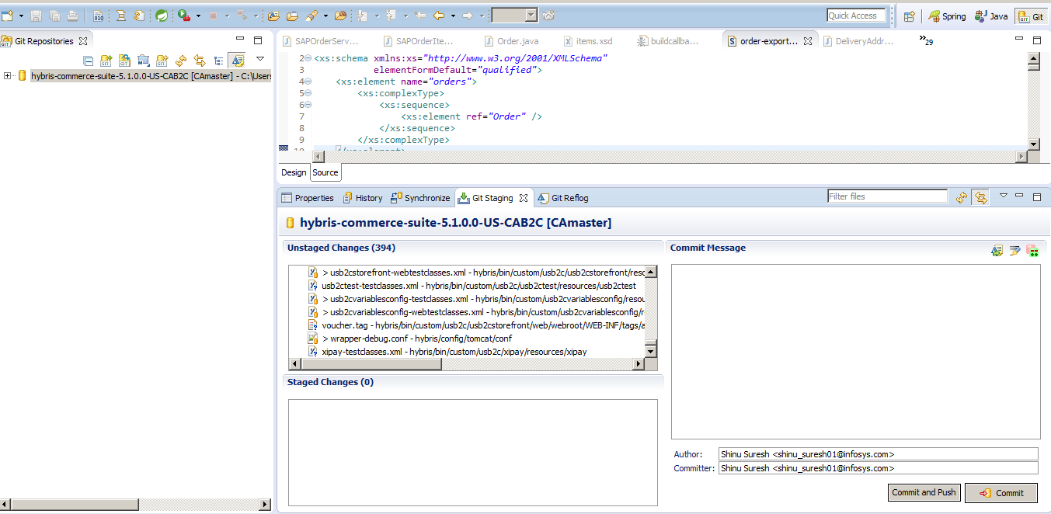
Git Staging View

Slide 39
GitLab
Opensource Git dashboard like GitHub
Activity Stream
File browser
Integrated wiki
Powerful Code review workflow
Issue Management
Code snippets
Web hooks (For CI integrations)

Slide 40
Workflow
Clone Project
Create branch with your feature
Write code, Commit changes
Push branch to GitLab
Review code on commit page
Create a merge request
Your team lead will review the code & merge it to the main branch

Slide 41
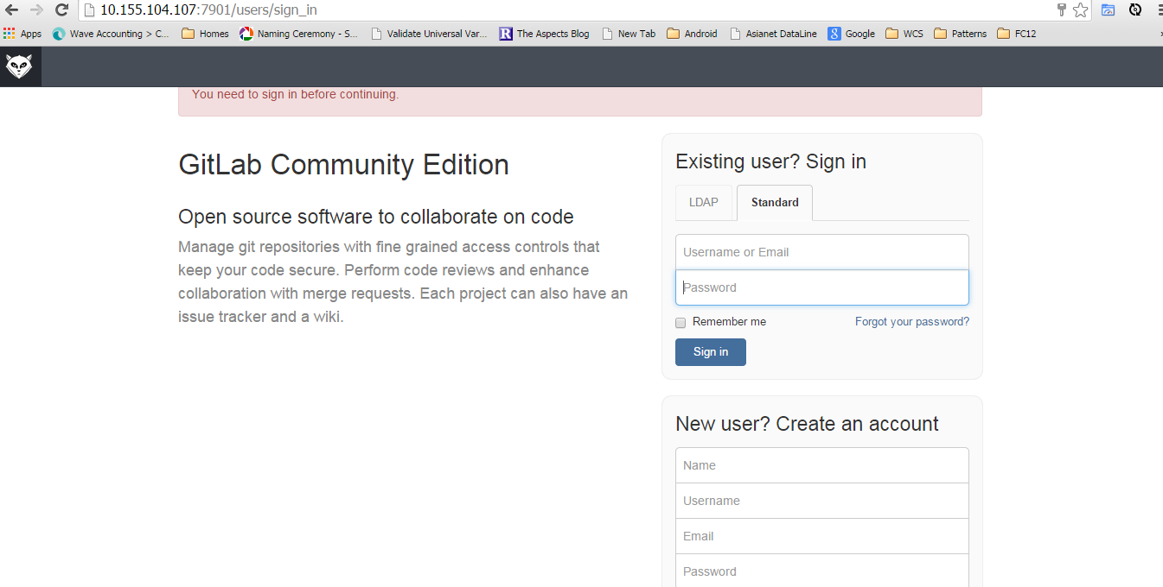
Git Lab – First Steps
Create a New User
Activate account

Slide 42
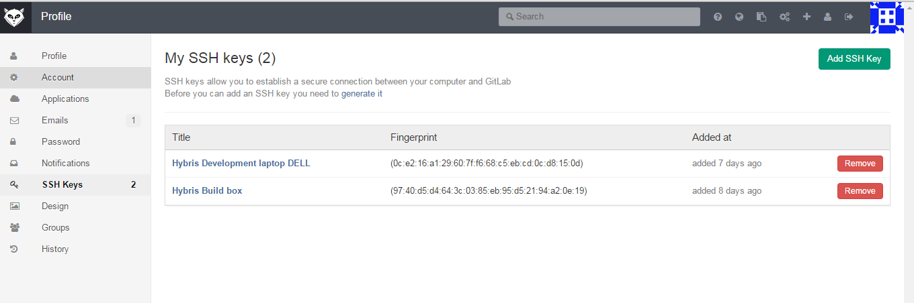
Git Lab – First Steps
Add SSH Key
Profile → SSH Key

Slide 43
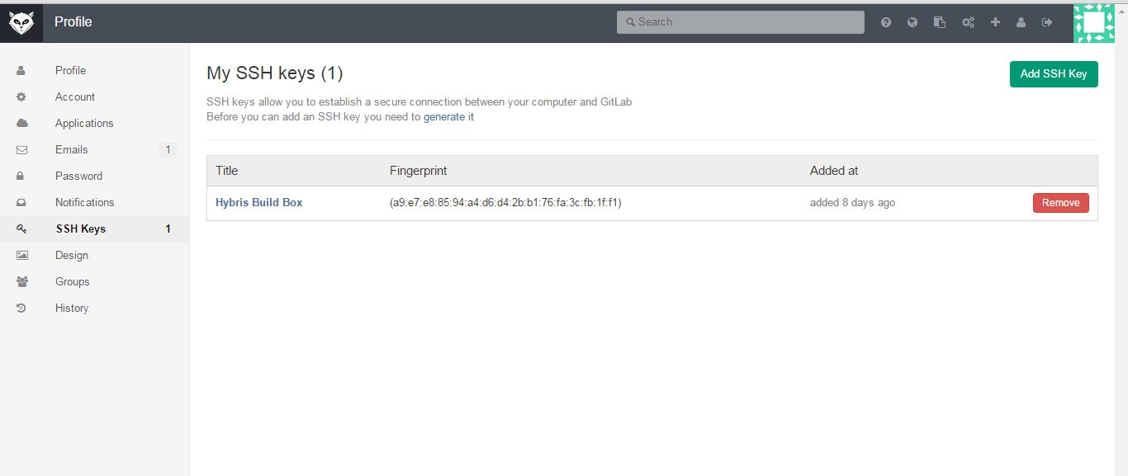
First Steps
Add SSH Key to your account

Slide 44
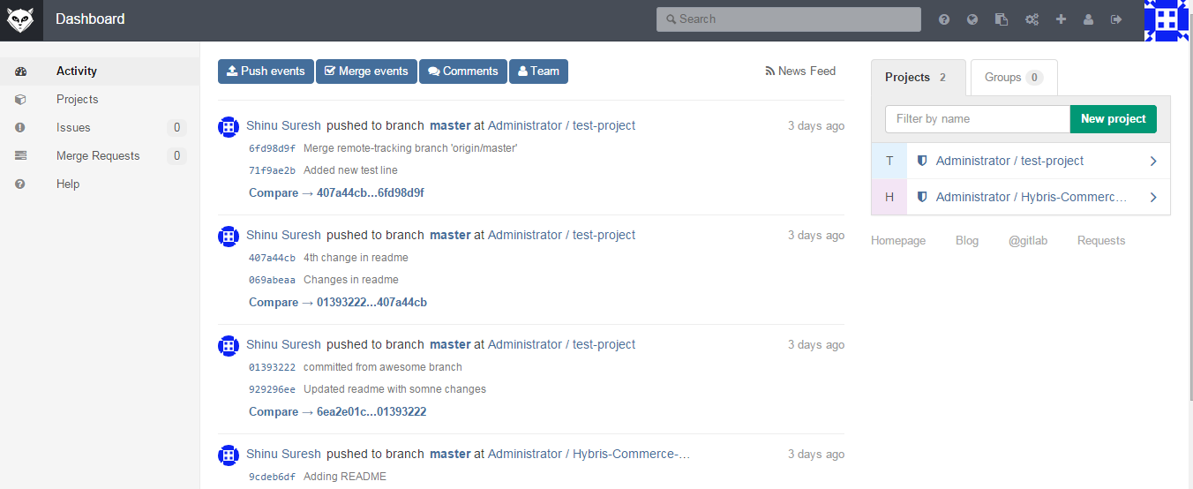
Dashboard – Activity Stream
Activities on project

Slide 45
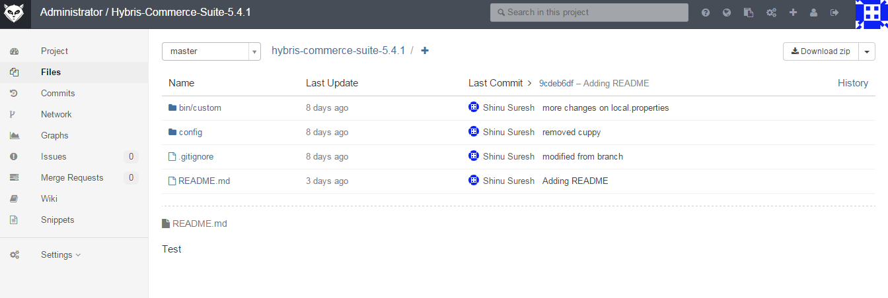
File Browser

Slide 46
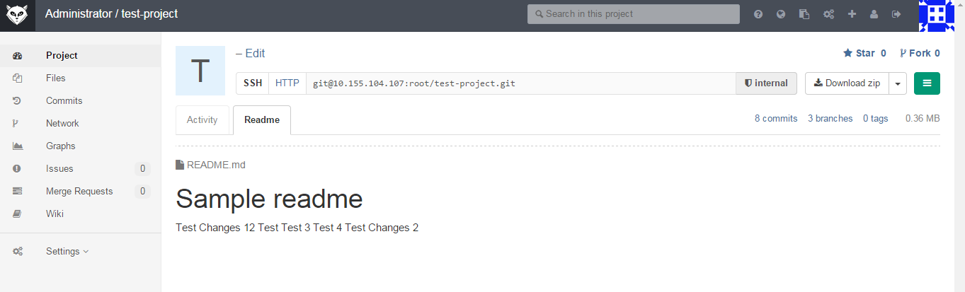
Wiki

Slide 47
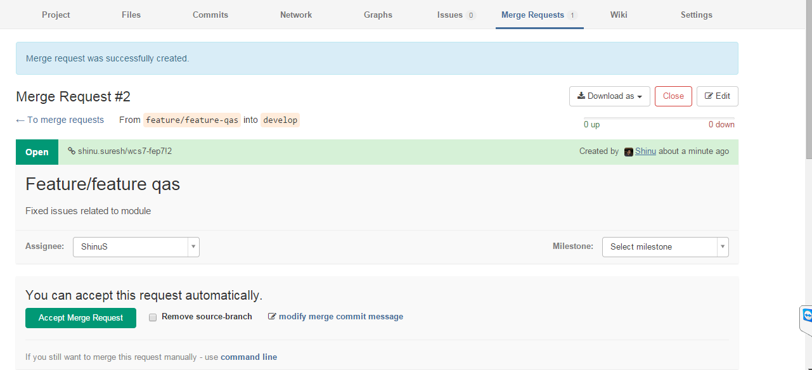
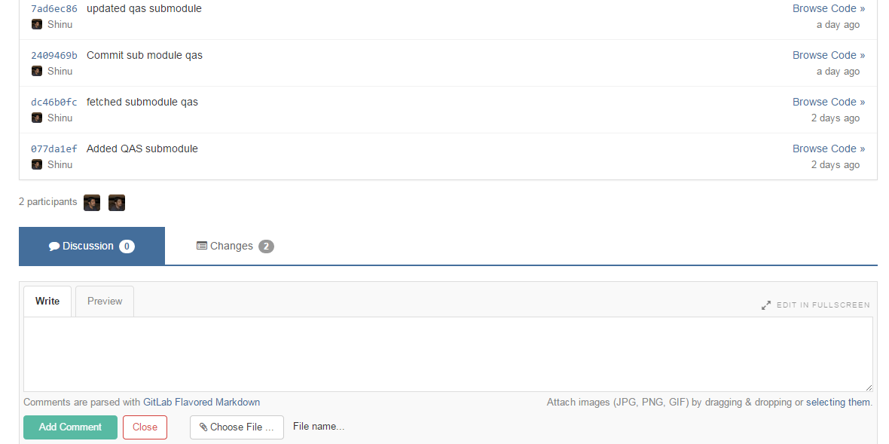
Merge Request & Code Review
Merge requests from branches which are cloned
Eg:- Merge request from development branch
Discuss merge requests. Side by side diff is available for review
Suggest/Accept/Reject changes
Once click merge is available from frontend itself if branch is fast-forward
Emails on merge requests and up on completions

Slide 48
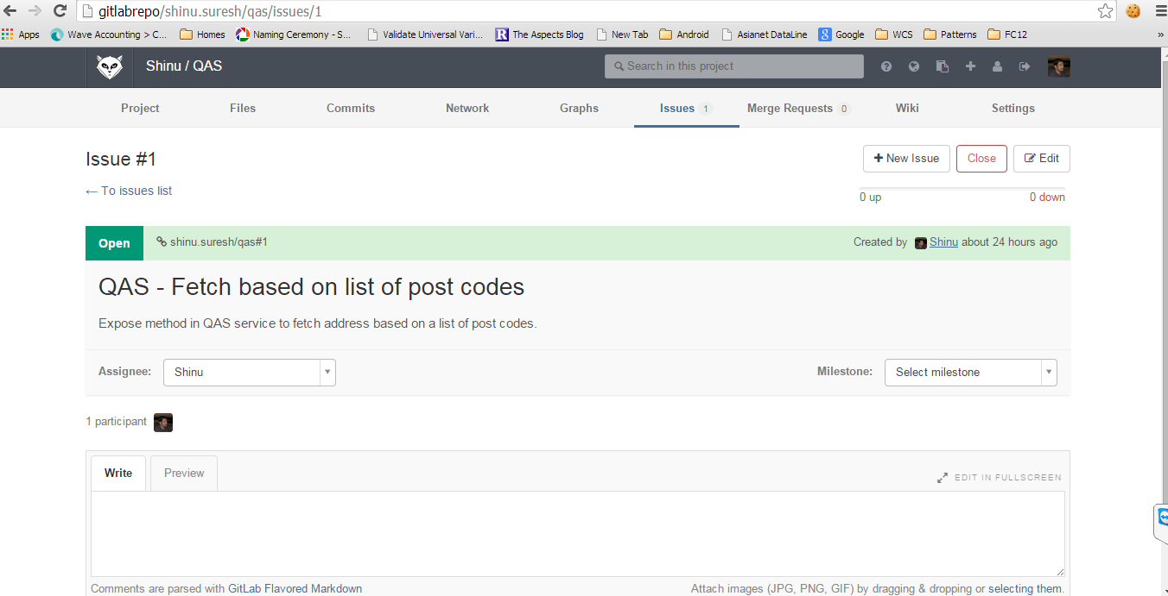
Issue Management
Release requirements can be an issue
Discussion threads
Designs can be discussed over comments
Milestones can be added

Slide 49
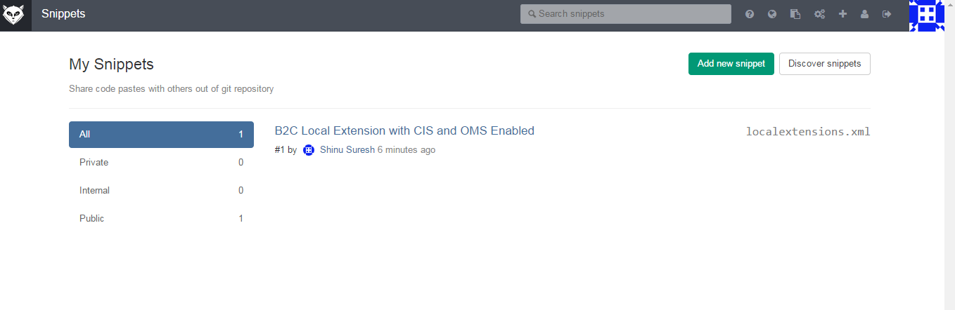
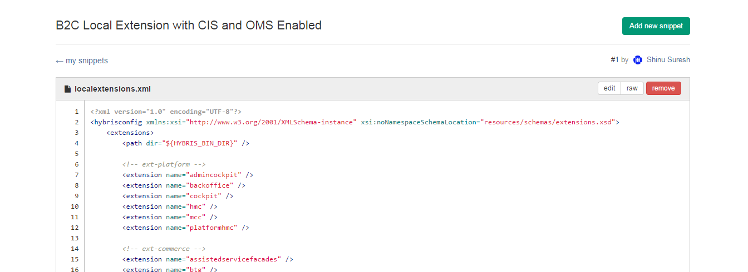
Code Snippets

Slide 50
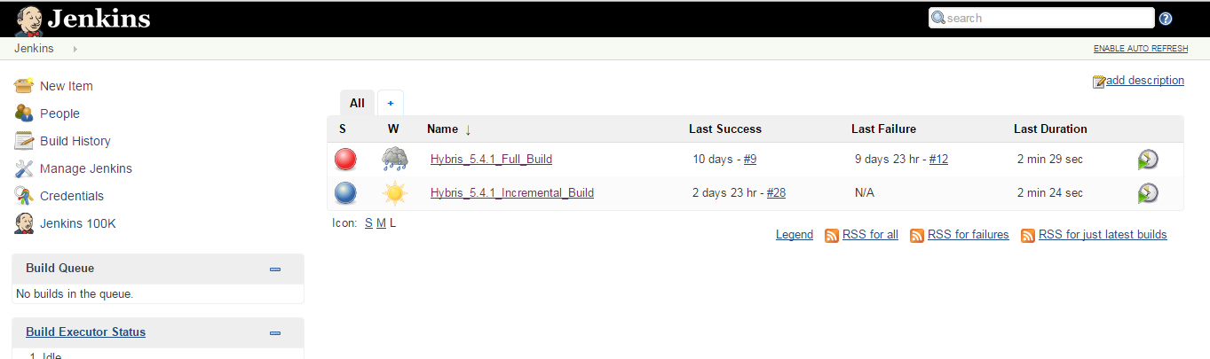
Jenkins Integration - CI

Slide 51
References
https://www.atlassian.com/git/tutorials/
https://try.github.io/levels/1/challenges/1
http://git-scm.com/docs/gittutorial
Eclipse Plugin tutorial
http://www.vogella.com/tutorials/EclipseGit/article.html

