Slide 1
Dimensionality Reduction
PCA and ICA
Saens

Slide 2
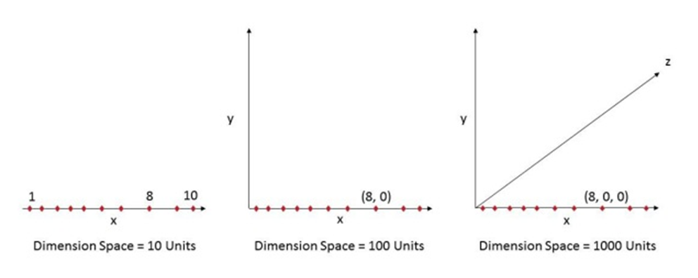
“ Curse of dimensionality ”
As the number of features or dimensions grows, the amount of data we need to generalize accurately grows exponentially.

Slide 3
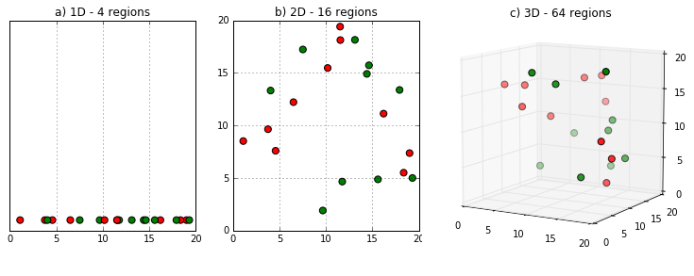
“ Curse of dimensionality ”
As the number of features or dimensions grows, the amount of data we need to generalize accurately grows exponentially.

Slide 4
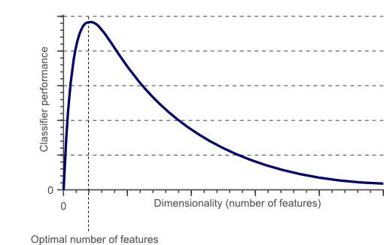
“ Curse of dimensionality ”
As the number of features or dimensions grows, the amount of data we need to generalize accurately grows exponentially.

Slide 5
Dimensionality Reduction

Slide 6
Dimensionality Reduction

Slide 7
Dimensionality Reduction

Slide 8
Dimensionality Reduction

Slide 9

Dimensionality Reduction
LDA :
Linear Discriminant Analysis
Fisher’s LDA
갈아 만든 ldH
같네요

Slide 10
Dimensionality Reduction

