Slide 1

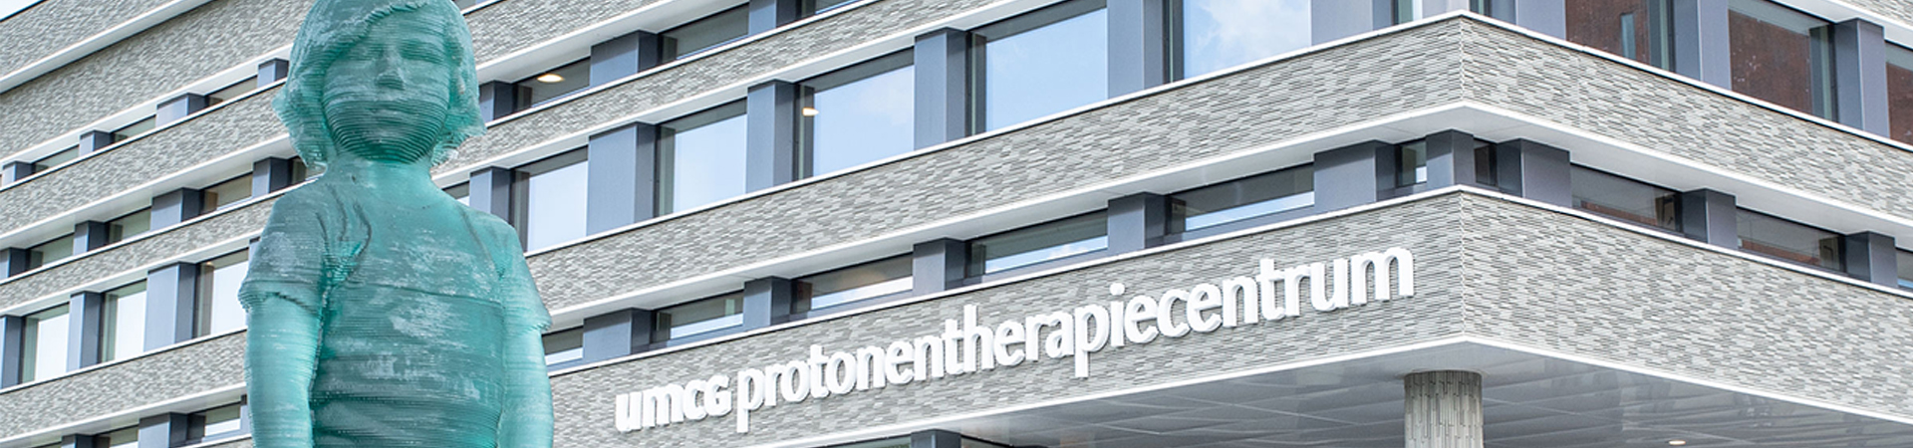
Deep Learning for Dose Based Positioning optimization
Sama Shahpouri, Arthur Galapon, Femke Oosterhof, Gabriel Guterres Marmitt, Stefan Both
Afdeling Radiotherapie, Universitair Medisch Centrum Groningen

Slide 2
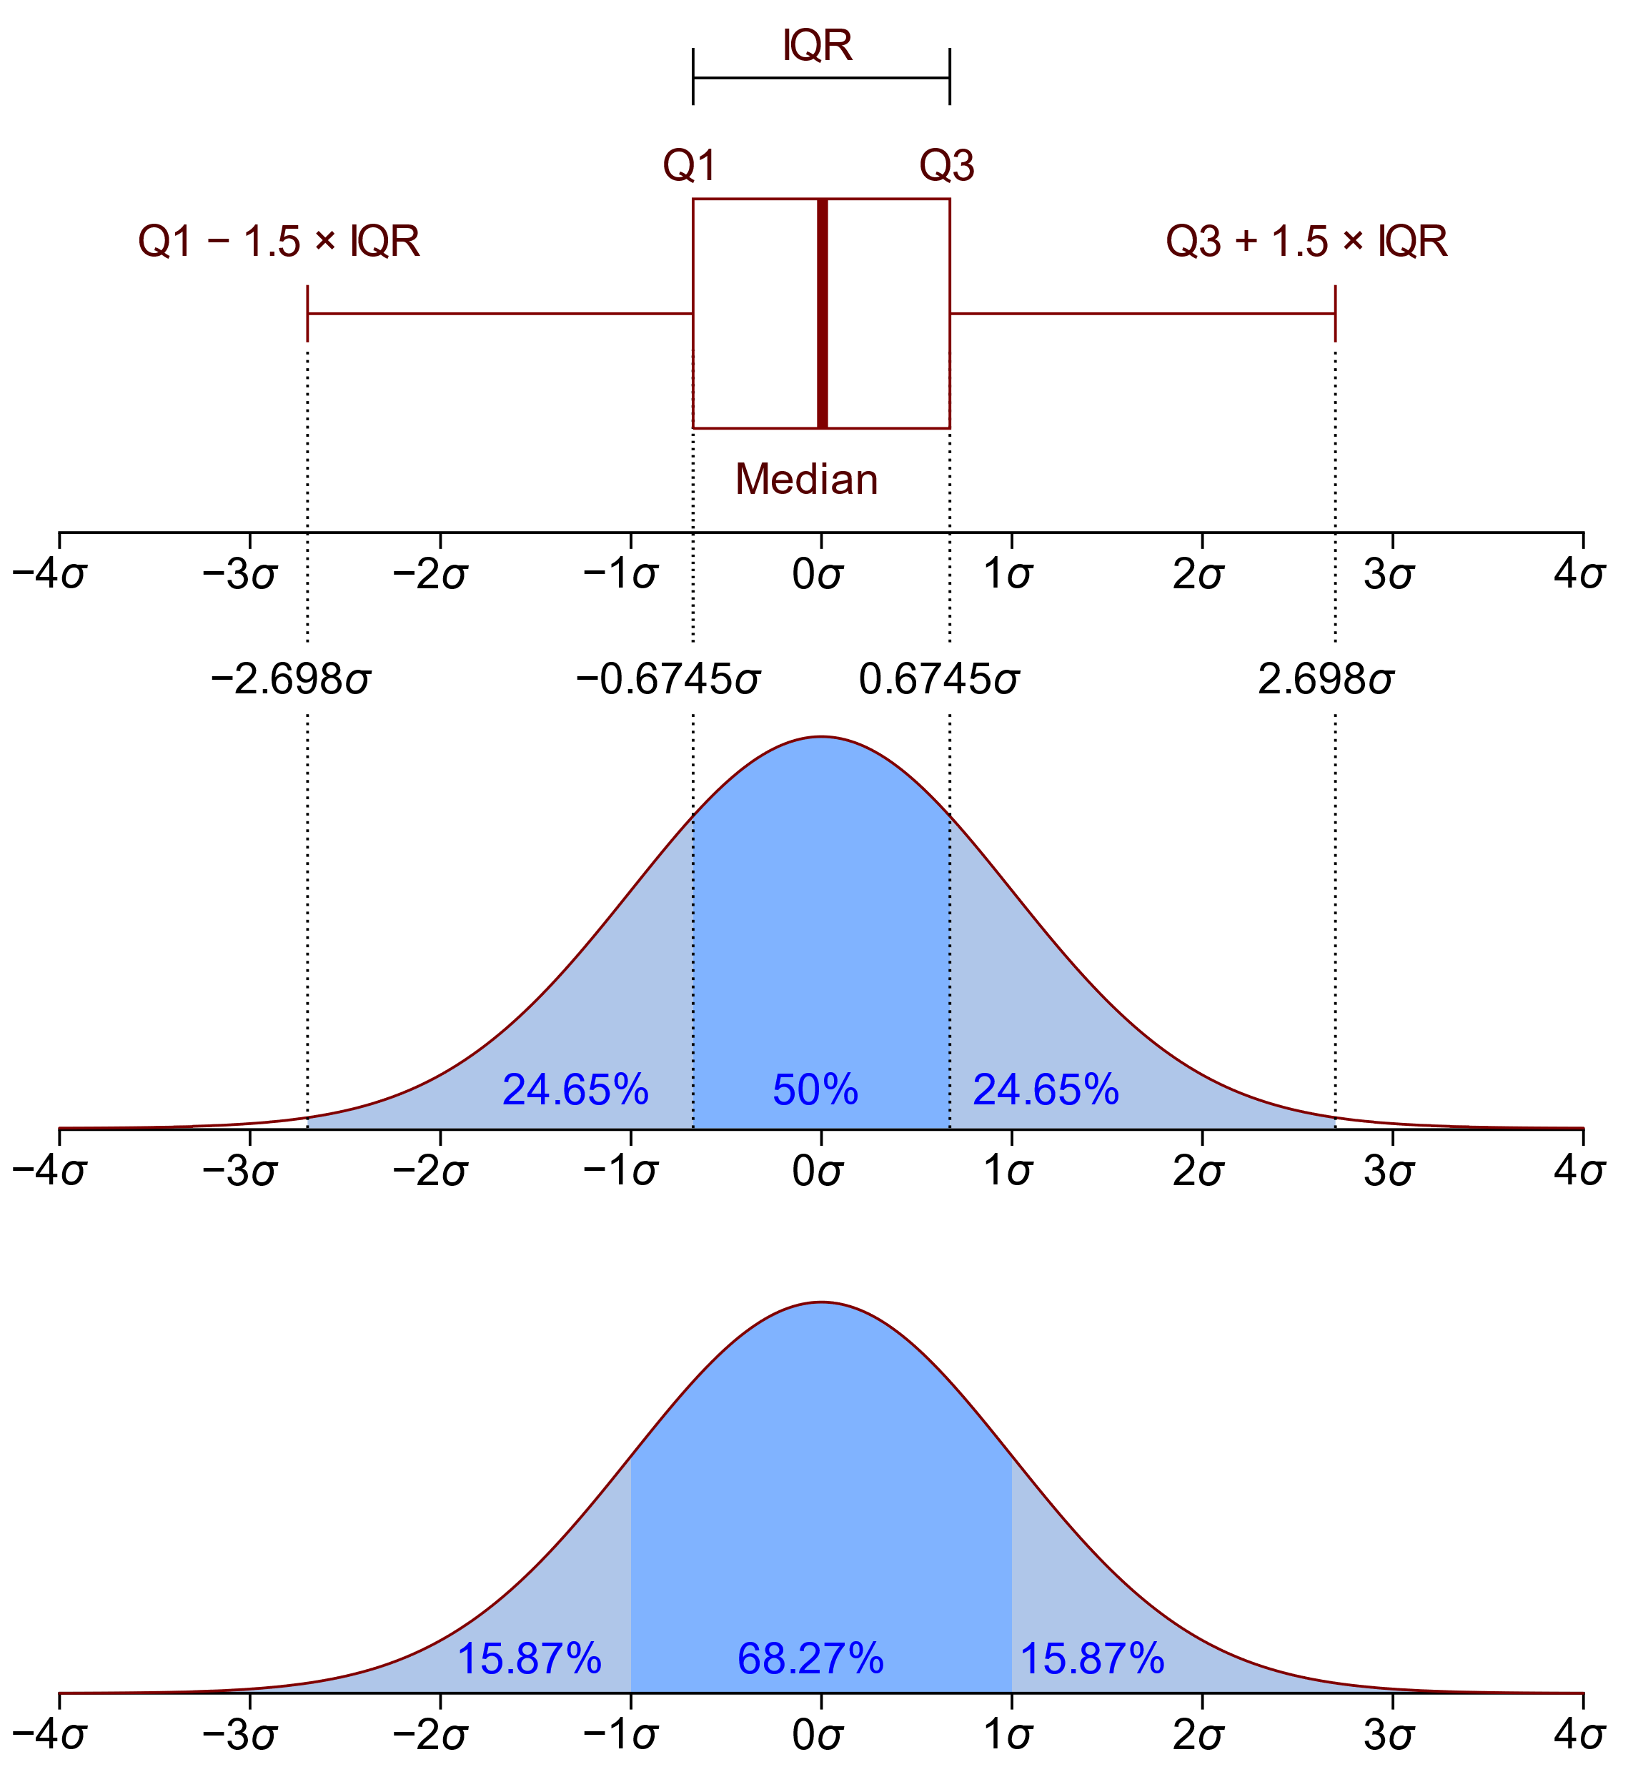
Whiskers plot (Box plot)

Slide 3
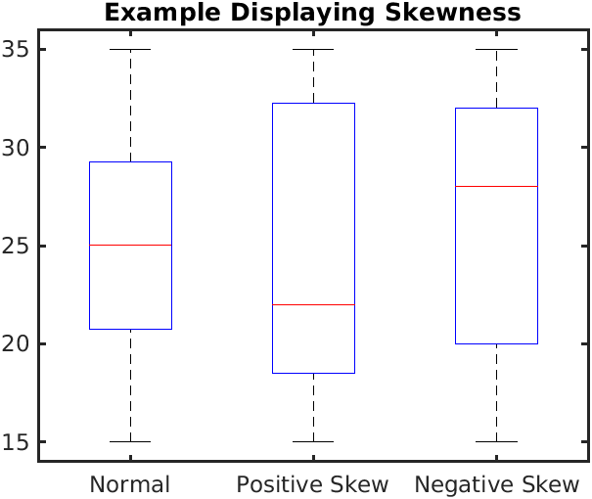
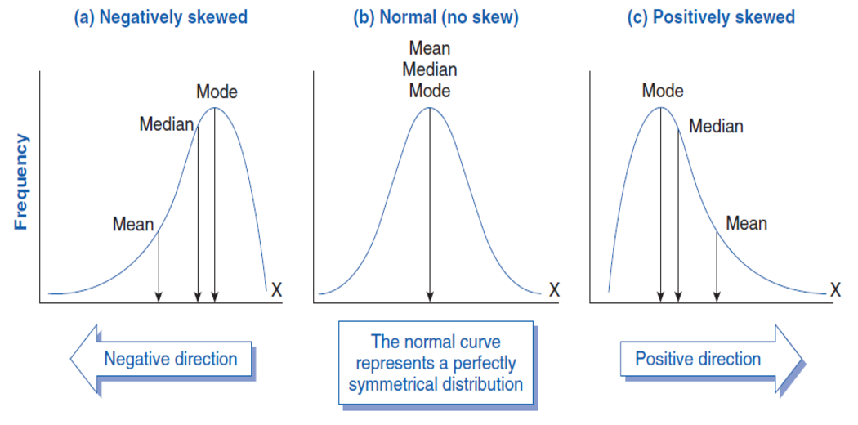
Skewness

Slide 4
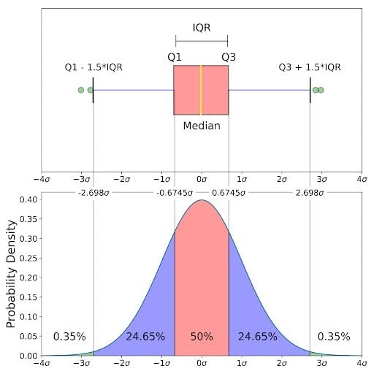

Slide 5
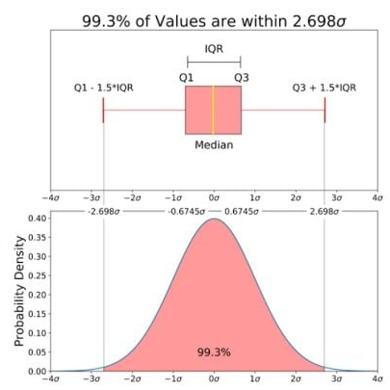

Slide 6
popular choice for the boundaries of the whiskers is based on the 1.5 IQR value

