Slide 1
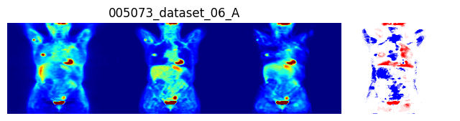
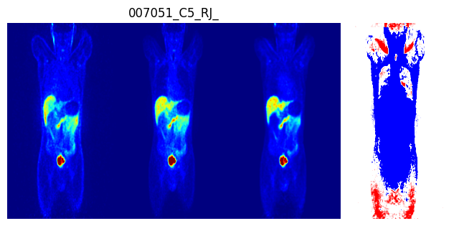
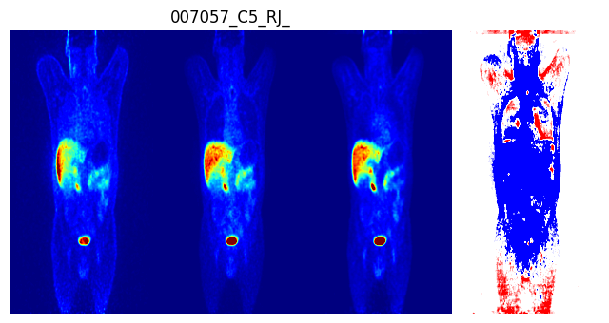
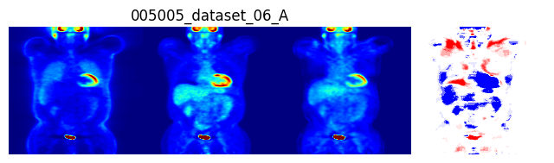

Slide 2
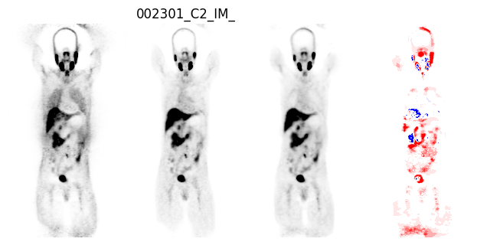
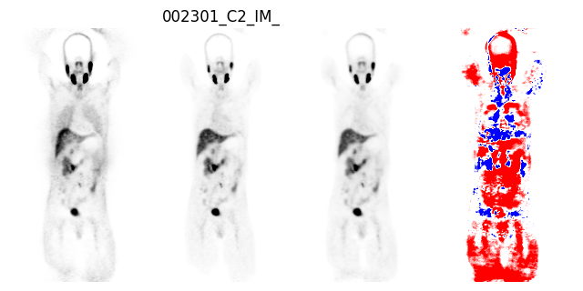
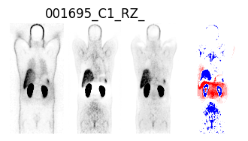

Slide 3
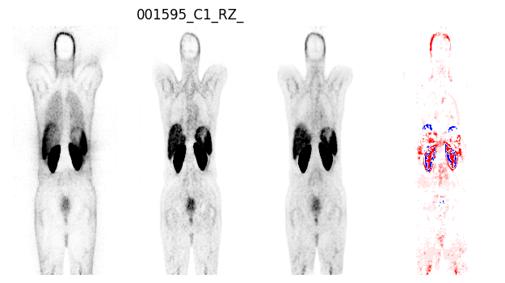
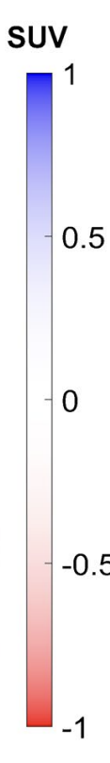
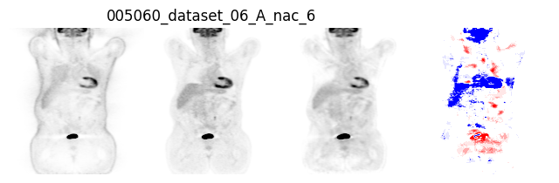
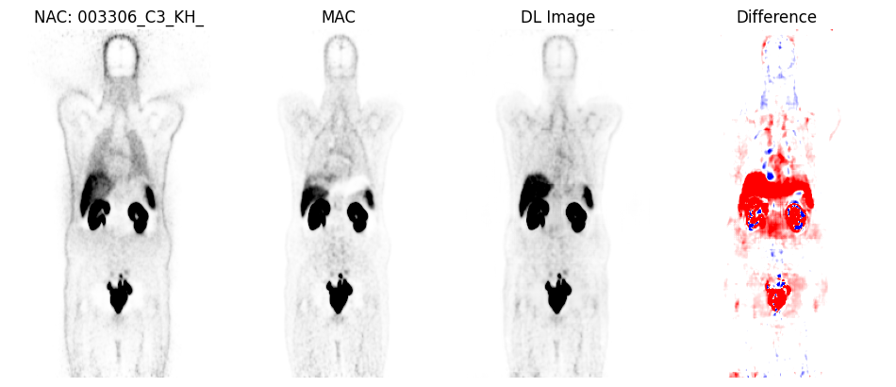
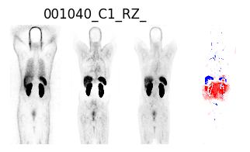
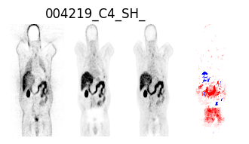
Non-ASC-PET ASC-PET/CT IMCM-DL Difference
⁶⁸Ga non-Artifact
¹⁸F-FDG non-Artifact
Motion Artifact
Kidney Artifact
Bladder Artifact
Figure1: Coronal views of 4 clinical studies showing from left to right, Non-ASC-PET, ASC-PET/CT, IMCM-DL and Difference between ASC-PET/CT and IMCM-DL.

Slide 4
Non-ASC-PET ASC-PET/CT IMCM-DL Difference
Ga Clean
Rt-Center
Motion Artifac
Bladder Artifact
Figure1: Coronal views of 4 clinical studies showing from left to right, Non-ASC-PET, ASC-PET/CT, IMCM-DL and Difference between ASC-PET/CT and IMCM-DL.

