Slide 1

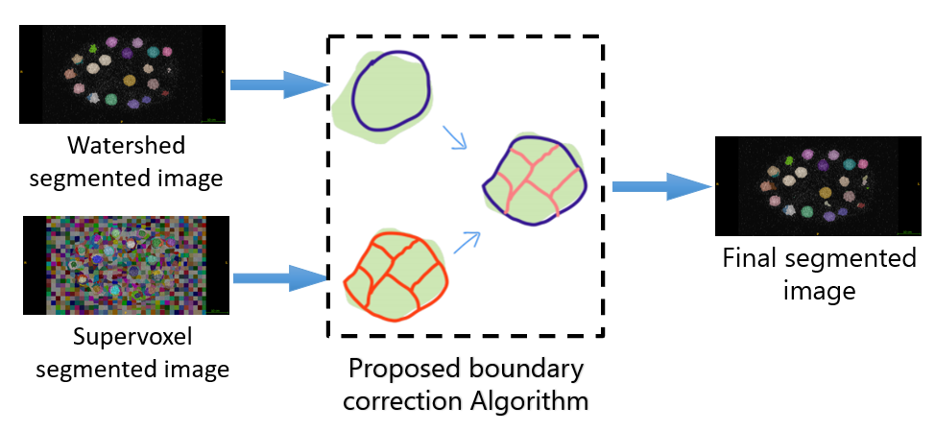
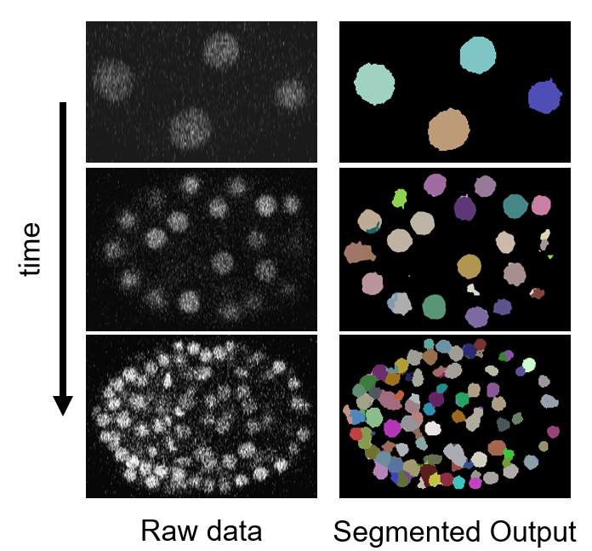
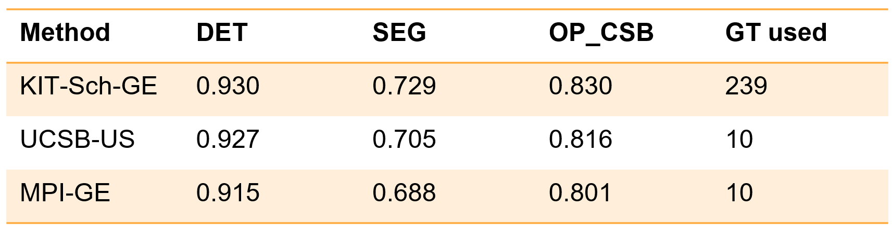
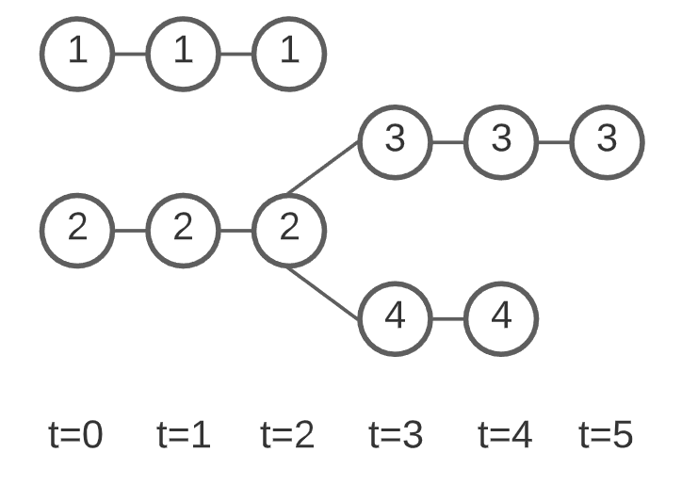
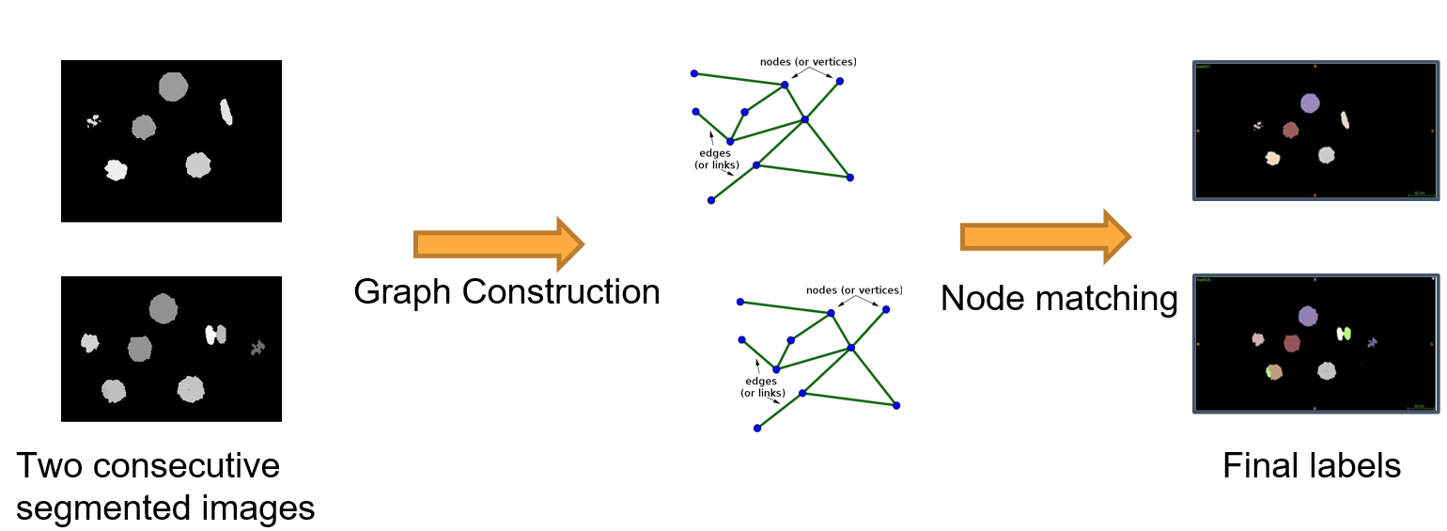
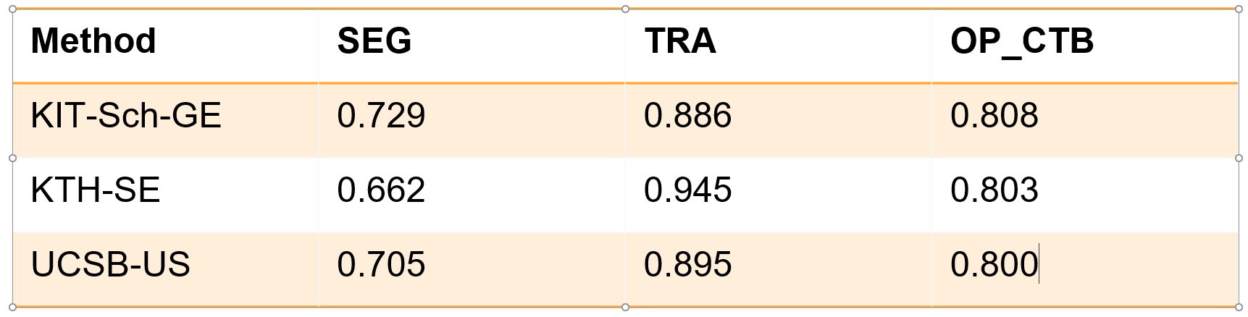
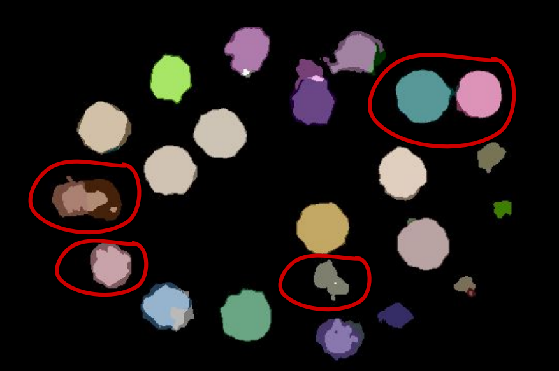
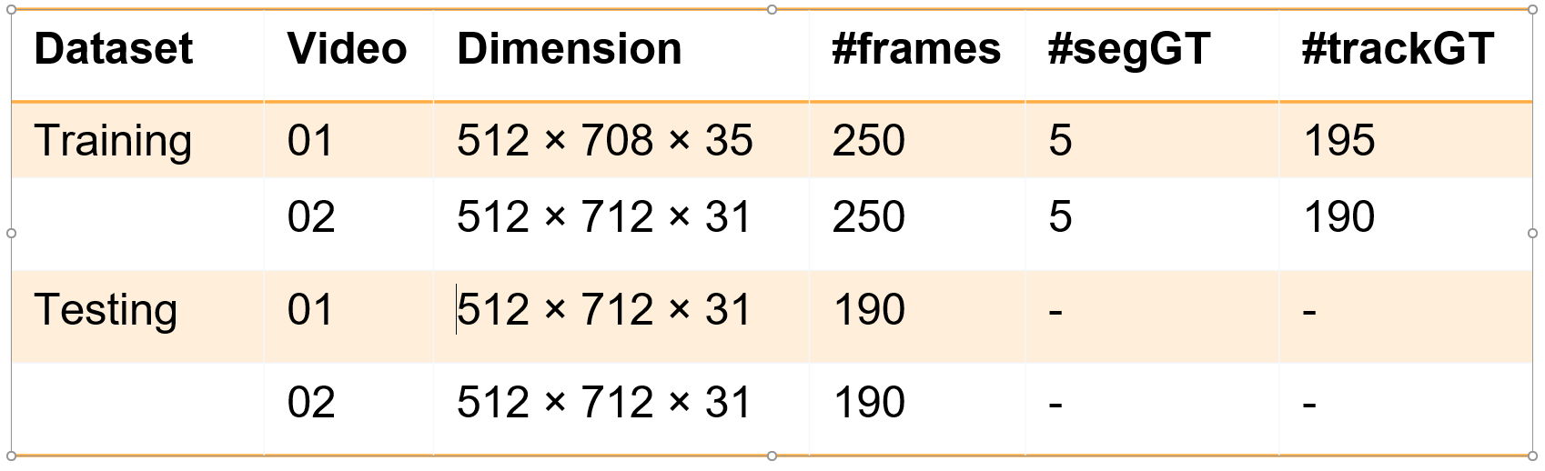
Semi supervised segmentation and graph-based tracking of 3D nuclei in time-lapse microscopy
S. SHAILJA¹ , JIAXING JANG¹ and B.S MANJUNATH¹
1University of California, Santa Barbara
ABSTRACT
A novel weakly supervised method to improve the boundary of the 3D segmented nuclei utilizing an over-segmented image. To track these segmented nuclei, our algorithm utilizes the relative nuclei location depicting the processes of nuclei division and apoptosis.
SEGMENTATION METHOD RESULTS
TRACKING METHOD
We evaluated the method using the scheme proposed in the online version of the Cell Tracking Challenge.
Five evaluation metrics, detection accuracy (DET), segmentation accuracy (SEG), tracking accuracy (TRA), Cell Segmentation Benchmark (OP_CSB), and Cell Tracking Benchmark (OP_CTB) are used.
INTRODUCTION
Gain biological insights into nuclei behavior by identifying individual nucleus and following them over time.
Challenges:
Less number of annotated ground truth data for analysis.
Presence of noise in the microscopic images.
Schematic diagram of the proposed segmentation method.
Nucleus tracking illustration: number is used to represent the unique ID for each track of nucleus. At t=3, nucleus 2 divides into 2 new nuclei 3 and 4
DATASET
The time series dataset in CTC2020 consists of 3D time-lapse video sequences of fluorescent counterstained nuclei microscopy image of C.elegans developing embryo.
Voxel size (microns): 0.09 x 0.09 x 1.0
Time step (min): 1 (1.5)
There are 2 videos in the training set and 2 videos in the challenge (testing) dataset. The details of the data is summarized in the Table 1.
2D slices of the raw and segmented data for 3D N3DH-CE at different time instances in minutes.
Schematic diagram of the proposed tracking method.
Conclusions
Explicitly carries boundary information of the nuclei thus improving the performance of the traditional watershed segmentation.
An intuitive graph-based tracking algorithm utilizing relative nuclei location information extracted from the adjacency graph.
References
1 Ulman V et al. An objective comparison of cell-tracking algorithms. Nature methods. 2017 Dec;14(12):1141-52.
2 Maška M et al. A benchmark for comparison of cell tracking algorithms. Bioinformatics. 2014 Jun 1;30(11):1609-17.
3. Magnusson KE et al. Global linking of cell tracks using the Viterbi algorithm. IEEE transactions on medical imaging. 2014 Nov 14;34(4):911-29.
4. Katharina Lffler et al. KIT-Sch-GE,”CellTracking Challenge, 2020.
`
Acknowledgements
This research is supported by a National Science Foundation (NSF) award # 1664172.
CONTACT INFORMATION
{shailja, jjiang00, manj}@ucsb.edu

