Slide 1
ML OPS
01
/ 04
DSR — September 2026 · Day 2: In Production

Slide 2
Goals for the day
By the end of today, you will be able to:
1. Package a trained model and serve it behind a REST API.
2. Containerize the service for portable deployment.
3. Design a CI/CD pipeline for ML (testing data, code, and models).
4. Monitor a model in production and detect data and concept drift.
5. Apply industry best practices around governance, security, and team structure.

Slide 3
Packaging Models
A trained model in memory is useless in production — you need a portable artifact*.
Common formats
*Definition time:
In software and ML, an artifact is any tangible output produced during the development process that you need to keep, version, or deploy. The primary artifact is the main deliverable of your workflow — in traditional software that's the application code/binary; in ML it's the code plus the trained model plus the data that produced it.
pickle / joblib | easy in Python; version-tied; security risk on untrusted files
ONNX | open, cross-framework, runtime-optimized inference
TorchScript / SavedModel | framework-native, production-grade, no Python needed
MLflow Model | wraps any of the above with metadata + signature
Notes:
pickle / joblib
Easy in Python; security risk if deserializing untrusted files; tied to library versions.
Pickle is a module from the Python Standard Library. It can serialize any Python object, including custom Python classes and objects.
joblib is more efficient than pickle when working with large machine learning models or large numpy arrays.
ONNX
Cross-framework, runtime-optimized inference.
ONNX is an open format built to represent machine learning models. ONNX defines a common set of operators - the building blocks of machine learning and deep learning models - and a common file format to enable AI devleopers to use models with a variety of frameworks, tools, runtimes, and compilers.
It holds the architecture and parameters i.e. "weights". It makes it easy to move a model between frameworks.
TorchScript
SavedModel
Framework-native, production-grade.
A subset of Python that allows developers to create serializable, optimizable, and production-ready models from PyTorch code.
It enables executing deep learning models in high performance environments without requiring a Python runtime.
Use when there are no Python dependencies, such as running models on mobile devices, edge computing platforms, or in C++ inference servers.
Trims overheads associated with the Python interpreter, allowing for faster inference times and hardware-level optimisations.
Saves entire model architectures, weights, and logic into a single .pt or .pth file.
MLflow Model
Wraps any of the above with metadata + signature. |

Slide 4
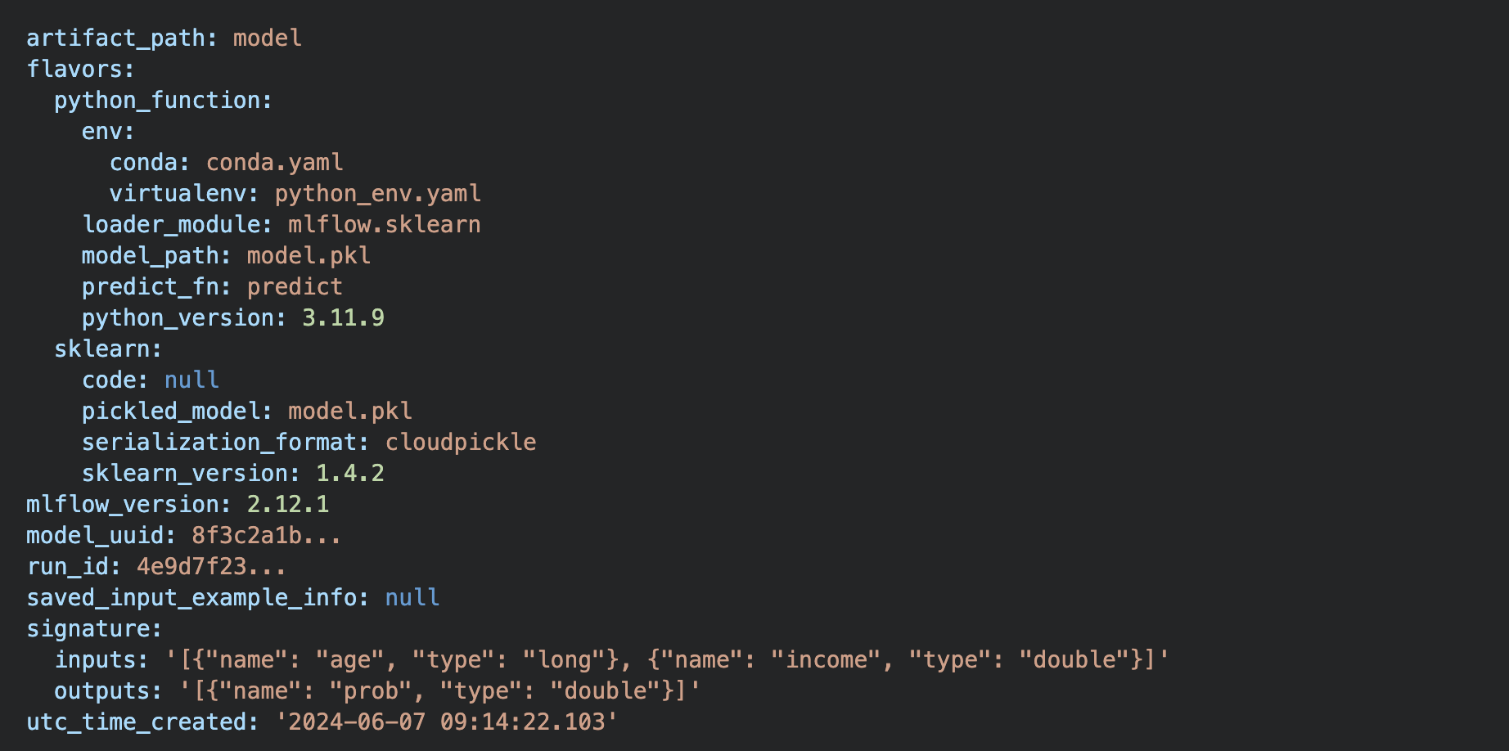
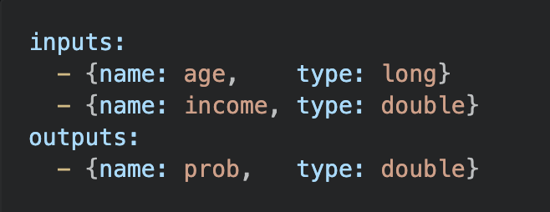
Model Signature & Schema
A model should declare what it accepts and returns.
Best practice to include a schema (example YAML)
In MLFLow it is Stored in the MLmodel manifest, written on every log_model()
In live production, this is usually stored in object storage
Notes:
It means the actual model artifacts (including the MLmodel file that holds the signature/schema) are saved to a cloud object store like S3, GCS, or Azure Blob rather than the local filesystem or a git repo.
- During dev, log_model() writes artifacts to a local directory or tracking server.
- In production, log_model() points the artifact store at object storage (e.g. s3://bucket/...), so the serialized model + its MLmodel manifest live there.
- Object storage is used because it's durable, scalable, versioned, and cheap — and serves as the single source of truth that a serving platform (SageMaker, Seldon, KServe, etc.) reads from when loading a model.
The key point: the schema/signature isn't just a file in your repo — it travels with the model artifact, and in production that artifact lives in object storage.

Slide 5
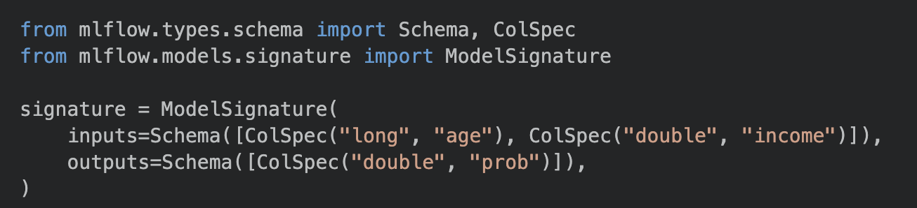
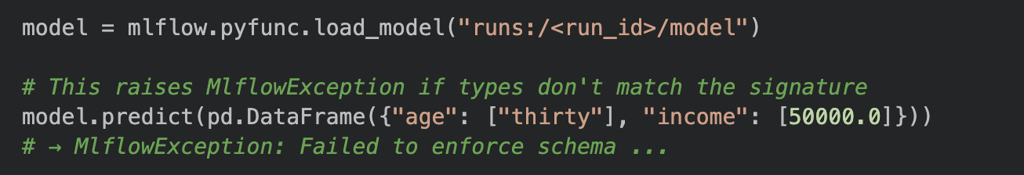
Model Signature & Schema
Inferred automatically or explicitly defined
When serving or loading the model, every input is validated against the schema before passing to the model.

Slide 6
Model Signature & Schema – the why
Governance and compatibility checks
Signature compared against previous version.
Schema schanges are flagged before model reaches production.
Signatures and metadata beyond Mlflow
The pattern — declare types at save time, validate at load/serve time, inspect for governance — is not MLflow-specific.
It appears across the ML ecosystem in different forms.
ONNX:
  Every .onnx file embeds typed input/output tensor specs directly in the binary.
  The ONNX runtime reads them before any inference and rejects mismatched inputs.
  Converting from sklearn to ONNX also forces you to declare types explicitly, which catches train/serve skew at export time rather than at runtime.
TensorFlow:
  A TensorFlow SavedModel stores named serving signatures inside saved_model.pb.

Slide 7
Serving Patterns
How the model is used in production
Four major serving patterns:
Batch | Usually offline. Data passed in batches at certain times to model. Output stored in DB
Online | Using APIs On Demand
Streaming/ real-time | Continuous event scoring (Kafka, Flink) Mainly for latency-sensitive cases
Embedded / on-device | Mobile, IoT

Slide 8



Sidebar – Kafka and Flink
Kafka is a distributed commit (event) log
Every written event is appended to the end of a log
Stays there for the retention window
Consumers read from a position and remember location
Stateful stream processor
Distributed processing engine
Reads events from Kafka (or other sources)
Applies transformations
Maintains state across events
Common use cases of both combined:
  Real-time data
  Continuous ETL pipelines
  Monitoring and analytics for IoT devices and clickstreams
Kafka:
https://www.youtube.com/watch?v=-RDyEFvnTXI&t=278s

Slide 9
Serving Patterns – Batch processing
Source DB/ data lake
Read
Model processing
Predict
Output table
Airflow orchestration / cronjob
Write
Trade-offs:
Simple to build and operate — it's just a Python script with a scheduler.
No latency requirements; you can score millions of rows overnight.
Scores go stale — the prediction was made hours ago and may not reflect the current state of the entity.
Works well when the downstream consumer (e.g. a marketing tool) pulls scores on a fixed schedule.

Slide 10
Serving Patterns – Online/ On-Demand
Client/ App
POST
API Server (model loaded into memory)
Response
The model is wrapped in an HTTP server that another service can call synchronously.
The caller sends features in the request body and gets a prediction back in the response, typically within tens of milliseconds.
The model is loaded once at startup and kept in memory. Every request hits the already-loaded model — no disk I/O per request.
Trade-offs:
The application blocks waiting for the response — low latency matters.
You pay for an always-on server even during idle periods.
Model updates require a rolling pod restart (or a blue/green deploy).

Slide 11
Serving Patterns – Streaming
Event
ESP
Streaming Framework (model loaded to memory)
Downstream consumption
* ESP – Event Streaming Platform
ESP
Events arrive on a message queue (Kafka, Kinesis, Pub/Sub) and are scored as they flow through.
The model is embedded inside a stream-processing job that consumes the topic, runs inference, and publishes results to an output topic.
Trade-offs:
Scores are available within milliseconds of the event arriving — no polling, no stale data.
Model updates require redeploying the Flink/Spark job and restarting the pipeline.
Operationally heavier: you need a running Kafka cluster and a stream processor.
Best for use cases where something else reacts to the score immediately (e.g. fraud block, real-time personalisation feed).

Slide 12
Serving Patterns – Choosing a pattern
Does the consumer need the score quicky?
Yes
No
Is the consumer on-device/ offline
Score needed within seconds of event?
Yes
No
No
Yes
Batch
Embedded
Message Queue in place?
Yes
No
Streaming
Online API

Slide 13
Serving with FastAPI
Purpose:
  A modern Python web framework that wraps trained models behind HTTP APIs to allow
  external systems to make prediction requests over a network.
MLOps Role:
  Serves as the "last mile," acting as the bridge between model files and production applications
  requiring real-time answers.
Functionality:
  Accepts JSON requests containing input features and returns the corresponding model predictions.
Key Benefits:
  Popular for its speed, automatic generation of API documentation, and use of Pydantic to
  validate inputs before they reach the model.

Slide 14
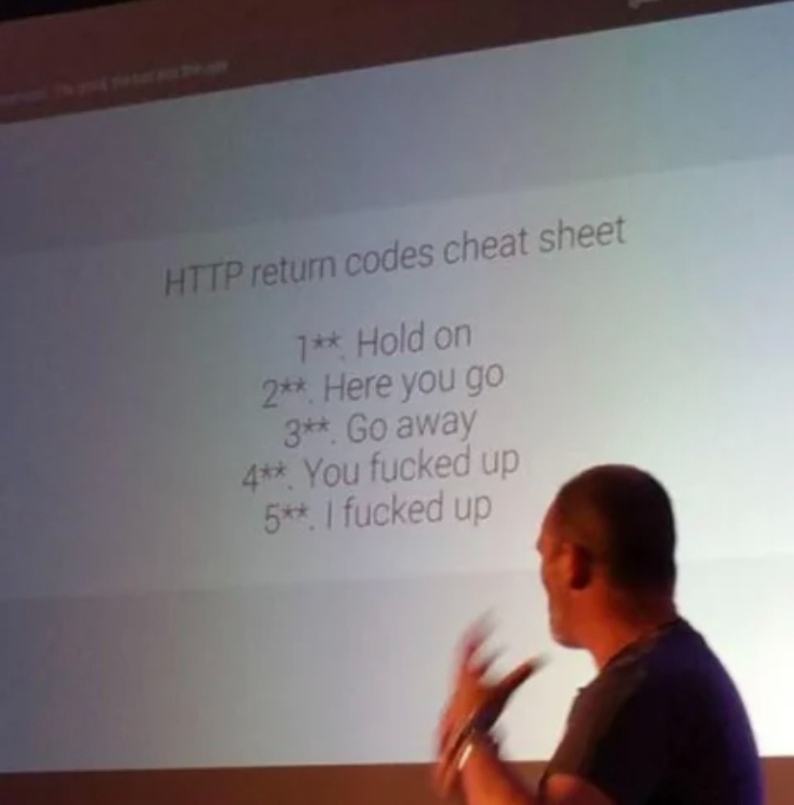
Exercise 1 – Building a FAST API Service
Please go to day2/Session_1

Slide 15
Containers & Docker
One reproducible image runs identically on laptop, CI, and Kubernetes.
Dockerfile essentials
  Essentially a recipe: Start from a base image, add layers, declare how the container starts.
  Start building from repo root
  Copy requirements first → pip-install layer caches separately from code
  Copy only the artifacts the service actually needs
Context essentials:
Build context:
  Docker client (terminal) sends directory information to the Docker daemon (background service)
Sending .venv/ directory to daemon is wasteful .dockerignore keeps it small (works like .gitignore)
Hardcoding configuration is not best practice. Pass values at runtime using and .env file.
Consider using multi-stage builds, which shrinks the image.
Use ‘docker-compose.yml’ for local development. It encodes the ‘docker build’ and ‘docker run’ arguments so the whole setup is one command ‘docker compose up –build’.
Notes:
When Docker builds an image, it executes each instruction (FROM, COPY, RUN, etc.) as a separate layer, and it saves a snapshot after each one. On the next build, before executing a layer, Docker checks: has anything changed since last time? If not, it reuses the saved snapshot instead of re-running the instruction — this is called a cache hit.
The key rule: once a layer's cache is invalidated, every layer after it also re-runs, even if those files haven't changed. So putting the slow, stable step (pip install) before the fast, frequently-changing step (COPY service.py) means you only pay the pip install cost when requirements.txt actually changes — not on every code edit.
When you run docker build, two separate processes are involved:
Your terminal (the Docker client) — where you type the command
The Docker daemon — the background service that actually builds the image
These can be on different machines (e.g. a remote build server). The client cannot just let the daemon read files off your local disk directly. Instead, it packages up a directory and sends it over to the daemon first. That package is the build context.
The daemon then executes each COPY instruction by pulling files out of that received tarball — not from your filesystem directly. This is why files outside the build context are completely invisible.
Sending a 2 GB .venv/ directory to the daemon on every build is wasteful. A .dockerignore file (placed next to the build context root, i.e., the repo root) works like .gitignore

Slide 16
Containers & Docker: Commands
Command | What it does
docker images | List local images
docker ps | List running containers
docker logs <name> | Stream container output
docker exec –it <name> bash | Open a shell inside the running container
docker stop <name> | Gracefully stop
docker rm <name> | Remove an image
docker compose up --build | Build and start all services from compose file.
docker compose down | Stop and remove all services
Notes:
When Docker builds an image, it executes each instruction (FROM, COPY, RUN, etc.) as a separate layer, and it saves a snapshot after each one. On the next build, before executing a layer, Docker checks: has anything changed since last time? If not, it reuses the saved snapshot instead of re-running the instruction — this is called a cache hit.
The key rule: once a layer's cache is invalidated, every layer after it also re-runs, even if those files haven't changed. So putting the slow, stable step (pip install) before the fast, frequently-changing step (COPY service.py) means you only pay the pip install cost when requirements.txt actually changes — not on every code edit.
When you run docker build, two separate processes are involved:
Your terminal (the Docker client) — where you type the command
The Docker daemon — the background service that actually builds the image
These can be on different machines (e.g. a remote build server). The client cannot just let the daemon read files off your local disk directly. Instead, it packages up a directory and sends it over to the daemon first. That package is the build context.
The daemon then executes each COPY instruction by pulling files out of that received tarball — not from your filesystem directly. This is why files outside the build context are completely invisible.
Sending a 2 GB .venv/ directory to the daemon on every build is wasteful. A .dockerignore file (placed next to the build context root, i.e., the repo root) works like .gitignore

Slide 17
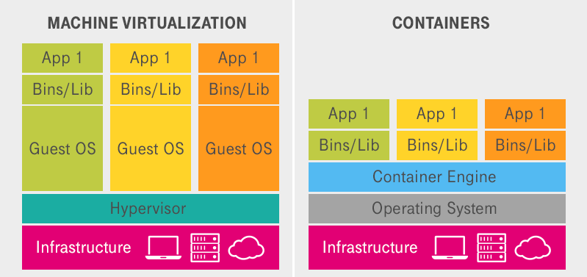
Sidebar – Virtualisation v Containerization
A VM virtualizes the hardware
Every VM gets its own operating system
A container virtualizes the operating system.
Every container shares the host’s kernel, but keeps own file system, libraries, and app.
Containers give you reproducibility of a VM at the fraction of a cost and startup time.
Trade isolation – Kernel vulnerability in the host can affect every container.
Notes:
When Docker builds an image, it executes each instruction (FROM, COPY, RUN, etc.) as a separate layer, and it saves a snapshot after each one. On the next build, before executing a layer, Docker checks: has anything changed since last time? If not, it reuses the saved snapshot instead of re-running the instruction — this is called a cache hit.
The key rule: once a layer's cache is invalidated, every layer after it also re-runs, even if those files haven't changed. So putting the slow, stable step (pip install) before the fast, frequently-changing step (COPY service.py) means you only pay the pip install cost when requirements.txt actually changes — not on every code edit.
When you run docker build, two separate processes are involved:
Your terminal (the Docker client) — where you type the command
The Docker daemon — the background service that actually builds the image
These can be on different machines (e.g. a remote build server). The client cannot just let the daemon read files off your local disk directly. Instead, it packages up a directory and sends it over to the daemon first. That package is the build context.
The daemon then executes each COPY instruction by pulling files out of that received tarball — not from your filesystem directly. This is why files outside the build context are completely invisible.
Sending a 2 GB .venv/ directory to the daemon on every build is wasteful. A .dockerignore file (placed next to the build context root, i.e., the repo root) works like .gitignore

Slide 18
CI/CD for ML
Regular CI/CD validates code.
ML CI/CD must additionally validate:
  Data (schema, distribution).
  Model quality (prediction scores)
  Operational behaviours (latency, payload size, memory)
Mature ML setup has three loosely-coupled pipelines that can run independently:
Code Change
Data/ schedule change
New model registered
CI
(Code)
Lint
Unit tests
CT
(Continuous Training)
Retrain on new data
Evaluate quality
Register if better
CD
(Continuous Delivery)
Canary Rollout
Monitor Metrics
Rollback if needed
Notes:
Linting — checks code style and structure without running it.
It catches things like undefined variables, unused imports, inconsistent formatting, and obvious mistakes — before the code even executes. It's the fastest check since no code runs.
Unit tests — test a single function in isolation.
You call one function with known inputs and assert the output is correct. Nothing else (database, network, other modules) is involved. Fast because there are no dependencies.
Integration tests — test multiple components working together.
You spin up the actual service (or a close approximation) and send real HTTP requests to it. This catches bugs that only appear when the model, server, and network stack are all running together — things a unit test can never catch.

Slide 19
Three Pipelines: CI · CT · CD
Pipeline | Trigger | What it checks | Who cares
CI (Code) | Push or Pull Requests | Does the code work? Tests pass? No import errors? | Engineers
CT (Continous Training) | New data arrives Code that affects training changes | New model at least as good as current prod model? | Data Scientists
CD (Deploy) | A new model version is registered and approved | Service run correctly in real environment? | MLEs/ Platform

Slide 20
Three Pipelines: CI · CT · CD
Three pipelines are loosely coupled.
CI runs on every commit
CT runs on a schedule or data trigger even if no code changed
CD only fires when a model is explicitly promoted
Matters because:
  Without CT, a model silently degrades in production
  CT automates model freshness from a manual tasks.

Slide 21
The ML Test Pyramid
Testing is part of Software Engineering most applicable to Data Science.
ML tests operate on multiple levels – Code – Data – Model
Integration
Smoke
Model
Behavioural
Data
Unit
Slow, few
Fast, many

Slide 22
The ML Test Pyramid
Integration | Runs after service started End-to-End Does the full service respond correctly?
Smoke | Post-deploy (after each deploy) Is the service alive in production?
Model | CT pipeline Quality gates AUC, latency
Behavioural | CT Pipeline Does the model make sense directionally?
Data | CT Pipeline start Training data what we expect?
Unit | Every commit (CI) Individual functions return correct values?
Notes:
Unit tests check a single function in isolation. These are the tests you may already be writing. They run in milliseconds and catch regressions immediately.
Data tests assert properties of the actual training or inference data. They catch pipeline bugs (a join that silently produced nulls, a schema change upstream) before they corrupt a model.
Model tests are quality gates that block a model from being promoted if it doesn't meet a minimum bar. They use a held-out evaluation set.
Behavioural tests check that the model makes intuitive sense — even when the exact output value is not predictable. These catch models that overfit to noise or have spurious correlations.
Integration tests hit the running service over HTTP. They catch issues that only appear when the model, server, and network are all in play together.
Smoke tests are the simplest possible checks run immediately after a deploy — just enough to confirm the process started and is reachable. They are often a single `curl /health` in a deployment script.

Slide 23
GitHub Actions
GitHub’s built-in automation platform.
YAML file that describes a sequence of shell commands
GitHub runs those commands on a fresh virtual machine every time a trigger condition is met.
Get results – pass or fail – directly on the pull request before merge.
For ML:
  Can automatically run data tests
  Retrain the model
  Check quality on every code change
Why train inside CI?
  Reproducibility gate - if training fails in a clean environment, can catch it immediately.
  Quality gate on what CI actually produces

Slide 24
GitHub Actions
Developer pushes code
GitHub detects push & reads .yml
GitHub spins up fresh Ubuntu machine
Step 1
Git clone the repo onto the VM
Step 2
Installs Python + packages
Step 3
Run train.py -> produces .joblib files
Step 4
Run test_data.py -> validates training data
Step 5
Run test_model.py -> validates the trained model

Slide 25
GitHub Actions
Approach | How it works | Works well when | Risks
Train in CI (default) | Every run trains from scratch on the CI VM | Fast training (<5 min), small data | CI minutes cost money at scale Slow PRs Flaky tests if training non-deterministic
Smoke-train in CI | CI trains on a tiny random sample just to check pipeline runs end-to-end | Large models/ datasets – code path is validated cheaply | Too weak to assert quality thresholds Only structural correctness is tested
Skip training in CI Test committed artifact | .pt file is committed or pulled from a model registry. | Want a fast CI and comfortable that artificat was validated by CT Pipeline | Testing stale artifact, not model code produces. Uncommitted weight changes are invisible to CI.
Separate CT | CI only runs unit + data tests Dedicated CT pipline handles retraining and quality gates | Models that take hours to train GPU workloads | Longer feedback loop – bad change may not be caught until the next CT run.
Artifact caching/ incremental training | CI checks whether inputs (code hash + data hash) changed since last run | Stable slow changing data | Cache invalidation is subtle Dependency upgrade that changes model behaviou may not change the hash.

Slide 26
GitHub Actions
Current industry consensus:
Keep CI fast (target < 10 minutes)
Long CI pipelines get disabled or bypassed.
Use smoke test to validate training code path in CI.
  Assert only that the model’s loss is moving the right direction
Run full retraining and quality gates in a separate CT pipeline.
  Gate deployment on CT outcome not CI.
Rule of thumb:
If a full training run takes more than a few minutes, introduce a smoke-train step in CI and move full retraining to a scheduled CT popeline. Split keeps CI fast, while preserving reproducibility and quality guarantees that matter most.

Slide 27
GitHub Actions: Exercise 3
Please go to day2/Session_3

Slide 28
GitHub Actions: Sharding
Splitting one unit of work into N independent pieces that run on N parallel runners, then merging the results.
Runner
Runner 1
Runner 1
Runner 1
Runner 1
Test 1
Test 1
Test 3
Test 5
Test 7
Test 2
Test 2
Test 4
Test 6
Test 8
Test 3
Test 4
Test 5
Test 6
Test 7
Results
Test 8
Results
Notes:
Ordering is only within a shart – don’t write tests that depend on another shard’s state
Each shard re-runs installations of packages
Should be balanced – 1 slow test will still leave you waiting

Slide 29
Safe Deployment Strategies
A worse new model fails silently.
  Pipeline is successful, but predictions are subtly wrong and business metrics quietly degrade.
Need strategies that go beyond simple deployment.
Core principle underlying everything:
  Expose the new model to a small, controlled fraction of traffic first
  Measure real-world behaviour
  Only widen rollout once confident that it is not worse than what it replaces.

Slide 30
Shadow/ dark launch
New model runs in production and receives same requests as the live model
Predictions are discarded – never used or acted upon
Can monitor how model behaves in live environment - edge cases, unusual inputs, full input distribution
No user-facing risk
Use when model is a significant architectural change
Cannot measure business outcomes because shadow predictions are never acted upon.
Model v1
(live)
Sends prediction downstream
Load/ balancer routing layer
User request
Copy of request
Model v2
(shadow)
Prediction logged only, not sent downstream

Slide 31
Canary release
A small percentage of live traffic – 1-5% routed to new model.
If model performs as well as old one across set of metrics, percentage is gradually increased.
Default strategy for iterative model updates, where change is incremental and new model is expected to be similar to old one.
Requires infrastructure to split traffic.
Canary population must be large enough to produce data for enough statistically meaningful work.
All request
Metrics OK?
Increase to 20%, 50%, 100%
Model v1
(stable)
Router / feature flag
Monitoring
Model v2
(canary)
Metrics regressed?
Auto-rollback to 100% v1

Slide 32
A/B Test
Goal is to measure whether the new model produces a measureable improvement in business metric, using a proper randomized controlled experiment.
Randomisation must be at the user or session level.
Use when not clear if model is better and need business case before committing.
Common in recommendation systems, ad ranking, and pricing models
Requires a business metric that is measurable and attributable to the model’s prediction.
Takes longer than canary and requires careful design.
Significant improvement
Ship v2
Group A
(50%)
Model v1
Monitoring
Random assignment of users
After N days
Group B
(50%)
Model v2
Monitoring
No difference/ worse
Keep v1

Slide 33
Blue/ Green deployment
Two complete, identical environments
Blue – current production, Green – new version
Run simultaneously
Router switched to send 100% of traffic to green instantaneously
Switch router back to blue as rollback, no redeployment
Use for a clean, instantaneous cutover
Double infrastructure costs and no gradual traffic ramp.
Often combined with a short canary phase.
Before switch
After switch
Traffic
Blue (v1)
Live
Blue (v1)
Idle (kept warm for rollback)
Green (v2)
Idle
Traffic
Green (v2)
Live

Slide 34
Blue/ green deployment
Requirement | Recommended strategy
Zero user impact while validating the new model on real traffic | Shadow launch
Gradual rollout with automatic rollback | Canary
Demonstrate business value | A/B test
Instant, clean cutover with instant rollback option | Blue/ green
Major changes (new schema, new model family) | Blue green after shadow launch
Never replace a model “atomically” in production, without a rollback plan.

Slide 35
Why Models Decay
Model is trained on a snapshot of the world as training data was collected -> world changes
Mismatch is called model decay or model staleness.

Slide 36
Data drift
Distribution of input features shifts
True relationship between features and label stays the same.
Model is still correct, but it is applied to a different population it was trained on.
Detect by comparing the distribution of each input feature in recent production traffic against the reference distribution (usually training data)
Flag features whose distribution has shifted beyond a threshold.
Training time | 6 months later
Age distribution: Mean = 42, std = 12 (older customer base) | Age distribution: Mean = 31, std = 10 (younger cohort from new campaign)
Model was calibrated for older customers -> features are now out of date. | Model’s probabilities estimates are now systematically off for the new population.

Slide 37
Concept drift
Relationship between features and label changes
Input distribution is the same, but correct output looks different.
Model cannot catch up just because the inputs look familiar -> ground truth has changed
Without labels, you can only see the symptom, not the cause.
Detection harder than data drift, because it requires ground truth labels.
Monitor prediction distribution as a proxy
Track business outcomes over time
Retrain model
Before new payment method: | After new payment method:
Transaction_amount = $800 Merchant = “electronics” | Transaction_amount = $800 Merchant = “electronics”
Fraud probability: 0.02 | Fraud probability: 0.45

Slide 38
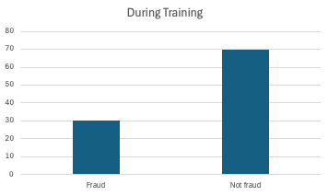
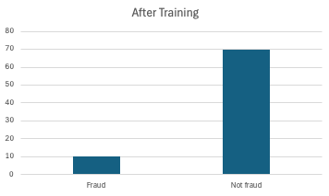
Label drift
Distribution of the label changes
Proportion of positive vs negative chases shifts, even if relationship between Output and Inputs is unchanged.
Models trained with class imbalance handling particularly sensitive.
Shift in base rate requires re-calibrating the decision threshold.
Training data | Production now
Spam = 30% of emails | Spam = 5% of emails (spam campaign ended)
 | Model generates too many false positives at new 5% rate.

Slide 39
Pipeline bugs
Not all degradation comes from the world changing.
Training data had a bug that was silently “baked in” the model that propagates to production in unexpected ways.
Bug | How it enters | Symptom
ETL fills missing values with 0 instead of NaN | New data pipeline release | Feature distribution shifts; model receives 0 where training data had the real median
Timezone mismatch in timestamp features | Infrastructure change | Temporal features are systematically off by hours
Feature scaling fitted on stale data | Model registry serves old preprocessor | Scaled values outside the range the model was trained on
Train/ serve skew | Feature computed differently at training time vs serving time | Model receives different values than it expects
Train/serve skew is one of the most difficult bugs to catch in ML systems. Feature engineering can run in two places, training and production and can silently diverge. Use a feature store that serves same precomputed features in both training and serving time.
Notes:
Transformations that were dependent on certain conditions in the data not carried out.

Slide 40
What to Monitor – Service health
Standard software reliability metrics.
Every production service should have them regardless of whether it uses ML.
Metric | What to track | Alert threshold
Uptime/ error rate | HTTP 5xx rate, process crashes | > 0.1% errors over 5 mins
Latency | Latency p50, p95, p99 response time (percentile of requests completed) | P99 > SLO (Service Level Objective)
Throughput | Requests per second | Sudden drop (service stopped receiving traffic?)
Resource usage | CPU, memory, GPU utilisation | OOM risk, runaway processes

Slide 41
What to Monitor – Data health
Check that what the model is actually receiving matches what it was trained on
Check | What it catches | How
Schema validation | Missing columns, wrong types, new unexpected valuesx | Compare incoming request schema against reference
Null/ missing rate | Upstream pipeline started producing nulls | Track null_rate_per_feature over time
Feature distribution | Data drift | Statistical tests vs reference dataset
Out-of-range values | Sensor failures, ETL bugs | Track fraction_outside_training_range per feature
Data health checks are the cheapest and most reliable early warning systems. A spike in null rates often predicts a model quality problem before any model metric detects it.

Slide 42
What to Monitor – Model health
Check that the model’s outputs look reasonable, even if you don’t have ground truth labels
Metric | What it catches | Notes
Prediction distribution | Concept drift, label drift | Compare histogram of prediction vs reference window
Confidence/ entropy | Model uncertainty increasing | Low-confidence predictions suggest OOD (Out of Distribution) inputs
Segment-level | Disparate impact, hidden subgroup degradation | Track performance by user segment, geography, time-of-day
Model version | Accidental rollback, cache serving stale artifact | Log model version on every prediction
Shift in prediction distribution is one of the earliest detectable signals of concept drift.

Slide 43
What to Monitor – Business KPIs
Ultimate measure of model quality is business impact.
Metric | Proxy metric | Business metric
Fraud detection | False positive rate, precision | Chargeback volume, customer complaints
Recommendation | CTR, NDCG | Revenue per session, subscriber retention
Credit scoring | AUC on holdout | Default rate on approved loans (lagged)
Medical diagnosis | Sensitivity, specificity | Clinical outcomes (weeks/months later)
Business KPIs are the ground truth but they have lag - may not see the effect of a model degradation for days or weeks.

Slide 44
Detecting Drift
Drift detection reduces to comparing two distributions: the reference (training data or other baseline) and the current (recent traffic)
Used metrics:
Metric | How it works | Interpretation | Trade-off
Population Stability Index (PSI) | Measures how much the distribution of a feature has shifted by comparing binned proportions | PSI < 0.1: no significant shift PSI 0.1 – 0.25: Moderate, consider retraining PSI > 0.25: Significant, retrain NOW | Fast and interpretable May not be best for outside of finance Sensitive to choice of bins
Kolmogorov – Smirnov (KS) | Maximum absolute difference between the two cumulative functions. Returns a p-value | p < 0.05: Investigate/ consider retraining | More rigorous Sensitive to sample size
Wasserstein distance | Measures minimum work required to transform one distribution into the other. | Need to define own threshold based on the scale of the features. | More sensitive than KS to outliers

Slide 45
Detecting Drift - Tools
Tool | How it works | Best for
Evidently | Most widely adopted Wraps statistical tests into a single API Generates human (HTML) and machine (JSON) readable metrics | One-shot reports Dashboards CI gates
NannyML | Solves hardest part of production monitoring – estimating model performance when there is no ground truth Uses Confidence-Based Performance Estimation | Ongoing time-series monitoring No-label AUC estimation When labels long after prediction
Great Expectations | Data quality library Define expectations about data and run as checkpoints in pipeline | Data contract validation at pipeline boundaries Catching errors at data ingestion
whylogs/ Whylabs | Generates compact statistical profiles of data batches Allows for continuous drift monitoring without overhead | Always-on lightweight statistical logging

Slide 46
The Label Problem
Need ground truth labels to know whether model has gotten worse
In production, model makes a prediction and then action is taken
True outcome often:
  Delayed – e.g. default happens months after credit decision
  Counterfactual – If model declined, never learn whether applicant would have defaulted
  Expensive to obtain – Human must review case
  Never available – In some domains there is no ground truth – only downstream metrics
Cannot compute AUC, precision, recall, or accuracy in real time for most production ML systems.
Need proxy signals and delayed evaluation strategies.

Slide 47
The Label Problem – Strategies
Strategy | What is it? | Trade-off
Proxy metrics | Monitor signals that are correlated with model quality but available immediately, without labels. E.g. concept drift, data drift | Imperfect Shift in prediction distribution can have many causes Treat as alerts for further investigation
Delayed label evaluation | Labels eventually do arrive Build system that logs every prediction and compares it to actuals Incorporate alerts if metrics fall below threshold | Lag between prediction and label defines how quickly you can detect concept drift.
Active labelling | Route small, random fraction of production traffic to human Use labels for near-real-time-quality estimation | Representative meaningful quality estimates Requires infrastructure for routing and human involvement
Held-out evaluation sets with temporal slices | Keep a rolling held-out dataset from recent traffic Evaluate model on this data set periodically | Reliable quality estimate Requires reliable holdout -> back to label availability problem.
Notes:
Proxy metrics: Chargebacks, Loan defaults, conversions etc.

Slide 48
Alerting That Works
Too many alerts is worse than none — people stop looking.
Alerts should be actionable, specific, and infrequent enough to take seriously
Tie alerts to business symptoms or operational consequences
Alert needs a runbook:
  What does this alert mean? What is the likely cause?
  How do I diagnose it? Which dashboards to look at, which queries to run.
  What are the possible causes? Data pipeline bug, feature drift, concept drift, model bug.
  What do I do? Roll back to the previous model? Disable feature? Contact data team?
  Who owns this model? Who to escalate to if the immediate fix does not work?
Tune thresholds against historical data
Avoid alert fatigue
Distinguish severity; not every alert requires waking someone up.

Slide 49
Governance & Security
For regulated domains, be able to answer:
What data trained this model, with what consent? — model cards, lineage
Who approved deployment? — approval workflow in the registry
Behaviour on protected groups? — bias/fairness checks in CI
How fast can you turn it off? — rollback plan, kill switch
Security checklist
No pickle.load of untrusted files
Rate-limit inputs
Secrets in env
pin & scan deps

Slide 50
Non-negotiables
# | Principle | What it means
1 | Reproducibility | Code + data + environment are versioned together
2 | Automation | One command retrains, one command deploys
3 | Testing | Code, data, and model quality all gate releases
4 | Observability | Know when model is misbehaving before users do
5 | Reversibility | Every deployment can be rolled back quickly
6 | Ownership | Every model has a named owner and runbook

