Slide 1


Slide 2
Types of version control system
Centralized version control systems store all the files in a central repositoryDistributed version control systems store files across multiple repositories.
Distributed version control systems store files across multiple repositories.

Slide 3
Version control system

Slide 4
Types of version control system
Centralized version control systems store all the files in a central repository
Distributed version control systems store files across multiple repositories.

Slide 5
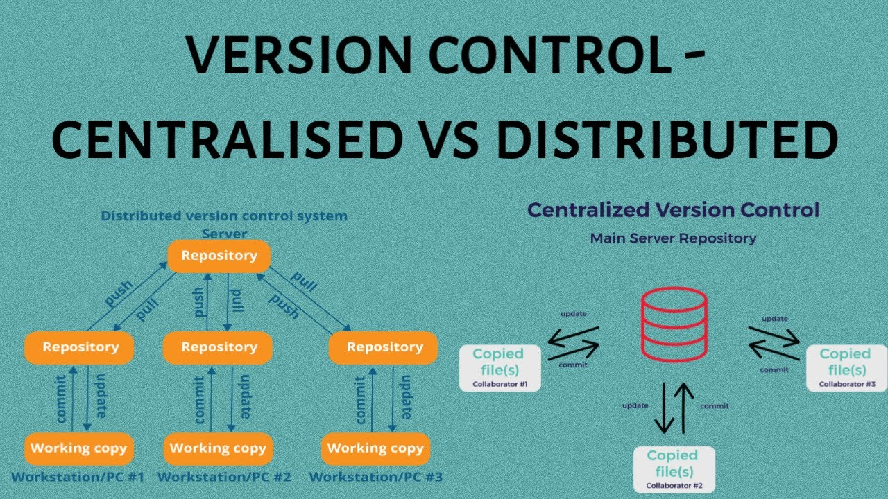

Slide 6
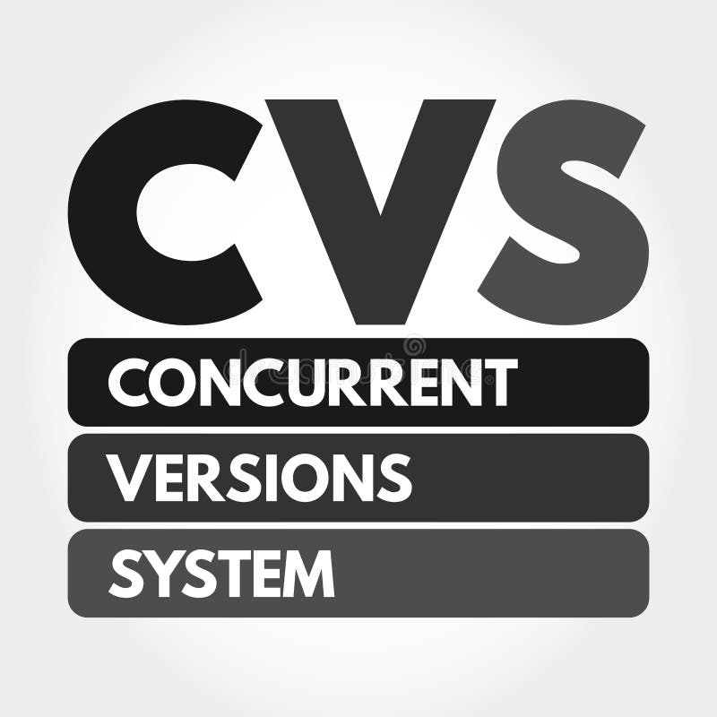

Slide 7

What is git
Global Information Tracker
Distributed Version control system

Slide 8
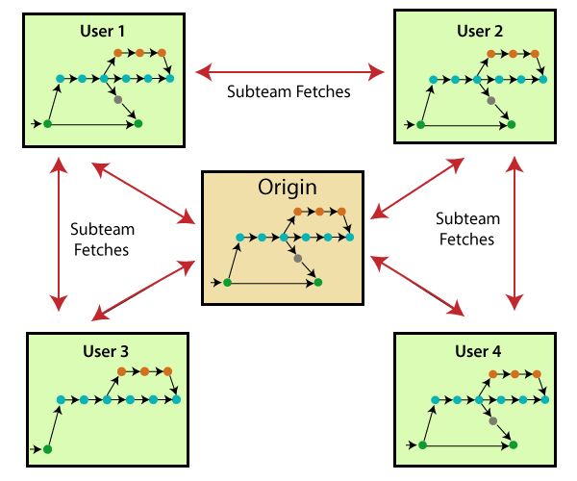
Why git ?

Slide 9
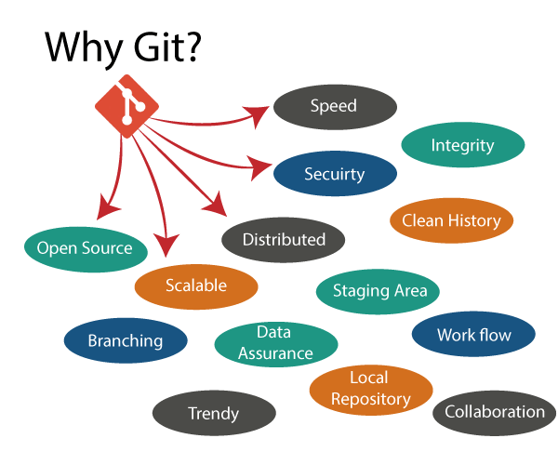

Slide 10
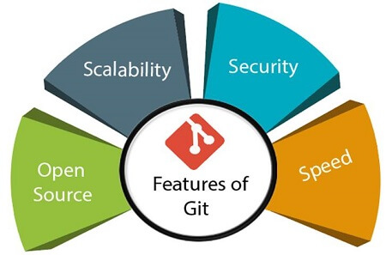

Slide 11
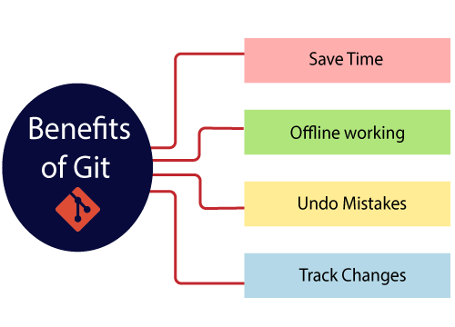
Benefits of Git

Slide 12
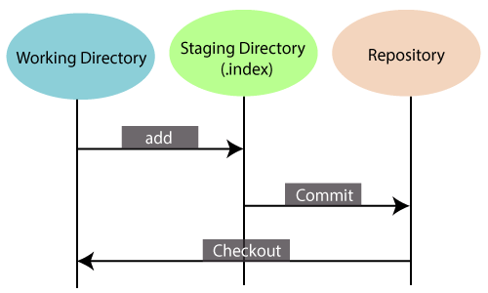

Slide 13
Repository (Project folder)
repo sample-python (Remote)
Git status
main
PR
Day2_test
Git push
Git clone
Local laptop
Code change
(WD)
Staging Directory Day2_test
main
Git add
Local laptop
Git commit
Git checkout
Day2_test
(Working Directory)

Slide 14
code
Binary
Application

Slide 15
Approved
review
PR
Merged
My_branch
master
My_branch
Code changes

Slide 16
Create repo from UI
In CLI
Git clone and create new branch
Create 2 folder
Create 2 files in each folder
Commit & push
Update 1 file in each folder
Commit & push
Raise the PR

Slide 17
Task2
Create repo from UI
create new branch
Create 1 folder
Create 2 files in folder
Create ne file outside
Commit to the branch
Git clone in to CLI
Create one file in CLI
Create one file in UI
Git pull
See file from UI downloaded in to CLI

Slide 18
Create one repo in UI & add one file
Git clone that repo to CLI
Create 3 branches
Create 1 file in each branch and push the code to UI
Change the branch and see files are changing
Delete 2 branch & push it remote

Slide 19
Create repo from UI
In CLI
Git clone and create new branch
Create 2 folder
Create 2 files
Commit & push
Update 1 file in each folder
Commit & push
Delete 1 folder and 1 file (outside file)
Commit & push

Slide 20
Revert back in local WD
Revert it back after git add
Revert it back after git commit
Revert it back after git push

Slide 21
Create repo from UI
In CLI
Git clone and create new branch
Create 2 files
Commit & push
Delete File1 file locally
Revert it back
Delete File2
Do git add
Revert it back
Delete File1
Do git add and git commit
Revert it back
Delete File2
Do git add . and git commit & git push
Revert it back

Slide 22
Create repo from UI
In CLI
In main branch
create sample_main.txt file and one folder one file under this folder
git commit and push
create 2 branches (br1 and br2)
In br1 branch
Add test1.txt file
edit sample_main.txt file
git commit and push
In br2 branch
Add test2.txt file
edit sample_main.txt file
git commit and push
Raise PR for br1 and merge
Raise PR for br2 and resolve the conflict (keep only br2 content) and merge it

Slide 23
Do this assignment
Create repo from UI
Do git clone in CLI
Create following files (WD)
TC1.log, TC2.txt, TC3.doc, TC4.log
Add.py, apple.py, sample.py
Temp.c, local.c
Create .gitignore file & add the filtration
Only below files should be in the repo (remote)
TC1.log, TC4.log, Add.py, apple.py

Slide 24
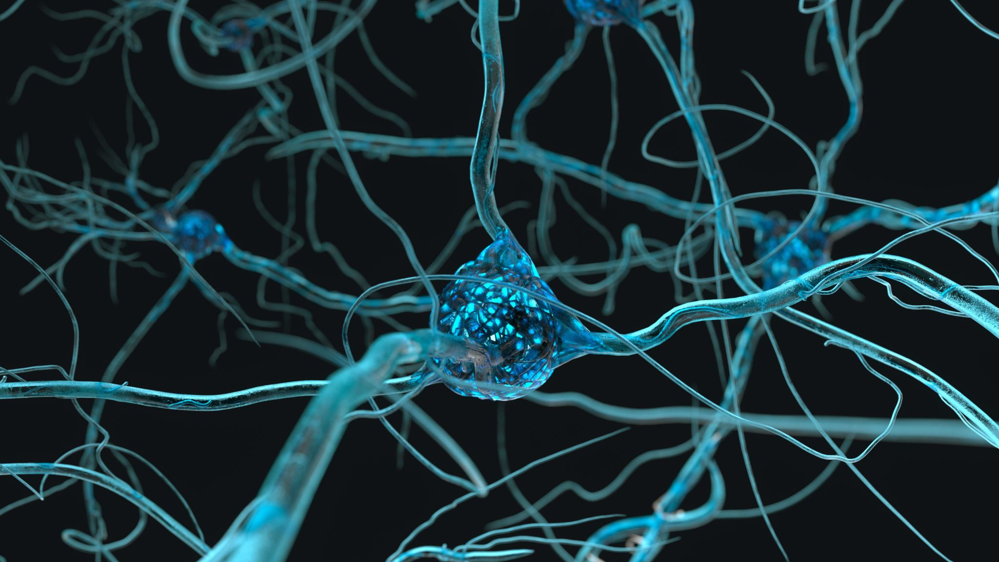
Branching strategies

Slide 25
GitFlow
Master
Develop
Feature- to develop new features that branches off the develop branch
Release- help prepare a new production release; usually branched from the develop branch and must be merged back to both develop and master
Hotfix- also helps prepare for a release but unlike release branches, hotfix branches arise from a bug that has been discovered and must be resolved; it enables developers to keep working on their own changes on the develop branch while the bug is being fixed.

Slide 26
GitHub
Master
Feature- to develop new features that branches off the develop branch

Slide 28
do this assignment
Create repo from UI
In CLI
In main branch
create sample_main.txt file with 3 lines
git commit and push
Modify sample_main.txt file (remove line1) in github UI
In CLI add 4th line to the sample_main.txt file
git commit and push
Do git pull and push

Slide 29
Do this assignment
Create repo from UI
In CLI
Create 2 commits and create tag1 | push it to github
Create 1 commit and create tag2 | push it to github
Create 2 commits create tag3 | push it to github
Share the github link in chat
Download the tags and unzip it and verify the content

Slide 30
Master (main)
#1
#2
#3
#4
dev
#1
#2

Slide 31
Master (main)
#1
#2
#3
#4
#5
dev
#1
#2

Slide 32
Master (main)
#1
#2
#3
#4
#5
#6

Slide 33
Create repo from UI
In CLI
In main branch 2 files
Create dev branch
Add two files in dev
Rebase dev to master

