Slide 1
Capstone Project : Battle of the Neighborhoods Report Sevda Tekin

Slide 2
Introduction
One of the best things about Toronto's multiculturalism is all the great food from diverse cultures. Among one of the best cuisines in Toronto is Thai food. This project aims to find the best locations to open a Thai Restaurant in Toronto, Canada. The people who want to open a Thai Restaurant in Toronto or the investors in food industry would be interested in this project.

Slide 3
Data
In order to find best locations to open a Thai Restaurant in Toronto, data on Toronto neighborhoods, boroughs,postcodes, latitude, longitude, restaurants, and restaurant ratings and tips are required.
Data containing the neighborhoods, boroughs and postcodes of Canada will be obtained from the data source:
https://en.wikipedia.org/wiki/List_of_postal_codes_of_Canada:_M
Data containing the geographical coordinates of each postal code has a link below :
http://cocl.us/Geospatial_data
All data related to locations and quality of Italian restaurants will be obtained via the FourSquare API utilized via the Request library in Python.

Slide 4
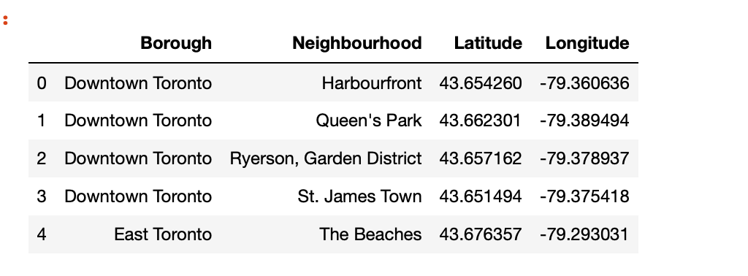
Methodology
we built and clean 2 dataframe and merge them. After merging we filter the data to only use boroughs in Toronto :

Slide 5
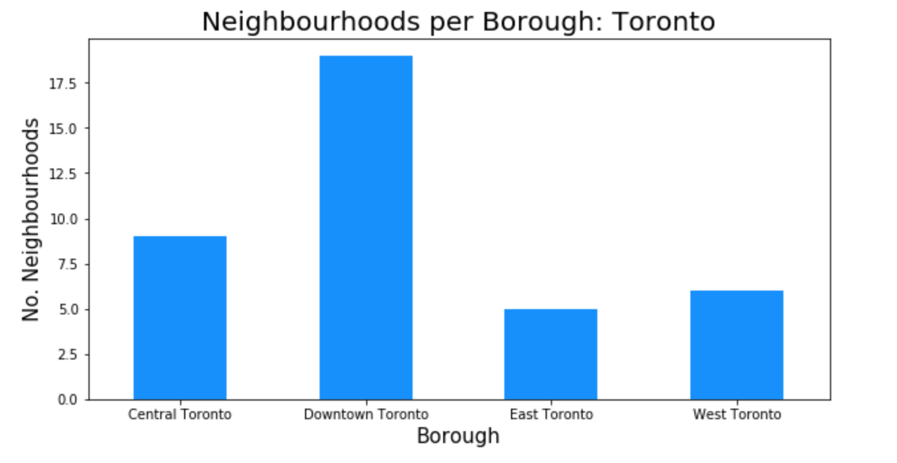
Methodology

Slide 6
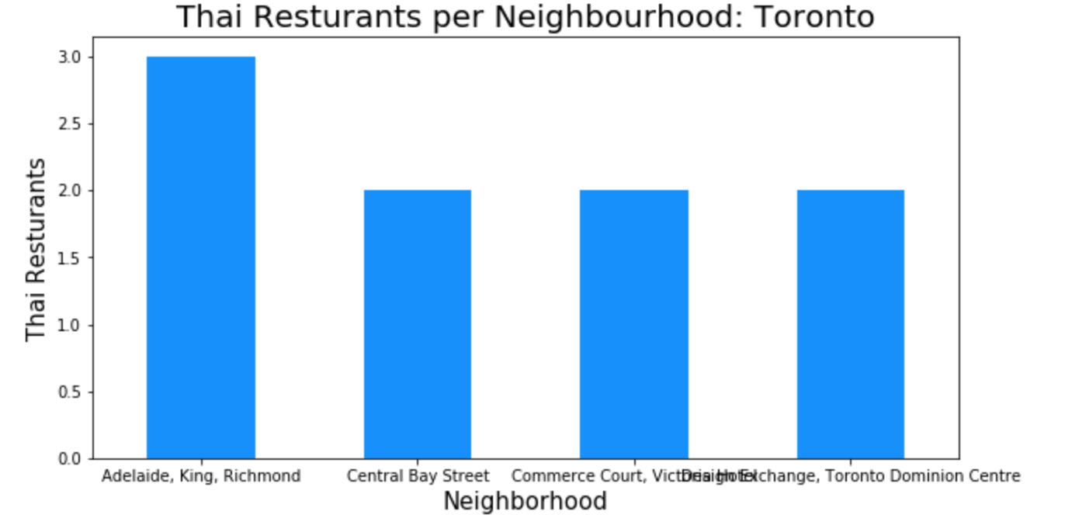
Methodology

Slide 7
Methodology
we run *k*-means to cluster the neighborhood into 5 clusters.

Slide 8
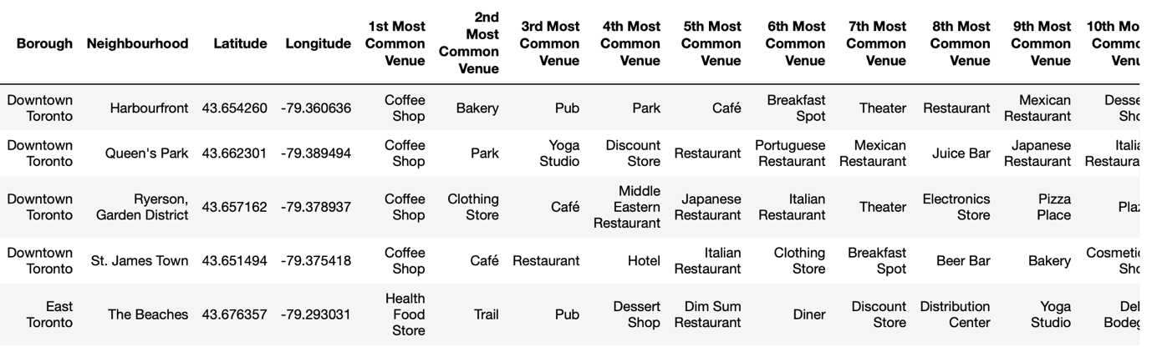
Results
We create a new dataframe that includes the cluster as well as the top 10 venues for each neighborhood.

Slide 9
Discussion
As we can see above 34 neighborhoods are in 'Cluster 1' out of 38. So maybe we can check the Thai restaurant's rating and then we can decide where we open the Thai Restaurant.
The neighborhood of Adelaide, King, Richmond has the highest number of Italian restaurants in all of Toronto and is actually located in the borough of Downtown Toronto.

Slide 10
Conclusion
So, as a result most of the neighbourhood are in cluster 1 and most of the borough in cluster 1 is Downtown Toronto. So, I would suggest to open a Thai restaurant in Downtown Toronto.

