Slide 1
CS1 Task 7 (System-Model)
SNE – Sne is not E-Health
Team white | 20.04.2016

Slide 2
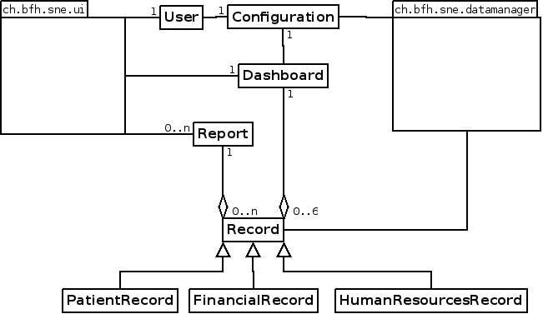
CS1 Task 7 : Domain Model

Slide 3
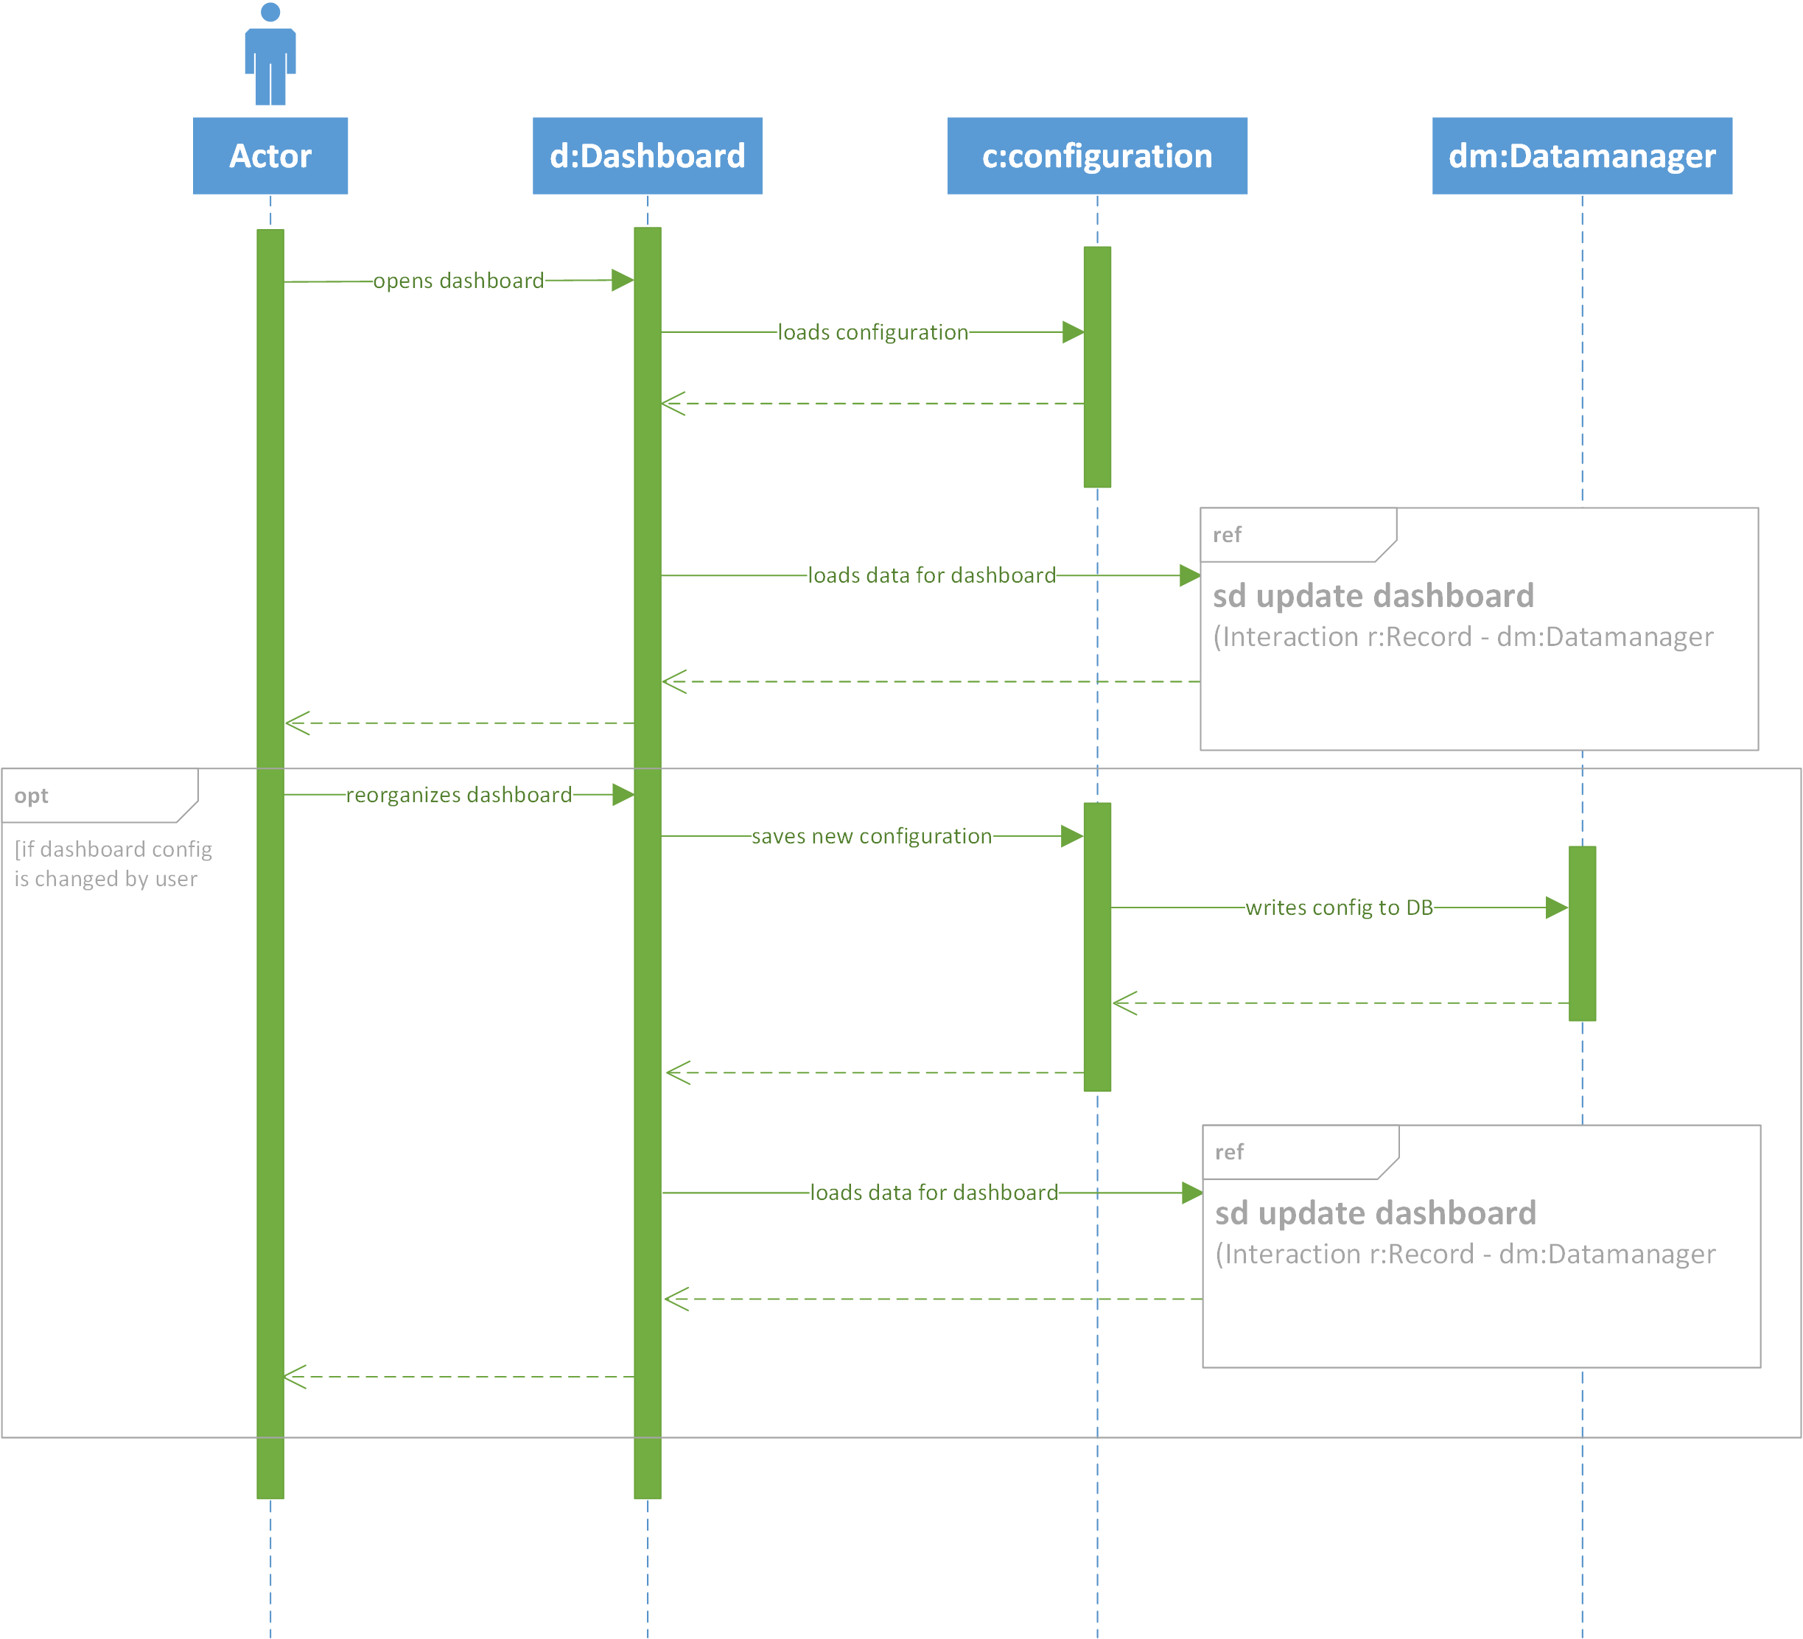
CS1 Task 7 : Sequenz Diagram 1

Slide 4
CS1 Task 7 : Sequenz Diagram 1

Slide 5
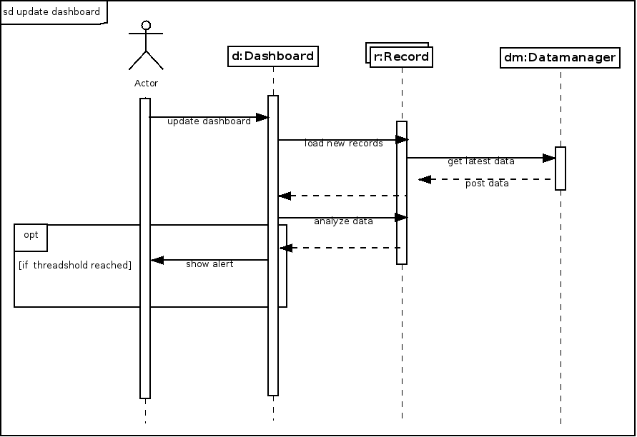
CS1 Task 7 : Sequenz Diagram 1

