Slide 1
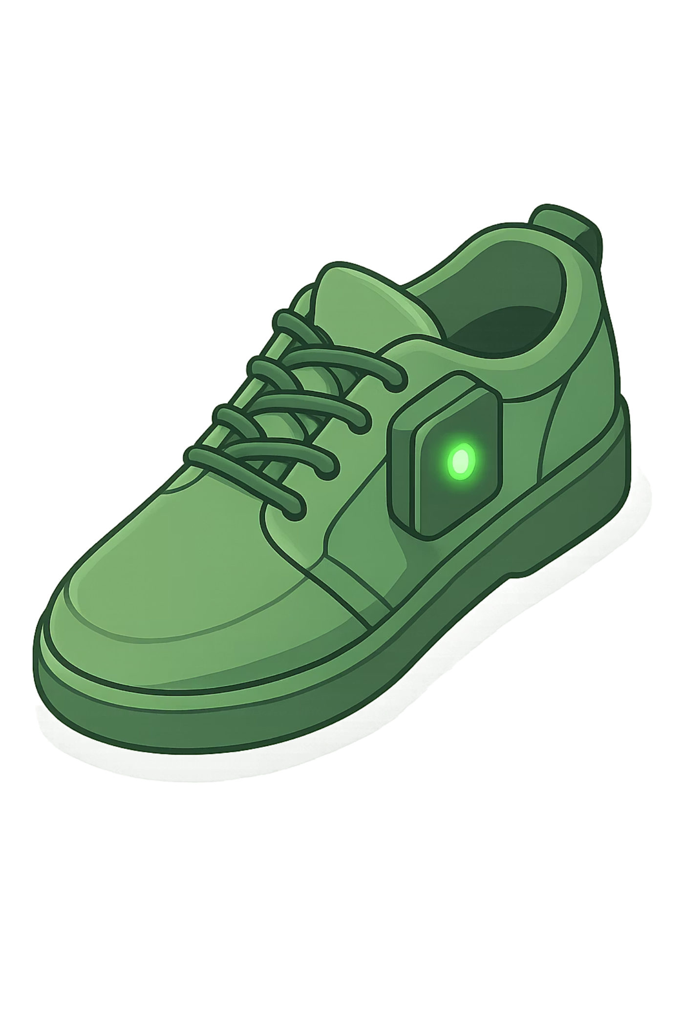
AI-Based Women Safety Smart Slipper
Intelligent Health Monitoring and Safety Device — automatic panic detection, real-time location tracking, and instant emergency alerts built into a wearable form factor.
TEAM PROJECT
Team: Shruti Kumari Jaiswal · Shiv Kumar Gupta · Surya Prabha B · Sugandeepak V

Slide 2

REVIEW 1 RECAP
The Problem We're Solving
Delayed Emergency Response
Current systems rely on manual activation — critical seconds are lost when a woman is in distress and cannot operate a device.
No Automatic Location Sharing
Existing apps require user input to share live location, which is often impossible during a panic situation.
Hands-Free Safety Gap
Women in isolated or threatening environments need a solution that works without any conscious interaction.

Slide 3

PROJECT OBJECTIVE
What We Set Out to Build
Wearable Safety
Auto Panic Detection
A slipper-embedded device providing continuous, unobtrusive protection.
AI-driven analysis of physiological and motion data to identify distress automatically.
Real-Time Tracking
Instant Alerts
GPS module shares live location with emergency contacts instantly.
GSM-triggered SOS messages and calls sent without any user action.

Slide 4
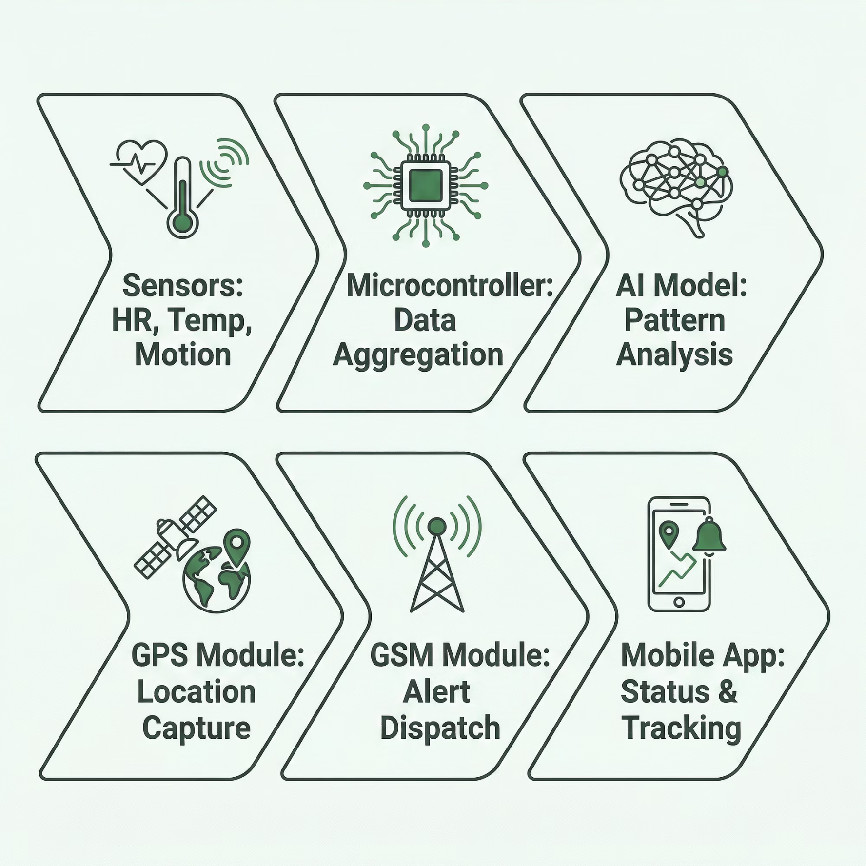

SYSTEM DESIGN
System Architecture
The smart slipper operates as an end-to-end safety pipeline — from
raw sensor data to emergency notification — with zero manual
intervention required from the user.

Slide 5


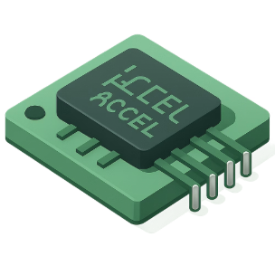

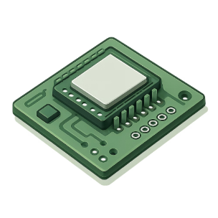
HARDWARE
Core Hardware Components
Heart Rate Sensor
Temperature Sensor
Accelerometer
GPS + GSM Modules
Monitors BPM in real time — elevated heart rate is a primary panic indicator.
Detects abnormal body temperature spikes that may correlate with stress or fear.
Captures motion patterns — sudden running, falls, or erratic movement trigger analysis.
GPS pinpoints location; GSM sends SMS alerts and triggers emergency calls.
Microcontroller (ESP32)
Central processing unit — aggregates sensor data and runs the AI inference model.

Slide 6
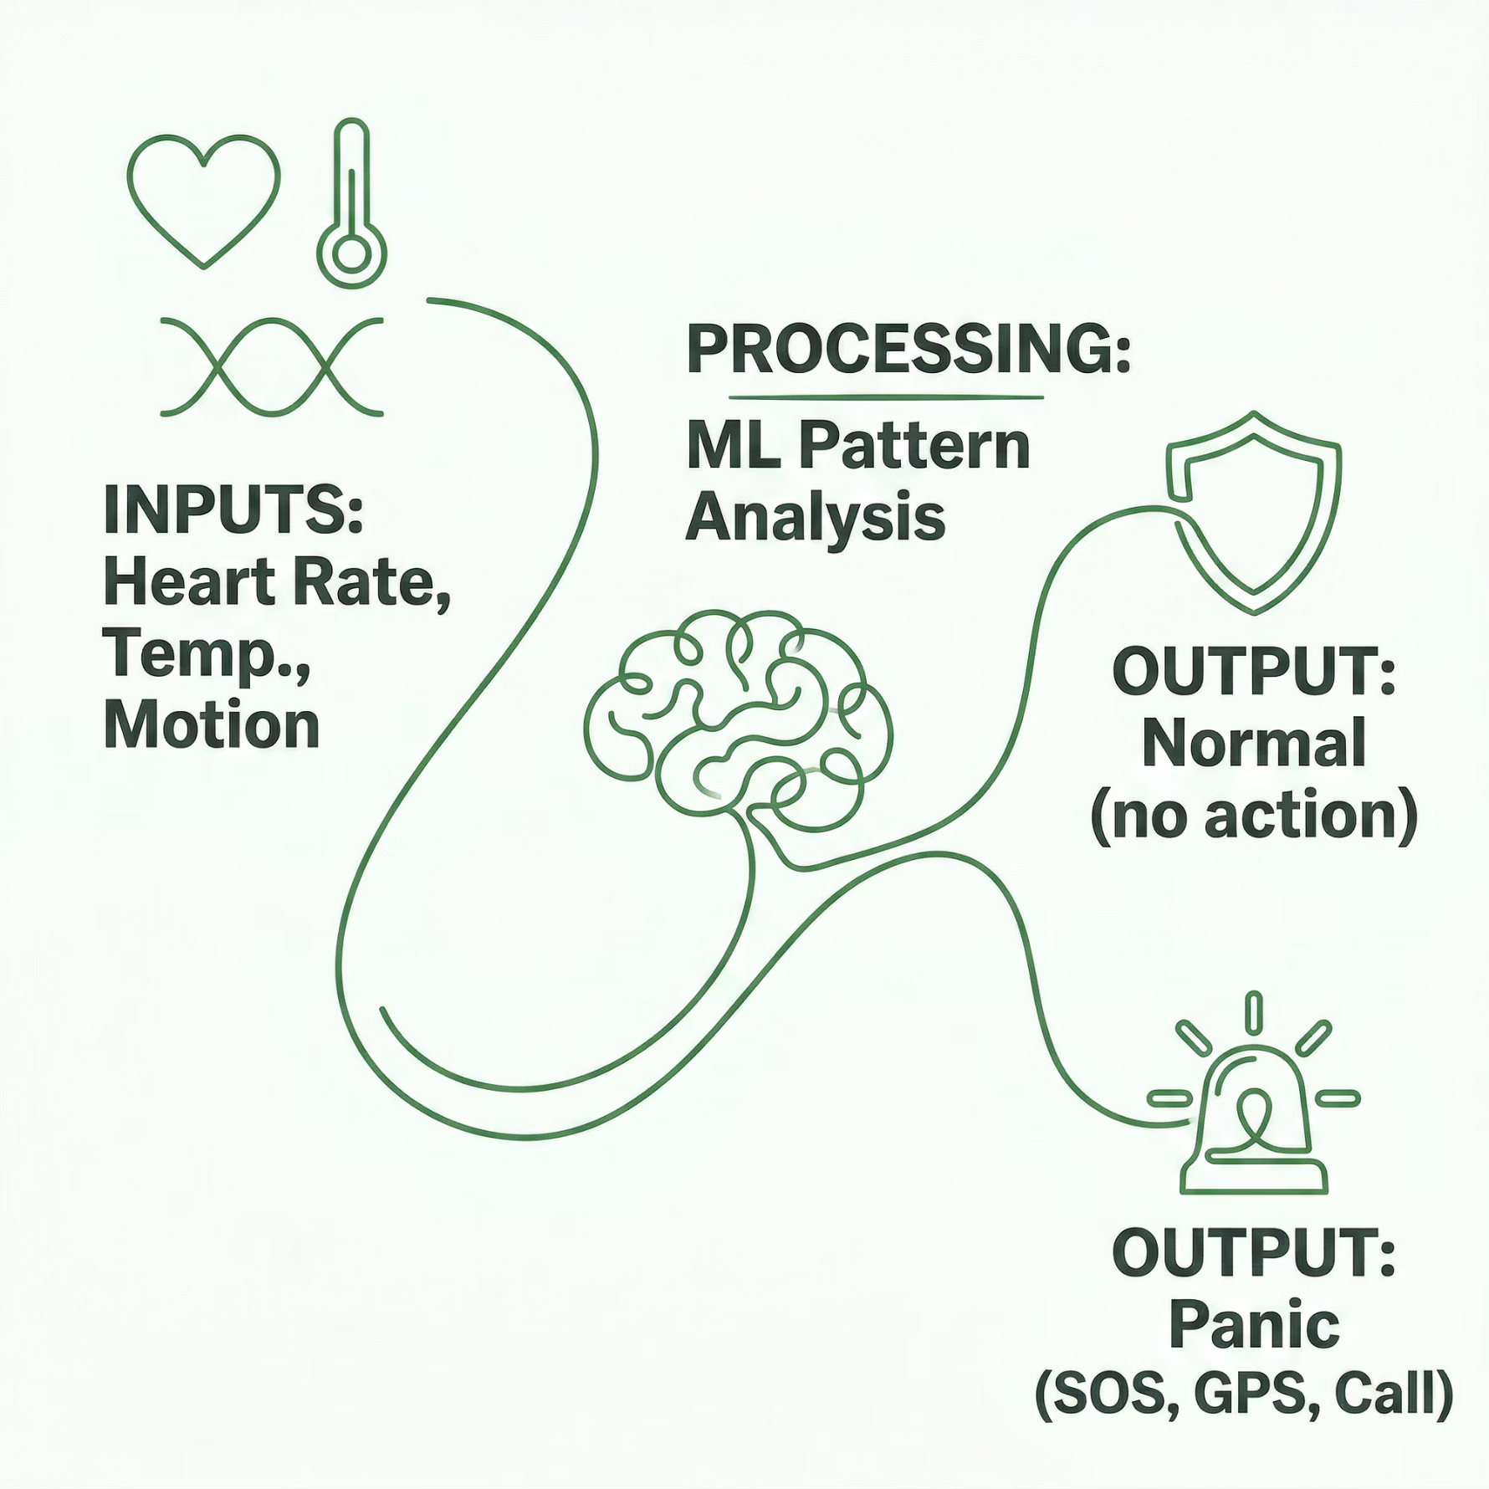
SOFTWARE
Software Stack & AI Logic
AI Decision Flow
Software Components
AI/ML Panic Detection Model — trained on physiological and motion
datasets to classify normal vs. distress states.
Android Mobile App — displays live status, location map, and
manages emergency contacts.
Embedded Firmware — Arduino IDE-based code running on ESP32 for real-time
sensor polling.

Slide 7

WORKING PRINCIPLE
How the Smart Slipper Works
Monitoring
Aggregation
AI Analysis
Alert
Response
“Safety you wear, intelligence that protects.”
The entire pipeline operates autonomously — from first sensor reading to emergency notification — typically within seconds, ensuring no delay in critical situations.

Slide 8

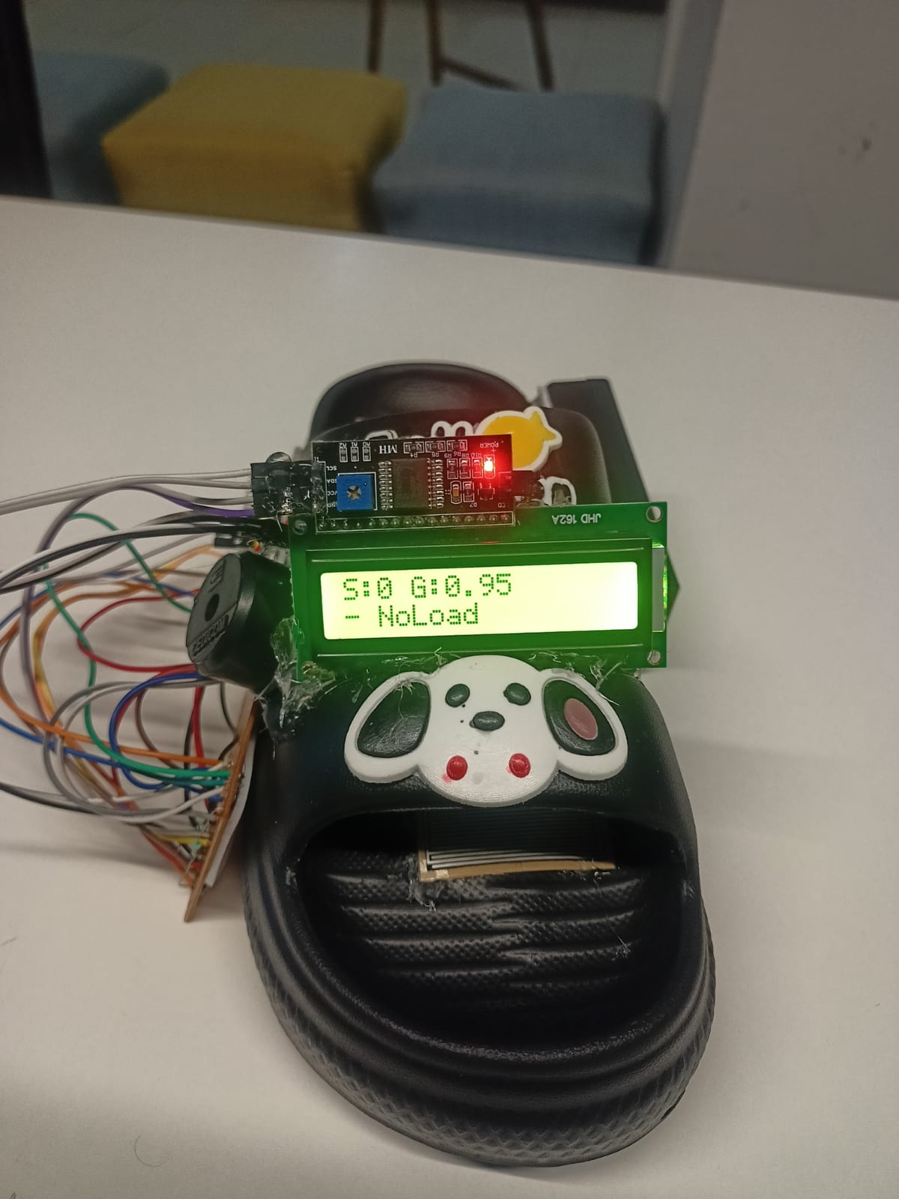
PROGRESS UPDATE
Implementation Progress Output
“This prototype demonstrates that safety can be embedded into everyday wear, making protection continuous, intelligent, and effortless with real-time emergency response. ”
👟 Working Model: AI-Based Smart Safety Slipper
👟 Smart Wearable Design ⚡ Real-Time Monitoring 🚨 Instant Emergency Response 🧠 Intelligent Detection System 🔋 Efficient & Reliable System

Slide 9
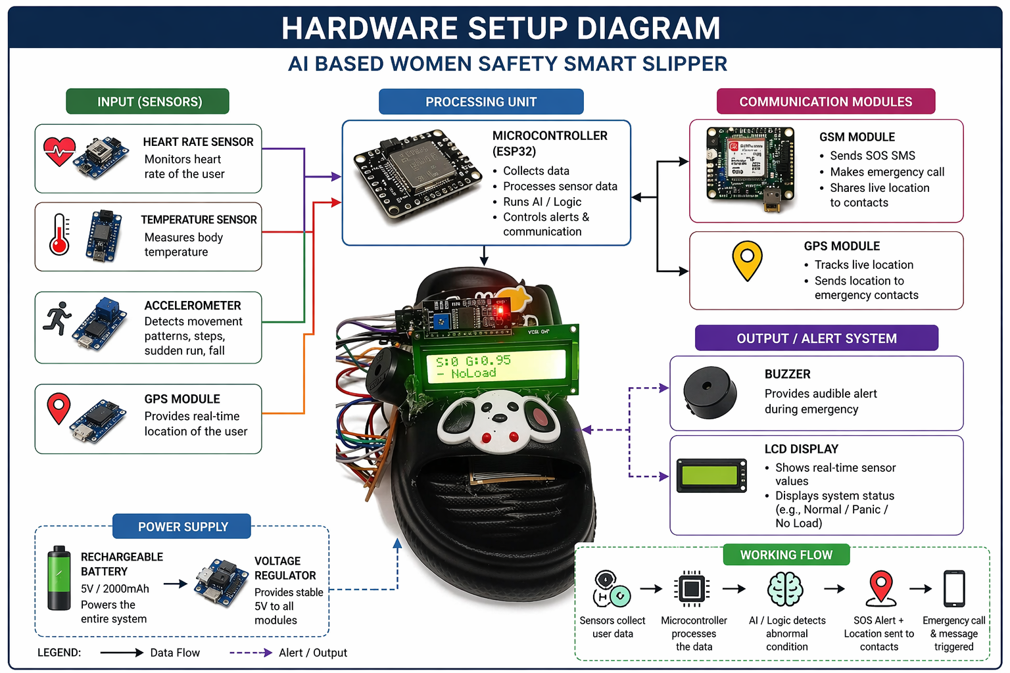

“This architecture shows how our system moves from sensing → intelligence → action, making safety proactive instead of reactive.”

Slide 10
EXPECTED OUTCOMES
What Success Looks Like
0s
3
Manual Input
Alert Channels
Fully automatic — no button press required to trigger an alert.
SOS SMS, live GPS share, and emergency call dispatched simultaneously.
24/7
<5s
Monitoring
Response Time
Continuous sensor surveillance ensures no panic event goes undetected.
Target alert dispatch within seconds of panic detection.

Slide 11
LOOKING AHEAD
Challenges & Future Scope
⚠️ Current Challenges
🚀 Future Enhancements
Sensor Accuracy — Noise and environmental factors can affect readings.
Power Management — Continuous monitoring requires efficient battery usage.
Police Integration — Direct API connection to emergency services.
Voice Alerts — Built-in speaker for audible SOS or deterrent alarm.
Cloud IoT Dashboard — Remote monitoring and historical data analytics.
Improved AI Model — Federated learning for personalized panic thresholds.
False Positives — Distinguishing exercise from panic needs robust AI training.
Network Dependency — GSM/GPS requires cellular coverage in the area.

Slide 12
DOCUMENTATION
References
Key research papers, technical documentation, and open-source projects that informed the development of the AI-Based Women Safety Smart Slipper.
AI-based Real-time Panic Detection for Wearable Devices - IEEE Xplore, 2018.
Arduino IDE Documentation - Official Arduino Documentation for ESP32 firmware development.
ESP32 Datasheet & Technical Reference Manual - Espressif Systems.
Android Developers Documentation - Guides and API references for mobile application development.
TinyML: Machine Learning for Tiny Devices - Resources and projects for on-device AI inference.

