Slide 1
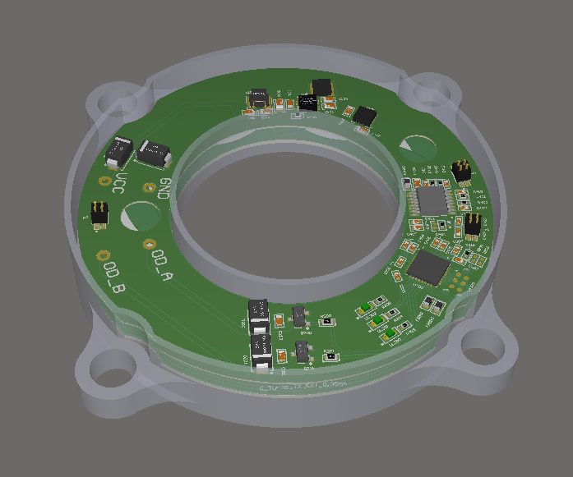
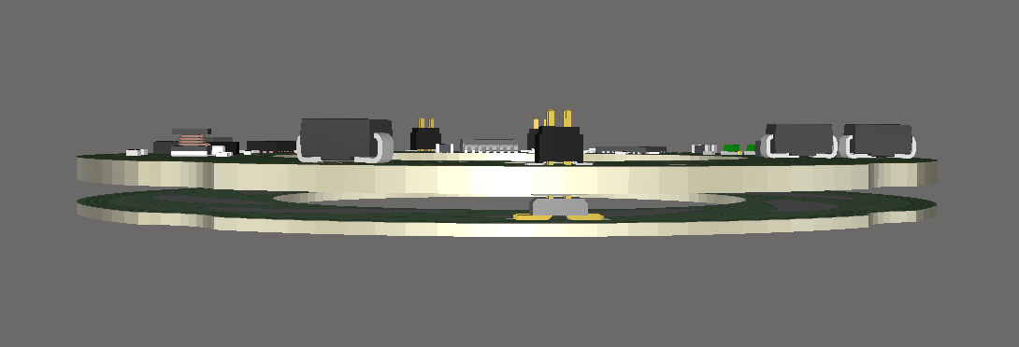
Sensore IPS

Slide 2
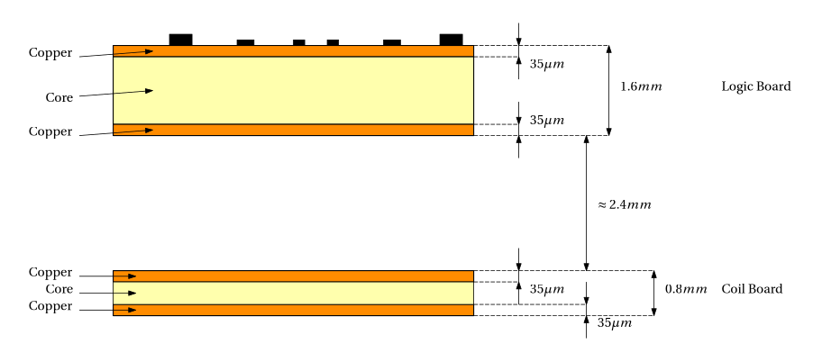
Current Stackup
Coupled via pin-strips
Cost: _____________________ €/$
(2 x 2 layer boards with all components on top layer)

Slide 3
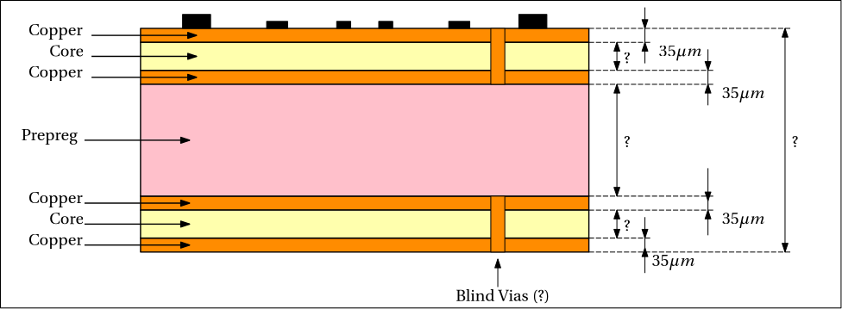
Proposed Stackup
Minimize (?)
Maximize (?)
Cost: _____________________ €/$
(1 x 4 layer board with all components on top layer +
Blind vias Top – Inner 1 + Blind vias Inner 2 - Bottom)

Slide 4
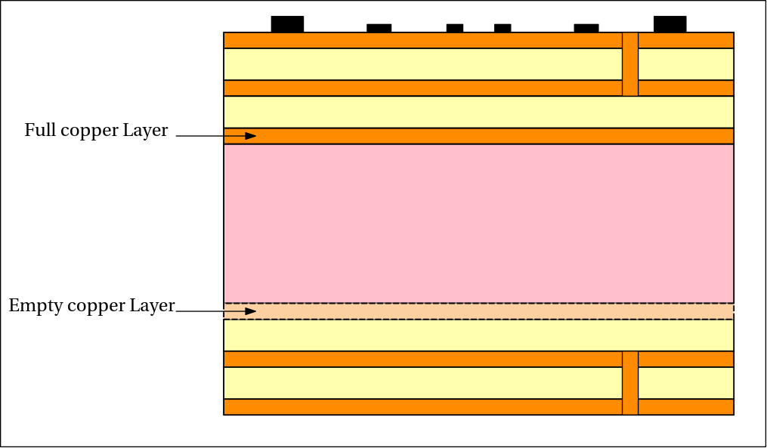
Proposed Stackup
Full GND Plane
Avoid shielding of the coils
Is this considered an asymmetric stackup?
Is this feasible?

