Slide 1
Disaster Relief with Tweet Learning
By: Samrin Zafar, Udayshankar Menon and Anthony Lathrop

Slide 2
Data Collection
Data was collected by using Twitter’s API
Tweepy was used to scrape tweets in real time

Slide 3
Exploratory Data Analysis (EDA) & Cleaning
A function was implemented to clean the data; hashtags were retained
Text was converted to lowercase, punctuation was removed using Regular Expressions and English stopwords were removed

Slide 4
Preprocessing & Visualizations
Text data pulled from Twitter was preprocessed by CountVectorizer
Seaborn was used to visualize the most common words for fire related disasters

Slide 5
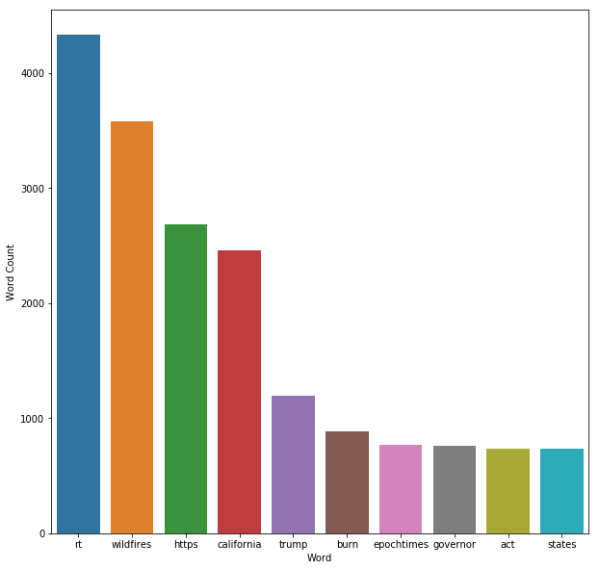
Most Common Words

Slide 6
Modeling - Objective
Identify regions of specific damage based on tweets from prior disaster areas.
Assumption 1: The vocabulary of tweets from a local disaster must be similar to their counterparts from a similar disaster in history.
Assumption 2: Every disaster has a unique lexicon that should make the tweets mutually exclusive in kind.

Slide 7
Modeling – Challenges
Web-scraping twitter for historic tweets is not easy, requires lot of energy due to time limit on scraping and the large amount of time it takes.
The problem at hand is not unique or pursued by ancestors in data science
Need for new perspectives and approach

Slide 8
Modeling - Approach
Save time by not repeating steps: Reached out and searched for open source resources sharing compilation of tweets
Exploit the diversity of information available to create a new perspective

Slide 9
Modeling - Datasets
CrisisLex.org is a resource that studies disaster related tweets.
CrisisLex26 is a compilation of 26 different disaster related tweets.
The tweets have been labeled based on their relevance and information contained
Two categories we consider:
Related – not informative & Related and informative

Slide 10
Modeling – Data Cleaning & Tagging
Tag tweets based on “relatedness” and the disaster “type” they are know to originate from
Remove duplicates from the freshly scraped tweets: 45% tweets were duplicates
Compiling various tweets into a single data frame to use in modeling phase
Categories and disaster types: 7 different label
0: Fire, 1: Cyclone, 2: Earthquakes, 3: Man-made, 4: Floods, 5: Others
99: Unrelated

Slide 11
Modeling – Single Class Classifier
Identifying tweets specific to “floods” from the entire corpus of tweets we compiled
Tagged all flood related tweets, category 4 in previous labels to 1 for floods and 0 for no floods
Count vectorizer and Logistic Regression model to identify flood related tweets.
Accuracy:
Training score: 98.96%
Testing score: 97.82%

Slide 12
Modeling – Multiclass Classifier
Classify tweets to the 7 different categories
CountVectorizer and Logistic Regression
Accuracy:
Training score: 88.36%
Testing score: 87.73%
Drop in accuracy is understandable due to possible overlaps - makes the problem of interest.
Eg: Wildfire tweets maybe similar to tweets from man-made incidents

Slide 13
Model - Improvement
Objective: Add more dimensions
We could go back to original datasets and look for other features such as information type – most tweets are sympathetic and supporting
Unsupervised learning: Cluster the vectorized tweet space
Possibly clustering of tweets based on similar disaster
Accuracy:
Training score: 94.86%
Testing score: 92.26%

Slide 14
Modeling – California Test Data
Objective is to avoid the need to better classify the millions of current tweets
Pinpoint resources specific to need of the hour
Classifying the CA fire tweets to specific damage kind
Disaster Type | Label
Fire | 0
Tropical Storm | 1
Earthquake | 2
Man-Made | 3
Floods | 4
Others | 5
Unrelated | 99

Slide 15
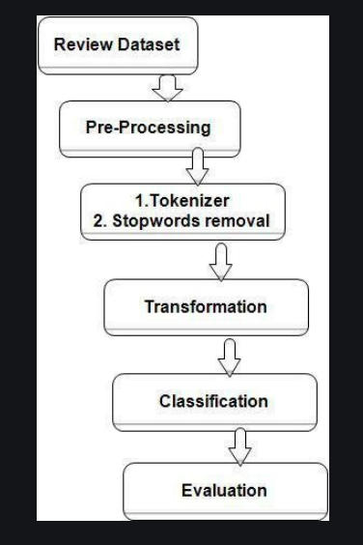
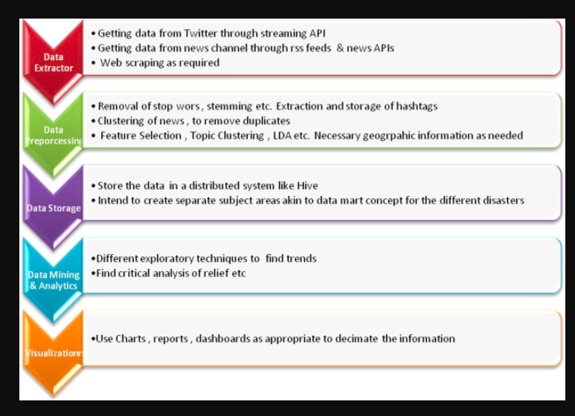
Our Workflow

Slide 16
Clustering
The word ‘clustering’ means grouping similar things together. The most commonly used clustering method is K-Means (because of its simplicity).
In reference to our project, Text Clustering aims at grouping similar text units together within a collection of documents.
This task is unsupervised since, unlike in text classification, we have no prior idea about the categories.
Running k-means for the same data set with multiple parameters, the results of the clustering process will be different and hence the accuracy calculated.
Preprocess your data before performing K-Means: K-Means is sensitive to outliers, just like every other algo that uses average/mean values

Slide 17
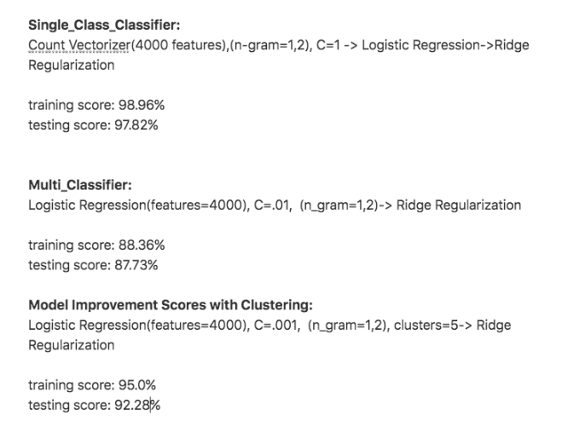
Scores

Slide 18
Conclusion
Pre-labelled tweets and text messages were scraped from Twitter’s API from social media and messaging that have taken place following past natural disasters.
During and post disasters it is difficult to recognize critical tweets that require immediate attention from response teams, and those which do not.
Survey says, typically only 1 in 1000 messages actually require direct attention.
This is more helpful in capturing the nuance in the text accurately as compared to simply using a keyword search
After initial cleaning the data and constructing, a ML pipeline is constructed, maximizing accuracy.
Finally the model is to be deployed to a web app where new messages can be predicted and categorise.
CONCLUSION: This project created a supervised machine learning model using natural language processing that accurately categorised tweets/messages to be forwarded to relevant disaster response teams.

Slide 19
Future Work
Consider more features in labeling the tweets
Use word embedding to observe relatedness of words/tweets
Exploit more advanced machine learning tools
Collect more data and identify new ways to add useful features

