Slide 1
Analytics
By YenHsun, Huang

Slide 2



Mixpanel
Google analytics
Flurry

Slide 3
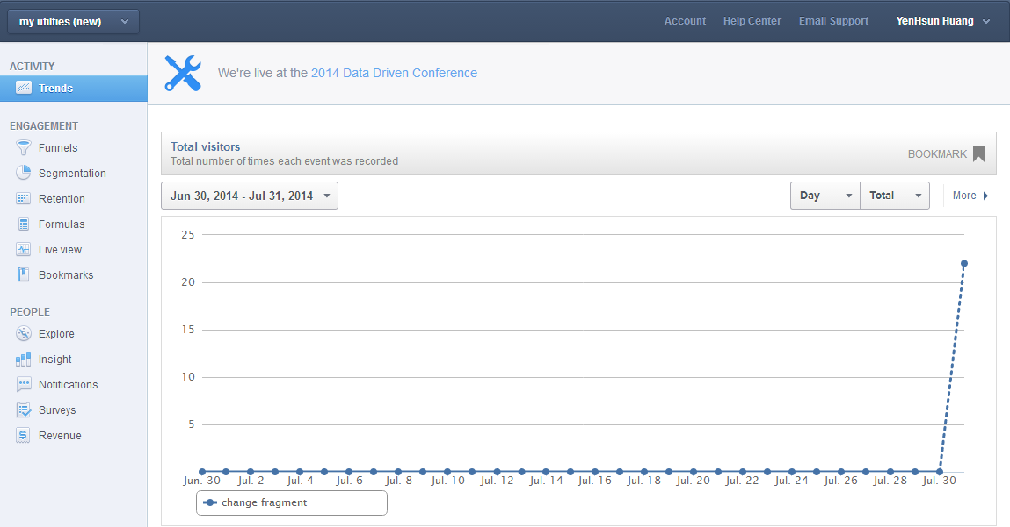
Mixpanel

Slide 4
Mixpanel
Short response time
Save individual data
Notifications
Survey
Easy to use

Slide 5
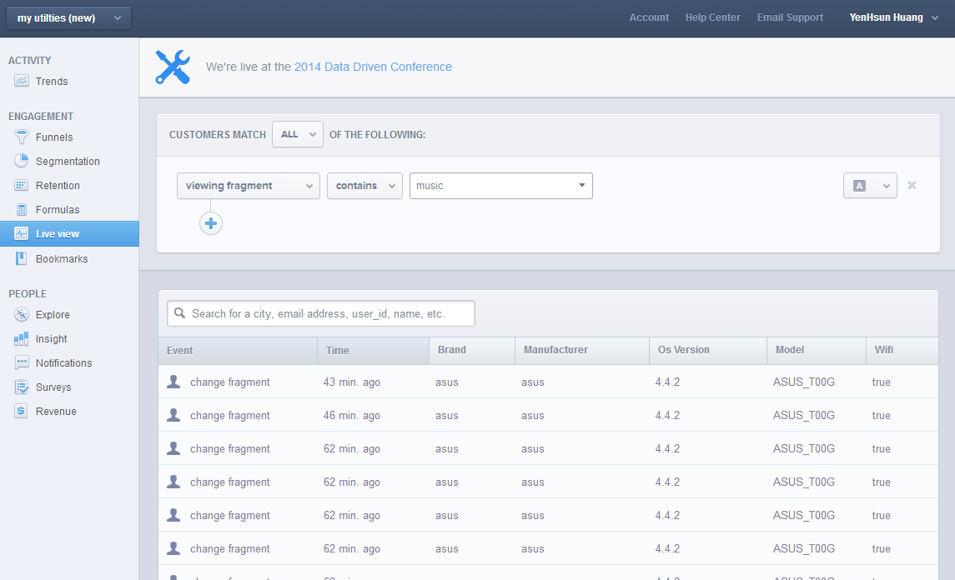
Mixpanel

Slide 6
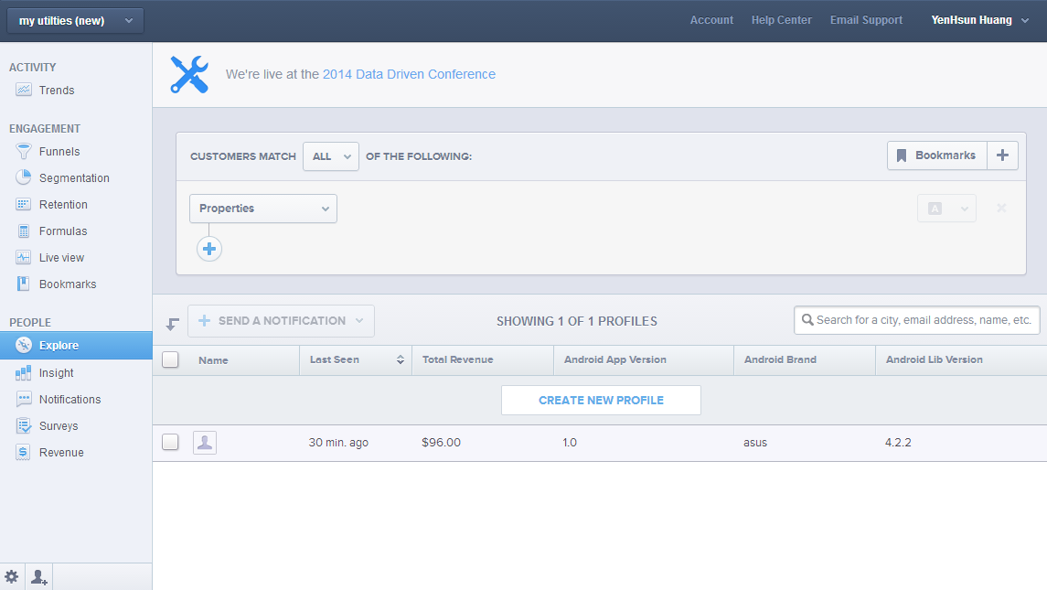
Mixpanel

Slide 7
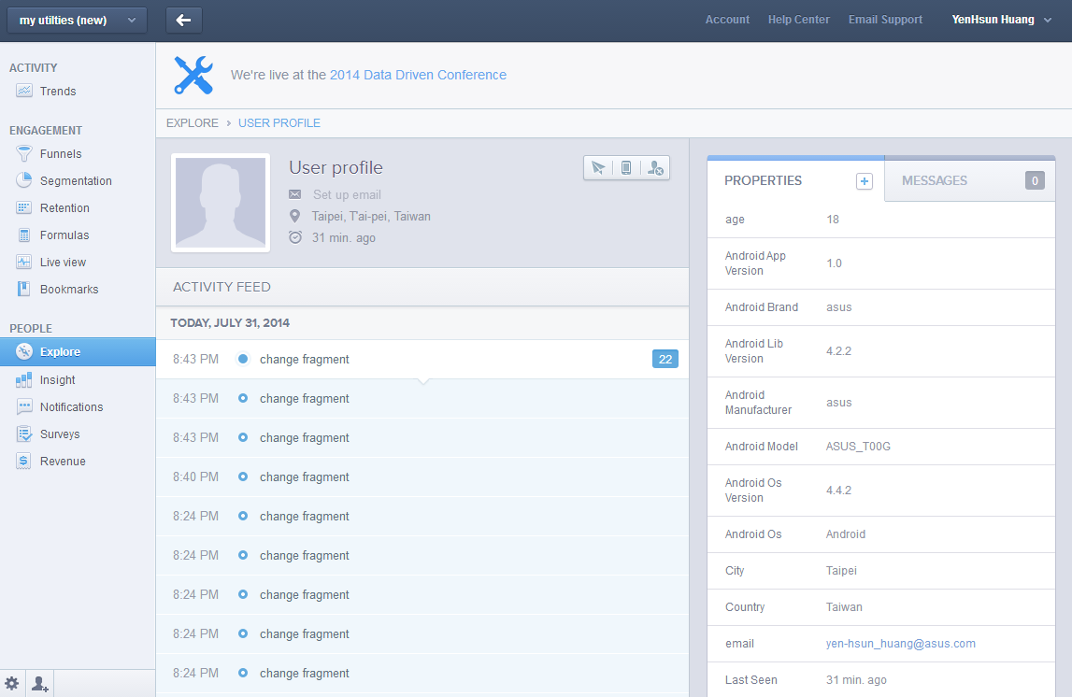
Mixpanel

Slide 8
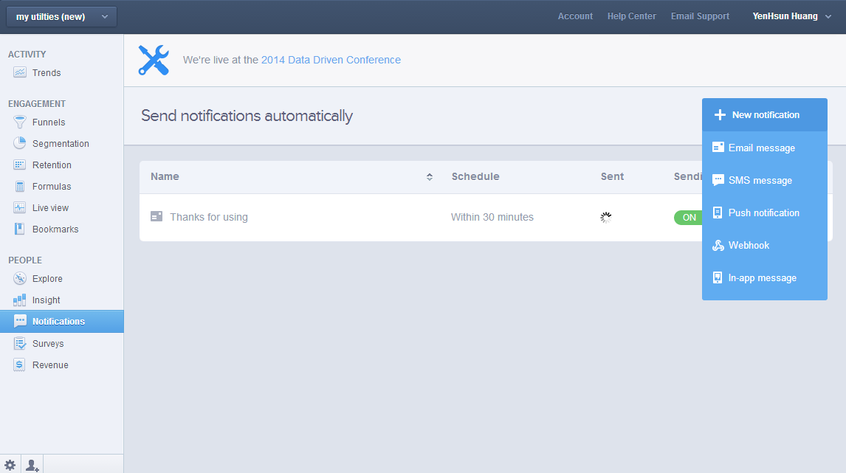
Mixpanel

Slide 9
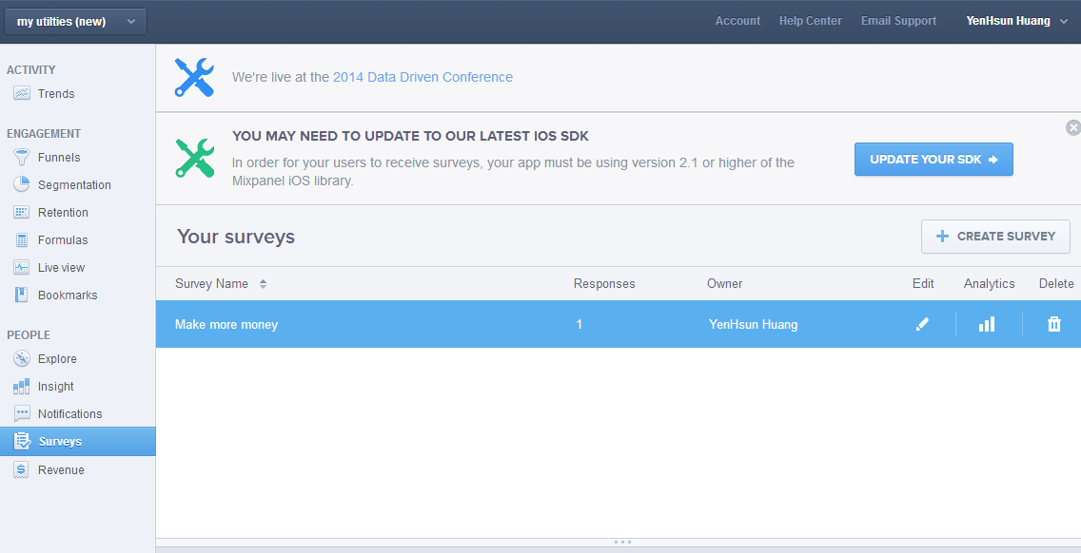
Mixpanel

Slide 10
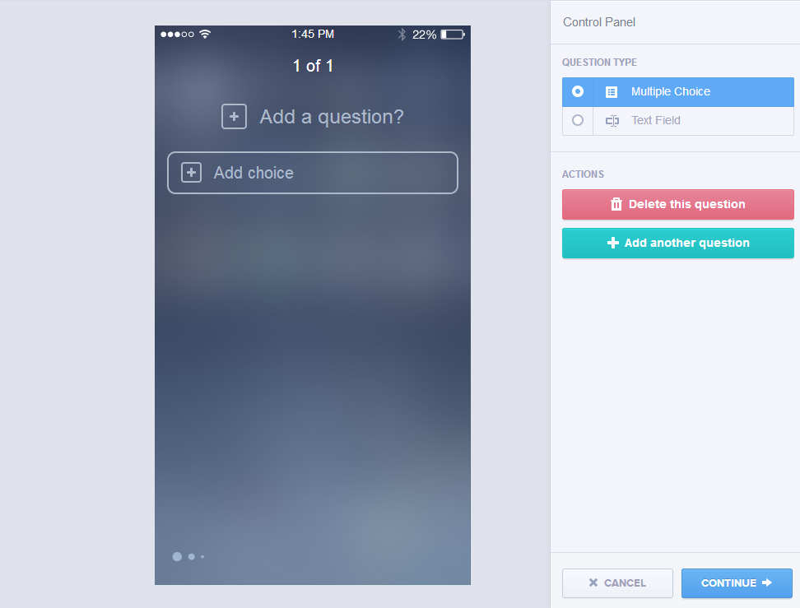
Mixpanel

Slide 11
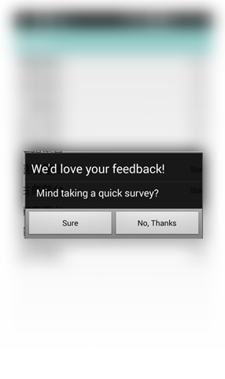
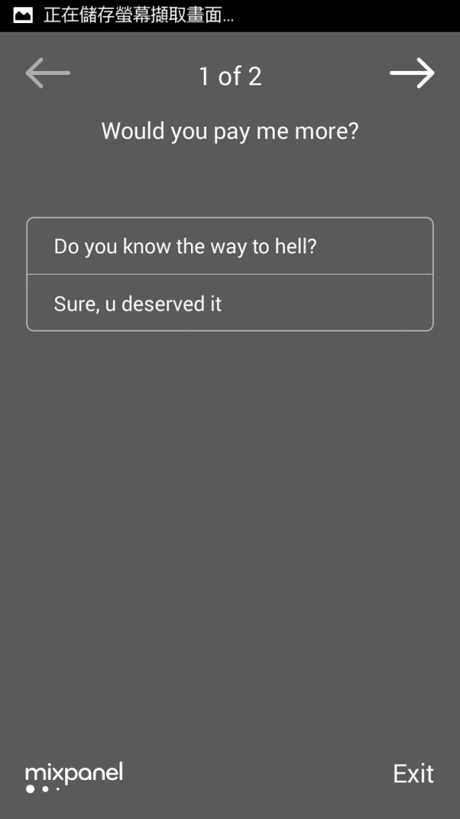
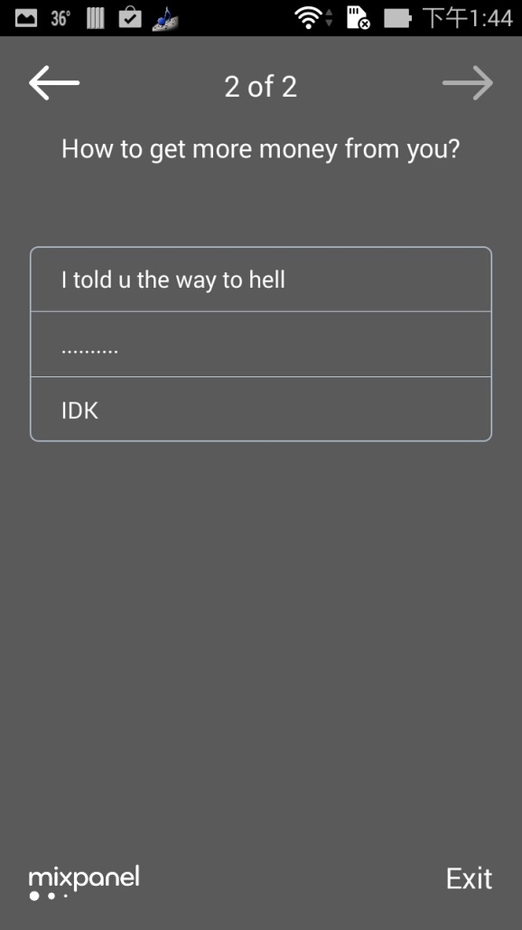
Mixpanel

Slide 12
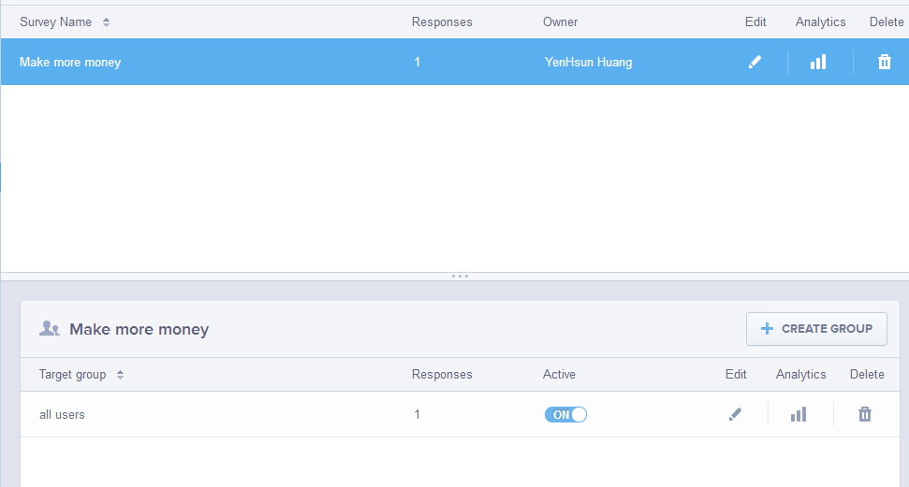
Mixpanel

Slide 13
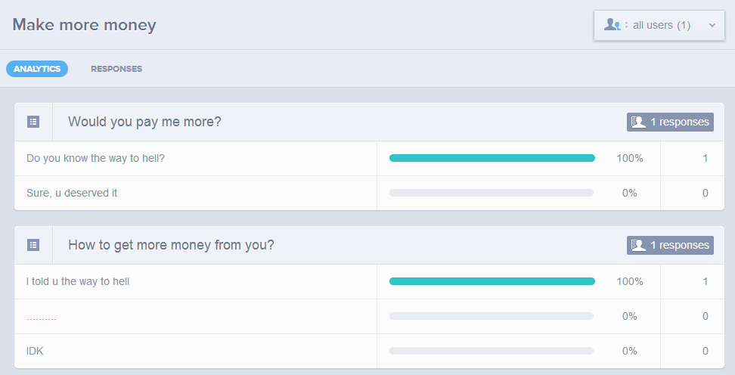
Mixpanel

Slide 14
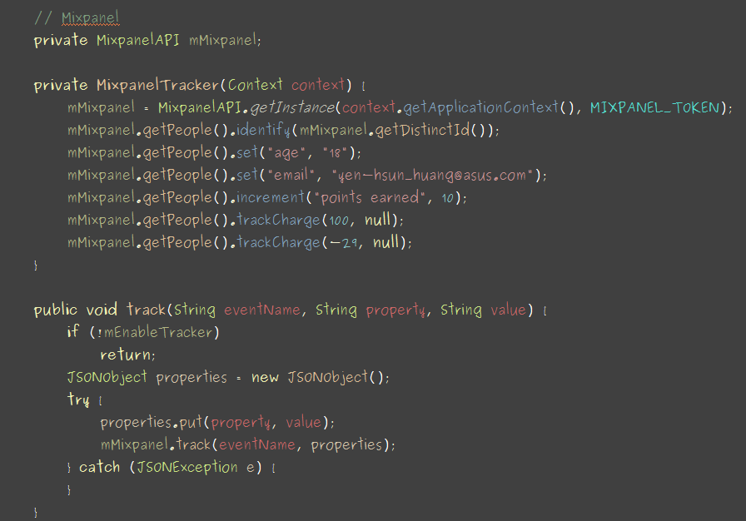
Mixpanel

Slide 15
Mixpanel
Doc:
http://mixpanel.github.io/mixpanel-android/index.html
Reference:
https://mixpanel.com/help/reference/android

Slide 16
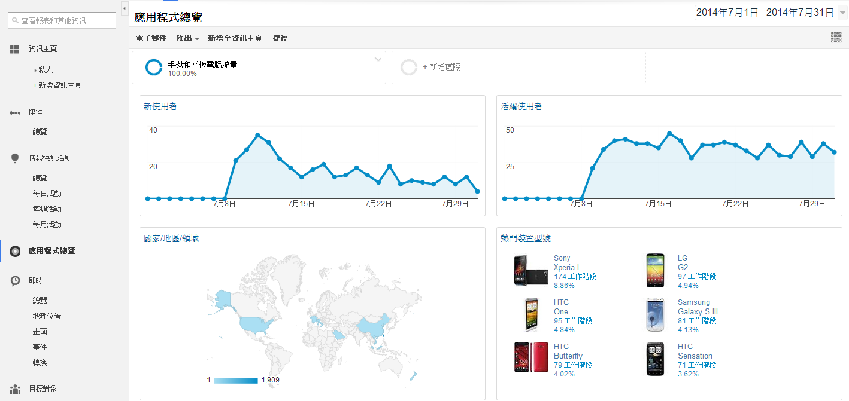
Google Analytics

Slide 17
Google Analytics
Friendly GUI
Save session information
Clearly device information
Integrate with google services (adword, play)
Capture exceptions

Slide 18
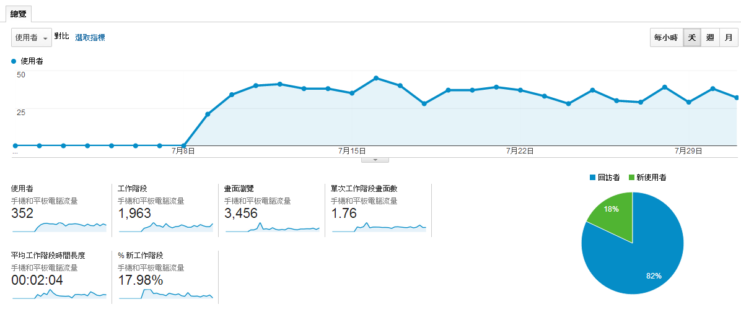
Google Analytics

Slide 19
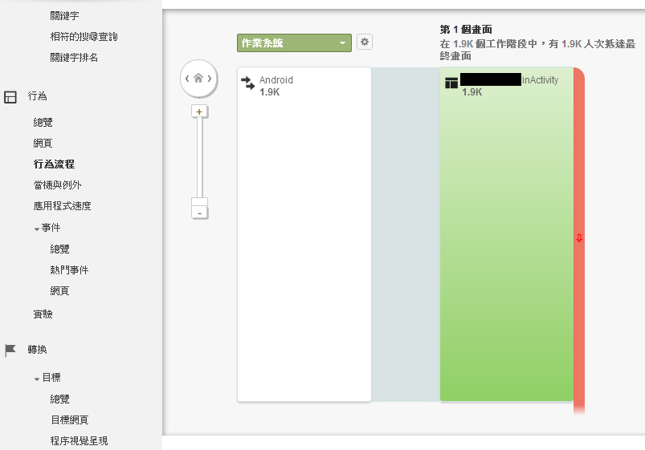
Google Analytics

Slide 20
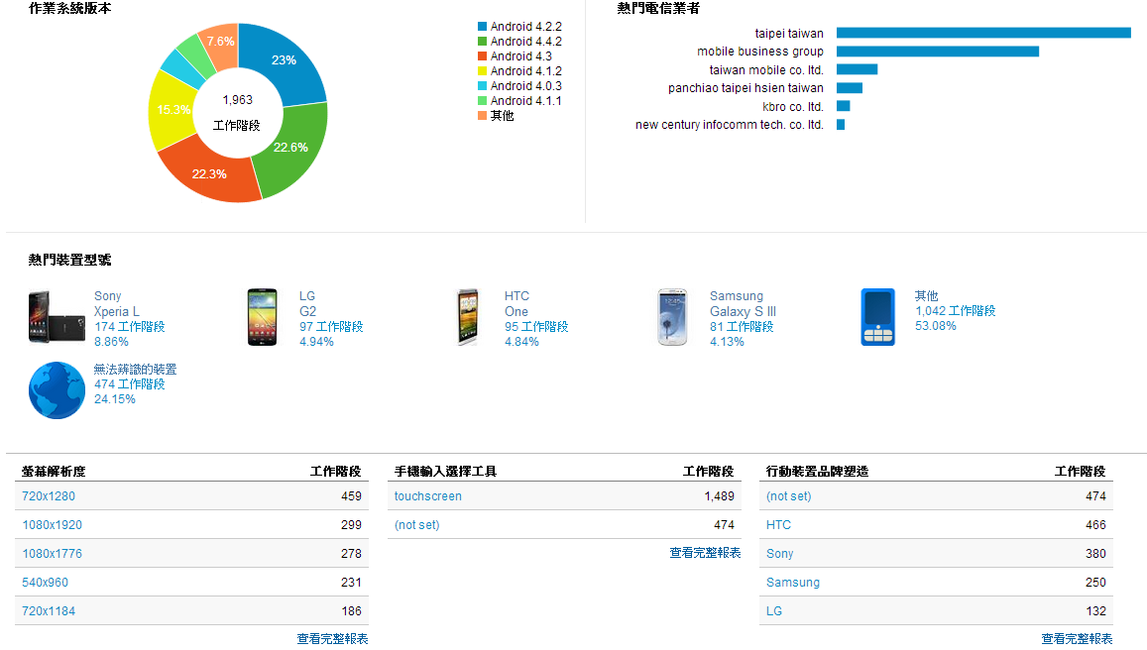
Google Analytics

Slide 21
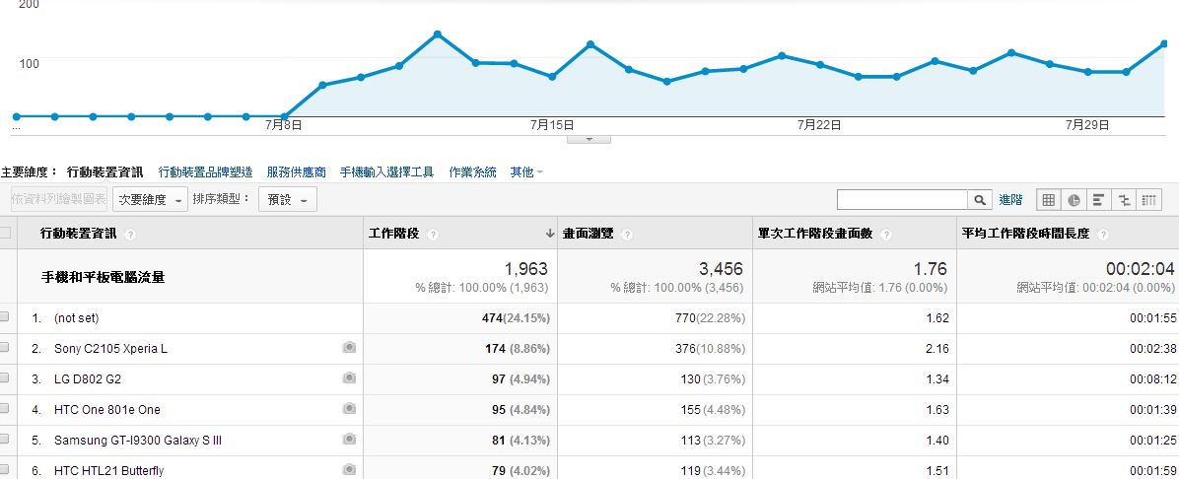
Google Analytics

Slide 22
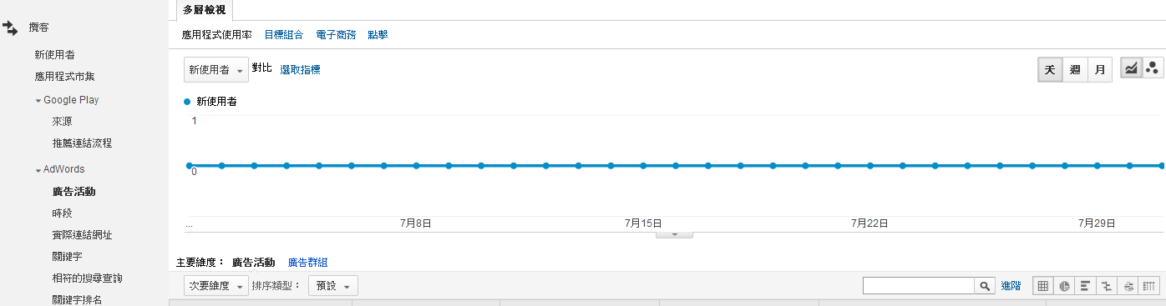
Google Analytics

Slide 23
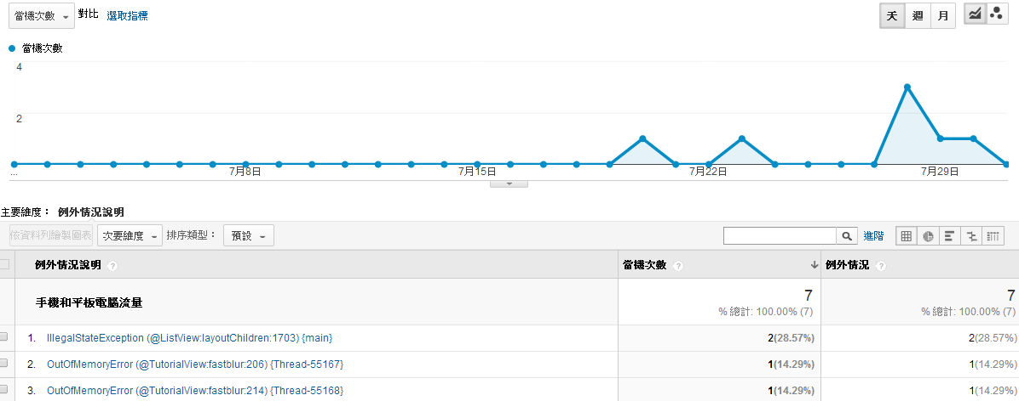
Google Analytics

Slide 24
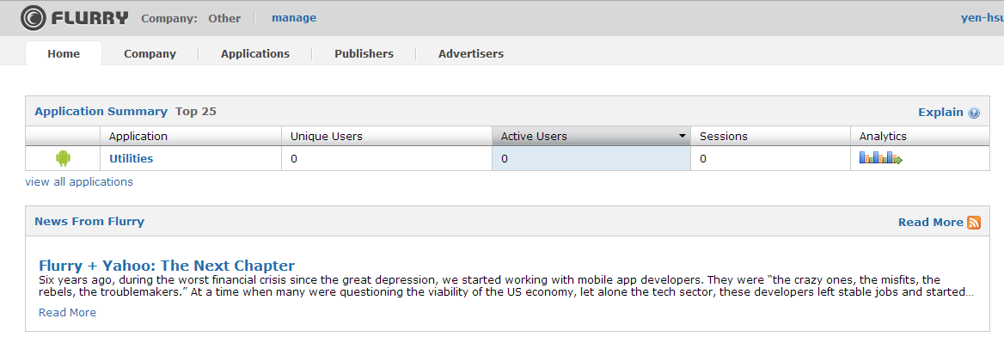
Flurry

Slide 25
Flurry
Integrate with banners (an ad platform)
Almost as same as google analytic

Slide 26
Flurry

Slide 27
Flurry

Slide 28
Flurry

Slide 29
Flurry

Slide 30
Flurry

Slide 31
Flurry
Reference
http://support.flurry.com/index.php?title=Analytics/GettingStarted/Android

