Slide 1

MOD2-02 Microelectronics & HW-SW Co-Design
Luca Brodo Tural Hasanov Man Chui Ng, Jacky
Notes:
Introduction – Luca
our workflow for the project
Theory – Luca
Literature – Tural
Virtual Prototype: algorithm on MATLAB simulation – Luca

Slide 2
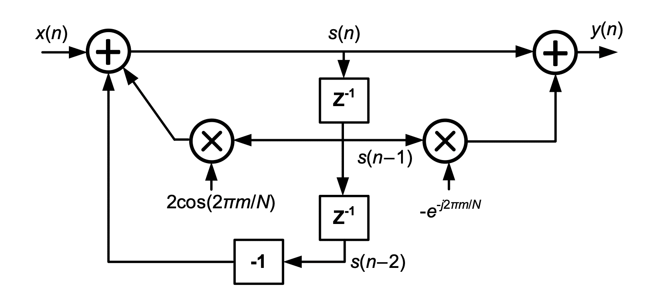
Introduction
What is the Goertzel Filter?
(1)
Notes:
The Goertzel Filter is a digital signal processing algorithm used to determine the presence or absence of a particular frequency component in a signal. It offers a computationally efficient approach to perform frequency analysis and is especially useful for applications involving real-time or embedded systems with limited computational resources.

Slide 3
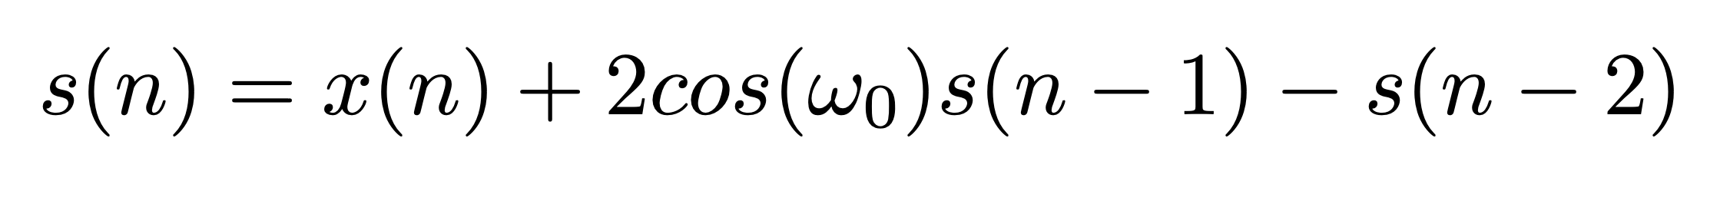
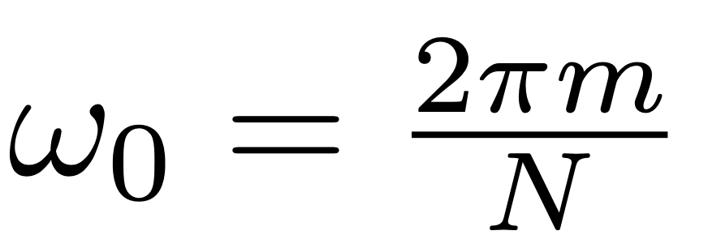
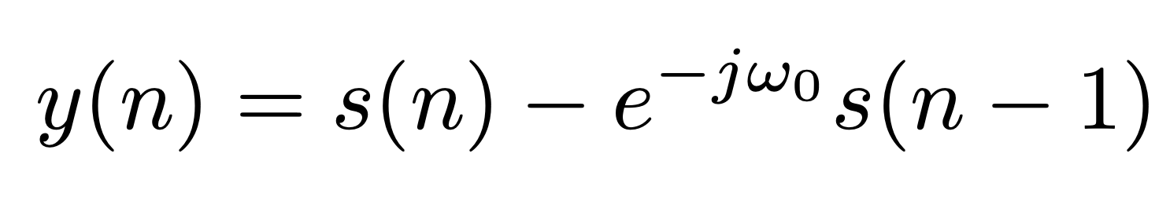
Introduction
(1)
Notes:
The Goertzel Filter is a digital signal processing algorithm used to determine the presence or absence of a particular frequency component in a signal. It offers a computationally efficient approach to perform frequency analysis and is especially useful for applications involving real-time or embedded systems with limited computational resources.

Slide 4
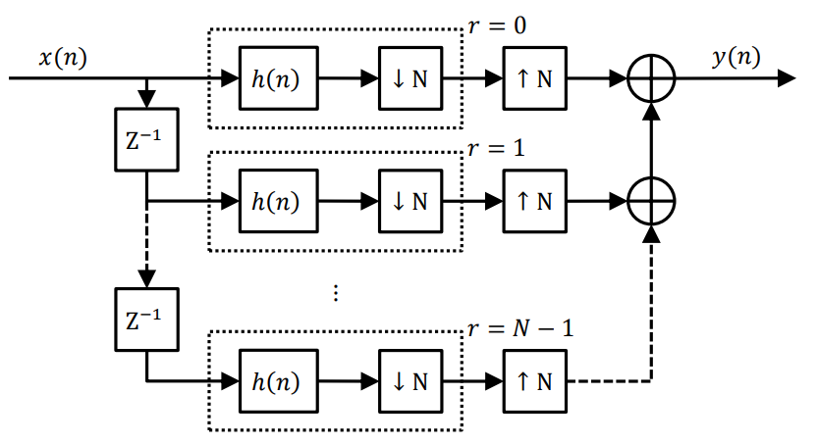
Literature Review
A novel structure of the Goertzel filter
N mutually delayed branches of the filter multiplexed and summed
Used where a higher resolution of the signal is required temporarily (for ex. synchronization purposes).
(1)​
(2)
Notes:
Filip Záplata and Miroslav Kasal
A modified Goertzel algorithm evolved for DTMF signal detection

Slide 5
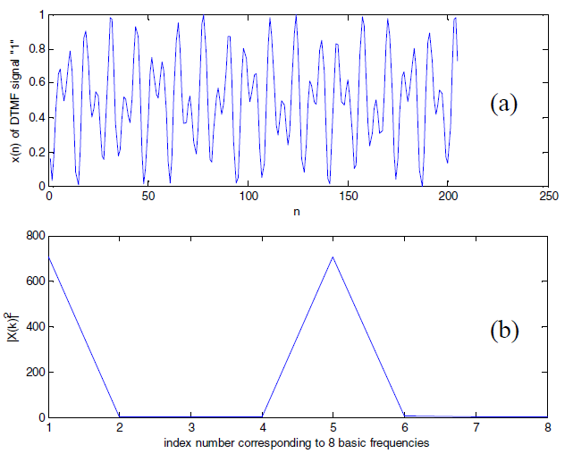
Literature Review
Dual Tone Multi-Frequency (DTMF) signal detection
Using a comparator and a counter instead of multiply operations and two addition operations.
The performance is same as traditional algorithm but, the usage of hardware resources are reduced significantly
(3)
Notes:
Zhang Xinyi

Slide 6
Literature Review
Usage of fixed-point arithmetic over floating-point arithmetic
16-bit precision most accurate
Not viable if the CPU lacks sufficient processing power.
Modified Discrete Cosine Transform (MDCT) calculations
Obtained from the discrete-time convolution sum representing the MDCT.
Require fewer arithmetic operations
Less susceptible to coefficient quantization errors
Reduces hardware
Notes:
Stephen Brown, Joe Timoney, and Tom Lysaght
specifically focus on comparing the accuracy of the Goertzel Algorithm with different precisions of fixed-point arithmetic
Trevor W. Fox and Alex Carriera

Slide 7



Simulation – Input Signals
16383 = 2¹⁴ - 1
Sine waves
Frequency: 5, 49, 50, 51, 200 kHz, combined
Phase: 0°, 30°, 45°, 90°, 120°
Rectangular waves
Frequency: 10, 16, 50, 200 kHz, combined
Phase: 0°, 30°, 45°, 90°, 120°
Triangle waves
Frequency: 50 kHz
Phase: 0°, 90°
0
Notes:
Rapid prototyping

Slide 8
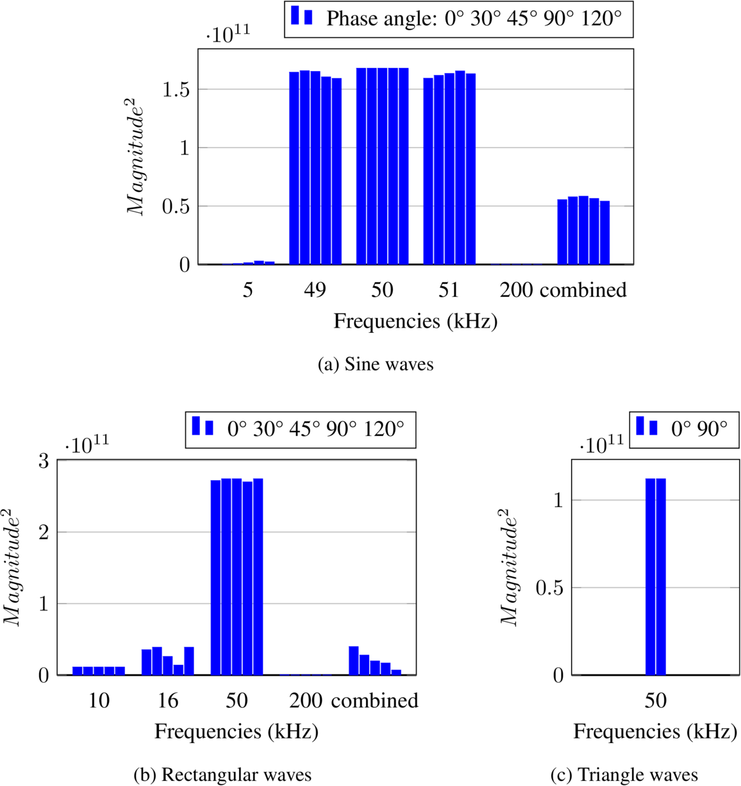
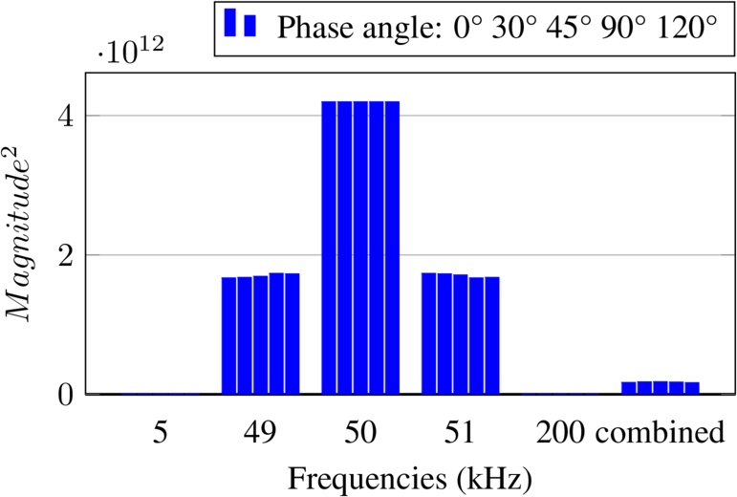
Simulation – Input Signals
↑ # samples → ↑ frequency resolution
When N = 500:

Slide 9
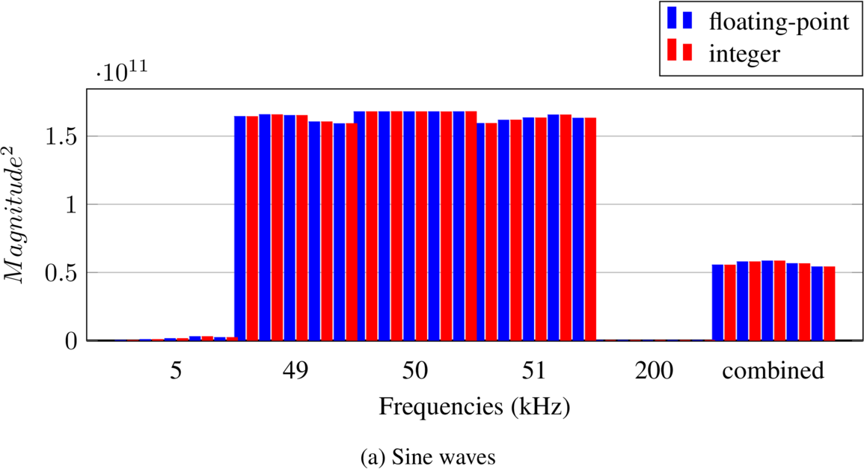
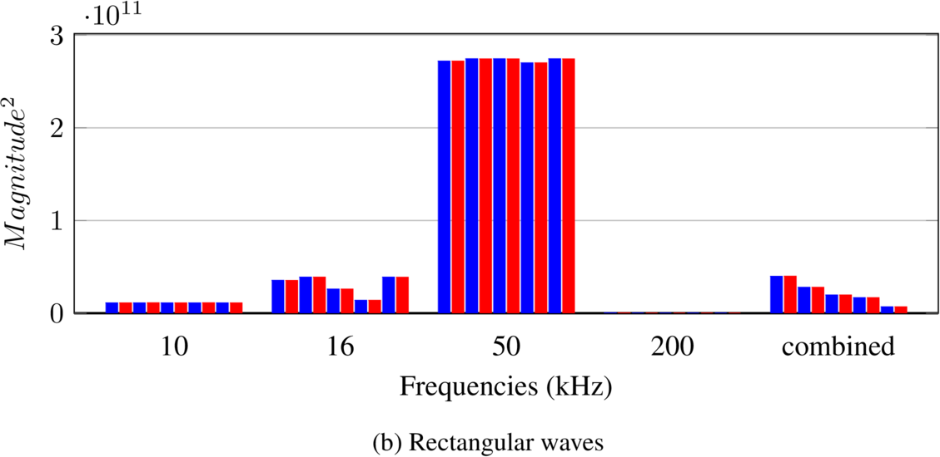
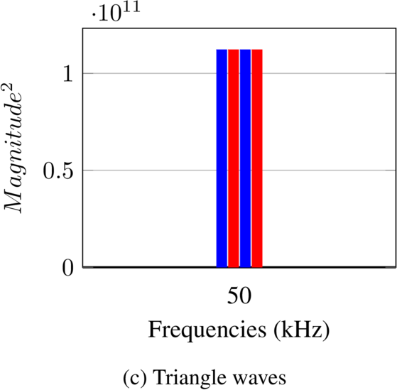
Simulation – Int vs Float
Deviation is due to truncation error
Minimal difference between 2 versions
Notes:
The differences between the 2 versions is at most 1.2 × 10^8, and considering that the output is in the magnitude of 10^11, the error is less than 0.1%

Slide 10
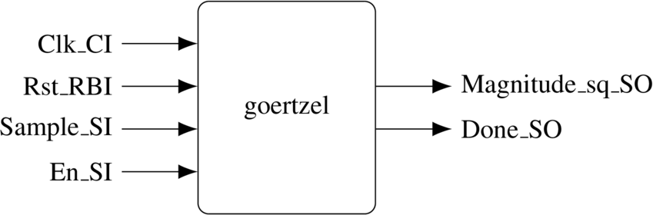
Implementation – Port Description
Clock
Reset
Data
Control Signals
GENERIC (
N : POSITIVE := 100; -- Number of samples
SIG_BW : POSITIVE := 14; -- bit width for input signal
INT_BW : POSITIVE := 18; -- bit width for internal data
LSB_TRUNC : POSITIVE := 5; -- truncate internal data's LSB to avoid overflow
MAG_TRUNC : POSITIVE := 11; -- truncate final result (Magnitude_sq_SO)
C : SIGNED(INT_BW - 1 DOWNTO 0) := "01" & x"E6F1";
C_F : POSITIVE := INT_BW - 2 -- # of bits of fractional part of C
);
Notes:
With the knowledge of the theory & algorithm -> we BUILT our implementation on top of them
First -> interfaces
Ports...
On top of that: generics
Constants are parameterized -> easier to reuse the code in case we want to have the filter in different configuration

Slide 11
Implementation – Port Description
Clock
Reset
Data
Control Signals
En_SI: enable signal
Done_SO: indicate Magnitude_sq_SO is valid
Notes:
With theory & algorithm -> BUILT our implementation on top of them
First -> interfaces
Ports...
On top of that: generics
Constants are parameterized -> easier to reuse the code in case we want to have the filter in different configuration

Slide 12
Implementation – Algorithm
C_F (16 bits)
cos(ω₀) = C =
0 | 1 | 1 | 1 | 1 | 0 | 0 | 1 | 1 | 0 | 1 | 1 | 1 | 1 | 0 | 0 | 0 | 1
C : SIGNED(INT_BW - 1 DOWNTO 0) := "01" & x"E6F1"; -- 124657
C_F : POSITIVE := 16 -- # of bits of fractional part of C
LSB_TRUNC (5 bits)
1 | 1 | 0 | 0 | 1 | 1 | 0 | 0 | 1 | 1 | 1 | 0 | 1 | 1 | 0 | 1 | 1 | 1 | 0 | 0 | 0 | 0 | 0
LSB_TRUNC : POSITIVE := 5;
...
SIGNAL s0, s1_D, s2_D : SIGNED(INT_BW - 1 DOWNTO 0);
Notes:
"Since we're using integer" -> limitation scaling factor
Implementation of algorithm
1st limitation we have considered -> floating-pt uses ↑ HW resources -> use integer
cos(ω_0) -> named C -> not an integer
C_F: scaling factor of 2^-16 -> in turn shift the decimal point (or comma if you're German) by 16 bits, as shown here
2nd limitation: limit overall HW resources -> use up to 18 bit for internal data
MATLAB -> s(n) can grow up to >2^21

Slide 13
Implementation – Algorithm
LSB_TRUNC (5 bits)
s(n-1)
1 | 1 | 0 | 0 | 1 | 1 | 0 | 0 | 1 | 1 | 1 | 0 | 1 | 1 | 0 | 1 | 1 | 1 | 0 | 0 | 0 | 0 | 0
C_F (16 bits)
1 | 1 | 0 | 0 | 1 | 1 | 0 | 0 | 1 | 1 | 1 | 0 | 1 | 1 | 0 | 1 | 1 | 1 | 0 | 0 | 0 | 0 | 0
C
0 | 1 | 1 | 1 | 1 | 0 | 0 | 1 | 1 | 0 | 1 | 1 | 1 | 1 | 0 | 0 | 0 | 1
0 | 1 | 1 | 1 | 1 | 0 | 0 | 1 | 1 | 0 | 1 | 1 | 1 | 1 | 0 | 0 | 0 | 1
s(n-1) × C
1 | 1 | 1 | 0 | 0 | 1 | 1 | 1 | 1 | 0 | 1 | 1 | 0 | 1 | 1 | 0 | 1 | 1 | 0 | 1 | 0 | 0 | 0 | 1 | 1 | 0 | 0 | 1 | 0 | 1 | 0 | 0 | 0 | 1 | 1 | 1
1 | 1 | 1 | 0 | 0 | 1 | 1 | 1 | 1 | 0 | 1 | 1 | 0 | 1 | 1 | 0 | 1 | 1 | 0 | 1 | 0 | 0 | 0 | 1 | 1 | 0 | 0 | 1 | 0 | 1 | 0 | 0 | 0 | 1 | 1 | 1
x(n)
0 | 0 | 0 | 0 | 0 | 0 | 0 | 0 | 0 | 0 | 0 | 0 | 0 | 0
11 bits
0 | 0 | 0 | 0 | 0 | 0 | 0 | 0 | 0 | 0 | 0 | 0 | 0 | 0
Truncation instead rounding
+ HW resource ↓
Accuracy ↓
s(n-2)
1 | 1 | 0 | 1 | 0 | 0 | 1 | 0 | 1 | 1 | 1 | 0 | 0 | 0 | 0 | 0 | 0 | 0 | 0 | 0 | 0 | 0 | 0
1 | 1 | 0 | 1 | 0 | 0 | 1 | 0 | 1 | 1 | 1 | 0 | 0 | 0 | 0 | 0 | 0 | 0 | 0 | 0 | 0 | 0 | 0
s(n)
1 | 1 | 1 | 1 | 0 | 1 | 0 | 0 | 0 | 1 | 0 | 1 | 1 | 0 | 1 | 1 | 1 | 0 | 0 | 0 | 0 | 0 | 0 | 1 | 1
store to memory
Notes:
"With this in mind, the calculation of the intermediate result s(n) become more complicated"
How we decided to do the scaling, take cal. of s(n) as an example
s(n-1) & C: both 18-bit -> 36-bit
s(n-1) & C: xxx bits before/after the decimal point -> 11 bit after -> shift right before adding…

Slide 14

Implementation – Timing
(1)
Notes:
"another optimization we've considered is regarding timing..."

Slide 15
Implementation – Timing
Shorten critical path
(1)

Slide 16
Implementation – Timing
goertzel
Magnitude_sq_SO
(1)
Notes:
"However, now the critical path become this" -> therefore

Slide 17
Implementation – Timing
goertzel
Magnitude_sq_SO
Flip-flop behind output port
+ better for downstream circuits
(1)

Slide 18
Verification
VHDL Testbench to verify functional behaviour
Read files from MATLAB simulation (in hexadecimal) readline(fptr, file_line); hread(file_line, var_data);
Feed into the filter Sample_SI <= resize(var_data, Sample_SI'LENGTH);
Compare with the expected results ASSERT (resize(var_expected, Magnitude_sq_SO'LENGTH) = Magnitude_sq_SO) REPORT "FAIL, Expected Magnitude_sq_SO: " & INTEGER'IMAGE(to_integer(var_expected)) & "Actual: " & INTEGER'IMAGE(to_integer(Magnitude_sq_SO)) SEVERITY WARNING;
Notes:
"One the implementation is complete" -> testbench -> to verify
Test suite files
Possible Future improvement:
In the sim, we found that overflow may happen -> “solve” by truncate 5 bit
Not guarantee that it will not happened with any test signals, may change the condition, e.g. adding # of samples
Add overflow output signal -> Indicate the user -> happened
ASSERT -> auto -> no visual inspection manually

Slide 19
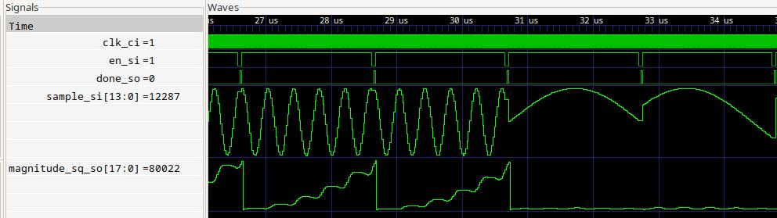
Results
Filter performance match perfectly to simulation
With expected error
Portable
Synthesizable

Slide 20
Louis Regnacq, Yu Wu, Nazanin Neshatvar, Dai Jiang, and Andreas Demosthenous. A goertzel filter-based system for fast simultaneous multi-frequency eis. IEEE Transactions on Circuits and Systems II: Express Briefs, 68(9):3133–3137, 2021
Záplata, Filip and Kasal, Miroslav. Using the Goertzel algorithm as a filter. Signal diagram of the Goertzel filter in parallel 1-3, 2014
Zhang Xinyi. The FPGA Implementation of Modified Goertzel Algorithm for DTMF Signal Detection 4811-4815, 2010

Slide 21
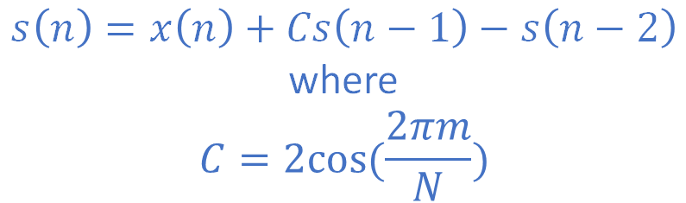
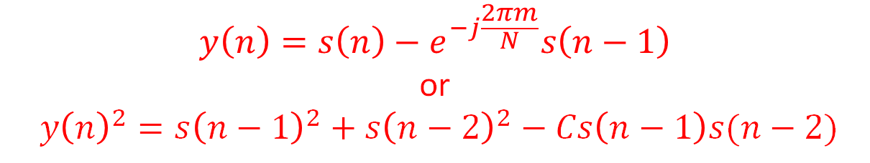
$$s\left(n\right)=x\left(n\right)+Cs\left(n−1\right)−s\left(n−2\right)$$
where
$$C=2cos⁡(\frac{2πm}{N})$$
$$y\left(n\right)=s\left(n\right)−e^{−j\frac{2πm}{N}}s\left(n−1\right)$$
or
$${y\left(n\right)}^{2}={s\left(n−1\right)}^{2}+{s\left(n−2\right)}^{2}−Cs\left(n−1\right)s(n−2)$$

Slide 22
ENTITY goertzel IS
GENERIC (
N : POSITIVE := 100; -- Number of samples
SIG_BW : POSITIVE := 14; -- bit width for input signal
INT_BW : POSITIVE := 18; -- bit width for internal data
LSB_TRUNC : POSITIVE := 5; -- truncate internal data's LSB to avoid overflow
MAG_TRUNC : POSITIVE := 11; -- truncate final result (Magnitude_sq_SO)
C : SIGNED(INT_BW - 1 DOWNTO 0) := "01" & x"E6F1";
C_F : POSITIVE := INT_BW - 2 -- # of bits of fractional part of C
);
PORT (
Clk_CI : IN STD_LOGIC;
Rst_RBI : IN STD_LOGIC;
Sample_SI : IN UNSIGNED(SIG_BW - 1 DOWNTO 0);
Magnitude_sq_SO : OUT SIGNED(INT_BW - 1 DOWNTO 0);
En_SI : IN STD_LOGIC;
Done_SO : OUT STD_LOGIC
);
END ENTITY goertzel;

Slide 23
-- calculate the intermediate result
-- C: (INT_BW - C_F - 1 DOWNTO -C_F) -> (1 DOWNTO -16)
-- s1_D: (INT_BW + LSB_TRUNC - 1 DOWNTO LSB_TRUNC -> 22 DOWNTO 5)
-- product: ((INT_BW - C_F - 1) + (INT_BW + LSB_TRUNC - 1)) DOWNTO -C_F - (-LSB_TRUNC)) -> (23 DOWNTO -11)
-- take interger part -> shift (C * s1_D) right by 11 bits (C_F - LSB_TRUNC)
Sum <=
resize(SIGNED('0' & Sample_SI), Sum'LENGTH) +
resize(shift_right(C * s1_D, C_F - LSB_TRUNC), Sum'LENGTH) -
shift_left(resize(s2_D, Sum'LENGTH), LSB_TRUNC);
s0 <= Sum(INT_BW + LSB_TRUNC - 1 DOWNTO LSB_TRUNC);
-- results has been shifted by 2*LSB_TRUNC = 10 bits
-- MATLAB sim shows that the results take at most 38 bits, hence truncate additional 11 bits (MAG_TRUNC) to fit into INT_BW (18 bits)
Magnitude_sq <= resize(shift_right(
s1_D * s1_D +
s2_D * s2_D -
shift_right(s1_D * s2_D * C, C_F),
MAG_TRUNC), Magnitude_sq'LENGTH);

Slide 24
PROCESS (Clk_CI)
...
BEGIN
IF rising_edge(Clk_CI) THEN
IF Rst_RBI = '1' THEN ... ELSE
... IF (Active_V = '1') THEN -- store intermediate result
s1_D <= s0;
s2_D <= s1_D;
ELSE
s1_D <= (OTHERS => '0');
s2_D <= (OTHERS => '0');
END IF;
...
END IF;
Magnitude_sq_SO <= Magnitude_sq;
END IF;
END PROCESS;
Notes:
Structured as the suggested method to safely with a sequencial circult

Slide 25
PROCESS (Clk_CI)
VARIABLE Active_V : STD_LOGIC;
BEGIN
IF rising_edge(Clk_CI) THEN
IF Rst_RBI = '1' THEN
Cnt_D <= (OTHERS => '0');
Active_D <= '0';
Done_SO <= '0';
...
ELSE
Active_V := Active_D;
Done_SO <= '0';
Cnt_D <= Cnt_D + 1;
IF (Active_V = '0' AND En_SI = '1') THEN -- calculated starts
Active_V := '1';
Cnt_D <= (OTHERS => '0');
END IF;
IF (Active_V = '1') THEN -- store intermediate result
...
END IF;
-- check if calculation is finished
IF (Active_V = '1' AND Cnt_D = to_unsigned(N - 1, Cnt_D'LENGTH)) THEN
Active_V := '0';
Done_SO <= '1';
END IF;
Active_D <= Active_V;
END IF;
Notes:
Structured as the suggested method to safely with a sequencial circult

