Slide 1

Stock Prediction
with TA-Lib : Technical Analysis Library
Bildquelle: https://www.americanbanker.com/slideshow/early-returns-2018s-top-performing-bank-stocks
Marius Poppel, Patrick Pister

Slide 2
Structure
The paper
Stock prediction & TA-Lib
Our goal
The data
Preprocessing, validation, calculation
Network architecture
Results

Slide 3
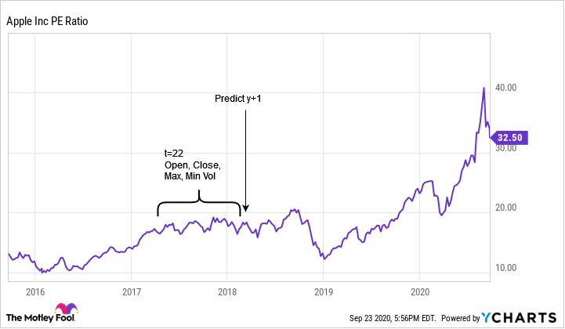
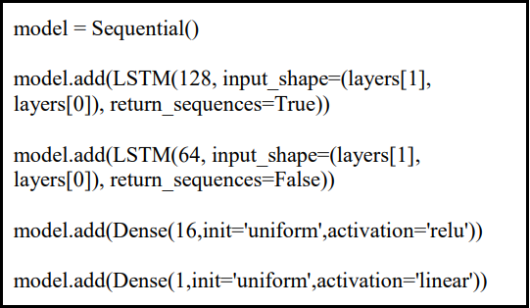
The paper - Predicting Stock Prices Using LSTM
Stock example Apple Inc.
Network architecture

Slide 4

Stock prediction & TA-Lib
Technical Performance Indicators: mathematical calculations performed on different stock parameters like Open, Max ...
Help us to make investment strategies
TA-Lib - an open-source python library
Examples: Bollinger Bands, Simple Moving Average (SMA), Exponential Moving Average
Financial ratios are divided into different classes

Slide 5
Our goal
Bollinger Bands
Simple Moving Average (SMA) Exponential Moving Average
….
+
Calculated financial ratios from eight different classes
Stock example Apple Inc.

Slide 6
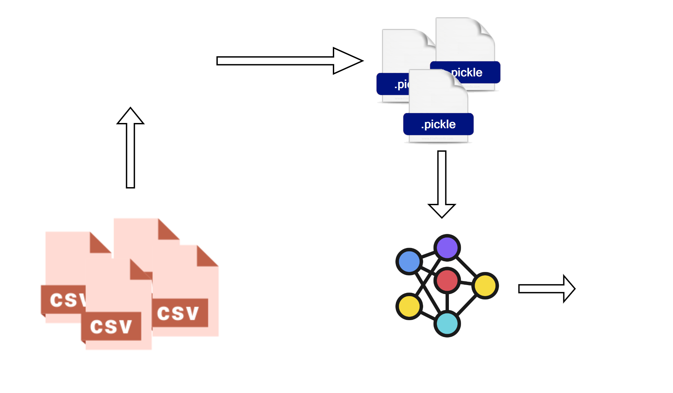
Basic procedure

Slide 7
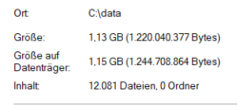
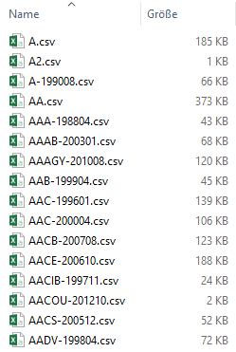
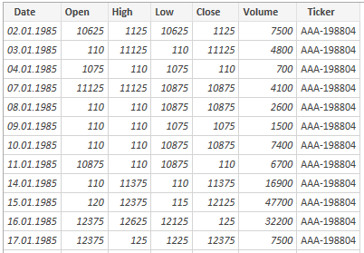
The data
More than 1 GB of stock data
CSV format with ticker as filename
Data structure:
Properties of the folder
Inside AA-198804.CSV
The folder in editor view

Slide 8
Preprocessing, validation, Calculation
Einlesen, Löschen, Validieren, Talib Berechnung beschreiben; TaLib Klassen beschreiben

Slide 9
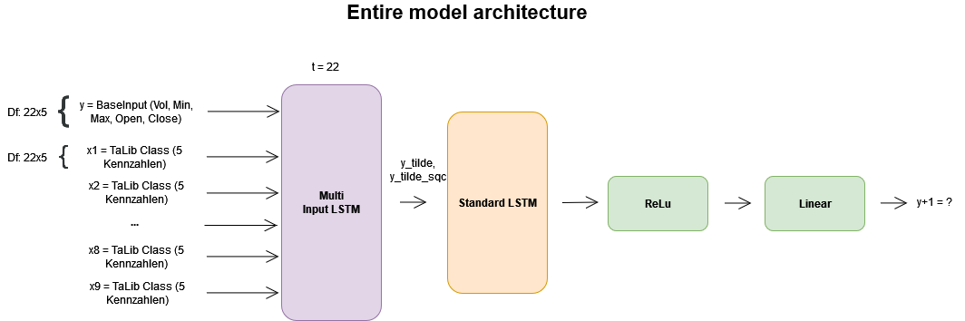
Network architecture

Slide 10
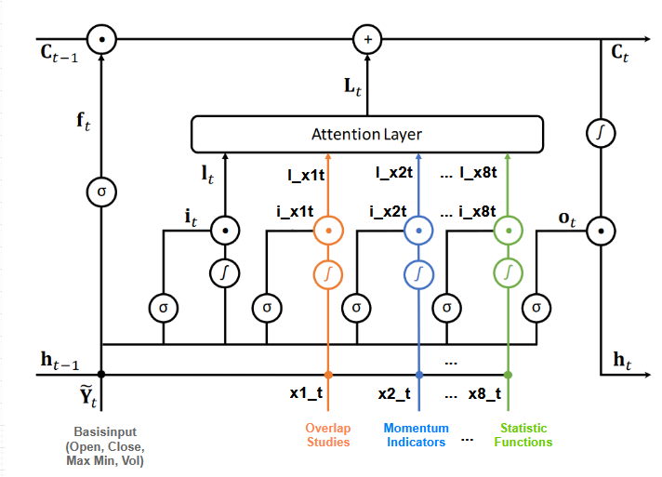
Custom Multi Input LSTM cell

Slide 11
Results
Besser, schlechter als Paper?

